Slide 1



What is Customer Business?
Leading Data Analytics solution provider.
It provides Data Science Solution to multiple industries across Horizontals and Verticals.
Customer also runs a Education wing by which:
Provides Training and data science certification to aspiring students
The classes are conducted with physical and virtual presence.
This is managed by an LMS portal called AISPRY.

Slide 2


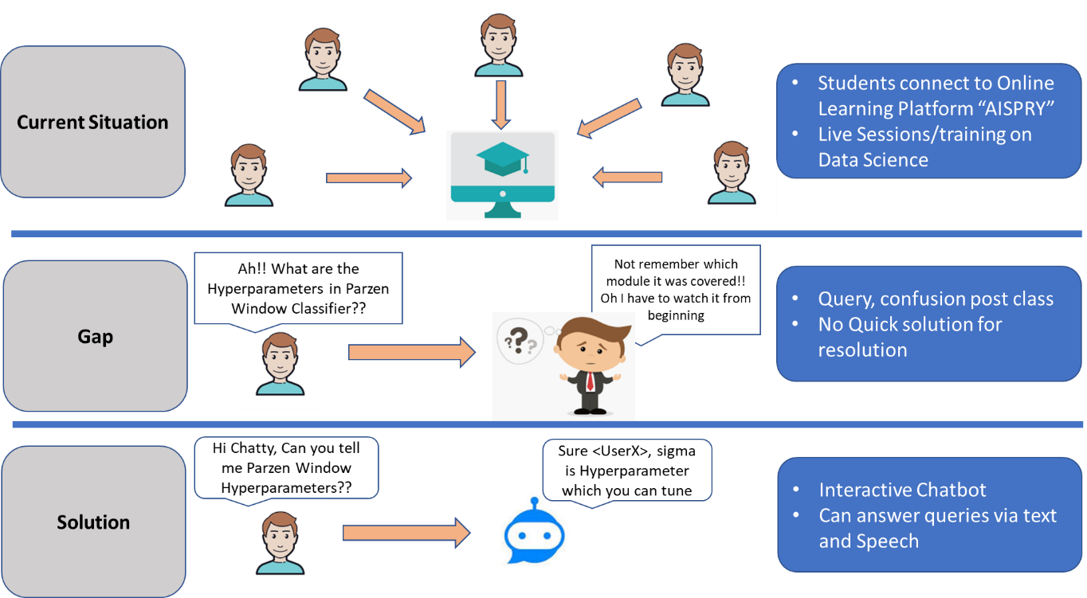



Why “AISPRY” – AI GENERATIVE CHATBOT INTERACTIVE?
How it will help me?
Is my Investment Justified?
Reducing dropout rate
New Users
Less engagement with tutor post sessions
Saving tutor cost
Effectiveness of course content
Enable course correction

Slide 3
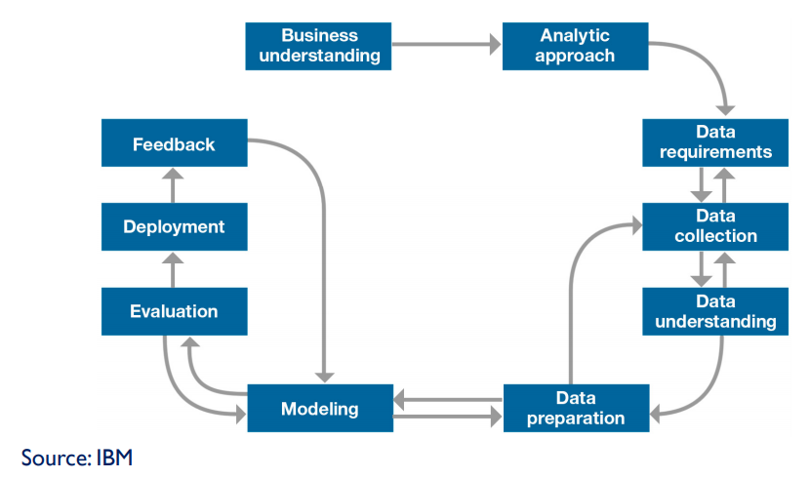
How to Deliver – Project Lifecycle
Business Understanding
Analytic Approach
Functional Requirements
Technical requirements
Deliverables

Slide 4



Business Understanding – Functional Requirement (In scope)
<Question>
<Answer based on Generative Model>
Model 1
Classify module
Model 2
If model covered in learning Status
Yes
No
Mention this topic will be clear once you complete X Module
Generate Relevant Answer

Slide 5
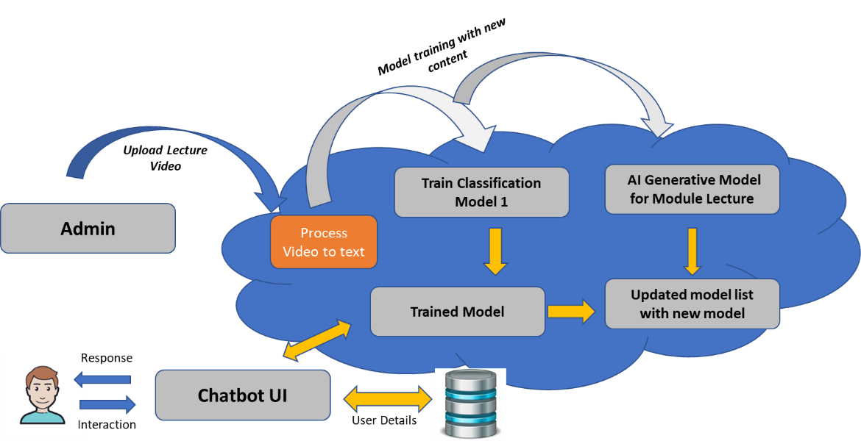
Analytical Approach – Technical Requirement
Our Delivery Scope

Slide 6
Analytical Approach – Agreed Deliverables
S.No | Deliverable | Data required | Acceptance Criteria
D-1 | Video to Text Functionality | Lecture Videos | Can be able to upload new Video Lectures Video to Text with ~ 70% accuracy
D-2 | Classification Model | Corpus – D1 | Predict the name of session with min 80% accuracy Trainable Model
D-3 | AI Generative Model | Corpus - D1 | Enable “Social conversation” Provide suitable response to user Capture feedback Terminate session

Slide 7
How to Deliver – Project Lifecycle
Data Requirements, Collection,
Understanding

Slide 8



Technical Journey: Data Creation
Data Requirements – Type of Data?
Understanding data
Various data nuisances in Video file, following challenges after carefully observation
We need Domain Text Data for:
Knowledge Repository
Train the Chatbot models
Size and Duration
Each video is ~ 3.5 hours long with size of ~ 500 mb
Which software to use?
Accent and Disturbances
local accent and pronunciations captured in audio/Video
Pauses and Logical content
Long pause in Video.
Tutor drawing on screen and explaining to students.
Multiple students talking or replying – dim voice.
Data Collection – How much and availability?
Quantity v/s Quality
Need Both with focus on Quality Data
Data available in form of Lecture Video Recordings
Collect Videos and convert to Text

Slide 9
How to Deliver – Project Lifecycle
Data Preparation

Slide 10
















Technical Journey: Data Preparation
Video 2 Audio
Pydub
Reduction in Audio Length by ~20 mins
Remove Long Pauses/Silences
Remove Dim speech and disturbances
Clean Audio
Freeware
Licenced Tools
Speech Recogniser – Google, Sphinx
Cheapest
Best accuracy (~70%)
Transcribe Punctuation
Azure Speech to Text
Automatic transcripts Generator
Google Cloud API
Deep Speech Model
Amazon Transcribe
Google Docs – real time

Slide 11
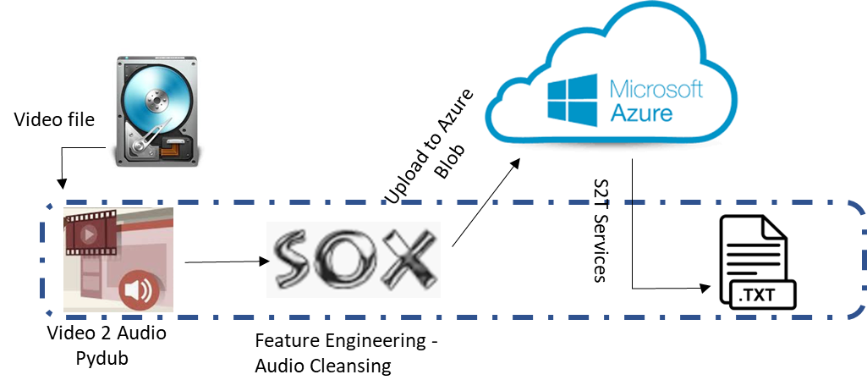
Technical Journey: Data Preparation – Final touch
Data Pipeline Architecture
Max accuracy of ~70% max : Accent, Hindi Phrases, intermit recording issues…
Can we improve further?
Resort to old days of working i.e. Manual checks and calibration.
Correct the words and Sentences, wrongly outputted from model
~3 hours effort for manual correction of text output generated from the above pipeline.
This completes creation of text pipeline and initiation of Knowledge repository.
Next exercise is model analysis, evaluation and appending finalized model in pipeline.

Slide 12
How to Deliver – Project Lifecycle
Model Evaluation
Model Iterations

Slide 13
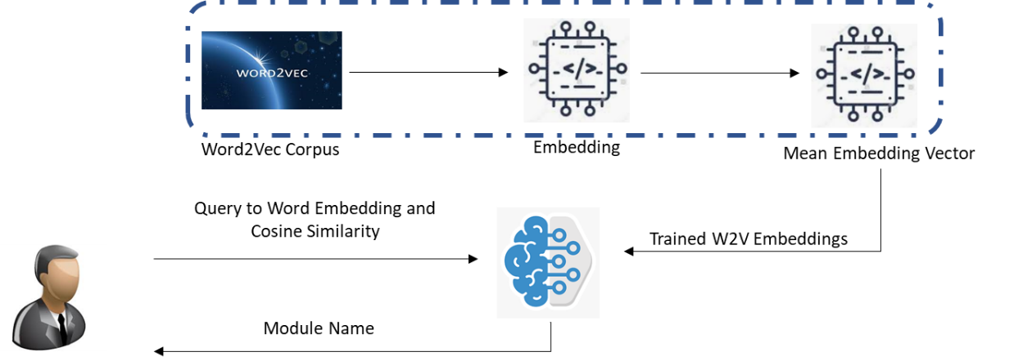
Technical Journey: Modelling – Classification
Model Significance: Key model predicting “chapter of knowledge repository containing answer” for input query.
Multiple text classification models were evaluated in 3 rounds:
Round 1
Round 2
Sentence Tokenize and labelling
Train and test Split
Text Feature | Model | Train Accuracy | Test Accuracy
TF IDF | Naiive Bayes | ~77% | ~60%
TF IDF | Multi Logit | ~80% | ~70%
W2V | Multi Logit | ~80% | ~72%
D2V | Multi Logit | ~75% | ~70%
Low Accuracy
Overlapping sentences – affecting model
Accuracy: ~80%,
Model parked for further evaluation

Slide 14
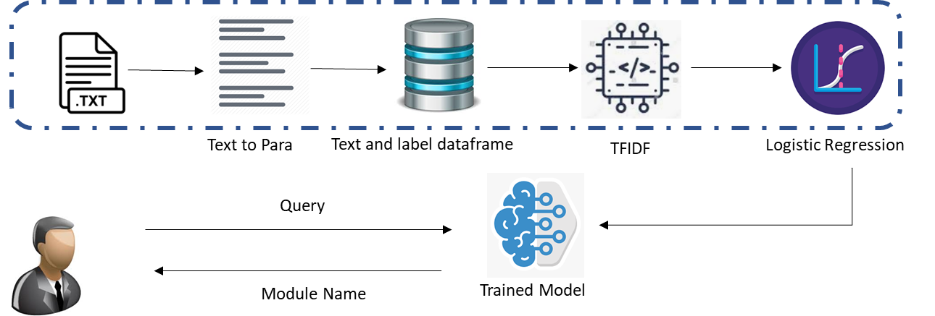
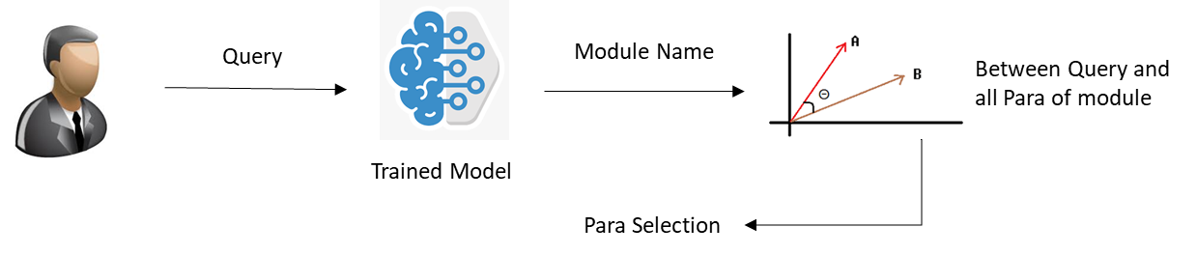
Technical Journey: Modelling – Classification – Round 3
Intuition:
“Context – Question Pair” approach
Max 512 token length
Changes:
Reconversion of Text corpus
2 models : Session name and Para Identification
Session Name Identification
Paragraph/Context Identification
Train Accuracy: ~ 88%, Test Accuracy: ~85%

Slide 15
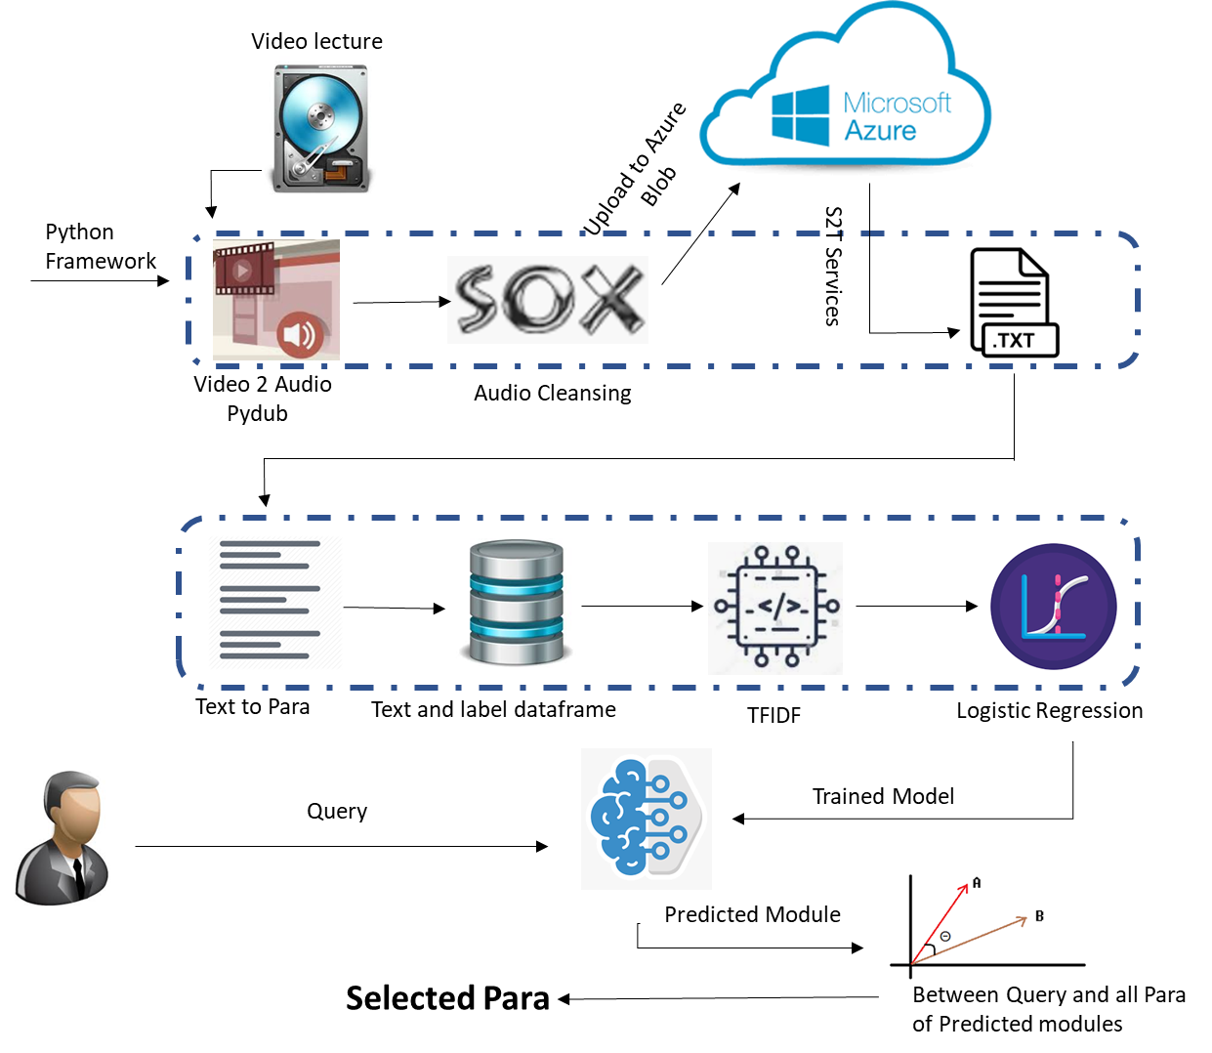
Technical Journey: Data Pipeline + Classification
Now we are ready for implementing the final model i.e. “Heart” of AI text generative Chatbot.

Slide 16
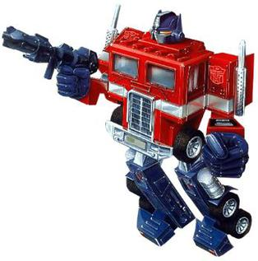
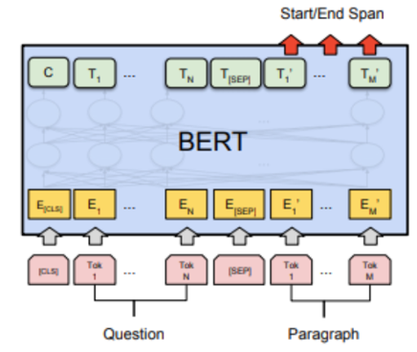

Technical Journey: Modelling – AI Text Generative
Transformers based models
New approach — attention modules
learn the dependencies between Attention Head i.e. Query, Key and Value.
Why BERT for our project
Extensive research and training for model stabilization
Stanford Question Answering Dataset
Reading comprehension dataset, consisting of questions on a set of Wikipedia articles
Multiple layers, each with several Attention Heads
Support Ecosystem
Can be further trained with domain data very easily
What is SQuAD?
Various trained models available for evaluation
Answer to every question is a segment of text, or span, from the corresponding reading passage

Slide 17
Technical Journey: Modelling – AI Text Generative
Round 1
Bert-large-uncased-whole-word-masking-finetuned-squad2.0 ,Transformers library from Huggingface.
Pipeline
Return Answer, Score, Start and End position
~40% EM
BertForQuestionAnswering.
from_pretrained
Return index of start and end of answers from context
~40% EM
Good Explain ability
Low Explain ability as no Confidence Score
Classification model : Top 3 session names
Cosine Model : output top 6 paras
Run Pipeline Wrapper for 6 paras to get answer and output answer with highest confidence.
EM Score increases by 10%
Round 2
Bert-base-cased-finetuned-squad (SQuAD 1.1 dataset) from DeepPavlov library.
The model displays similar behaviour as Pipeline Wrapper of Transformers model (in Round 1) and was able to fit in the tweaked architecture.

Slide 18


Technical Journey: Modelling – AI Text Generative
Round 3
From cdQA library:
Bert-large-uncased-whole-word-masking-finetuned-squad (SQuAD 1.1 dataset)
Distilbert-large-uncased-whole-word-masking-finetuned-squad (SQuAD 1.1 dataset)
Why cdQA based model?
Inbuilt classification model, trainable with domain data
Flexibility of using own choice of classification model
Provide UI to create Domain training data in SQuAD format
Change Required in Text Corpus
In Knowledge repository all paragraphs of one session in a single list as 1 row in dataframe and label name as session name.
Post model training with “Unsupervised Learning” topic
EM score > 95%, customer confirmation

Slide 19
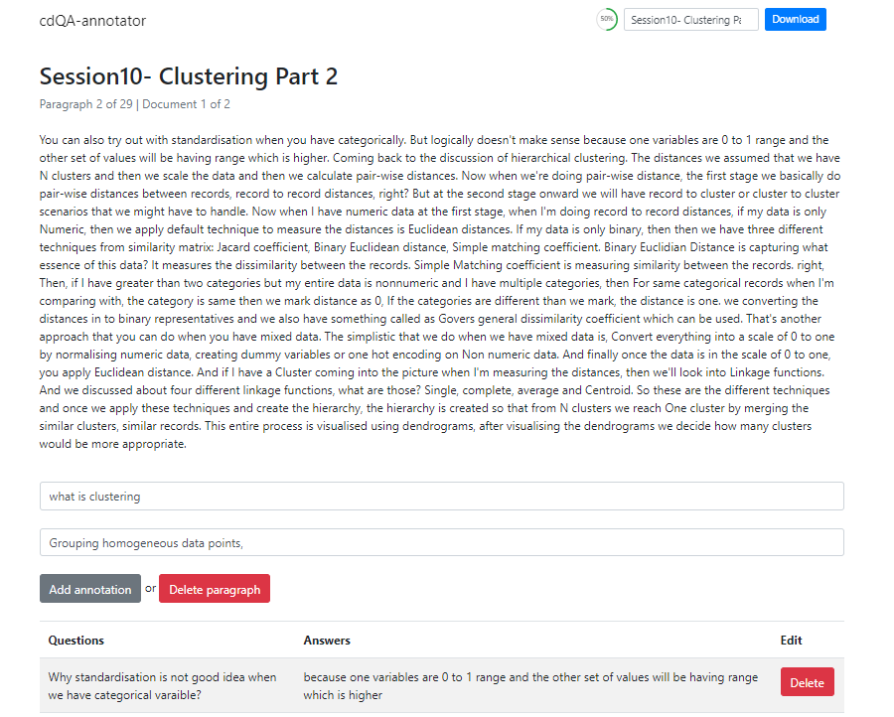
Technical Journey: Modelling – AI Text Generative
Snapshot of UI for Model Training – cdQA Annotator

Slide 20
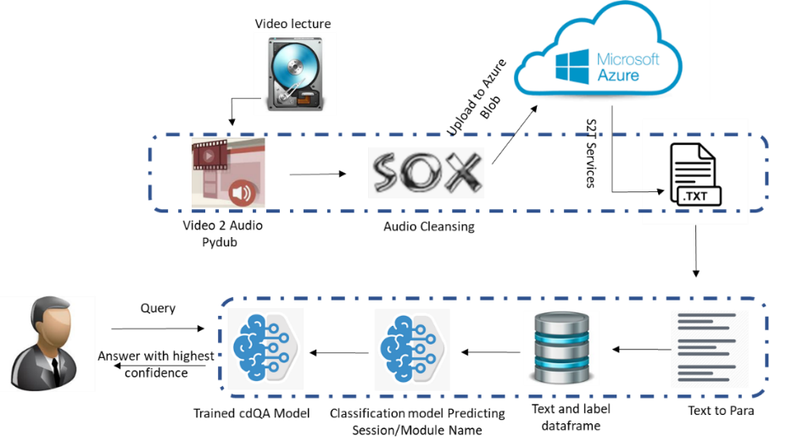
Technical Journey: Final Platform Architecture and Delivery
Code
Video to Audio Conversion
Text transformation in BERT Format
Architecture
Video to text
Text Classification, Training and Chatbot
SOPs
SOX Installation
Text Corpus
Training Data Creation
Model Training
Chatbot
Clean text corpus for Session 9 and 10
Steps to use Azure services S2T
Training data creation with front end – cdQA Annotation
Train the model DistilBert/BERT model
Text corpus for other sessions, where video was provided

