Slide 1

Assignment Insights
eClerx
Paras Malik
+91-8874800433

Slide 2

Summary of Solution
1. Text Preprocessing of data
2. Tokenizing the words to convert them into numbers
3. Using KMeans algorithm to cluster the reviews

Slide 3
Creating the data
Steps taken:
1. A genuine customer will create a new tweet about his own experience to the company rather than retweet on someone’s else issue of his problem.
2. The retweets of other user is neglected as our main focus is the tweet initiated by the first user to reveal his experience
3. The tweets on which company has marked a response is only used for the training as they are tweets which which has a more reach and impact
Implementation:
Response ID of the tweet is null and Inbound column is True
Response ID NULL will take care of it.
The inbound function is False and initial tweet id of customer tweet is joined with in_response_to_tweet_id of company tweet using pandas
4. All the null values in the data are removed initially before implementing the above three steps

Slide 4
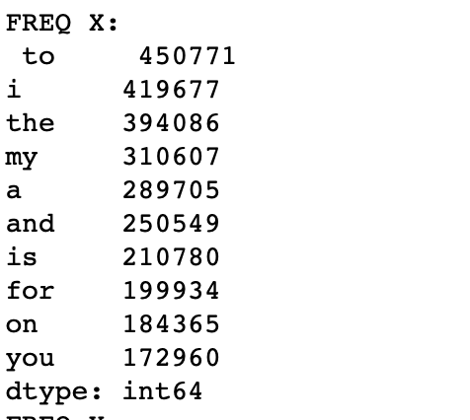
Preprocessing the data
Steps taken:
1. The emoji plays a very important role to understand the gist of a tweet (happy or angry) so emojis are converted to text in the tweets
2. The upper case letters are converted to lower case
3. Punctuation marks are removed to avoid any impact on training
4. Top 10 most frequent used words are removed from the data (like: It, is , for that , etc.)
5. As user will refer to respective company for product so there is no need to train on the basis of company name. Hence company names are also removed from the tweet
6. The very rarest words are removed from the tweet (as they generally refer to spelling mistake)
The frequent words used in the tweet with number of times they are used

Slide 5
Word to Text Conversion
Steps taken:
1. We can only perform training on numbers not the text so we create a corpus (dictionary) from the words already in our data and mark the position of each text from the dictionary
For example:
“ Laptop love product” will become [4000 5000 6000] where 4000,5000 and 6000 represents the position of Laptop love and product respectively in the dictionary
2. As the the maximum character of a tweet is 140 and average of 5 character a word make it approximately 30 words. After removing frequent words from data our max length converted to 25. So initially the experiment started with max length 25 but tuned according
3. Padding type is post (in case if some tweets are less than 25 words)
4. There is another word worked “OOV” at position 1 for the words which are not available in our dictionary
5. If the length of words is more than max_length then truncation also done from end of the sentence similar to padding
6. Initially the dictionary was limited to 50,000 words but after various experimentation the best results came are obtained at 100000 words corpus
7. All the above defined steps are used to convert text to number. The final outcome is [no.of tweets X max_length]
8. Then data set is divided into three parts of test, validation and training with ratio of ~ 10%,10% and 90%
Validation data set is used to tune hyper-parameters as defined above:
Word limit of corpus
Max length
Type of padding and truncating
Preprocessing of data

Slide 6
Training
Algorithm used:
K-Means algorithm is used for clustering because:
a. Relatively simple to implement.
b. Scales to larger data set
c. Guarantees convergence
d. Can warm start the positions of centroids
e. Easily adapts to new example
f. Generalises to clusters of different shapes and sizes, such as elliptical clusters
Implementation:
1. sklearn already defined K means algorithm is used for the training
2. Initially number of clusters were set to 5 but 3 clusters were coming very proximate to each other which justified our initial assumption of positive ,negative, neutral/informative
After performing the trained model on validation set we were able to identify them into various clusters which solved our problem of clustering according to views of customer

Slide 7
Insights
After clustering the reviews to positive, negative, neutral/informative we can analyse the number of review of each cluster a particular company is tagged on Twitter.
If the % is skewed towards negative reviews for a company then best solution is to take a more focussed approach towards solving the customer problem and customer satisfaction
If the % of positive reviews for a company are more then company can use this to run campaigns on the website, social media or E-comm to showcase their customer satisfaction
If the % of neutral reviews for a company are more that can be because of informative reviews which a company can link with Ecom website product link to showcase real time experience and information by already existing customers
More analysis can be performed to distribute the neutral reviews and informative reviews into further clusters

Slide 8
Thank you very much !!

Slide 9


