Slide 1
Tight Analyses for Non-Smooth Stochastic Gradient Descent
Nick Harvey Chris Liaw Yaniv Plan Sikander Randhawa
University of British Columbia

Slide 2
Importance of Stochastic Gradient Descent (SGD)
Of utmost importance in Machine Learning
Training neural networks
Minimizing convex loss functions (e.g. least squares regression)
Many TCS papers use gradient methods for combinatorial optimization:
k-server problem [Buchbinder-Gupta-Molinaro-Naor `18]
Max-flow [Lee, Rao, Srivastava `13]
But, there are still some basic questions that have been left unanswered.

Slide 3
Shamir’s Open Questions [2012]
($50) “What is the expected suboptimality of the last iterate returned by GD?”
“An extra $20 will be awarded for proving a tight bound on the suboptimality of [the last iterate] which holds in high probability.”
We solve these problems.

Slide 4
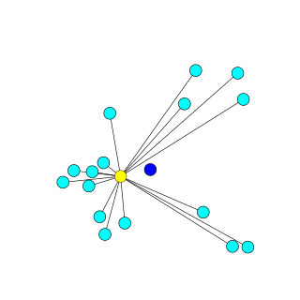
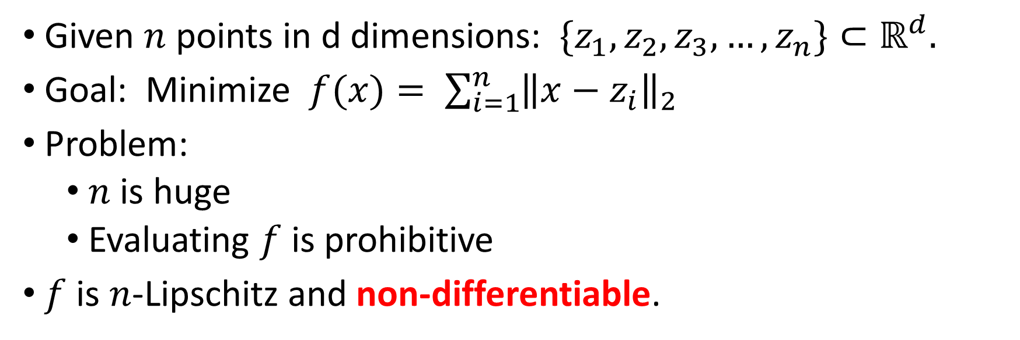
Example: Geometric Median e.g. [Cohen, Lee, Miller, Pachocki, Sidford ‘16]
Given $n$ points in d dimensions: ${\{z}_{1}, z_{2},z_{3}, …, z_{n}\}⊂ℝ^{d}.$
Goal: Minimize $f(x)= \sum_{i=1}^{n}{{\left\|x−z_{i}\right\|}_{2}}$
Problem:
$n$ is huge
Evaluating $f$ is prohibitive
$f$ is $n$-Lipschitz and non-differentiable.
Setting for today: Lipschitz and Non-Smooth functions

Slide 5
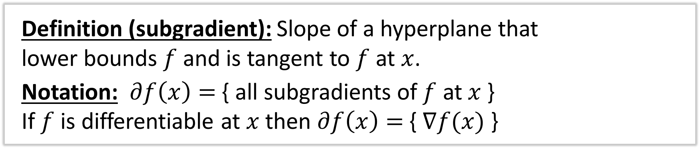


Subgradients
Definition (subgradient): Slope of a hyperplane that lower bounds $f$ and is tangent to $f$ at $x$.
Notation: $∂f\left(x\right)=${ all subgradients of $f$ at $x$}
If $f$ is differentiable at $x$ then $∂f\left(x\right)=${ $∇f(x)$ }
$$f\left(x\right)=|x|$$
$$g\left(x\right)=0.5x$$

Slide 6
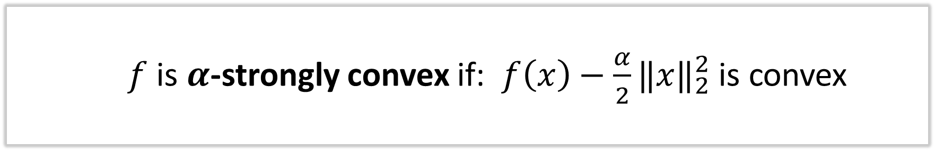
Strongly Convex Functions
$f$ is $α$-strongly convex if: $f\left(x\right)−\frac{α}{2}{‖x‖}_{2}^{2}$ is convex
Canonical Example: convex function with $ℓ_{2}^{2}$-regularization

Slide 7
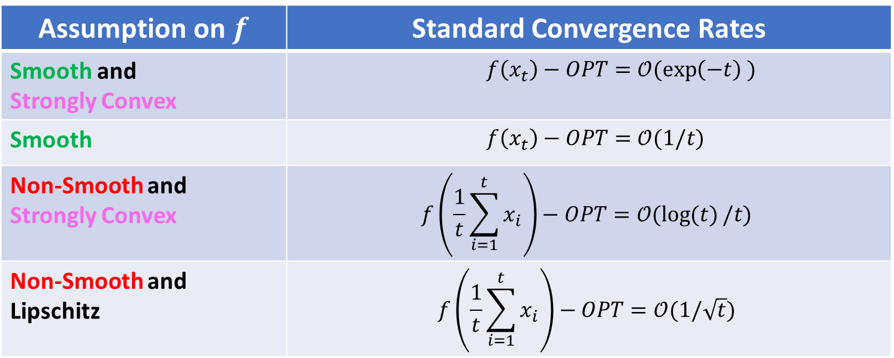
Gradient Descent in a Nutshell
From current iterate, $x_{t}:$ Produce $x_{t+1}←x_{t}−η_{t}g_{t}$ where $g_{t}∈∂f (x)$
Assumption on $f$ | Standard Convergence Rates
Smooth and Strongly Convex | $f\left(x_{t}\right)−OPT=𝒪(\exp\left(−t\right) )$
Smooth | $f\left(x_{t}\right)−OPT=𝒪(1/t)$
Non-Smooth and Strongly Convex | $$f\left(\frac{1}{t}\sum_{i=1}^{t}{x_{i}}\right)−OPT=𝒪(\log{(t)}/t)$$
Non-Smooth and Lipschitz | $$f\left(\frac{1}{t}\sum_{i=1}^{t}{x_{i}}\right)−OPT=𝒪(1/\sqrt{t})$$
Standard results in non-smooth setting require averaging of iterates.
Optimal for non-smooth Lipschitz functions.
Notes:
Importantly, these results are for GRADIENT descent, not SGD.
For smooth and strongly convex – Nesterov’s alg improves dependence on kappa
For smooth – Nesterov gets O(1/t^2)
For non-smooth strongly convex: optimal is O(1/t)
For non-smooth lipschitz: optimal is O(1/sqrt(t)).

Slide 8
Do there exist algorithms in the non-smooth setting where individual iterates converge to OPT at the optimal rate?
Yes... [Nesterov-Shikman ‘15] provide an algorithm where the final iterates converge to OPT at the optimal rate.
Fundamental question: do the individual iterates of GD converge to OPT? If so, at what rate?

Slide 9
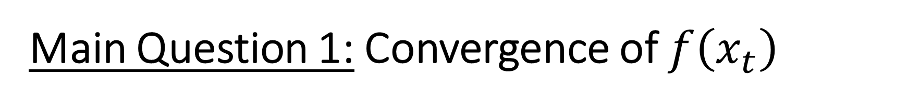
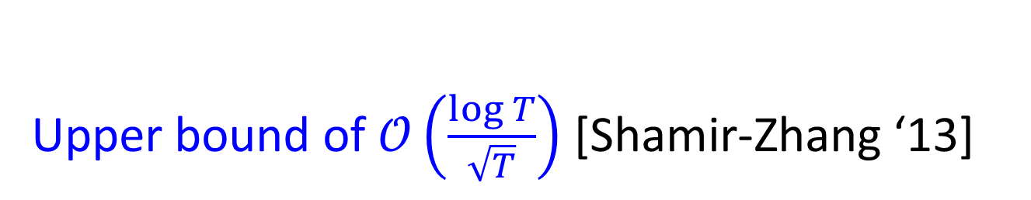
Main Question 1: Convergence of $f\left(x_{t}\right)$
How fast does $f\left(x_{t}\right)$ converge to OPT, if at all?
Upper bound of $𝒪\left(\frac{\log{T}}{\sqrt{T}}\right)$ [Shamir-Zhang ‘13]
($50) “What is the suboptimality of the last iterate returned by GD?” [Shamir ’12]

Slide 10






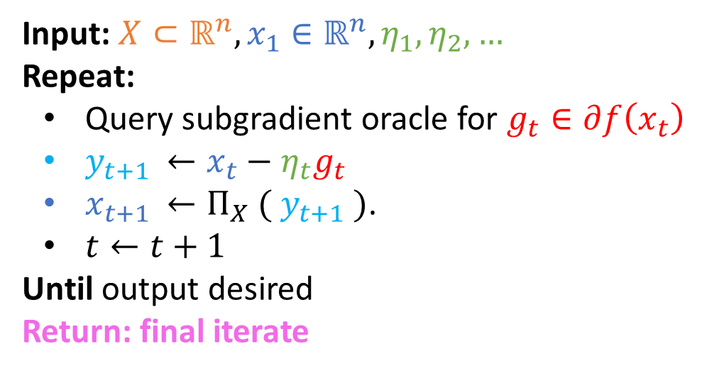



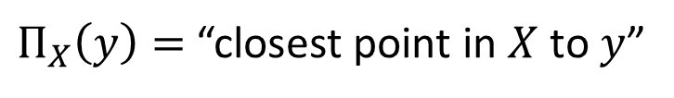
Sub-Gradient Descent
Feasible set
Initial point
Step sizes: Today we fix $η_{t}= \frac{1}{\sqrt{t}}$
Input: $X⊂ℝ^{n}, x_{1}∈ℝ^{n}, η_{1},η_{2},…$
Repeat:
Query subgradient oracle for $g_{t}∈∂f\left(x_{t}\right)$
$y_{t+1 }←x_{t}−η_{t}g_{t}$
$x_{t+1 }←Π_{X} ( y_{t+1} )$.
$t←t+1$
Until output desired
Return: final iterate
$$f\left(x_{t+1}\right)>f\left(x_{t}\right)$$
$$f\left(x\right)$$
$Π_{X}\left(y\right)=$ “closest point in $X$ to $y$”
$${∇ f(x}_{t}) >0$$
$$− η_{t}g_{t}$$
$$y_{t+1}$$
$$x_{t+1}$$
$$Π_{X}(y_{t+1})$$
$$x_{t}$$
Feasible set $X$
Problem: not monotonic $⇒$ final iterate could be bad.

Slide 11
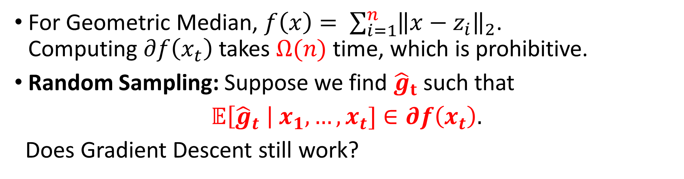
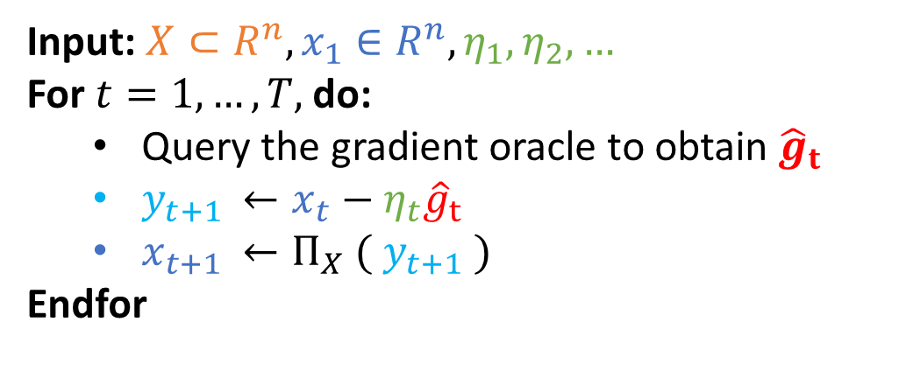
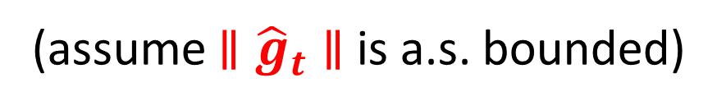
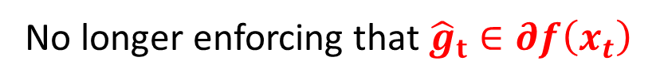
Stochastic Sub-Gradient Descent
For Geometric Median, $f\left(x\right)= \sum_{i=1}^{n}{{\left\|x−z_{i}\right\|}_{2}}$. Computing $∂f\left(x_{t}\right)$ takes $Ω(n)$ time, which is prohibitive.
Random Sampling: Suppose we find ${\hat{g}}_{t}$ such that
$𝔼\left[{\hat{g}}_{t} \right| x_{1}, …, x_{t}]∈∂f\left(x_{t}\right).$
Does Gradient Descent still work?
(assume $∥{\hat{g}}_{t}∥$ is a.s. bounded)
Input: $X⊂R^{n}, x_{1}∈R^{n}, η_{1},η_{2},…$
For $t=1, …, T,$ do:
Query the gradient oracle to obtain ${\hat{g}}_{t}$
$y_{t+1 }←x_{t}−η_{t}{\hat{g}}_{t}$
$x_{t+1 }←Π_{X} ( y_{t+1} )$
Endfor
SGD:
No longer enforcing that ${\hat{g}}_{t}∈∂f\left(x_{t}\right)$

Slide 12
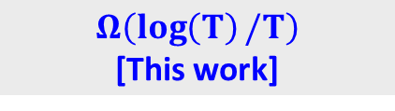
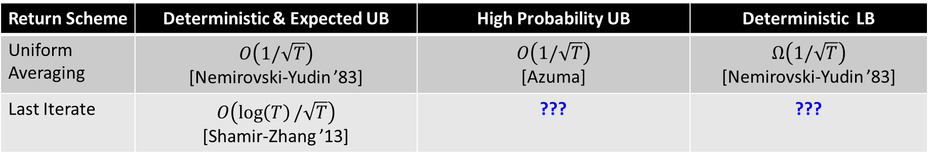
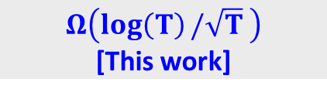



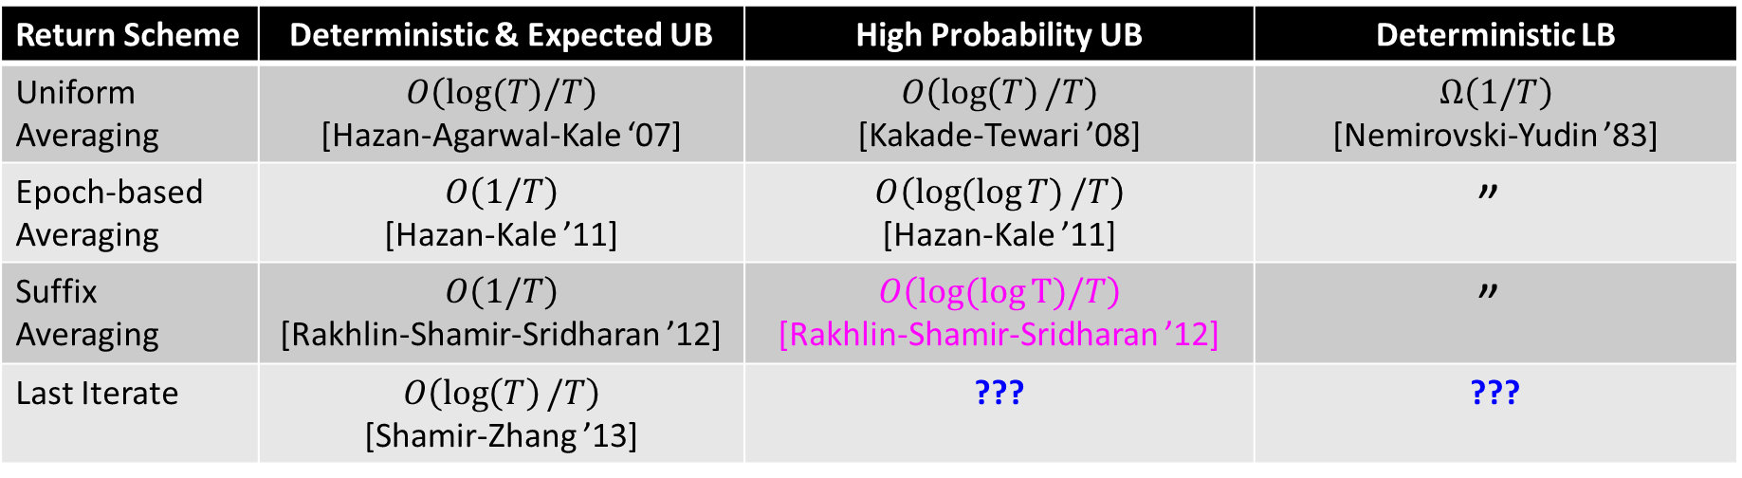

Lipschitz Functions
Return Scheme | Deterministic & Expected UB | High Probability UB | Deterministic LB
Uniform Averaging | $$O\left(1/\sqrt{T}\right)$$ [Nemirovski-Yudin ’83] | $O\left(1/\sqrt{T}\right)$ [Azuma] | $Ω\left(1/\sqrt{T}\right)$ [Nemirovski-Yudin ’83]
Last Iterate | $$O\left(\log\left(T\right)/\sqrt{T}\right)$$ [Shamir-Zhang ’13] | ??? | ???
Tight
Tight*
$$O\left(\log\left(T\right)/\sqrt{T} \right)$$
[This work]
$$Ω\left(\log\left(T\right)/\sqrt{T} \right)$$
[This work]
Strongly Convex & Lipschitz Functions
Return Scheme | Deterministic & Expected UB | High Probability UB | Deterministic LB
Uniform Averaging | $$O\left(log(T)/T\right)$$ [Hazan-Agarwal-Kale ‘07] | $$O\left(\log\left(T\right)/T\right)$$ [Kakade-Tewari ’08] | $Ω\left(1/T\right)$ [Nemirovski-Yudin ’83]
Epoch-based Averaging | $$O\left(1/T\right)$$ [Hazan-Kale ’11] | $$O\left(\log{(\log{T)}}/T\right)$$ [Hazan-Kale ’11] | $$\text{”}$$
Suffix Averaging | $$O\left(1/T\right)$$ [Rakhlin-Shamir-Sridharan ’12] | $$O\left(log(\log{T})/T\right)$$ [Rakhlin-Shamir-Sridharan ’12] | $$\text{”}$$
Last Iterate | $$O\left(\log\left(T\right)/T\right)$$ [Shamir-Zhang ’13] | ??? | ???
$$O\left(1/T\right)$$
[This work]
Tight
$$O\left(\log\left(T\right)/T \right)$$
[This work]
Tight*
$$Ω\left(\log\left(T\right)/T\right)$$
[This work]
* dependence on $log⁡(1/δ)$ is not completely tight
Notes:
O(1/T) for suffix averaging is the first time that a high probability upper bound is proven for strongly convex functions with the optimal rate.
Remark that UA HP bound is an ingredient in final iterate HP bound, similarly for suffix average/last iterate for strongly convex funcs.

Slide 13
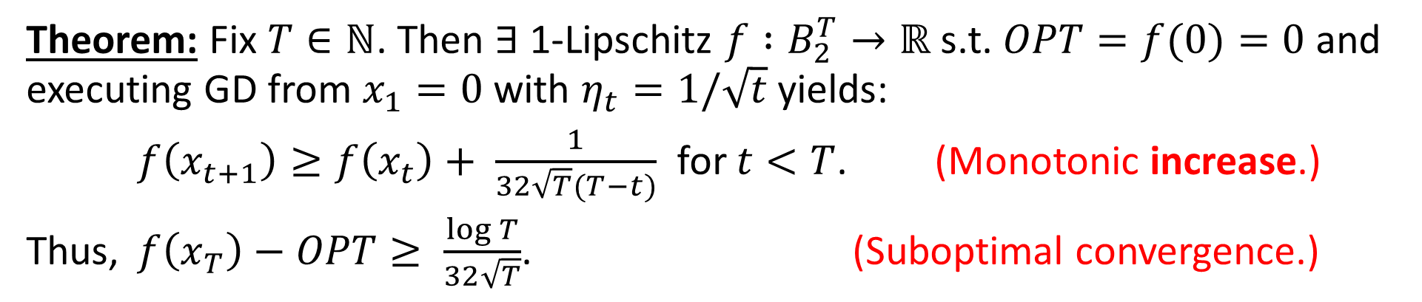

Main Result 1: Lower Bound, Lipschitz case
Euclidean ball in $ℝ$^{T}
Theorem: Fix $T∈ℕ$. Then $∃$ 1-Lipschitz $f :B_{2}^{T}→ℝ$ s.t. $OPT=f(0)=0$and executing GD from $x_{1}=0$ with $η_{t}=1/\sqrt{t}$ yields:
$f\left(x_{t+1}\right)≥f\left(x_{t}\right)+ \frac{1}{32\sqrt{T}(T−t)}$ for $t<T$. (Monotonic increase.)
Thus, $f\left(x_{T}\right)−OPT≥ \frac{\log{T}}{32\sqrt{T}}$. (Suboptimal convergence.)

Slide 14
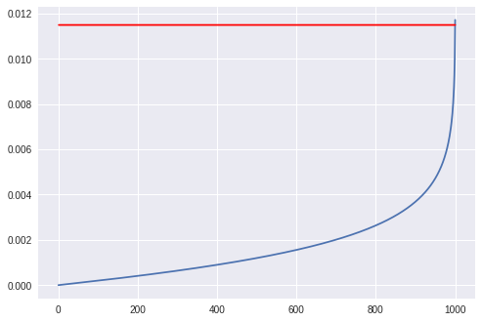

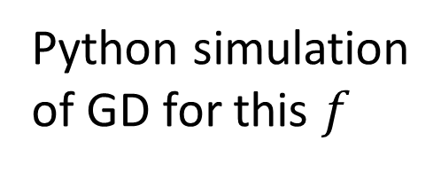
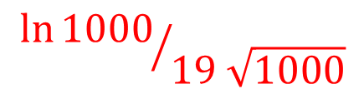

Theorem: Fix $T∈ℕ$. Then $∃$ 1-Lipschitz $f :B_{2}^{T}→ℝ$ s.t. $OPT=f(0)=0$and executing GD from $x_{1}=0$ with $η_{t}=1/\sqrt{t}$ yields:
$f\left(x_{t+1}\right)≥f\left(x_{t}\right)+ \frac{1}{32\sqrt{T}(T−t)}$ for $t<T$. (Monotonic increase.)
Thus, $f\left(x_{T}\right)−OPT≥ \frac{\log{T}}{32\sqrt{T}}$. (Suboptimal convergence.)
$${\ln{1000}}/{19 \sqrt{1000}}$$
Python simulation of GD for this $f$
Error
$$f\left(x_{t}\right)−OPT$$
Iteration
Notes:
ADD GRAPH HERE!

Slide 15
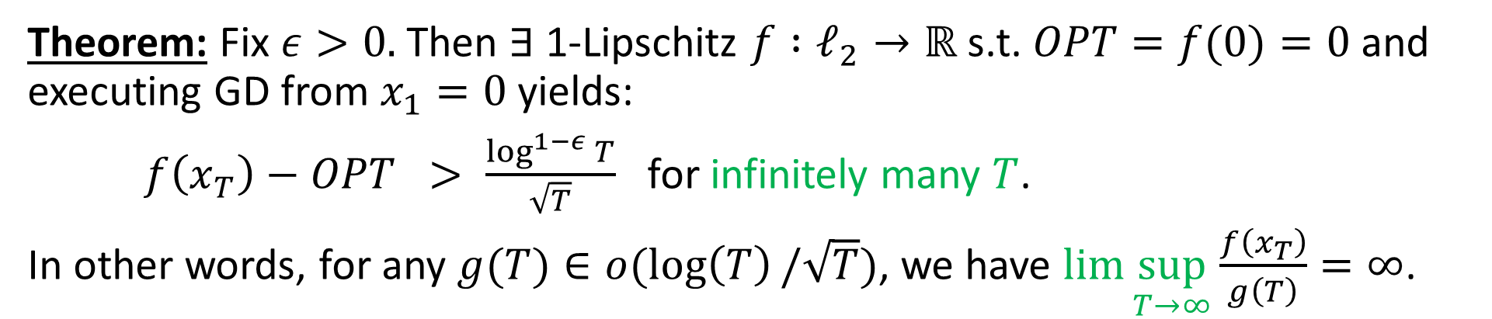
Theorem: Fix $T∈ℕ$. Then $∃$ 1-Lipschitz $f :B_{2}^{T}→ℝ$ s.t. $OPT=f(0)=0$and executing GD from $x_{1}=0$ with $η_{t}=1/\sqrt{t}$ yields:
$f\left(x_{t+1}\right)≥f\left(x_{t}\right)+ \frac{1}{32\sqrt{T}(T−t)}$ for $t<T$. (Monotonic increase.)
Thus, $f\left(x_{T}\right)−OPT≥ \frac{\log{T}}{32\sqrt{T}}$. (Suboptimal convergence.)
Theorem: Fix $ε>0.$ Then $∃$ 1-Lipschitz $f :ℓ_{2}→ℝ$ s.t. $OPT=f(0)=0$and executing GD from $x_{1}=0$ yields:
$f\left(x_{T}\right)−OPT > \frac{\log^{1−ε}{T}}{\sqrt{T}}$ for infinitely many $T$.
In other words, for any $g(T)∈o(\log\left(T\right)/\sqrt{T})$, we have $\lim{\sup_{T→∞}{\frac{f\left(x_{T}\right)}{g\left(T\right)}}=∞}$.
Notes:
ADD GRAPH HERE!

Slide 16
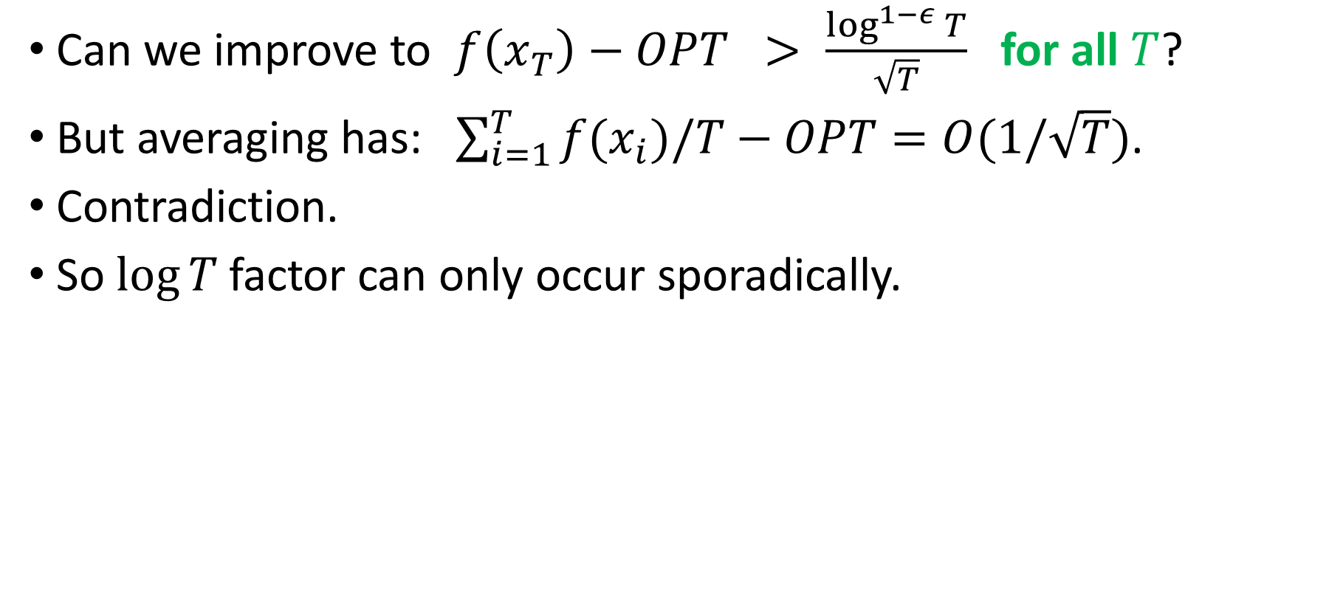
Why “infinitely often” and “lim sup”?
Can we improve to $f\left(x_{T}\right)−OPT > \frac{\log^{1−ε}{T}}{\sqrt{T}}$ for all $T$?
But averaging has: $\sum_{i=1}^{T}{f(x_{i})/T}−OPT=O(1/\sqrt{T})$.
Contradiction.
So $log⁡T$factor can only occur sporadically.

Slide 17
Why “infinitely often” and “lim sup”?
Can we improve to $f\left(x_{T}\right)−OPT > \frac{\log^{1−ε}{T}}{\sqrt{T}}$ for all $T$?
But averaging has: $\sum_{i=1}^{T}{f(x_{i})/T}−OPT=O(1/\sqrt{T})$.
Contradiction.
So $log⁡T$factor can only occur sporadically.

Slide 18
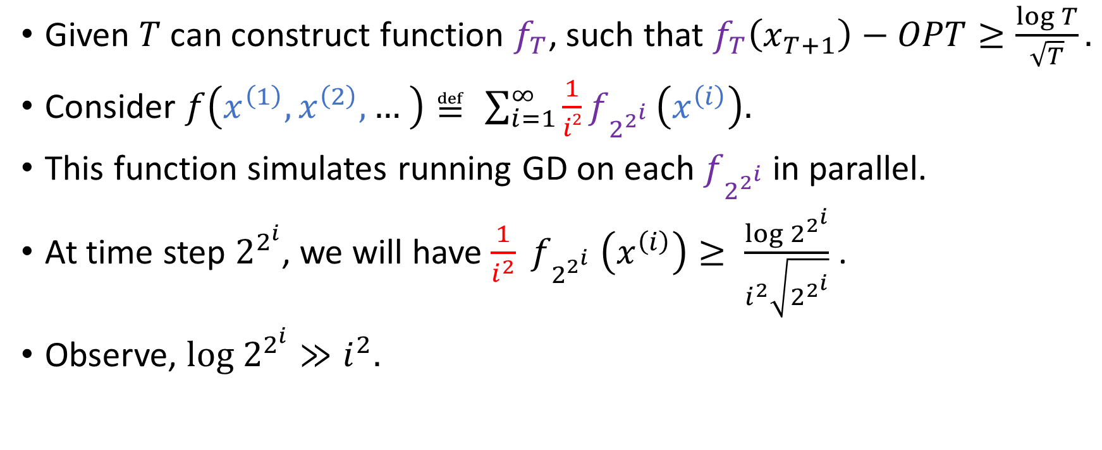
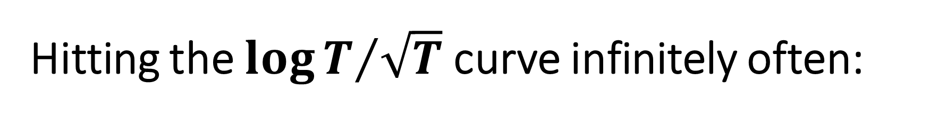

Hitting the ${\log{T}}/{\sqrt{T}}$curve infinitely often:
Compatible with $f_{2^{2^{i}}}$
Maintains Lipschitzness
Given $T$ can construct function $f_{T}$, such that $f_{T}\left(x_{T+1}\right)−OPT≥\frac{\log{T}}{\sqrt{T}}.$
Consider $f\left(x^{\left(1\right)}, x^{\left(2\right)}, … \right)≝ \sum_{i=1}^{∞ }{\frac{1}{i2}f_{2^{2^{i}}}}\left(x^{\left(i\right)}\right).$
This function simulates running GD on each $f_{2^{2^{i}}}$ in parallel.
At time step $2^{2^{i}}$, we will have ${\frac{1}{i^{2}} f}_{2^{2^{i}}} \left(x^{\left(i\right)}\right)≥ \frac{\log{2^{2^{i}}}}{i^{2}\sqrt{2^{2^{i}}}}$ .
Observe, $log 2^{2^{i}}≫i^{2}.$

Slide 19


Some intuition about the lower bound…
Consider the function $f\left(x\right)=|x|$ on the interval [-1,1] with initial point $x_{1}=0$.
-1 is a sub-gradient at 0
$$x_{1}$$
$$x_{2}$$
Takeaway: Non-differentiable points can increase the function value
Hence if the sub-gradient oracle selects -1 for $g_{1}$, then $x_{2}=x_{1}−\left(−1\right)=1$
Notes:
Shorten this slide

Slide 20
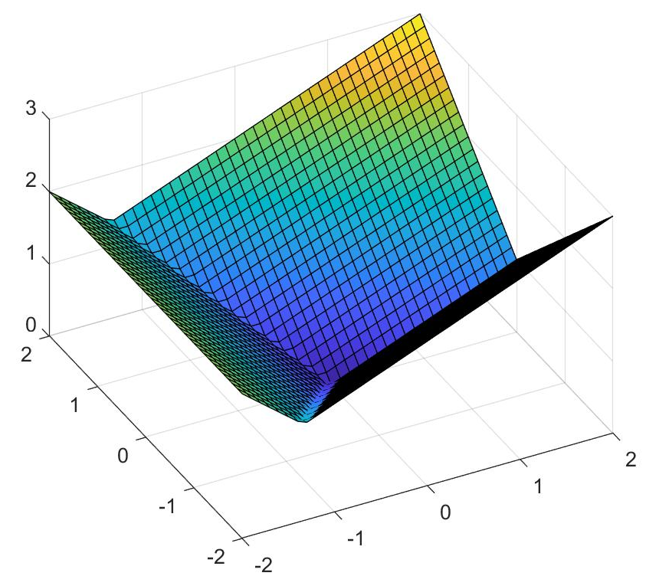








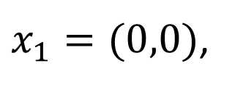

How to keep increasing?
Introduce another dimension
Consider $f\left(u,v\right)=\max\left\{−u, 0.5u−v, 0.5u+0.5v\right\}.$
$x_{1}=(0,0)$,
$$f\left(x_{1}\right)=0$$
$$x_{2}=\left( 1, 0 \right),$$
$${f(x}_{2})=0.5$$
$$x_{3}= \left(0.646, 0.354\right),$$
$${f(x}_{3})=0.677$$
$$x_{3}$$
$$x_{2}$$
$$x_{1}$$
v
u

Slide 21
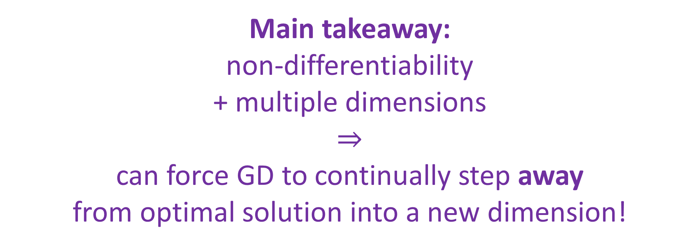
How to keep increasing?
Main takeaway:
non-differentiability
+ multiple dimensions
$⇒$
can force GD to continually step away from optimal solution into a new dimension!

Slide 22
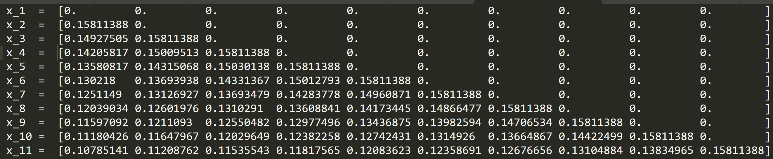
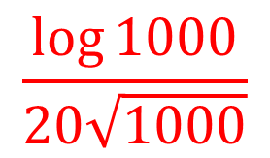

More on the lower bound
Error
Monotonically increase objective value at each step!
$$\frac{\log{1000}}{20\sqrt{1000}}$$
$$f\left(x_{t}\right)−OPT$$
Move into a new dimension at each iteration!
Time

Slide 23
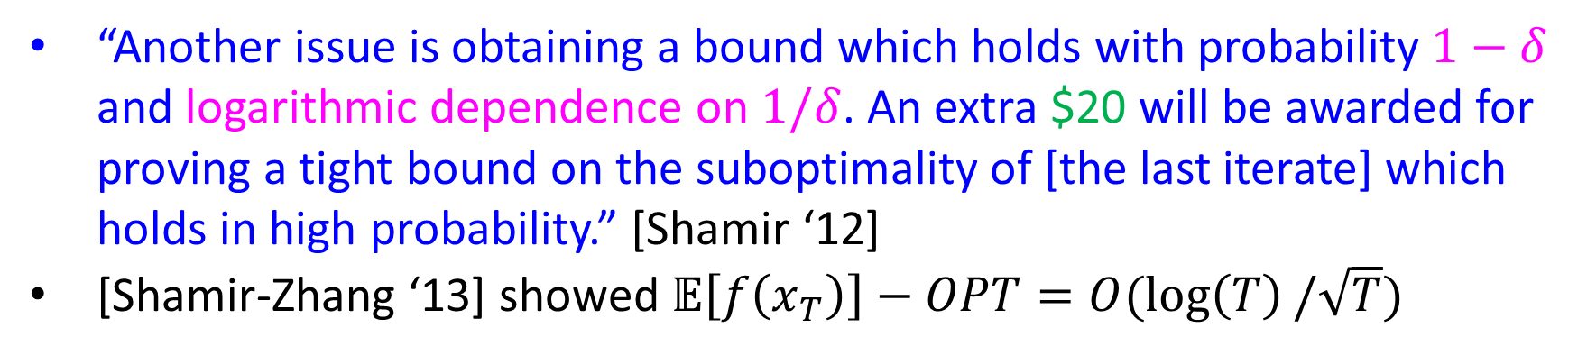
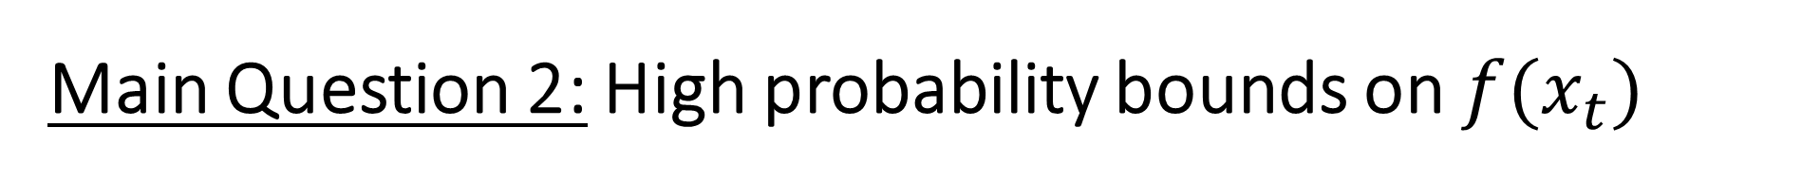
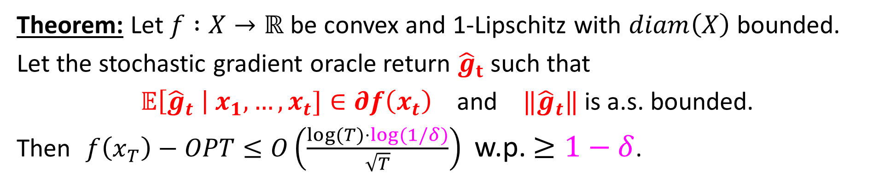
Main Question 2: High probability bounds on $f(x_{t})$
“Another issue is obtaining a bound which holds with probability $1−δ$ and logarithmic dependence on $1/δ$. An extra $20 will be awarded for proving a tight bound on the suboptimality of [the last iterate] which holds in high probability.” [Shamir ‘12]
[Shamir-Zhang ‘13] showed $𝔼\left[f\left(x_{T}\right)\right]−OPT=O(\log\left(T\right)/\sqrt{T})$
Main Result 2: High prob UB, Lipschitz case
Theorem: Let $f :X→ℝ$ be convex and 1-Lipschitz with $diam\left(X\right)$ bounded.
Let the stochastic gradient oracle return ${\hat{g}}_{t}$ such that
$𝔼\left[{\hat{g}}_{t} \right| x_{1}, …, x_{t}]∈∂f\left(x_{t}\right)$ and ${‖\hat{g}}_{t}‖$ is a.s. bounded.
Then $f\left(x_{T}\right)−OPT≤O\left(\frac{\log{(T)}⋅log⁡(1/δ)}{\sqrt{T}}\right)$ w.p. $≥1−δ$.

Slide 24

Setup for the high probability upper bound
Recall assumptions:
$diam\left(X\right)≤R$
$𝔼\left[\hat{g_{t}} | x_{1},…, x_{t}\right]∈∂f(x_{t})$
${‖\hat{g}}_{t}‖$ is a.s. bounded
Decompose: $\hat{g_{t}}=g_{t}−\hat{z_{t}}$
$g_{t}∈∂f\left(x_{t}\right)$ [True subgradient]
$𝔼$ $\left[\hat{z_{t}}| x_{1},…, x_{t}\right]=0$ [Mean-zero noise]
We’ll assume $‖\hat{z_{t}}‖≤1$ a.s.
(Can relax to $‖\hat{z_{t}}‖$ is subgaussian.)

Slide 25
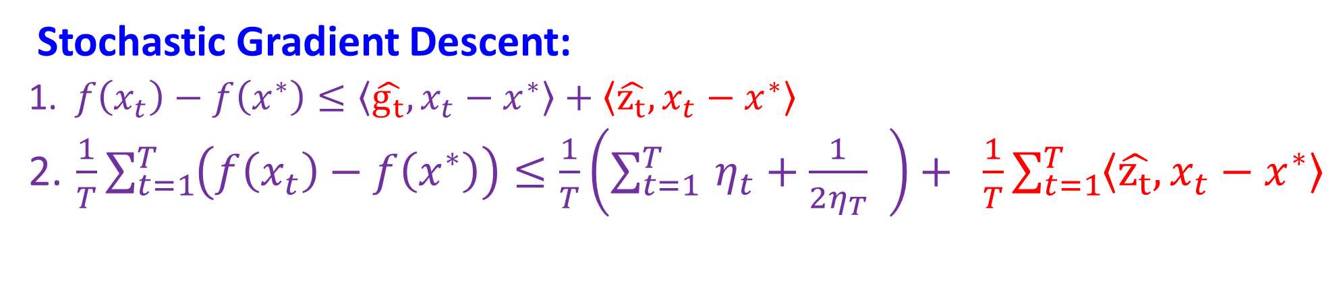
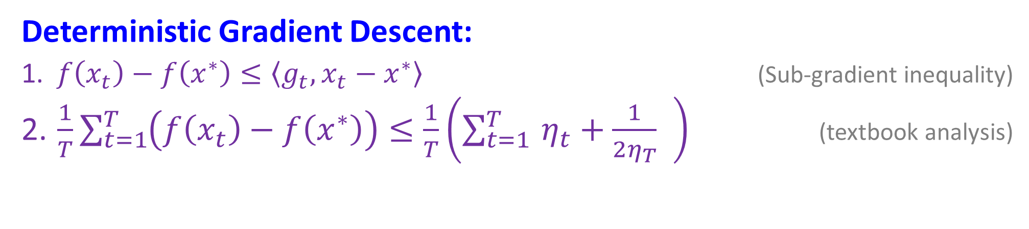

Birds Eye View of Uniform Average High Prob Bound
Deterministic Gradient Descent:
$f\left(x_{t}\right)−f\left(x^{∗}\right)≤\left\langle g_{t}, x_{t}−x^{∗}\right\rangle$ (Sub-gradient inequality)
$\frac{1}{T}\sum_{t=1}^{T}{\left(f\left(x_{t}\right)−f\left(x^{∗}\right)\right)≤\frac{1}{T}\left(\sum_{t=1 }^{T}{η_{t}+\frac{1}{2η_{T}} }\right) }$ (textbook analysis)
$η_{t}= 1/{\sqrt{t}}$ gives UB of $𝒪\left(1/{\sqrt{T}}\right)$
Stochastic Gradient Descent:
$f\left(x_{t}\right)−f\left(x^{∗}\right)≤\left\langle \hat{g_{t}}, x_{t}−x^{∗}\right\rangle +\left\langle \hat{z_{t}}, x_{t}−x^{∗}\right\rangle$
$\frac{1}{T}\sum_{t=1}^{T}{\left(f\left(x_{t}\right)−f\left(x^{∗}\right)\right)≤\frac{1}{T}\left(\sum_{t=1 }^{T}{η_{t}+\frac{1}{2η_{T}} }\right)+ }$ $\frac{1}{T}\sum_{t=1}^{T}{\left\langle \hat{z_{t}}, x_{t}−x^{∗}\right\rangle }$
We just need a bound on the noise term!

Slide 26
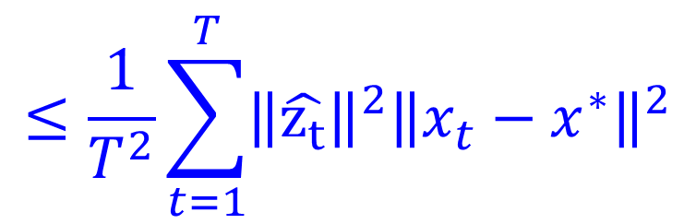


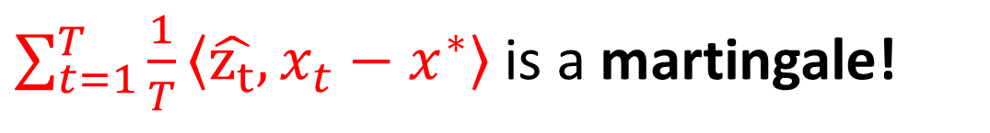
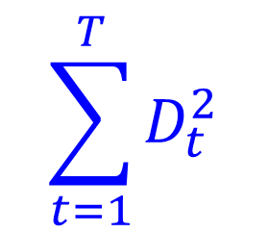
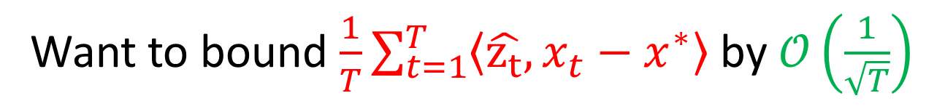
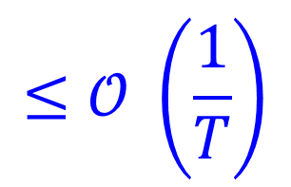
Handling the accumulated noise
Want to bound $\frac{1}{T}\sum_{t=1}^{T}{\left\langle \hat{z_{t}}, x_{t}−x^{∗}\right\rangle }$ by $𝒪\left(\frac{1}{\sqrt{T}}\right)$
$\sum_{t=1}^{T}{\frac{1}{T}\left\langle \hat{z_{t}}, x_{t}−x^{∗}\right\rangle }$ is a martingale!
Need almost sure bound on square function
$$≔D_{t}$$
A martingale is bounded by $𝒪\left(\sqrt{\sum_{t=1}^{T}{D_{t}^{2}}}\right)$, whp
Azuma’s Inequality:
$$\sum_{t=1}^{T}{D_{t}^{2}}$$
$$≤\frac{1}{T^{2}}\sum_{t=1}^{T}{{\left\|\hat{z_{t}}\right\|}^{2}{\left\|x_{t}−x^{∗}\right\|}^{2}}$$
$$≤𝒪 \left(\frac{1}{T}\right)$$
So, “noise” is bounded by $𝒪\left(\frac{1}{\sqrt{T}}\right)$with high probability!

Slide 27
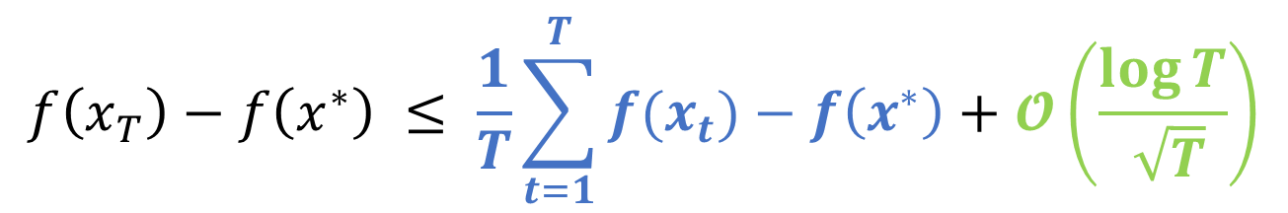
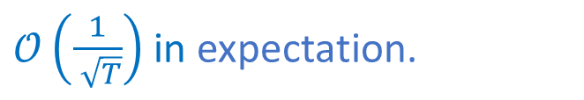
Modifying the final iterate result of [Shamir-Zhang]
[Shamir-Zhang ‘13] showed $f\left(x_{T}\right) −OPT=O(\log\left(T\right)/\sqrt{T})$ for deterministic GD.
Key idea: Recursively sum “standard analysis” over all suffixes.
$$f\left(x_{T}\right)−f\left(x^{∗}\right) ≤ \frac{1}{T}\sum_{t=1}^{T}{f(x_{t})}−f\left(x^{∗}\right)+𝓞\left(\frac{\log{T}}{ \sqrt{T}}\right)$$
Error of uniform averaging
Harmonic sum
$𝒪\left(\frac{1}{ \sqrt{T}}\right)$ in expectation.
The analysis works for GD, but doesn’t account for the “noise”.

Slide 28
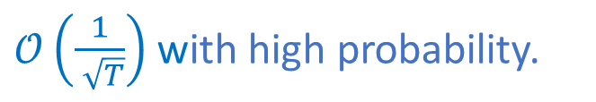
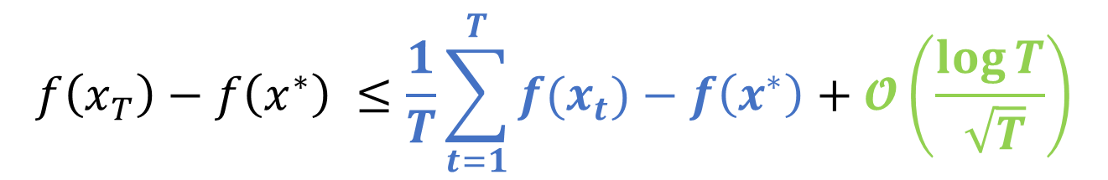
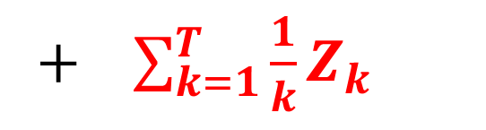
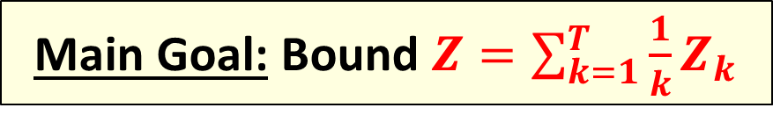

Modifying the final iterate result of [Shamir-Zhang]
Can modify analysis to account for noise terms, like we did for uniform averaging:
$$f\left(x_{T}\right)−f\left(x^{∗}\right) ≤\frac{1}{T}\sum_{t=1}^{T}{f(x_{t})}−f\left(x^{∗}\right)+𝓞\left(\frac{\log{T}}{ \sqrt{T}}\right)$$
+ $\sum_{k=1}^{T}{\frac{1}{k}Z_{k}}$
Error of uniform averaging
Deterministic
$𝒪\left(\frac{1}{ \sqrt{T}}\right)$ with high probability.
Main Goal: Bound $Z=\sum_{k=1}^{T}{\frac{1}{k}Z_{k}}$
Error due to noisy subgradients
where $Z_{k}=\frac{1}{k+1}\sum_{t=T−k}^{T}{\left\langle \hat{z_{t}}, x_{t}−x_{T−k}\right\rangle }$

Slide 29





Handing the accumulated noise
$$= \sum_{i=1}^{T}{\left\langle \hat{z_{t}}, \sum_{t=1}^{i−1}{\frac{1}{{(T−t)}^{2}} (x_{t}−x_{i})} \right\rangle }$$
A martingale
$$Z$$
Try to bound this
$$≤ \sum_{i=1}^{T}{{\left\|\sum_{t=1}^{i−1}{\frac{1}{{(T−t)}^{2}} (x_{t}−x_{i})}\right\|}^{2} }$$
$$≝\sum_{i=1}^{T}{D_{i}^{2}}$$
$\sum_{i=1}^{T}{{\left\langle \hat{z_{t}}, \sum_{t=1}^{i−1}{\frac{1}{{\left(T−t\right)}^{2}} \left(x_{t}−x_{i}\right)} \right\rangle }^{2}}$
Sum of squared increments
Cauchy-Schwarz & bounded noise

Slide 30

Bounding sum of squared increments
If we could bound $\sum_{i=1}^{T}{D_{i}^{2}}$ by $𝒪\left({\log^{2}{T}}/T\right)$ w.p. 1:
Azuma bounds noise by $𝒪\left({\log{T}\log\left(1/δ\right)}/{\sqrt{T}}\right)$ w.p. $1 −δ$, and we’re done.
Seems not: only a.s. bound is diameter bound, which yields $𝒪\left(1\right)$ bound.
Maybe we can bound $\sum_{i=1}^{T}{D_{i}^{2}}$ by $𝒪\left({\log^{2}{T}\log\left(1/δ\right)}/T\right)$ w.p. $1−δ$?
But Azuma won’t work (needs a.s. bound)
There is another option though.

Slide 31
Freedman’s Inequality
Morally: “It is not likely that the martingale is much larger than the square root of its total conditional variance.”

Slide 32


Freedman’s Inequality
Let $D_{1},D_{2},…$ be the increments of a martingale.
Assume $\left|D_{i}\right|≤1$a.s.
Suppose $D_{i}^{2}≤V_{i}$ where $V_{i}$ is $ℱ_{i−1}$ measurable.
Let $V_{n}= \sum_{1}^{n}{V_{i}}$.
Then for every $v$, $\operatorname{Pr}\left[\sum_{1}^{n}{D_{i}}≥v\log{\frac{1}{δ}} and V_{n}≤v^{2}\right]≤δ,$
Suppose ${\left(X_{n}\right)}_{n∈ℕ}$ is a martingale. If $\left|X_{k}−X_{k−1}\right|≤c_{k}$ almost surely. Then,
$\operatorname{Pr}\left[\left|X_{N} −X_{0}\right|≥t\right]≤\exp\left(−\frac{t^{2}}{\sum_{1}^{N}{c_{k}^{2}}}\right).$
Corollary: Assume $V_{n}≤v^{2}\log{\frac{1}{δ}}$. Then, $S_{n}=𝒪\left(v\log{\frac{1}{δ}}\right)$ w.p. at least $1 −δ$.
So, if $\sum_{i=1}^{T}{D_{i}^{2}}$ = $𝒪\left({\log^{2}{T}\log\left(1/δ\right)}/T\right)$ w.p. $1 −δ$, Corollary bounds noise by $𝒪\left({\log{T}\log\left(1/δ\right)}/{\sqrt{T}}\right)$
Notes:
Fix issue: V_n vs V_i

Slide 33

A Chicken and Egg Phenomenon
A careful analysis of ${\left\|x_{t}−x_{j}\right\|}^{2}$ yields:
$\sum_{i=1}^{T}{D_{i}^{2}}≤𝒪\left(\frac{\log^{2}{T}}{T}\log{\frac{1}{δ}}\right) +𝒪\left(\frac{\log{T}}{\sqrt{T}}\log{\frac{1}{δ}}\right)Z$ [w.h.p.]
Desired bound
Not captured by Freedman
Solution: Build our own martingale concentration inequality, specialized for “Chicken and Egg Martingales”

Slide 34

Martingale
Variance

Slide 35

親子丼
Oyakodon – a Japanese rice bowl dish which contains chicken and egg.

Slide 36

鮭親子丼
Salmon Oyakodon – a Japanese rice bowl dish which contains salmon and roe.

Slide 37


The “Oyakodon” Theorem
The Oyakadon Theorem [HLPR 2018]– a martingale concentration inequality useful when the variance is bounded by the martingale:
Suppose ${\left(X_{n}\right)}_{n∈ℕ}$ is a martingale. If $\left|X_{k}−X_{k−1}\right|≤c_{k}$ almost surely. Then,
$\operatorname{Pr}\left[\left|X_{N} −X_{0}\right|≥t\right]≤\exp\left(−\frac{t^{2}}{\sum_{1}^{N}{c_{k}^{2}}}\right).$
Let $D_{1},D_{2},…$ be the increments of a martingale.
Assume $\left|D_{i}\right|≤1$a.s.
Suppose $D_{i}^{2}≤V_{i}$ where $V_{i}$ is $ℱ_{i−1}$ measurable.
Let $V_{n}= \sum_{1}^{n}{V_{i}}$.
T$h$en, $\operatorname{Pr}\left[𝒮_{n}≥x and V_{n}≤β+α𝒮_{n}\right]≤exp \left(−\frac{x^{2}}{4αx+8 β} \right).$
Turns out to be what we need to complete the high probability analysis of $Z$!

Slide 38



The “Oyakodon” Theorem vs. Freedman
Let $D_{1},D_{2},…$ be the increments of a martingale.
Assume $\left|D_{i}\right|≤1$a.s.
Suppose $D_{i}^{2}≤V_{i}$ where $V_{i}$ is $ℱ_{i−1}$ measurable.
Let $V_{n}= \sum_{1}^{n}{V_{i}}$.
Then for every $v$, $\operatorname{Pr}\left[\sum_{1}^{n}{D_{i}}≥x and V_{n}≤β\right]≤exp \left(−\frac{x^{2}}{8 β} \right).$
Suppose ${\left(X_{n}\right)}_{n∈ℕ}$ is a martingale. If $\left|X_{k}−X_{k−1}\right|≤c_{k}$ almost surely. Then,
$\operatorname{Pr}\left[\left|X_{N} −X_{0}\right|≥t\right]≤\exp\left(−\frac{t^{2}}{\sum_{1}^{N}{c_{k}^{2}}}\right).$
Freedman’s Inequality
Suppose ${\left(X_{n}\right)}_{n∈ℕ}$ is a martingale. If $\left|X_{k}−X_{k−1}\right|≤c_{k}$ almost surely. Then,
$\operatorname{Pr}\left[\left|X_{N} −X_{0}\right|≥t\right]≤\exp\left(−\frac{t^{2}}{\sum_{1}^{N}{c_{k}^{2}}}\right).$
Oyakodon Theorem
Let $D_{1},D_{2},…$ be the increments of a martingale.
Assume $\left|D_{i}\right|≤1$a.s.
Suppose $D_{i}^{2}≤V_{i}$ where $V_{i}$ is $ℱ_{i−1}$ measurable.
Let $V_{n}= \sum_{1}^{n}{V_{i}}$.
T$h$en, $\operatorname{Pr}\left[𝒮_{n}≥x and V_{n}≤β+α𝒮_{n}\right]≤exp \left(−\frac{x^{2}}{4αx+8 β} \right).$
Notes:
EMPHASIZE: Recover Freedman by taking alpha = 0.

Slide 39


Conclusions
$f(x_{t})$can be asymptotically worse than $f(\sum_{i=1}^{t}{x_{t}}/t)$, for Lipschitz or Strongly Convex GD (in pathological cases)
High probability bounds for $f\left(x_{t}\right)$ and suffix averaging.
Open questions
Bound on $f(xt)$ when $1/{\sqrt{t}}≤η_{t}≤{log⁡(t)}/{\sqrt{t}}$
UB on $f(x_{t})$is $O\left(\log\left(T\right)\log\left(1/δ\right)/\sqrt{T} \right)$. [Subexponential] LB is $Ω\left(\frac{\log\left(T\right)+\sqrt{log⁡(1/δ)}}{\sqrt{T}} \right)$. Not quite tight. [Subgaussian]
Are these techniques useful in analyzing game dynamics?`
Notes:
Orally mention teaching GD: what about last iterate?

Slide 40
Thank you!
Questions?

