Slide 1
Introduction to
Figma
FIGMA
UI Design Fundamentals for Beginners
2 Days · Hands-on Learning · Beginner Level
Day 1
Day 2
Instructor: [Your Name]

Slide 2





DAY 1 / 01
What is Figma?
A modern cloud-based design tool used by millions of professionals worldwide.
Cloud-Based
UI/UX Design
Real-time Collab
Auto-Save
Free to Start
No installation needed — design in your browser
Build interfaces for web and mobile apps
Multiple designers work on one file simultaneously
Your work is always saved to the cloud automatically
Figma's Starter plan is free — perfect for students

Slide 3





DAY 1 / 02
Why Figma?
Design Websites & Apps
Create Wireframes
Build polished screens for any platform
Sketch low-fidelity layouts quickly
Build Prototypes
Team Collaboration
Link screens to simulate real user flows
Work together in real time, no conflicts
Easy Sharing
Free to Use
Share a link — anyone can view or comment
Starter plan is 100% free for learners

Slide 4





DAY 1 / 03
Who Uses Figma?
Figma is used across the entire product team — not just designers.
UI Designers
UX Designers
Product Designers
Design beautiful, pixel-perfect interfaces
Map user journeys and create wireframes
Own the full product visual experience
Developers
Startups
Students
Inspect designs and extract CSS values
Ship fast with a shared design system
Learn industry-standard tools for free

Slide 5
DAY 1 / 04
Figma Interface Overview
Toolbar (Top)
Layers Panel
(Left)
Canvas (Centre)
Properties
Panel (Right)
Layers Panel: Manage stacking, hide/show, and rename layers
Properties Panel: Inspect and edit every property of the selected element
Toolbar: Access every tool with one click or keyboard shortcut

Slide 6
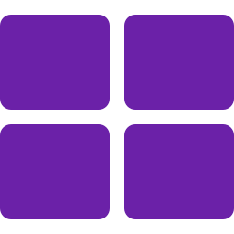

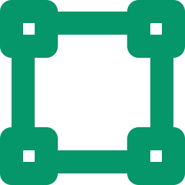


DAY 1 / 05
Basic Tools in Figma
F
Frame Tool
Creates the main screen container — the starting point of every design.
V
Move Tool
Select, move, and resize any element on the canvas.
R
Rectangle Tool
Draw boxes, cards, buttons, and layout blocks.
T
Text Tool
Add headings, labels, body text, and UI copy.
H
Hand Tool
Pan around the canvas without accidentally selecting elements.

Slide 7
DAY 1 / 06
What is a Frame?
Every design in Figma starts inside a Frame — think of it as your screen or browser window.
Desktop Frame (1440 × 900)
Press F and choose any device preset to create a frame
All elements must sit inside a frame
One file can hold multiple frames (pages)
Button
Desktop Frame
Mobile Frame (390 × 844)

Slide 8
DAY 1 / 07
Design Fundamentals
01
02
Structure
Alignment
Organise elements in a clear, logical hierarchy
Every element should align with another — nothing should be placed randomly
03
04
Spacing
Consistency
Consistent margins and padding create breathing room and improve readability
Reuse the same fonts, colours, and components throughout the design
05
06
Visual Balance
Clean Layout
Distribute visual weight evenly — no single area should feel too heavy
Simplicity is the ultimate sophistication — remove anything that doesn't serve the user

Slide 9
DAY 1 / TASK
Mini Practical Task
Design a Login Screen
Must Include
Apply These Skills
1. Title / Heading text
2. Email input field
3. Password input field
4. Submit / Login button
1. Use a Desktop Frame (F)
2. Align elements to centre
3. Add equal spacing between fields
4. Label all elements clearly
Tip: Use Ctrl+R for rectangle, T for text, V to select. Align via the toolbar when multiple elements are selected.

Slide 10

Day 1 Recap
Here is what we covered today:
What Figma is and why it replaced older tools like Photoshop
The core use cases: websites, wireframes, prototypes, and team work
Who uses Figma — designers, developers, students, and startups
The Figma interface: Toolbar, Canvas, Layers panel, Properties panel
Five essential tools: Frame (F), Move (V), Rectangle (R), Text (T), Hand (H)
What a Frame is and how to create one for desktop or mobile
See you in Day 2 — Layouts & Auto Layout in Figma →

Slide 11
Layouts &
Auto Layout
in Figma
DAY 2
Alignment · Spacing · Auto Layout · Card Design
Day 2
Design Workshop
Instructor: [Your Name]

Slide 12


DAY 2 / 01
Why Layout Matters
Makes Design Clean
A structured layout removes visual clutter instantly
Improves Readability
Users can scan and understand content much faster
Creates Visual Balance
Balanced designs feel trustworthy and professional
Professional Appearance
Consistent layout signals quality and attention to detail
Better User Experience
Logical layouts guide users to take the right actions

Slide 13




DAY 2 / 02
Alignment Tools
Select two or more elements, then use the alignment toolbar to position them precisely.
Align Left
Align Centre
All elements snap to the leftmost edge
All elements share the same horizontal centre
Align Right
Align Top
All elements snap to the rightmost edge
All elements snap to the topmost edge
Align Bottom
Distribute Space
All elements snap to the bottommost edge
Equal gaps between all selected elements

Slide 14
DAY 2 / 03
Spacing Principles
Spacing Demo
Equal spacing
Use consistent spacing values — 8px, 16px, 24px system
Padding
Margin
Proper margins
Leave clear space between your design and the frame edges
Proper padding
Add inner space inside buttons and cards for breathing room
Avoid overcrowding
Whitespace is not wasted space — it improves focus
Maintain balance
Visual weight should feel even across the layout

Slide 15

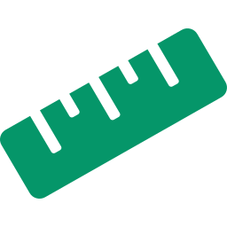



DAY 2 / 04
What is Auto Layout?
Auto Layout is Figma's version of CSS Flexbox — elements arrange and resize themselves automatically.
Shortcut: Select elements → press Shift + A
Organises Automatically
Controls Spacing
Elements stack or flow without manual repositioning
Set exact pixel gaps between child elements
Adds Padding
Adjusts Size Dynamically
Define inner space around the container
Container grows and shrinks as content changes
Creates Structured Designs
Mirrors the structure of real HTML/CSS code

Slide 16




DAY 2 / 05
Benefits of Auto Layout
01
Saves Time
No manual repositioning when content changes
02
Maintains Consistency
Spacing and alignment stay perfect automatically
03
Easy Editing
Edit one element and the whole layout reflows
04
Professional Workflow
Mirrors how real CSS Flexbox works in code
05
Responsive Structure
Designs adapt as content grows or shrinks

Slide 17
DAY 2 / 06
How Auto Layout Works
1
Select Elements
Click on a frame or select multiple items you want to group into a layout
2
Apply Auto Layout
Press Shift+A — or right-click → Add Auto Layout. A dotted border appears.
3
Adjust Spacing (Gap)
In the right panel, set the Gap between items — e.g. 16 for 16px spacing
4
Adjust Padding
Set top, right, bottom, left padding inside the container — e.g. 24px all sides
5
Choose Direction
Horizontal: items flow left to right. Vertical: items stack top to bottom.

Slide 18
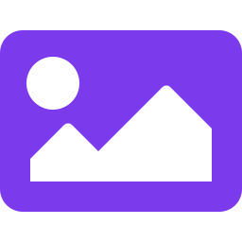

DAY 2 / 07
Card Design Structure
Cards are one of the most common UI patterns. Here's how to build one properly in Figma.
Skills Applied
Image Block
Image
Frame to contain the card
Auto Layout for stacking
Title
Title Text
Alignment tools for precision
Description
Description
Consistent spacing & padding
Button
CTA Button
Reusable as a Component

Slide 19
DAY 2 / TASK
Practical Task
Design a Profile Card
Must Include
Apply These Skills
1. Profile image (circle shape)
2. Name — bold heading text
3. Short description / bio
4. Action button (e.g. 'Follow')
1. Use Auto Layout for vertical stacking
2. Align everything to centre
3. Add 16px padding inside the card
4. Apply consistent spacing between items
Tip: Create the card in a Mobile Frame (390px wide). Use Shift+A to apply Auto Layout once you've arranged the elements.

Slide 20

Final Recap
Everything you mastered in 2 days:
Figma interface: Toolbar, Canvas, Layers Panel, Properties Panel
Core tools: Frame (F), Move (V), Rectangle (R), Text (T), Hand (H)
Design fundamentals: Structure, Alignment, Spacing, Consistency
Alignment tools: Align Left / Centre / Right / Top / Bottom / Distribute
Spacing principles: Margins, Padding, Equal gaps, and avoiding clutter
Auto Layout: Shift+A — automatic spacing, padding, and responsive sizing
Card Design: Image, Title, Description, Button — built with Auto Layout
Congratulations on completing the Figma 2-Day Workshop! 🎉
Clean UI structure: Every design decision should serve the user

