Slide 1








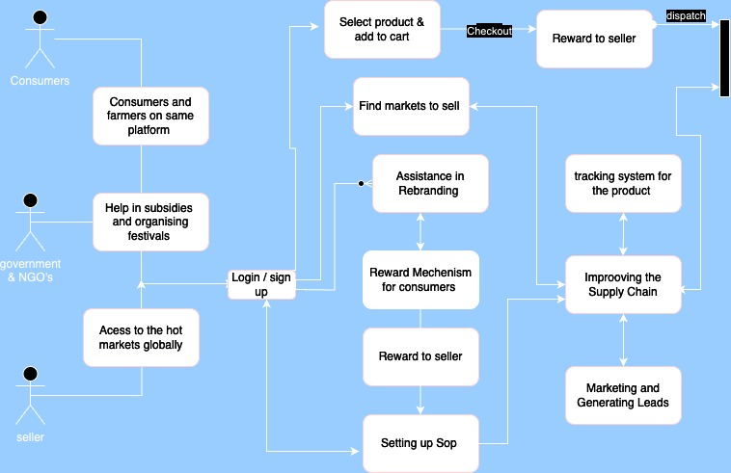













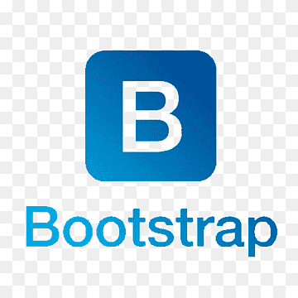




Idea/Approach Details
DATA FLOW DIAGRAM
We created a solution by creating both Web-based and Android application which aims to streamline the supply chain, enhance product visibility, and promote equitable remuneration for local producers and artisans.
Our platform well predict the best demanding product in the best market with the best prices, using Machine Learning.
Through our recommendation system, SOPs are set up to increase the quality and consistency of products using TS Forecasting.
Will develop a Digital Inventory Management System that helps local producers and artisans using Smart contracts of blockchain.
Providing the E-learning and educating the local Artisans.
"Blockchain technology, Ethereum smart contracts, MetaMask, and Etherscan are pivotal for managing supply chains, tracing product provenance as NFTs, and optimizing shipping routes for cost-effective and timely deliveries.”
Creating a Reward Based System for each efficient sale.
"Facilitating the seamless integration of cutting-edge Gen-AI technology into the mid-journey of rebranding products, elevating them to meet international standards with unparalleled efficiency.”
Organizing the fairs/fest with help of Government and NGO to take buyers and Artisians on the same platform.
Describe your Technology stack here:-

Slide 2
Idea/Approach Details
Our USPs are : -
The supply chain leakage issue will be resolved with the aid of blockchain.
By minimizing the need for a middleman, a relationship between the end user and the artist or vendor will increase revenues for the seller and provide customers with high-quality goods.
Using generative AI and machine learning, rebranding and marketing is made simpler.
Both sellers and customers will have access to a 24/7 hotline chat bot.
Linking several hot markets together with the ML recommendation system will expand sales and reach.
Speech overlay capabilities for non-literate sellers so they can use the platform with ease
Real-time tracking of product trends and market conditions
All this features combining will be resulting in making each district of J&K an export hub.
Describe your Dependencies :-
Our platform will support more than 32 different languages which will serve the term “ODOP” in a proper and efficient structure.
Providing a secure employment to those vendors who had stable sources of income and were dependent on local people.
Automatic generation of cashback points according to the quality of the product through review and feedback mechanism.
AI powered 24/7 hot line chat-bot is available to help both artisans and consumers.
User can donate set of amount towards the planting of tree at the end of each purchase of ODOP product, the geo-graphical location of which will be shared with the user later.
Real-Time Market Tracking and Real Time Product Tracking will be available.

