Slide 1


ECO-SYNC
Team Name: Eco-Sync
Team leader: Aditi Sinha
Member 1: Sikander Singh
Member 2: Abhishek
Member 3: Akshat Tiwari
Problem Statement: Developing solution to effective linkage and promotion of One District One Product
Solution(Title Only): Pioneering Integrated Solutions for Empowered Artisans and Expansive Markets with digital solution

Slide 2
ECO-SYNC
Problem Statement
Developing solution to effective linkage and promotion of One District One Product
Describe Your Idea Solution: Our Platform is an integrated platform leveraging blockchain security and a 3- login system to streamline One District One Product (ODOP) challenges. It ensures a transparent and secure supply chain, eliminating intermediaries and verifying product authenticity. ML drives market awareness, aiding artisans in linking to high-demand markets and facilitating rebranding. The platform offers Smart E-learning to users and artisans, promoting tech adoption for cost-effective production. Government costs reduce significantly, and exports from J&K are projected to reach 1.32 lakh Crore approx. in three years, creating around 1 lakh new jobs. The technology stack includes Blockchain, ML, AR/VR, and various modules enhancing product visualization, traceability, inventory management, and more, optimizing the ODOP initiative's impact. The implementation of Our Platform is expected to have a significant economic impact on the region. By exempting the government from setting up Common Facility Centre’s (CFCs), approximately 300 crores of government expenditure can be saved.

Slide 3
ECO-SYNC
OPPORTUNITY
Unifying ODOP through 3-Login System, Integrated Supply Chain, Direct Market Linkage, and Skill Training Platform.
Through our recommendation system, SOPs are set up to increase the quality and consistency of products using TS Forecasting.
Will develop a Digital Inventory Management System that helps local producers and artisans using Smart contracts of blockchain.
By implementing this Solution Government will save directly Rs. 300 crore from all over Jammu & Kashmir.
Blockchain technology, Ethereum smart contracts, MetaMask, and Etherscan are pivotal for managing supply chains, tracing product as NFTs, and optimizing shipping routes for cost-effective and timely deliveries.
Creating a Reward Based System for each efficient sale.
Providing the E-learning and educating the local Artisans.
Organizing the fairs/fest with help of Government and NGO to take buyers and Artisians on the same platform.
AR/VR try on integrated Feature

Slide 4
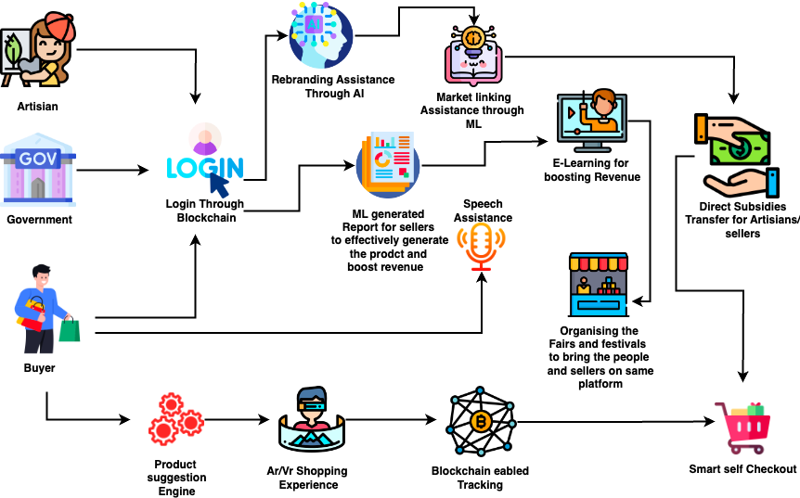
FLOW DIAGRAM:

Slide 5

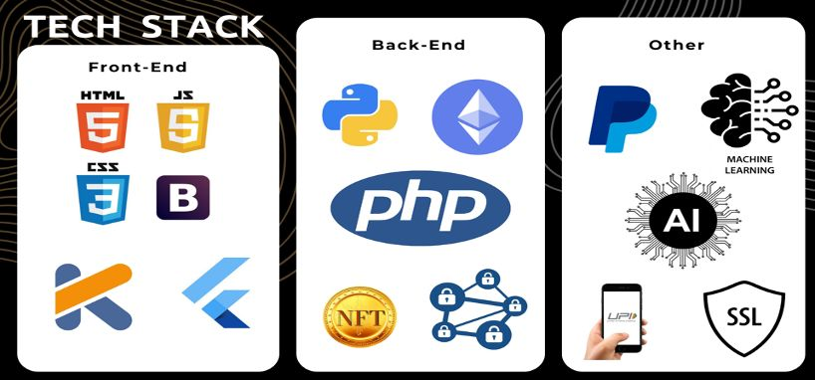
ECO-SYNC
FEATURES:
ML Recommendation System.
Rebranding Assistance.
Geo-Location Services.
Push Notification.
E-Learning artisans training content.
Product suggestion engine.
Counterfeit Prevention.
Sustainability and Ethical Sourcing.
Virtual Shopping Environments.
Speech Overlay Capabilities.
Multi-lingual Platform.
24/7 AI Chat-bot assistant.

Slide 6
CODE-CRAFT
USE CASES
The supply chain Leakage and the middleman's will be removed from the system using blockchain eventually increases revenue and high-quality goods.
With use of generative AI and ML, rebranding and marketing is made simpler.
Seller can find hot markets together with the ML recommendation system which will expand sales and reach.
Speech overlay capabilities for non-literate sellers so they can use the platform with ease.
Providing E-learning to both users and sellers of how to use blockchain wallet integration for products.
AI powered 24/7 hot line chat-bot is available to help both artisans and consumers.
This platform will support more than 32 different languages.
Real-Time Market Tracking and Real Time Product Tracking will be available.
For both sellers and buyers.
planting of tree at the end of each purchase of ODOP product, the geo-graphical location of which will be shared with the user later.
Product authenticity verification with blockchain Hash ID.
While delivering the product , QR will be scanned at each station , will be Tagged on blockchain , increasing transparency of the supply chain.
UNIQUE FEATURES

