Slide 1
Feature: View Batch Numbers
This feature allows the user to quickly access batch records. When navigating to the batch list, the system first loads and displays the latest 20 batch numbers to ensure fast response time and a smooth experience. If needed, the user can then choose to load and view all batch numbers for a complete history.

Slide 2
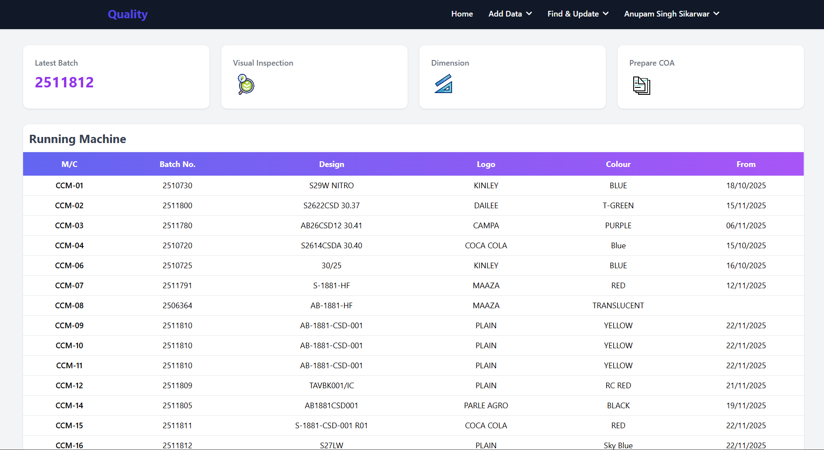
Click here to see the latest 20 batch numbers

Slide 3
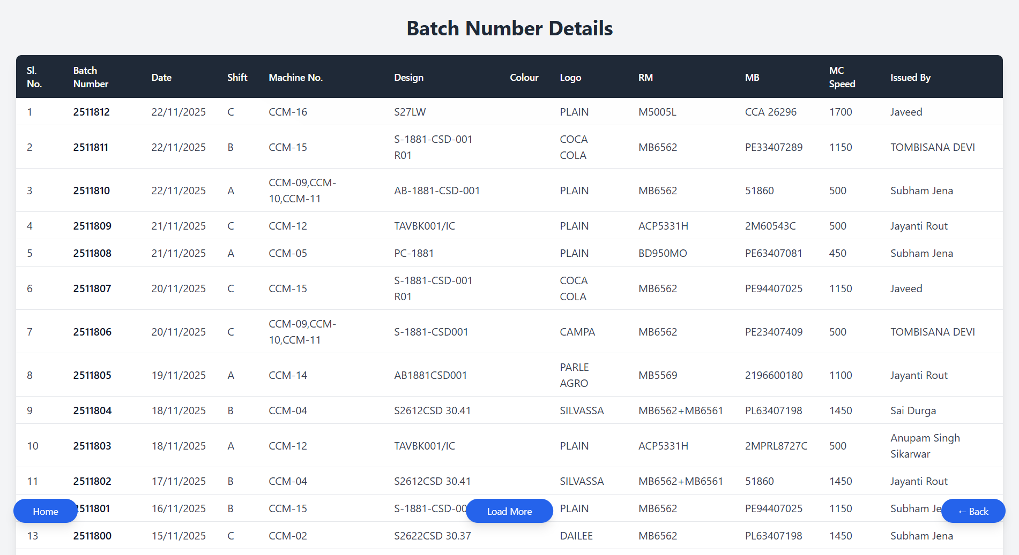
Click here to see the all-batch numbers
Click here to return on home page
Click here to go one step back

Slide 4
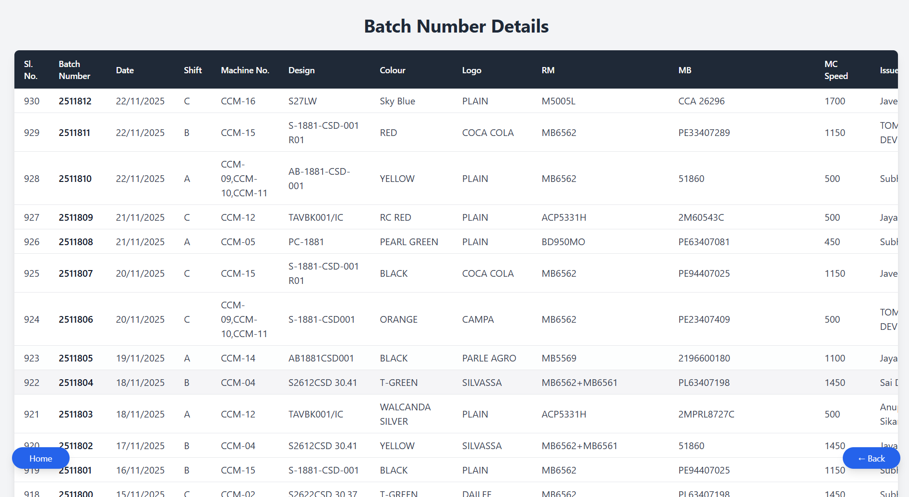
Click here to return on home page
Click here to go one step back

