Slide 1
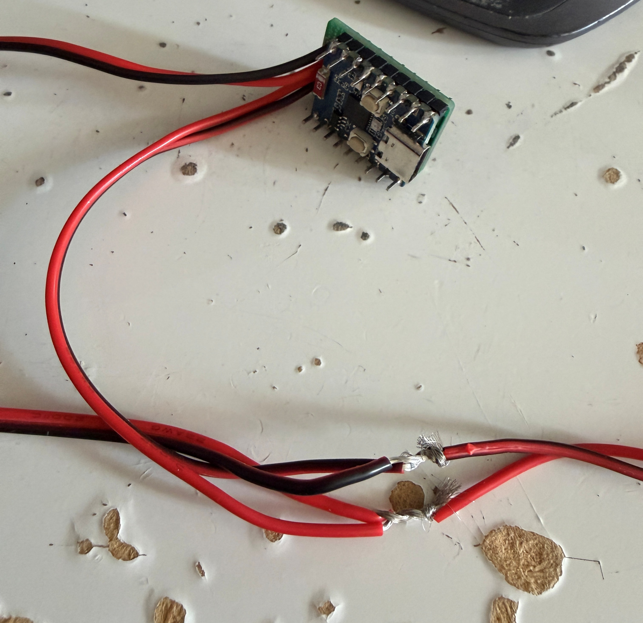
Sorry ☹
Run out of
Yellow & Green
wires
Power
Branch off CAN
Less than 10CM
Solder and tape
Existed CAN line

