Slide 1
Stacker fpga game
Team: Bits please
Members: Kaushik Mandiga, jonathan tran, denny luong, sikender shahid, Robert duenez

Slide 2
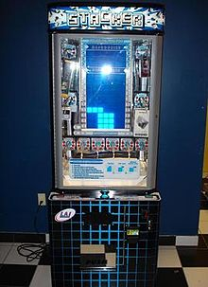
overview
Game is played with a single button. Blocks will move left and right. On button push, blocks stop moving. If properly stacked, new row appears above it. If improperly stacked, user loses blocks determined by offset from previous row. If user loses all blocks, results in a loss. If user makes it to the top, user wins.

Slide 3
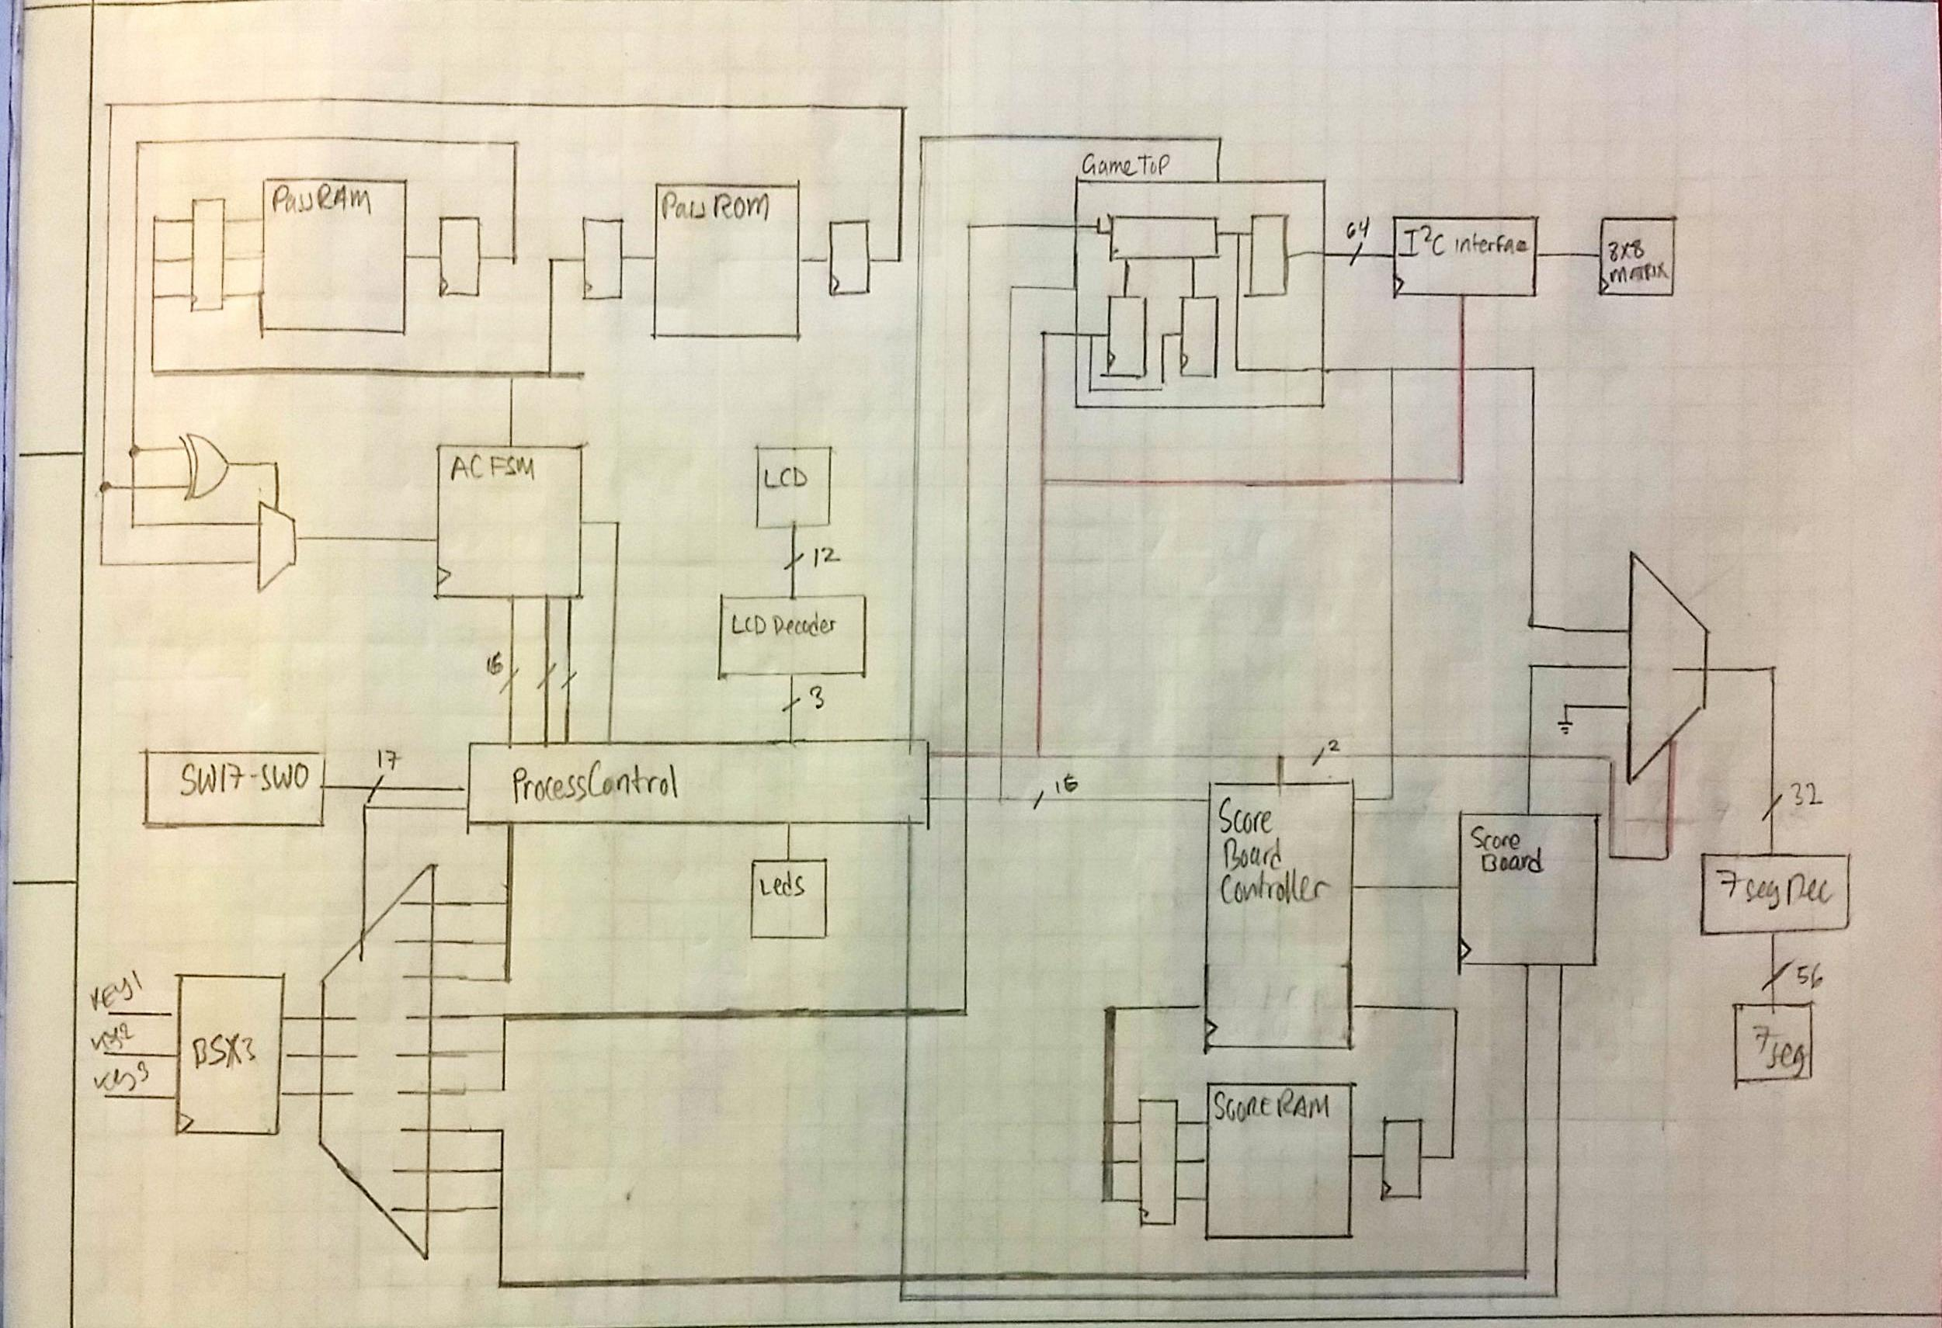
System architecture

Slide 4
authentication

Slide 5
Game logic

Slide 6
Lcd module

Slide 7
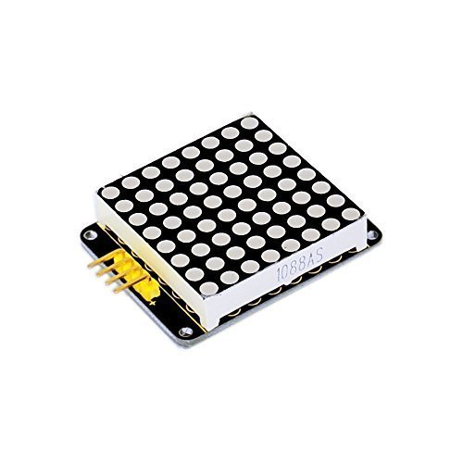
8x8 led matrix
I2C addressable LED DOT Matrix
Regular LED DOT Matrix

Slide 8
video

