Slide 1

BANGALORE INSTITUTE OF TECHNOLOGY
K.R.ROAD, V.V.PURAM, BANGALORE - 560004
DEPARTMENT OF INFORMATION SCIENCE AND ENGINEERING
An internship on
“MACHINE LEARNING”
at
“WATER PORTABILITY DETECTION”
Presented By
SATHVIK I K
USN: 1BI20IS083
Internal Guide
External Guide
Pavithra N
Assistant Professor
Dept. of ISE, BIT
Akash V
Software Engineer
Prinston Smart Engineers

Slide 2
CONTENTS
About the Company
Task Performed
Basic Training
Tasks Assigned.
Reflection Notes
Technical Outcomes
Non-Technical Outcomes
Conclusion

Slide 3
ABOUT THE COMPANY
Prinston Smart Engineers is a comprehensive service provider specializing in Mechanical, Electrical, and Plumbing (MEP) design, as well as IT services.
The company offers a wide range of services, including the design, construction, installation, and maintenance of Electro-Mechanical systems and networks, utilities, and equipment.
Their expertise extends to engineering documentation, submittal approval, shop drawings, coordinating drawings, commissioning, start-up, and as-built documentation.
Additionally, the company provides IT services and offers live instructor-led interactive online training to engineering students, enabling them to acquire industry-relevant skills.
For over 13 years, Smart Engineers has been a leading provider of maintenance and services in Delhi, as well as several other cities across India.
The company's objective is to cultivate responsive client relationships, enabling them to not only meet but also exceed the goals of each project they undertake.

Slide 4
SERVICES OF THE COMPANY
Design, construction, supply, installation, servicing, and upgrading of Electro-Mechanical Systems & Networks, Utilities, and Equipment
Engineering, Documentation, Submittal Approval, Shop Drawings, Coordinating Drawings, Commissioning, Start-Up, and As-Built ACC
Contract Programs adherence and Project Time Schedules compliance while meeting Consultant Specifications
Provision of IT services
Facilitation of live instructor-led interactive online training for engineering students
Maintenance & Services in Delhi and various other cities across India, surpassing client expectations
Skill development and Training programs for Engineering students in different domains
Addressing unemployment among Engineering graduates through skill training initiatives
Ensuring student exposure to the industrial environment and relevant technology through mandatory internships.

Slide 5
CLIENTS OF THE COMPANY
Honeywell: Honeywell is a global conglomerate that has been innovating for over 100 years. The company operates in various sectors, including aerospace technologies, building automation, energy & sustainability solutions, and industrial automation.
Kribhco: KRIBHCO (Krishak Bharati Cooperative Limited) is a premier National level Cooperative Society of India engaged in fertilizer production and distribution.
Shipra: Shipra Group of Companies has a rich heritage dating back to its establishment in 1984, embodying resilience and innovation throughout its journey. The brand has evolved into a celebrated legacy, empowering lives and shaping industries with unwavering determination.
C & S Electronics: C&S Electronics is a prominent player in the switchgear business segment and holds a market-leading position in the busbar business, commanding over 50% share in the Indian market.
The India Islamic Cultural Centre: IICC was established to promote mutual understanding and harmony among the people of India, showcasing the true essence of Islam as a tolerant, liberal, progressive, and forward-looking religion.

Slide 6
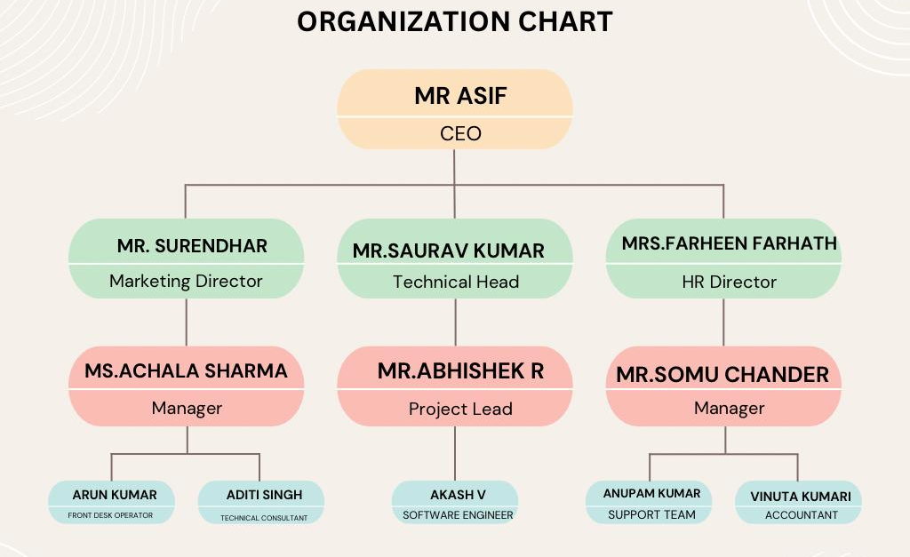
ORGANISATIONAL STRUCTURE

Slide 7
OBJECTIVES OF THE DEPARTMENT
To Provide Quality Internship Opportunities: By offering quality internship programs conducted by expert teams, the company aims to bridge the gap between theoretical knowledge and real-world applications, thereby preparing students for their future careers.
To Expand Services Through Collaborations: The collaboration with Wedir-tech Trading Contracting & Services W.L.L in Doha, Qatar, indicates a strategic move to enhance service offerings, leverage mutual benefits, and tap into new markets.
To Unite Education and Community for Business Growth: By creating a platform that integrates education and community engagement, Prinston Smart Engineers aims to foster sustainable business practices while contributing to the development of society.
To Address Unemployment Among Engineering Graduates: Prinston Smart Engineers aims to tackle the issue of unemployment among engineering graduates by providing skill development programs and training in various domains.

Slide 8
BASIC TRAINING
During the one-month internship program, I have acquired a strong understanding of machine learning concepts, including foundational Python programming skills.
Here's an expanded summary of what I've learned:
Python for Machine Learning:
Python Basics: I have learned the basics of Python programming, including data types, variables, control structures (if statements, loops), functions, and data structures (lists, tuples, dictionaries).
Libraries: I have gained proficiency in using essential Python libraries for machine learning, such as NumPy for numerical computing, Pandas for data manipulation and analysis, and Matplotlib/Seaborn for data visualization.
Scikit-Learn: I have been introduced to Scikit-Learn, a popular Python library for machine learning, which provides efficient tools for data preprocessing, model selection, training, and evaluation.
Supervised Learning: In supervised learning, the algorithm learns from labeled data, where each example in the dataset is associated with a corresponding target variable or label.
Popular Techniques:

Slide 9
BASIC TRAINING
Linear Regression: Linear regression is a simple yet powerful technique used for modelling the relationship between a dependent variable and one or more independent variables. It assumes a linear relationship between the input features and the target variable.
Support Vector Machines (SVM): SVM is a versatile supervised learning algorithm capable of performing classification, regression, and outlier detection tasks.
K-Nearest Neighbours (KNN): KNN is a non-parametric, instance-based learning algorithm used for classification and regression tasks. It predicts the target variable by averaging the values of its k nearest neighbours in the feature space.
Decision Trees: Decision trees are versatile supervised learning algorithms capable of handling both classification and regression tasks. They partition the feature space into regions based on feature values and make predictions based on the majority class or average target value within each region.

Slide 10
TASKS ASSIGNED
Water Portability Prediction
Utilizing machine learning for water potability prediction modernizes water quality assessment by analyzing various parameters like pH levels, hardness, solids content, and chemical compositions.
Automating water quality analysis reduces the workload of experts and speeds up the assessment process, facilitating prompt decisions regarding water safety.
Integration with existing water management systems and ongoing refinement enhances the system's usability, reliability, and effectiveness in real-world scenarios.

Slide 11
INTERNSHIP TIMELINE
SL. No. | WEEK | TASKS PERFORMED
1. | Week – 1 (11thAug, 2023 to 16thAug, 2023) | Joining the Internship Program. Getting to know about the Company and Mentors. Understanding the basics of Machine learning.
2. | Week – 2 (17thAug, 2023 to 23rdAug, 2023) | Learning the basics Python for ML – variables, datatypes, flow control, Libraries etc. Understanding Supervised Learning – Linear Regression, Logistic Regression, Decision Tree.
3. | Week – 3 (24thAug, 2023 to 30thAug, 2023) | Studying Unsupervised Learning: K-Means Clustering, Hierarchical Clustering, Dimensionality Reduction. Hands-on project with supervised and unsupervised learning algorithms.
4. | Week – 4 (31stAug, 2023 to 7thSept, 2023) | Got assigned a Task – “Water Portability Detection” to be performed. Started working on the allotted Project by the Company. Modifying the Project according to the requirements of the Clients.

Slide 12
Reflection Notes
TECHNICAL OUTCOMES:
Understanding of Machine Learning Concepts: I gained a solid understanding of fundamental machine learning concepts, including supervised and unsupervised learning, regression, classification, and clustering.
Programming Skills:
Python Programming: I honed my Python programming skills, which are indispensable for implementing machine learning algorithms and data manipulation tasks.
Libraries: I became proficient in utilizing Python libraries such as NumPy, Pandas, Matplotlib, and Scikit-Learn for data pre processing, visualization, and modelling.
Machine Learning Algorithms:
Regression Techniques: I learned about linear regression and its variants, as well as other regression techniques like Ridge Regression and Lasso Regression.
Classification Algorithms: I explored classification algorithms such as Support Vector Machines (SVM), Decision Trees, Random Forests, and K-Nearest Neighbors (KNN).
Clustering Methods: I delved into clustering algorithms like K-Means Clustering and Hierarchical Clustering.

Slide 13
NON-TECHNICAL OUTCOMES:
Adaptability: I learned to adapt to different project requirements and challenges encountered during the machine learning projects, showcasing flexibility in approach and problem-solving.
Teamwork: Collaborating with peers on machine learning projects enhanced my ability to work effectively in a team environment, fostering communication, coordination, and knowledge-sharing.
Time Management: Balancing multiple tasks and deadlines in machine learning projects helped me improve my time management skills, ensuring efficient utilization of resources and timely project delivery.
Critical Thinking and Problem-Solving: Engaging in complex machine learning tasks required critical thinking and problem-solving abilities, enabling me to analyse data, identify patterns, and derive meaningful insights to address real-world challenges.

Slide 14
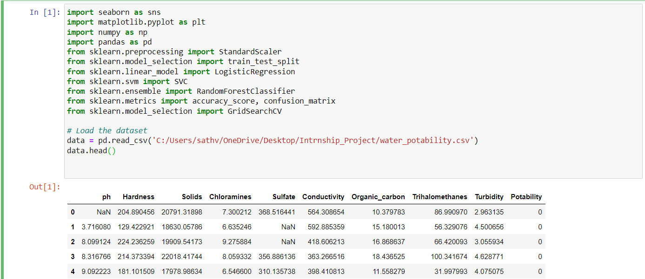
CODE SNIPPETS

Slide 15
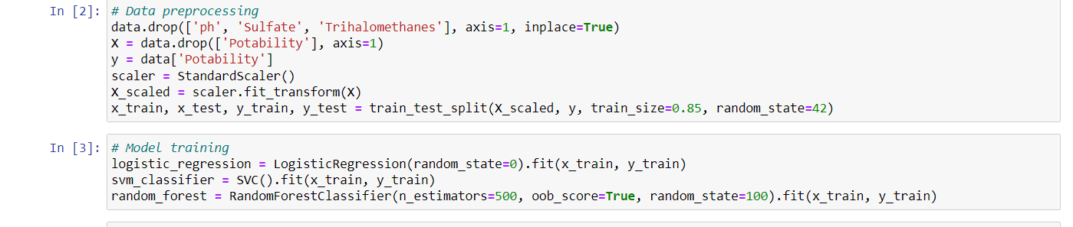
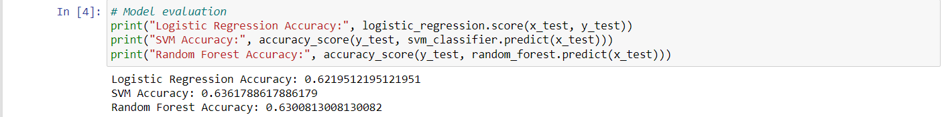

Slide 16
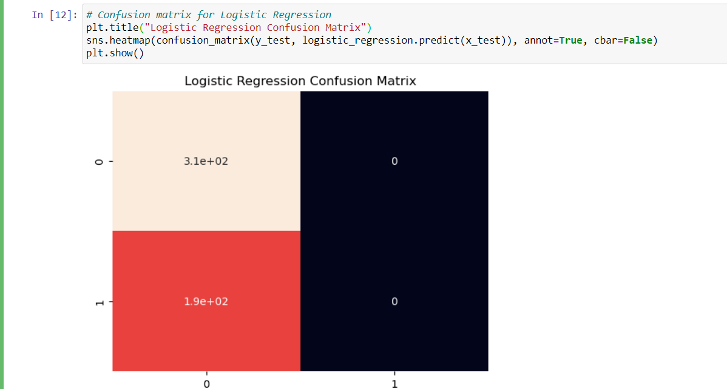

Slide 17
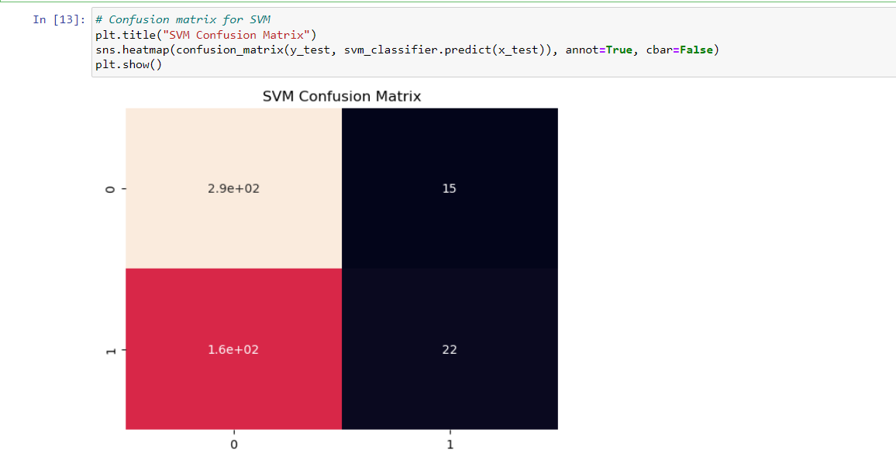

Slide 18
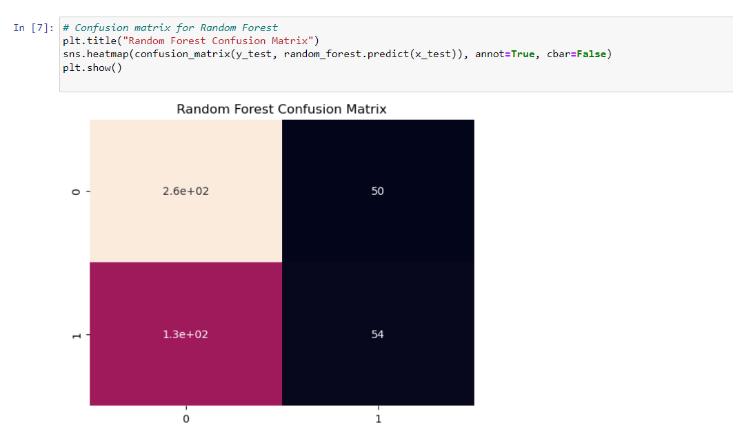

Slide 19
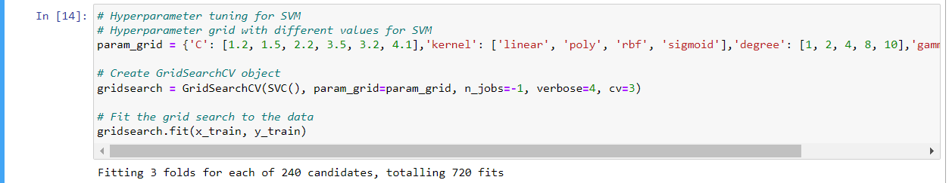

Slide 20
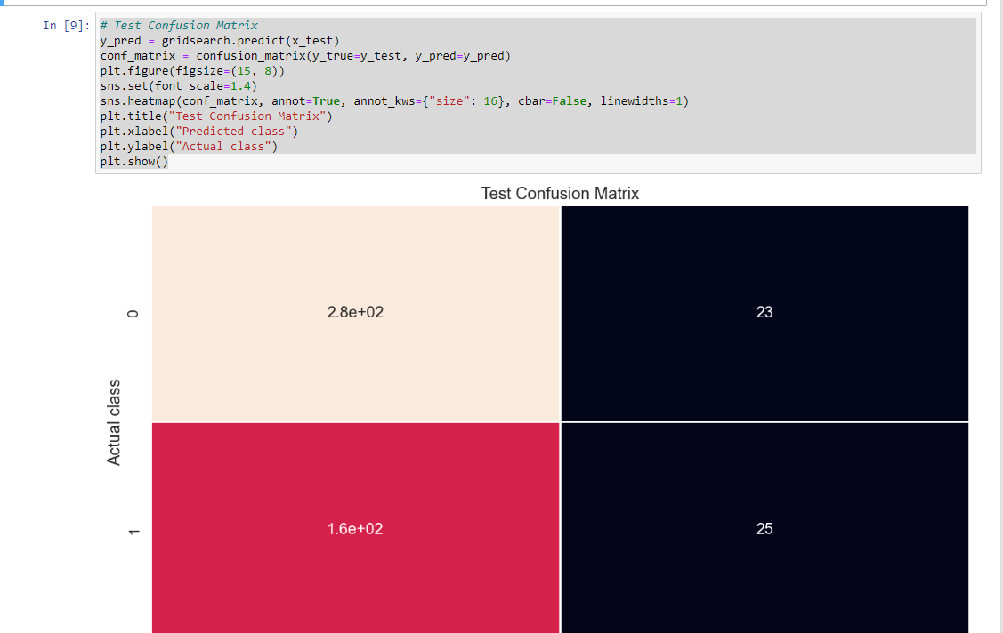

Slide 21
CONCLUSION
The machine learning internship provided an invaluable opportunity to delve into the intricacies of data science, equipping me with a solid foundation in Python programming and a comprehensive understanding of machine learning algorithms.
Throughout the program, I engaged in hands-on projects and interactive sessions, enabling me to apply theoretical concepts to real-world scenarios and hone my analytical skills.
Moreover, the internship fostered a collaborative learning environment, allowing me to work alongside peers and mentors, exchange ideas, and explore emerging trends in the field.
Overall, the experience not only expanded my technical expertise but also instilled in me a passion for leveraging data-driven solutions to address complex challenges, setting the stage for continued growth and exploration in the dynamic realm of machine learning.

Slide 22


