Slide 1
Sikhism
Conception, Theory, Beliefs, and People

Slide 2
A little about me…
Junior at UCD, premed
Raised in San Jose, CA
Attending camps/retreats/Khalsa School for the past 15 years
Contact: LGSINGH@UCDAVIS.EDU

Slide 3
Some terms to know
SIKH – student, disciple of the Sikh faith
GURU – teacher, refers to founders of Sikhism
GURDWARA – “Court of the Guru”, Sikh place of worship
WAHEGURU – Sikh name for God
GURBANI – the writings of the Guru Granth Sahib
GURU GRANTH SAHIB – Sikh scripture, current Guru

Slide 4
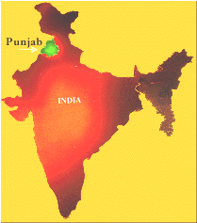
Historical Context
Invasions from the
West
Islam or death
Distraught Hindus

Slide 5
Guru Nanak
Born in 1469
Against ritualism and labels
Believed in quality of conscience
Universal brotherhood

Slide 6
kwnVw mhlw 5 ]
ibsr geI sB qwiq prweI ]
I have totally forgotten my jealousy of others
jb qy swDsMgiq moih pweI ]1] rhwau ]
Since I found the Sadhsangat, the company of the Holy.
nw ko bYrI nhI ibgwnw sgl sMig hm kaU bin AweI ]1]
I see no stranger, I see no enemy. Wherever I look, God is all I see.

Slide 7
Three Golden Rules
Naam Japo – Meditate on God’s Name
Kirat Karo – Earn your living honestly
Vand Chhakko – Share your earnings with the needy

Slide 8
Sikhism ahead of its time…

Slide 9
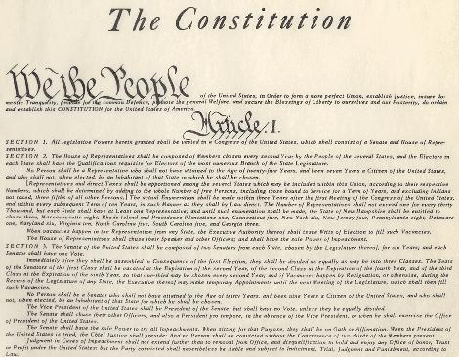
307 Years Before:

Slide 10
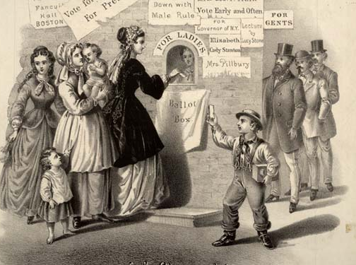
451 Years Before:

Slide 11
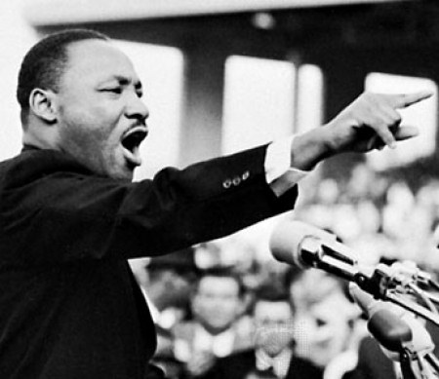
494 Years Before:

Slide 12
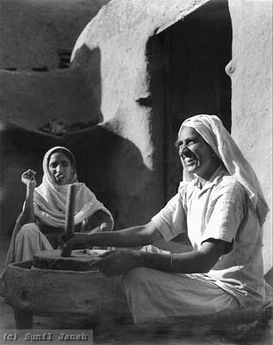
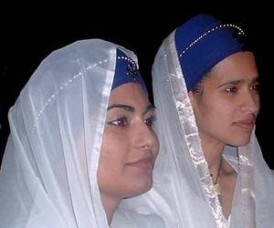
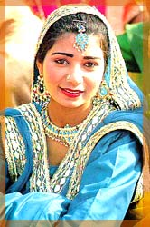
Women in Sikhism

Slide 13
m: 1 ]
BMif jMmIAY BMf inMmIAY BMd mMgxu vIAwhu ]
From woman, man is born; within woman, he is conceived; to woman he is engaged and married.
…
so ikau mMdw AwKIAY ijqu jMmih rwjwn ]
So why call her bad, she who gives birth to kings?

Slide 14
Women in Sikhism
Sikh women have complete equality with men
Empowerment through education and initiative

Slide 15
Sikhism and Other Religions
If you’re a Hindu, be a good Hindu.
If you’re a Muslim, be a good Muslim.
Each religion is a different path to the same destination
Martyrdom for freedom of faith

Slide 16
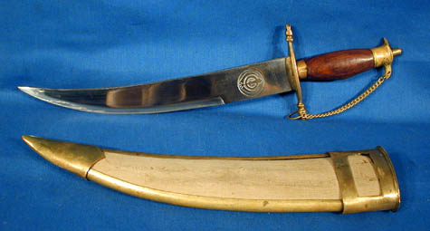
Sikhs Pick up the Sword
Guru Hargobind: Miri and Piri
Violence is a LAST resort
Series of battles in history in which the Sikhs participated

Slide 17
The Khanda
>

Slide 18
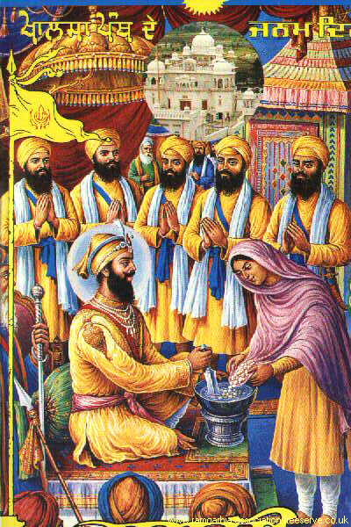
The Khalsa

Slide 19
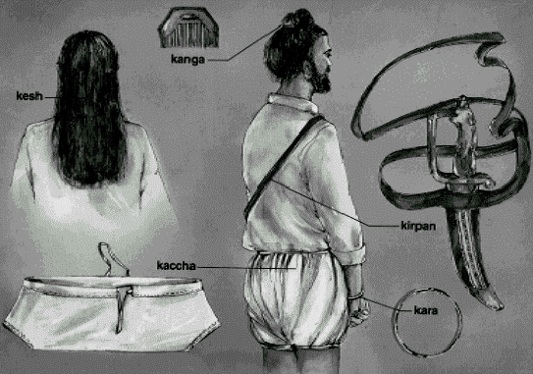
5 K’s

Slide 20
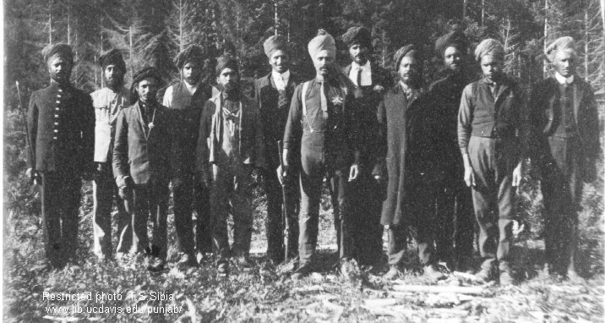
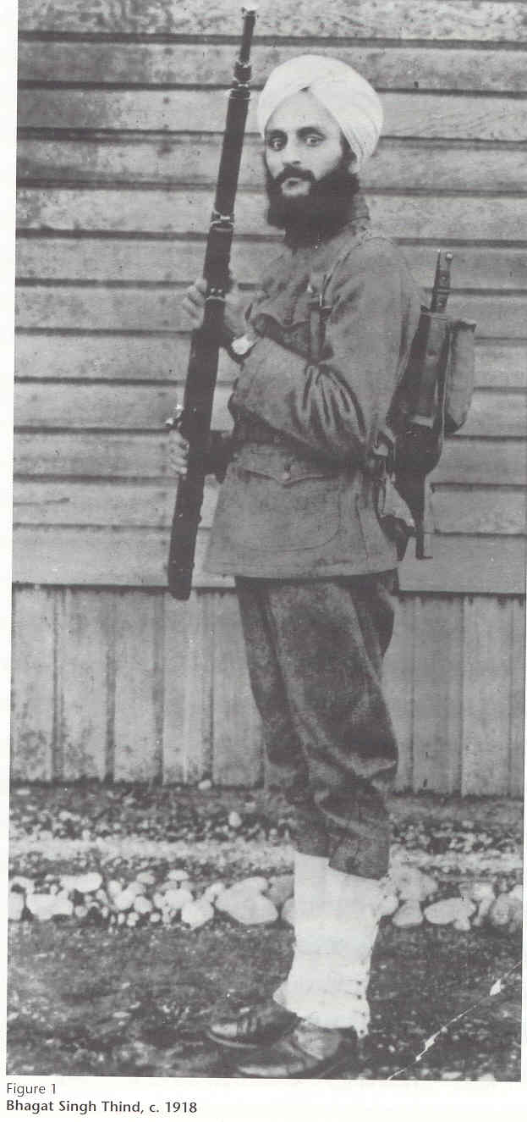

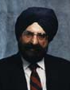
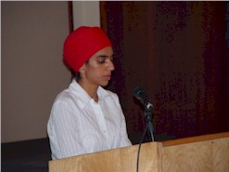
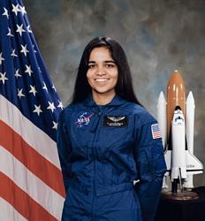
Sikhs Today

Slide 21
Resources
www.sikhs.org
www.sikhnet.com
www.sikhtimes.com
www.allaboutsikhs.org
www.sikh-history.com
The UCD Shields Library
Any questions?

Slide 22
Thank you!

