Slide 1

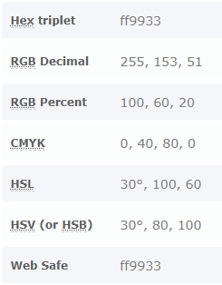

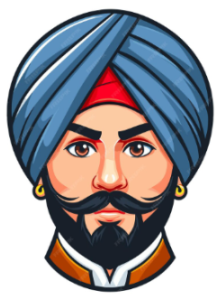
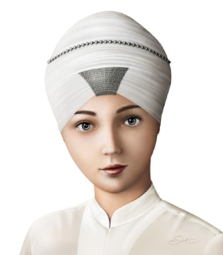
Gurudwaras
in UAE
About
Sikhism
Sikh Professionals in UAE

Slide 2
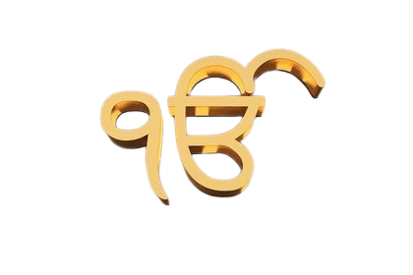
IK ONKAR
There is only one God

Slide 3


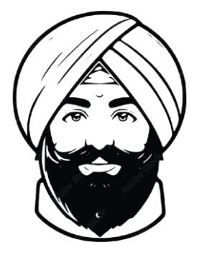
Sikhs in UAE

Slide 4
