Slide 1

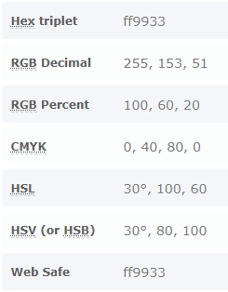

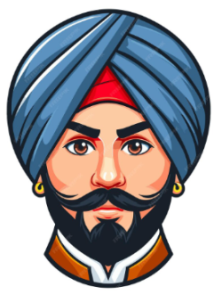
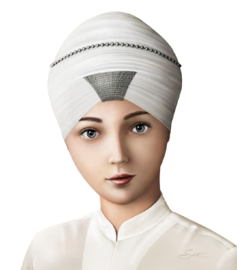
Gurudwaras
in UAE
About
Sikhism
Sikh Professionals in UAE

Slide 2
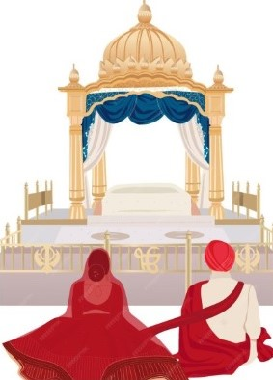
Gurudwaras
in UAE
About
Sikhism
Sikh Matrimonials for UAE

Slide 3
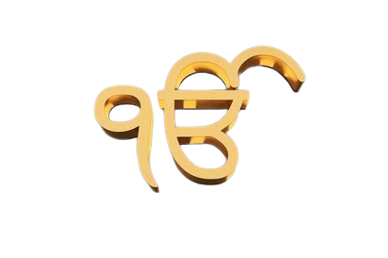
IK ONKAR
There is only one God

Slide 4


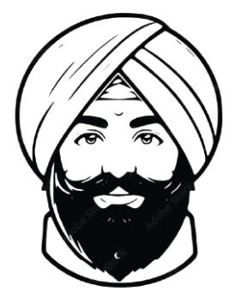
Sikhs in UAE

Slide 5
