Slide 1
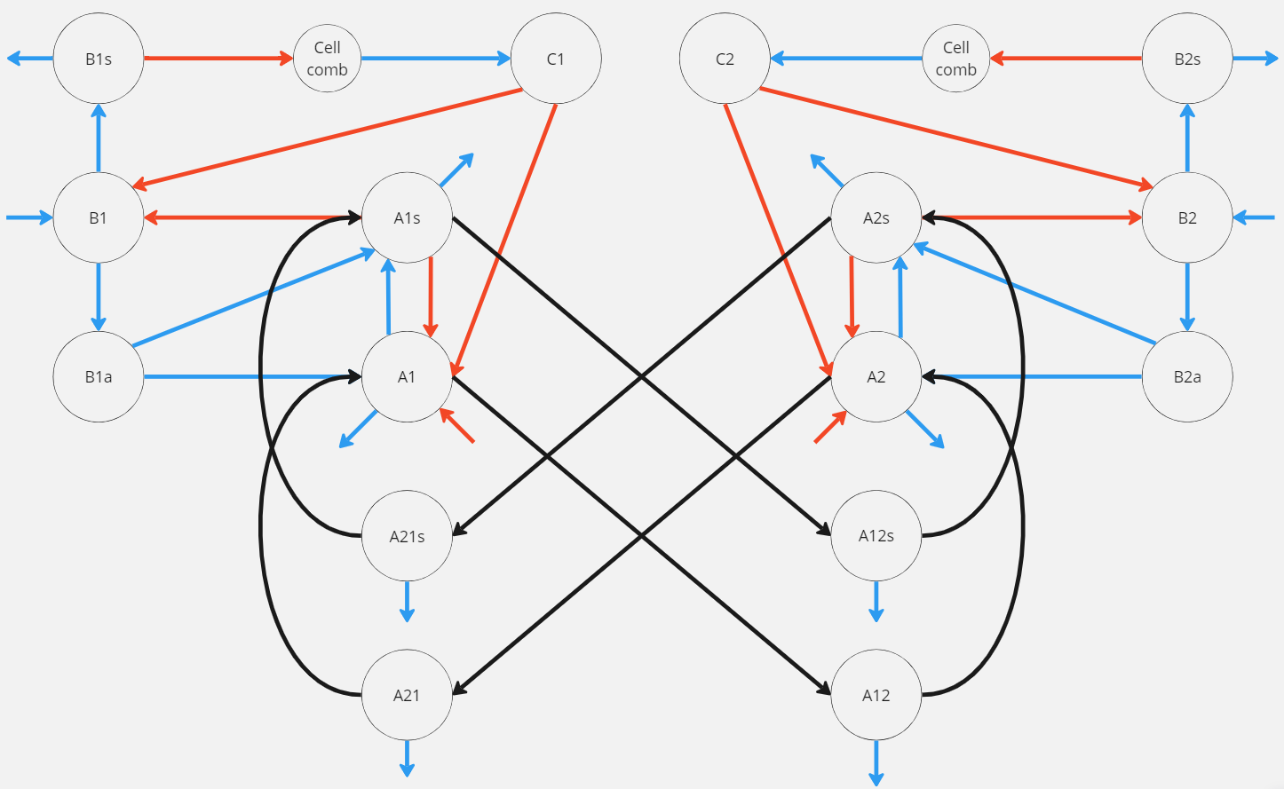




























$$B_{1s}$$
$$C_{1}$$
$$C_{2}$$
$$B_{2s}$$
$$B_{1}$$
$$A_{1s}$$
$$A_{2s}$$
$$B_{2}$$
$$aA_{21s}$$
$$m_{1}A_{1s}$$
$$m_{2}A_{2s}$$
$$aA_{12s}$$
$$B_{1a}$$
$$A_{1}$$
$$A_{2}$$
$$B_{2a}$$
$$m_{1}A_{1}$$
$$m_{2}A_{2}$$
$$aA_{21}$$
$$A_{21s}$$
$$A_{12s}$$
$$aA_{12}$$
$$uA_{21s}$$
$$uA_{12s}$$
$$A_{21}$$
$$A_{12}$$
$$uA_{21}$$
$$uA_{12}$$

Slide 2
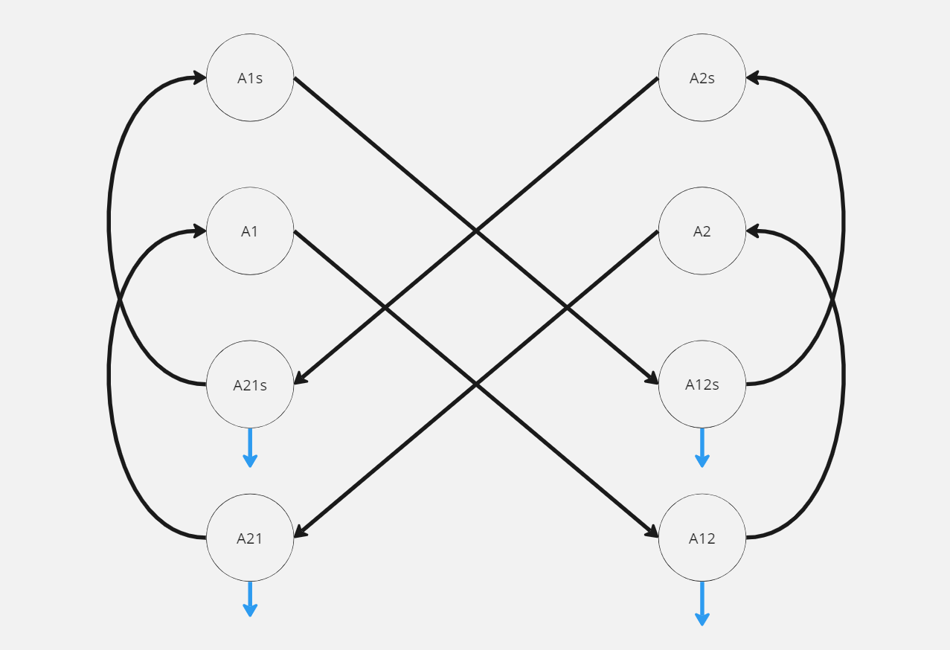




















$$A_{1s}$$
$$A_{2s}$$
$$aA_{1s}$$
$$m_{1}A_{1s}$$
$$m_{2}A_{2s}$$
$$aA_{2s}$$
$$A_{1}$$
$$A_{2}$$
$$m_{1}A_{1}$$
$$m_{2}A_{2}$$
$$aA_{1}$$
$$A_{21s}$$
$$A_{12s}$$
$$aA_{2}$$
$$uA_{21s}$$
$$uA_{12s}$$
$$A_{21}$$
$$A_{12}$$
$$uA_{21}$$
$$uA_{12}$$

Slide 3






$$\frac{dA_{21s}}{dt}=m_{2}A_{2s}−aA_{1s}−uA_{21s}$$
$$\frac{dA_{21}}{dt}=m_{2}A_{2}−aA_{1}−uA_{21}$$
$$\frac{dA_{12s}}{dt}=m_{1}A_{1s}−aA_{2s}−uA_{12s}$$
$$\frac{dA_{12}}{dt}=m_{1}A_{1}−aA_{2}−uA_{12}$$
$$\frac{dA_{ns}}{dt}=β_{2}α_{1}P_{n}B_{na}+α_{2}\frac{C_{n}}{v}A_{n}+α_{3}P_{n}A_{n}+α_{4}A_{n}−uA_{n}−m_{n}A_{ns}+aA_{ns}$$
$$\frac{dA_{n}}{dt}=β_{2}\left(1−α_{1}P_{n}\right)B_{na}−α_{2}\frac{C_{n}}{v}A_{n}−α_{3}P_{n}A_{n}−α_{4}A_{n}−uA_{n}−m_{n}A_{n}+aA_{n}$$
$$,where n=1,2$$
$$L_{1} and L_{2}$$

Slide 4
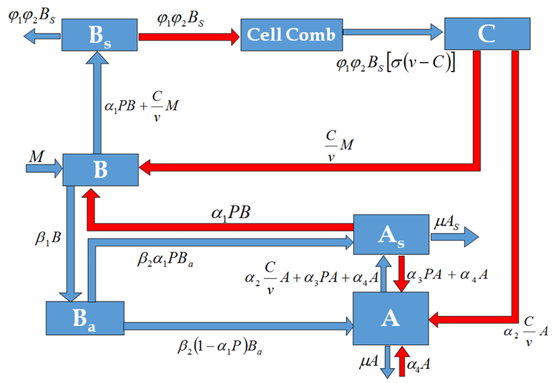

Slide 5
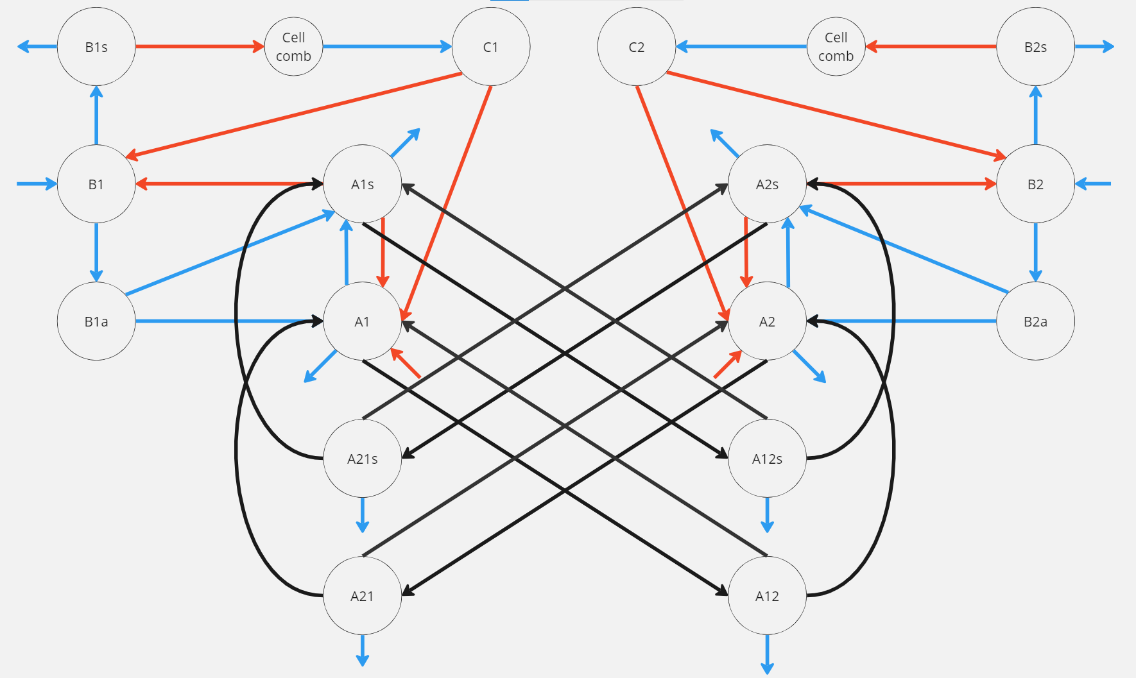

Slide 6
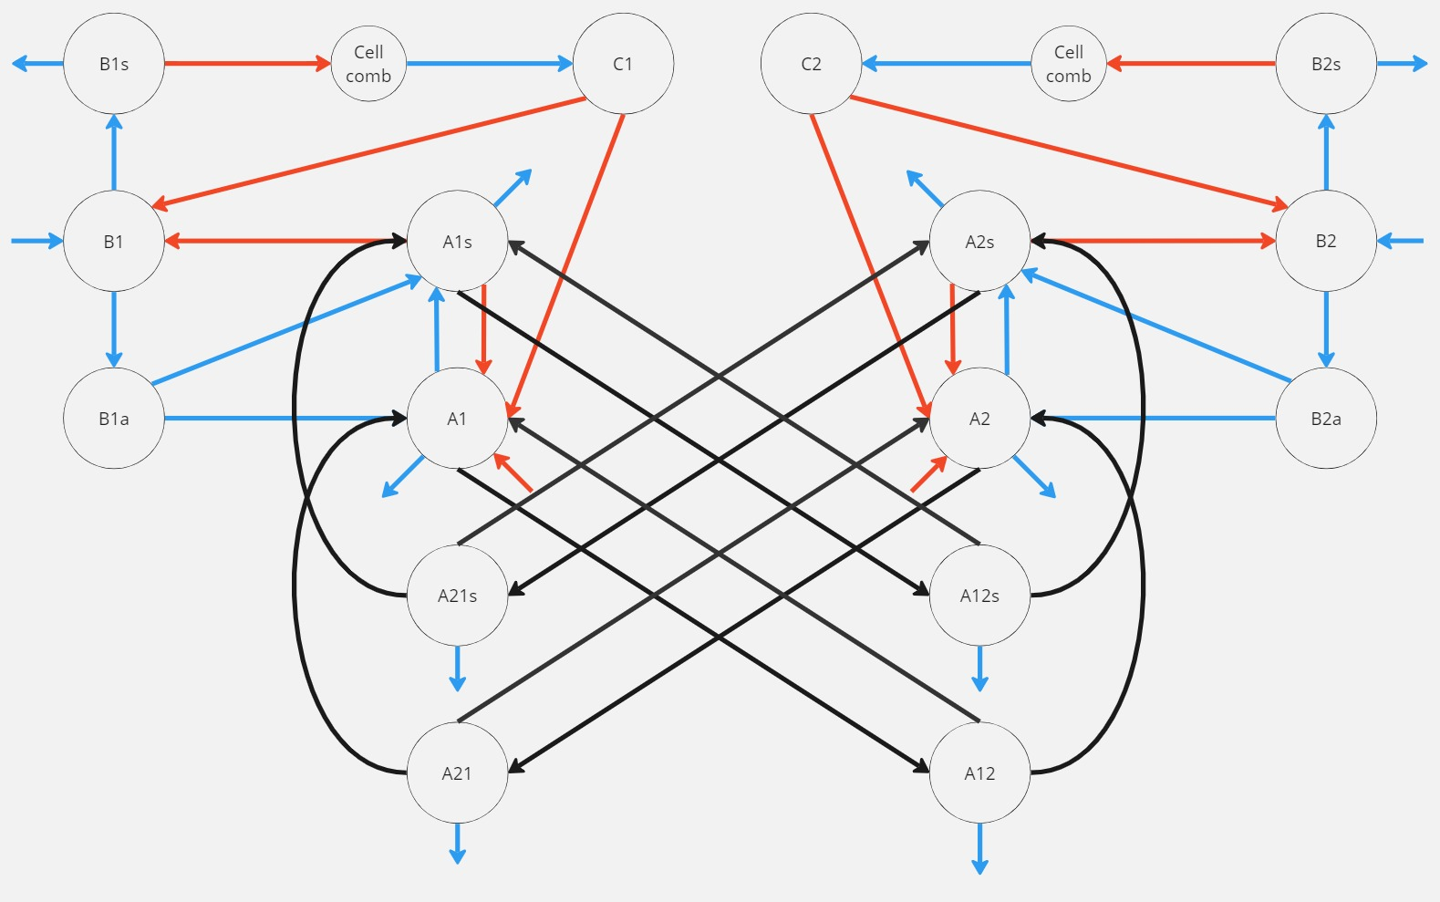

Slide 7
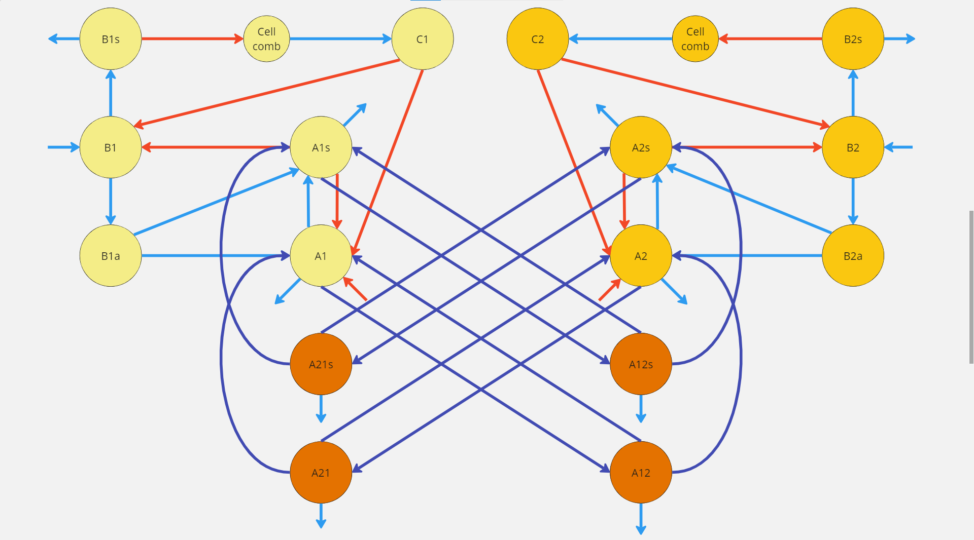

Slide 8
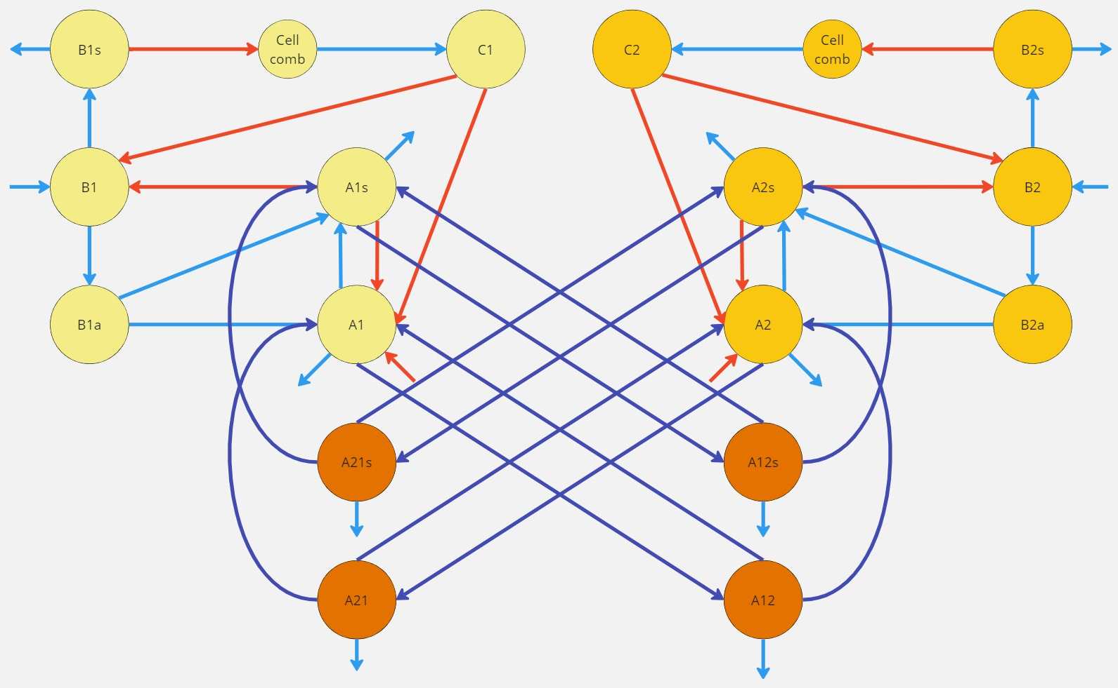

Slide 9
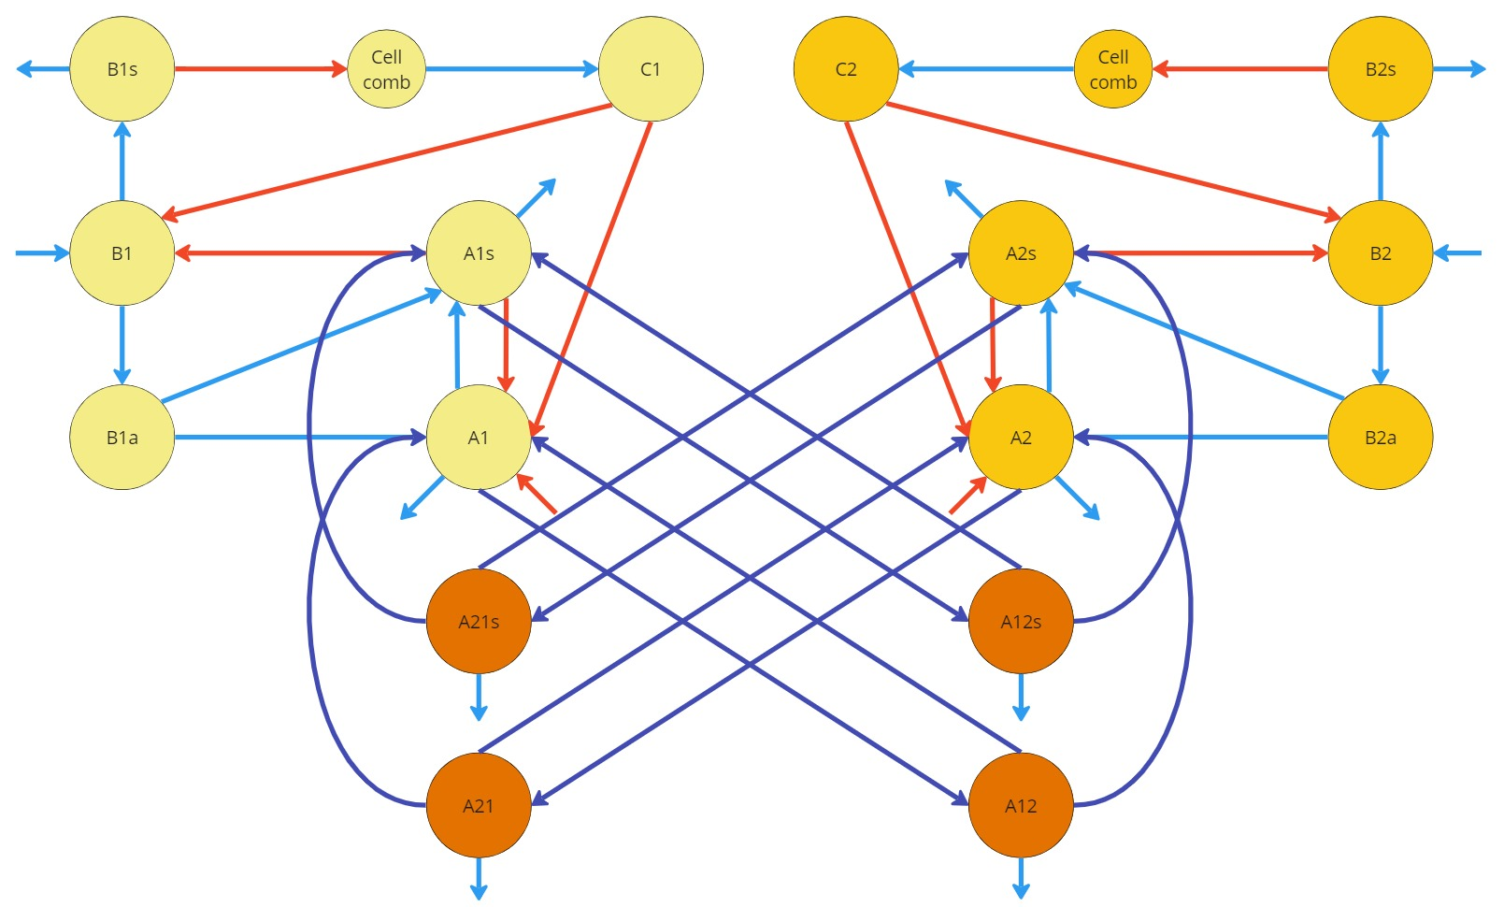

























$$B_{1s}$$
$$C_{1}$$
$$C_{2}$$
$$B_{2s}$$
$$B_{1}$$
$$A_{1s}$$
$$A_{2s}$$
$$B_{2}$$
$$r{(1−a_{1})A}_{12s}$$
$$r{(1−a_{2})A}_{21s}$$
$$a_{2}A_{21s}$$
$$m_{1}A_{1s}$$
$$m_{2}A_{2s}$$
$$aA_{12s}$$
$$B_{1a}$$
$$A_{1}$$
$$A_{2}$$
$$B_{2a}$$
$$aA_{21}$$
$$A_{21s}$$
$$A_{12s}$$
$$aA_{12}$$
$$uA_{21s}$$
$$uA_{12s}$$
$$r{(1−a_{2})A}_{21}$$
$$r{(1−a_{1})A}_{12}$$
$$m_{2}A_{2}$$
$$m_{1}A_{1}$$
$$A_{21}$$
$$A_{12}$$
$$uA_{21}$$
$$uA_{12}$$

Slide 10
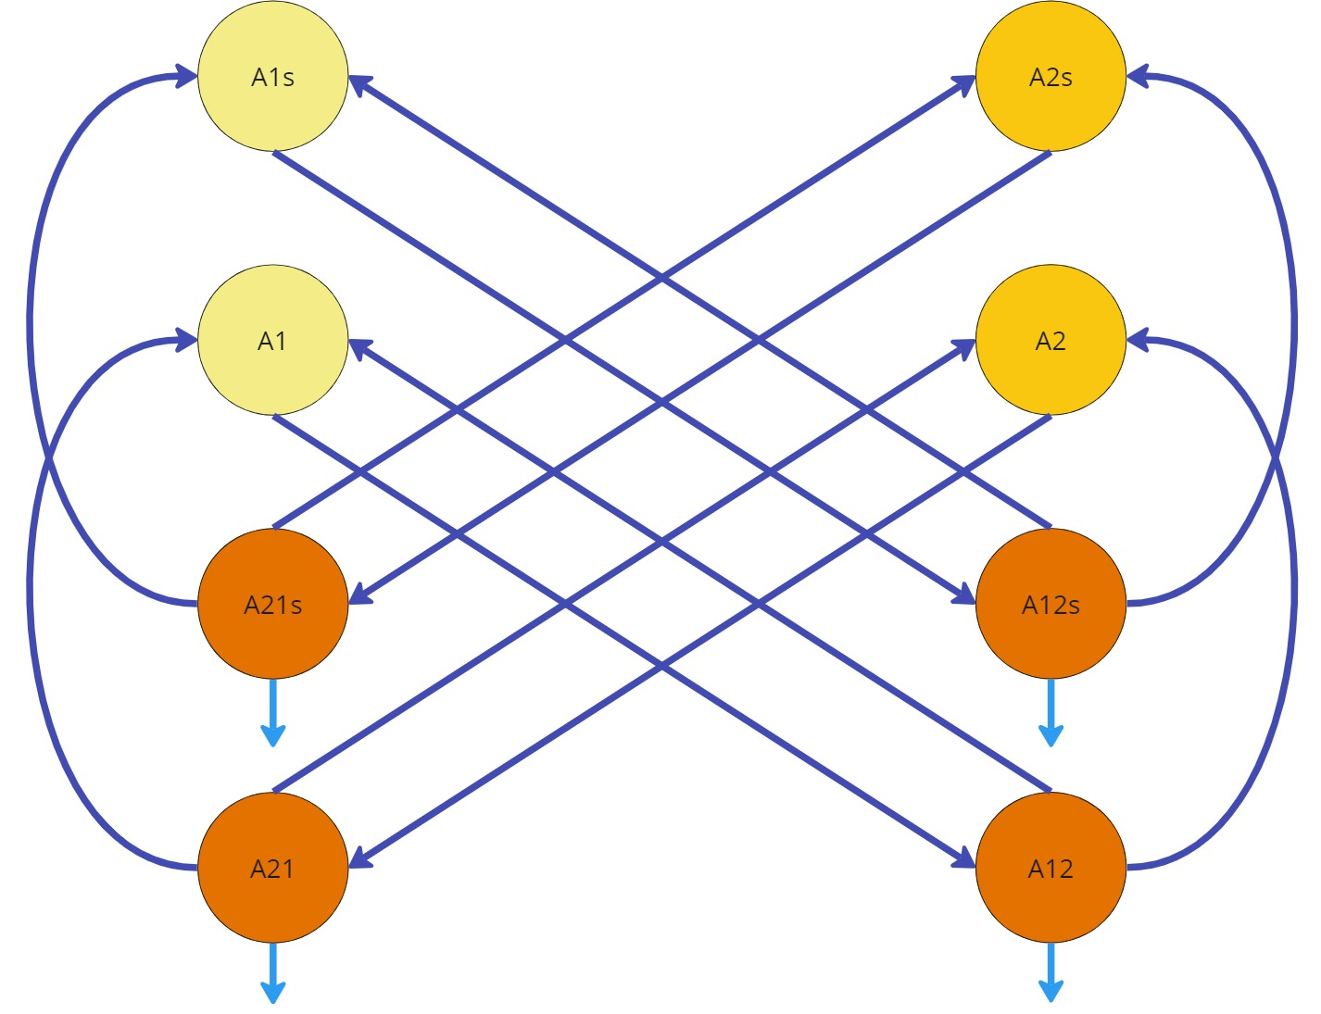





















$$A_{1s}$$
$$A_{2s}$$
$$r{(1−a_{1})A}_{12s}$$
$$r{(1−a_{2})A}_{21s}$$
$$m_{1}A_{1s}$$
$$m_{2}A_{2s}$$
$$a_{2}A_{21s}$$
$$aA_{12s}$$
$$A_{1}$$
$$A_{2}$$
$$A_{21s}$$
$$A_{12s}$$
$$aA_{21}$$
$$aA_{12}$$
$$uA_{21s}$$
$$r{(1−a_{2})A}_{21}$$
$$r{(1−a_{1})A}_{12}$$
$$uA_{12s}$$
$$m_{2}A_{2}$$
$$m_{1}A_{1}$$
$$A_{21}$$
$$A_{12}$$
$$uA_{21}$$
$$uA_{12}$$

Slide 11





$$\frac{dA_{21s}}{dt}=m_{2}A_{2s}−a_{2}A_{21s}−r(1−a_{2})A_{21s}−uA_{21s}$$
$$\frac{dA_{21}}{dt}=m_{2}A_{2s}−a_{2}A_{21}−r(1−a_{2})A_{21}−uA_{21}$$
$$\frac{dA_{12s}}{dt}=m_{1}A_{1s}−a_{1}A_{12s}−r(1−a_{1})A_{12s}−uA_{12s}$$
$$\frac{dA_{12}}{dt}=m_{1}A_{1}−a_{1}A_{12}−r(1−a_{1})A_{12}−uA_{12}$$
$$\frac{dA_{1s}}{dt}=β_{2}α_{1}P_{1}B_{1a}+α_{2}\frac{C_{1}}{v}A_{1}+α_{3}P_{1}A_{1}+α_{4}A_{1}−uA_{1}−m_{1}A_{1s}+a_{2}A_{21s}+r(1−a_{1})A_{12s}$$
$$\frac{dA_{2s}}{dt}=β_{2}α_{1}P_{2}B_{2a}+α_{2}\frac{C_{2}}{v}A_{2}+α_{3}P_{2}A_{2}+α_{4}A_{2}−uA_{2}−m_{2}A_{2s}+a_{1}A_{12s}+r(1−a_{2})A_{21s}$$
$$\frac{dA_{1}}{dt}=β_{2}\left(1−α_{1}P_{1}\right)B_{1a}−α_{2}\frac{C_{1}}{v}A_{1}−α_{3}P_{1}A_{1}−α_{4}A_{1}−uA_{1}−m_{1}A_{1}+a_{2}A_{21}+r(1−a_{1})A_{12}$$
$$\frac{dA_{2}}{dt}=β_{2}\left(1−α_{1}P_{2}\right)B_{2a}−α_{2}\frac{C_{2}}{v}A_{2}−α_{3}P_{2}A_{2}−α_{4}A_{2}−uA_{2}−m_{2}A_{2}+a_{1}A_{12}+r(1−a_{2})A_{21}$$
$$L_{1} and L_{2}$$

