Slide 1


$$\frac{dB}{dt}=M−a_{1}PB−α_{2}\frac{C_{1}}{v}A_{1}−uA_{21s}$$
$$\frac{dB}{dt}=m_{2}A_{2s}−a_{2}A_{21s}−r(1−a_{2})A_{21s}−uA_{21s}$$

Slide 2
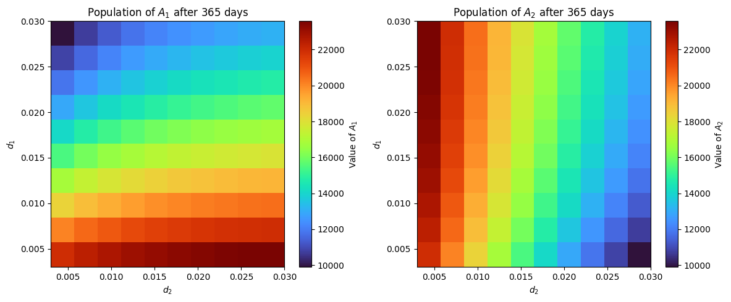

Slide 3


$$\frac{dA_{21s}}{dt}={d_{2}s_{2}A}_{2s}−r_{2}(1−s_{2})A_{21s}−{(1−r}_{2})(1−s_{2})A_{21s}−uA_{21s}+α_{1}P_{1}B_{1a}+a_{2}\frac{C_{1}}{v}A_{21}+α_{3}P_{1}A_{21}$$
$$\frac{dA_{21}}{dt}={d_{2}s_{2}A}_{2}−r_{2}(1−s_{2})A_{21}−{(1−r}_{2})(1−s_{2})A_{21}−uA_{21}−a_{2}\frac{C_{1}}{v}A_{21}−α_{3}P_{1}A_{21}$$
$$\frac{dA_{12s}}{dt}=m_{1}A_{1s}−a_{1}A_{12s}−r(1−a_{1})A_{12s}−uA_{12s}$$
$$\frac{dA_{12}}{dt}=m_{1}A_{1}−a_{1}A_{12}−r(1−a_{1})A_{12}−uA_{12}$$

Slide 4
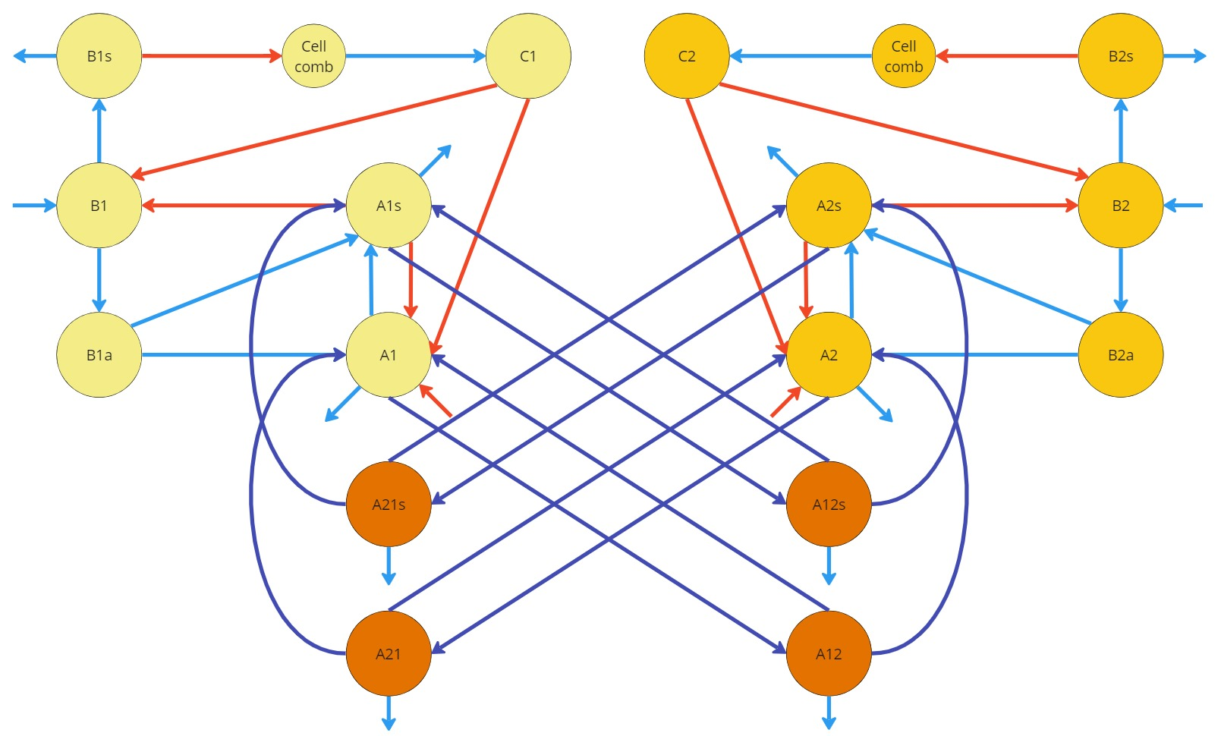
































$$B_{1s}$$
$$C_{1}$$
$$C_{2}$$
$$B_{2s}$$
$$B_{1}$$
$$A_{1s}$$
$$A_{2s}$$
$$B_{2}$$
$$r{(1−a_{1})A}_{12s}$$
$$r{(1−a_{2})A}_{21s}$$
$$a_{2}A_{21s}$$
$$m_{1}A_{1s}$$
$$m_{2}A_{2s}$$
$$a_{1}A_{12s}$$
$$B_{1a}$$
$$A_{1}$$
$$A_{2}$$
$$B_{2a}$$
$$a_{2}A_{21}$$
$$A_{21s}$$
$$A_{12s}$$
$$a_{1}A_{12}$$
$$uA_{21s}$$
$$uA_{12s}$$
$$r{(1−a_{2})A}_{21}$$
$$r{(1−a_{1})A}_{12}$$
$$m_{2}A_{2}$$
$$m_{1}A_{1}$$
$$A_{21}$$
$$A_{12}$$
$$uA_{21}$$
$$uA_{12}$$

Slide 5



$$d_{1}$$
Drift rate X percentage of forager bees
Sekulja X Garvey/Van der steen
$$γ_{1}$$
Staughton
Rejection rate
$$r_{1}$$
Return rate
Prado

Slide 6




$$\frac{dB_{1s}}{dt}=α_{1}P_{1}B_{1}+\frac{C_{1}}{v}M_{1}−φ_{1}φ_{2}B_{1s}$$
$$\frac{dB_{1}}{dt}=M_{1}−α_{1}P_{1}B_{1}−\frac{C_{1}}{v}M_{1}−β_{1}B_{1}$$
$$\frac{dB_{1a}}{dt}=β_{1}B_{1}−β_{2}B_{1a}$$
$$\frac{dC_{1}}{dt}=φ_{1}φ_{2}B_{1s}[σ\left(v−C_{1}\right)]$$
$$\frac{dA_{1s}}{dt}=β_{2}a_{1}P_{1}B_{1a}+a_{2}\frac{C_{1}}{v}A_{1}+a_{3}P_{1}A_{1}−μA_{1s}−d_{1}s_{1}A_{1s}+r_{1}(1−s_{1})A_{12s}$$
$$\frac{dA_{1}}{dt}=β_{2}\left(1−a_{1}P_{1}\right)B_{1a}−a_{2}\frac{C_{1}}{v}A_{1}−a_{3}P_{1}A_{1}−μA_{1}−d_{1}s_{1}A_{1}+r_{1}(1−s_{1})A_{12}$$

Slide 7





$$\frac{dA_{21s}}{dt}=m_{2}A_{2s}−a_{2}A_{21s}−r(1−a_{2})A_{21s}−uA_{21s}$$
$$\frac{dA_{21}}{dt}=m_{2}A_{2s}−a_{2}A_{21}−r(1−a_{2})A_{21}−uA_{21}$$
$$\frac{dA_{12s}}{dt}=m_{1}A_{1s}−a_{1}A_{12s}−r(1−a_{1})A_{12s}−uA_{12s}$$
$$\frac{dA_{12}}{dt}=m_{1}A_{1}−a_{1}A_{12}−r(1−a_{1})A_{12}−uA_{12}$$
$$\frac{dA_{1s}}{dt}=β_{2}α_{1}P_{1}B_{1a}+α_{2}\frac{C_{1}}{v}A_{1}+α_{3}P_{1}A_{1}+α_{4}A_{1}−uA_{1}−m_{1}A_{1s}+a_{2}A_{21s}+r(1−a_{1})A_{12s}$$
$$\frac{dA_{2s}}{dt}=β_{2}α_{1}P_{2}B_{2a}+α_{2}\frac{C_{2}}{v}A_{2}+α_{3}P_{2}A_{2}+α_{4}A_{2}−uA_{2}−m_{2}A_{2s}+a_{1}A_{12s}+r(1−a_{2})A_{21s}$$
$$\frac{dA_{1}}{dt}=β_{2}\left(1−α_{1}P_{1}\right)B_{1a}−α_{2}\frac{C_{1}}{v}A_{1}−α_{3}P_{1}A_{1}−α_{4}A_{1}−uA_{1}−m_{1}A_{1}+a_{2}A_{21}+r(1−a_{1})A_{12}$$
$$\frac{dA_{2}}{dt}=β_{2}\left(1−α_{1}P_{2}\right)B_{2a}−α_{2}\frac{C_{2}}{v}A_{2}−α_{3}P_{2}A_{2}−α_{4}A_{2}−uA_{2}−m_{2}A_{2}+a_{1}A_{12}+r(1−a_{2})A_{21}$$
$$L_{1} and L_{2}$$

Slide 8
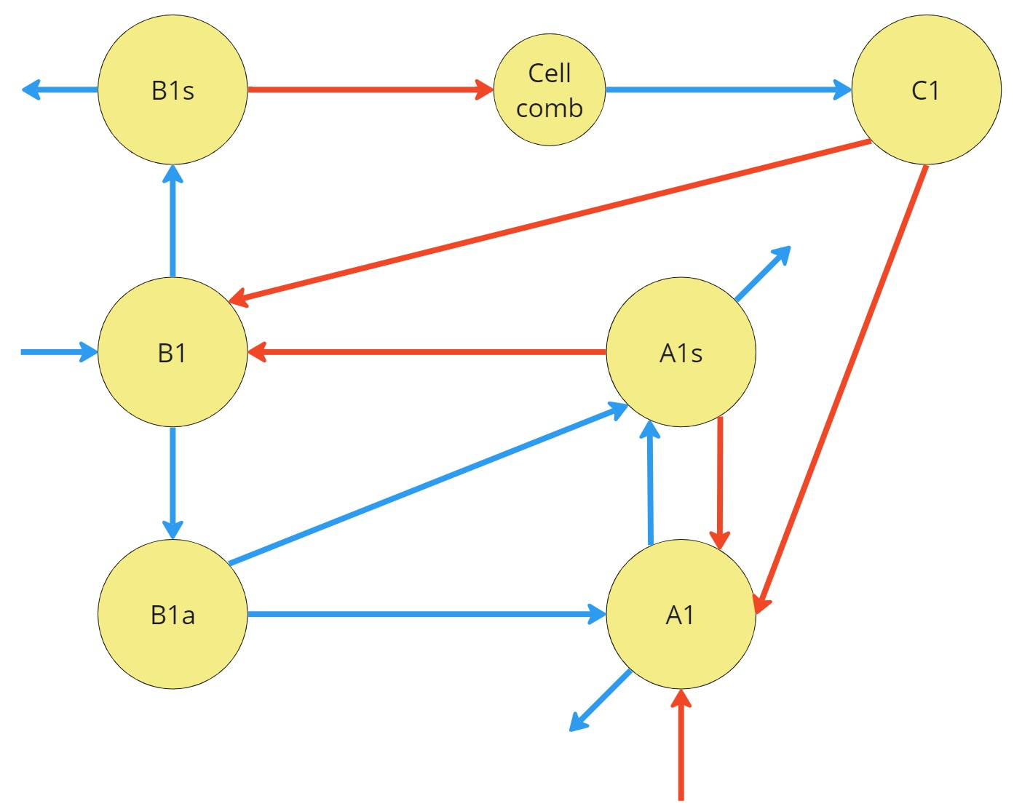





















$${μ_{B_{s}}φ_{1}B}_{1s}$$
$${μ_{B_{s}}φ_{1}B}_{1s}$$
Cell comb
$${μ_{B_{s}}φ_{1}B}_{1s}[σ\left(v−C_{1}\right)]$$
$$B_{1s}$$
$$C_{1}$$
$$\frac{C_{1}}{v}M_{1}$$
$$α_{1}P_{1}B_{1}+\frac{C_{1}}{v}M_{1}$$
$$μA_{1s}$$
$$M_{1}$$
$$B_{1}$$
$$α_{1}P_{1}B_{1}$$
$$A_{1s}$$
$$α_{2}\frac{C_{1}}{v}A_{1}$$
$$β_{1}B_{1}$$
$$β_{2}α_{1}P_{1}B_{1a}$$
$$α_{3}P_{1}A_{1}$$
$$α_{2}\frac{C_{1}}{v}A_{1}+α_{3}P_{1}A_{1}$$
$$B_{1a}$$
$$β_{2}\left(1−α_{1}P_{1}\right)B_{1a}$$
$$A_{1}$$
$$μA_{1}$$

Slide 9
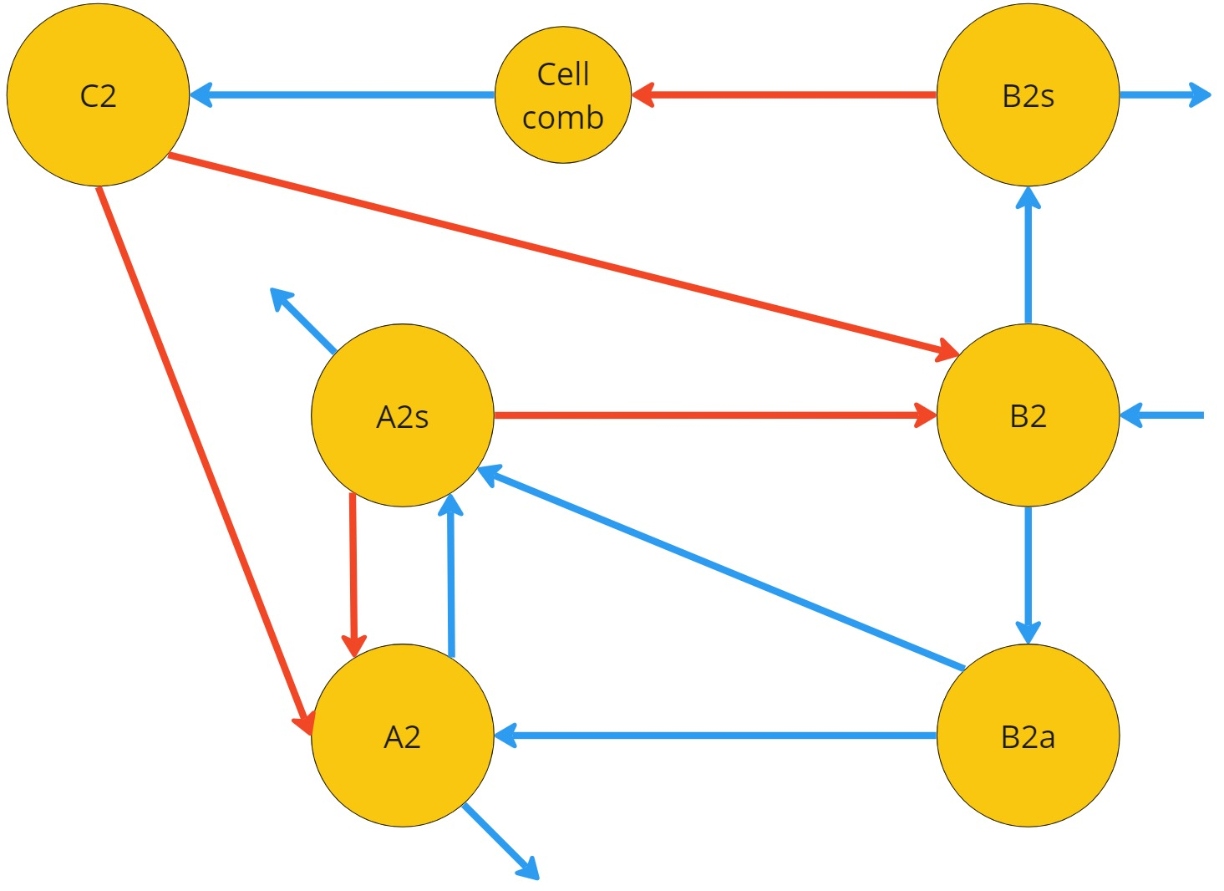





















$${μ_{B_{s}}φ_{1}B}_{2s}[σ\left(v−C_{2}\right)]$$
Cell comb
$${μ_{B_{s}}φ_{1}B}_{2s}$$
$${μ_{B_{s}}φ_{1}B}_{2s}$$
$$C_{2}$$
$$B_{2s}$$
$$\frac{C_{2}}{v}M_{2}$$
$$α_{1}P_{2}B_{2}+\frac{C_{2}}{v}M_{2}$$
$$μA_{2s}$$
$$A_{2s}$$
$$α_{1}P_{2}B_{2}$$
$$B_{2}$$
$$M_{2}$$
$$α_{2}\frac{C_{2}}{v}A_{2}$$
$$α_{3}P_{2}A_{2}$$
$$α_{2}\frac{C_{2}}{v}A_{2}+α_{3}P_{2}A_{2}$$
$$β_{2}α_{1}P_{2}B_{2a}$$
$$β_{1}B_{2}$$
$$A_{2}$$
$$β_{2}\left(1−α_{1}P_{2}\right)B_{2a}$$
$$B_{2a}$$
$$μA_{2}$$

Slide 10
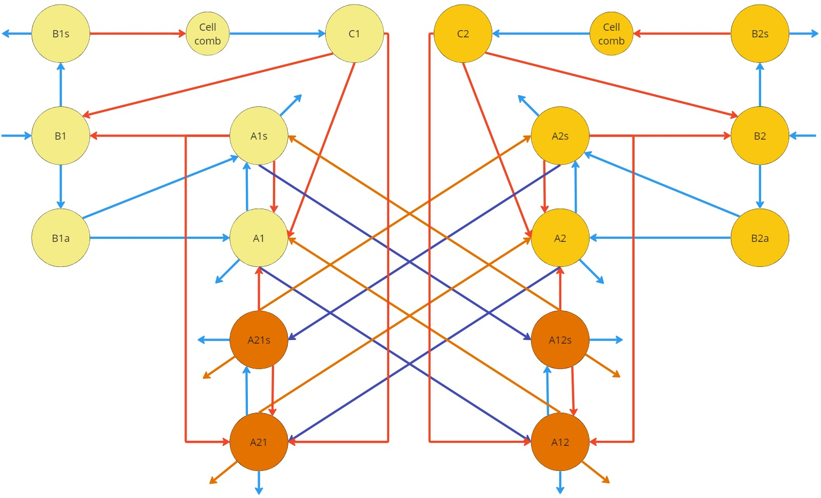











$$B_{1s}$$
Cell comb
$$C_{1}$$
$$C_{2}$$
Cell comb
$$B_{2s}$$
$$B_{1}$$
$$A_{1s}$$
$$A_{2s}$$
$$B_{2}$$
$$B_{1a}$$
$$A_{1}$$
$$A_{2}$$
$$B_{2a}$$
$$A_{21s}$$
$$A_{12s}$$
$$A_{21}$$
$$A_{12}$$

Slide 11












$$B_{1s}$$
Cell comb
$$C_{1}$$
$$C_{2}$$
Cell comb
$$B_{2s}$$
$$B_{1}$$
$$A_{1s}$$
$$A_{2s}$$
$$B_{2}$$
$$B_{1a}$$
$$A_{1}$$
$$A_{2}$$
$$B_{2a}$$
$$A_{21s}$$
$$A_{12s}$$
$$A_{21}$$
$$A_{12}$$

Slide 12
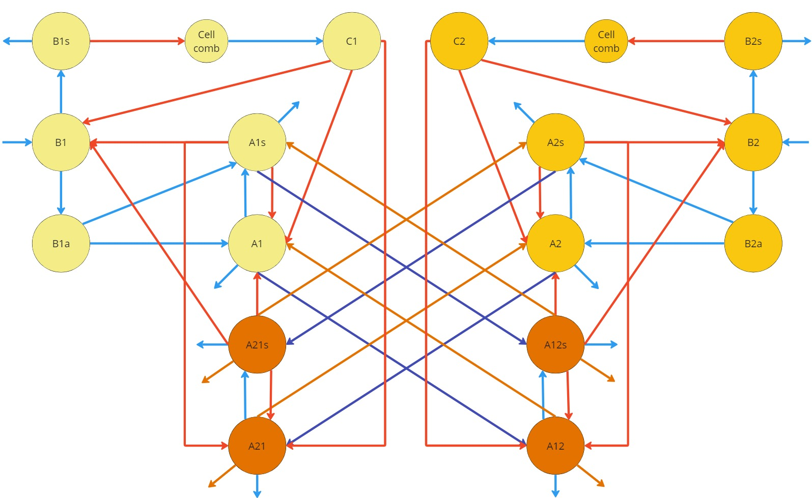












$$B_{1s}$$
$$B_{2s}$$
$$r_{1}{γ_{1}d_{1}A}_{1s}$$
$$r_{2}{γ_{2}d_{2}A}_{2s}$$
$${d_{1}A}_{1s}$$
$$d_{2}A_{2s}$$
$$B_{1a}$$
$$r_{1}{γ_{1}d_{1}A}_{1}$$
$$r_{2}{γ_{2}d_{2}A}_{2}$$
$$B_{2a}$$
$${d_{1}A}_{1}$$
$$d_{2}A_{2}$$
$${(1−r}_{2}){γ_{2}d_{2}A}_{2s}$$
$${(1−r}_{1}){γ_{1}d_{1}A}_{1s}$$
$${(1−r}_{2}){γ_{2}d_{2}A}_{2}$$
$${(1−r}_{1}){γ_{1}d_{1}A}_{1}$$

Slide 13
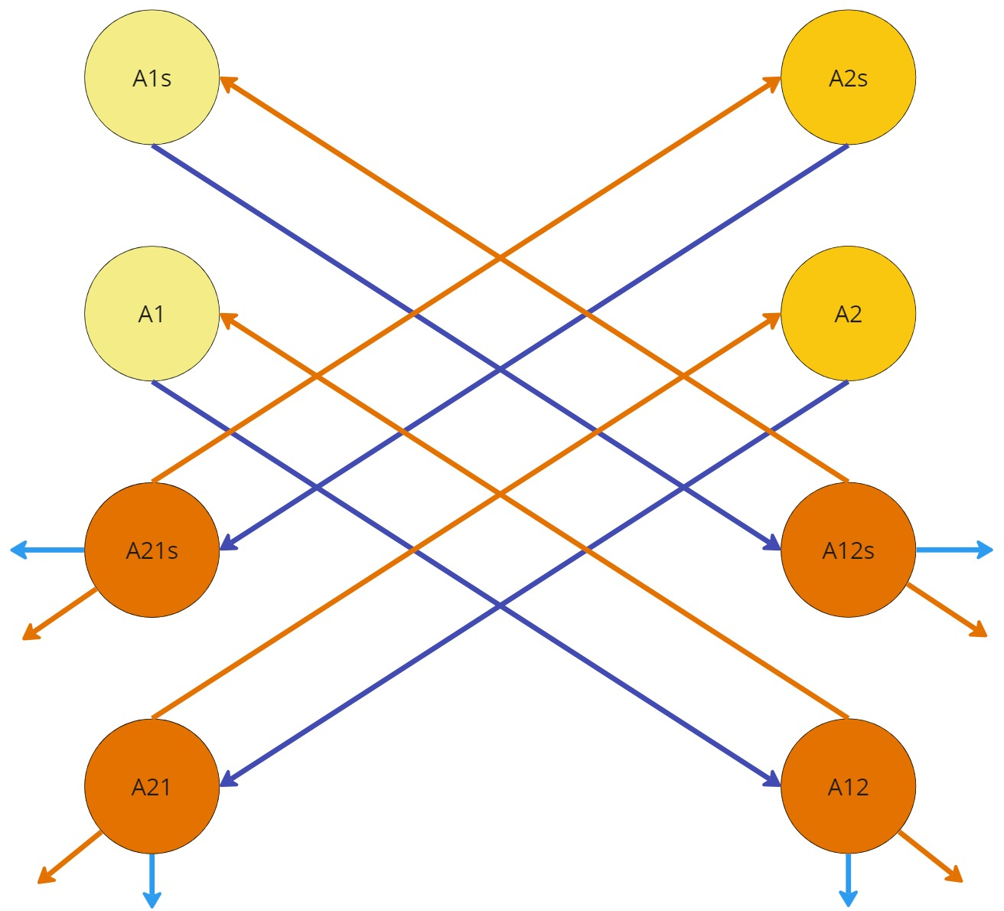
























$$A_{1s}$$
$$A_{2s}$$
$$r_{1}{γ_{1}d_{1}A}_{1s}$$
$$r_{2}{γ_{2}d_{2}A}_{2s}$$
$${d_{1}A}_{1s}$$
$$d_{2}A_{2s}$$
$$A_{1}$$
$$A_{2}$$
$$μA_{21s}$$
$$μA_{12s}$$
$$A_{21s}$$
$$A_{12s}$$
$${(1−r}_{2}){γ_{2}d_{2}A}_{2s}$$
$$r_{2}{γ_{2}d_{2}A}_{2}$$
$$r_{1}{γ_{1}d_{1}A}_{1}$$
$${(1−r}_{1}){γ_{1}d_{1}A}_{1s}$$
$$d_{2}A_{2}$$
$${d_{1}A}_{1}$$
$$A_{21}$$
$$A_{12}$$
$${(1−r}_{2}){γ_{2}d_{2}A}_{2}$$
$${(1−r}_{1}){γ_{1}d_{1}A}_{1}$$
$$μA_{21}$$
$$μA_{12}$$

Slide 14
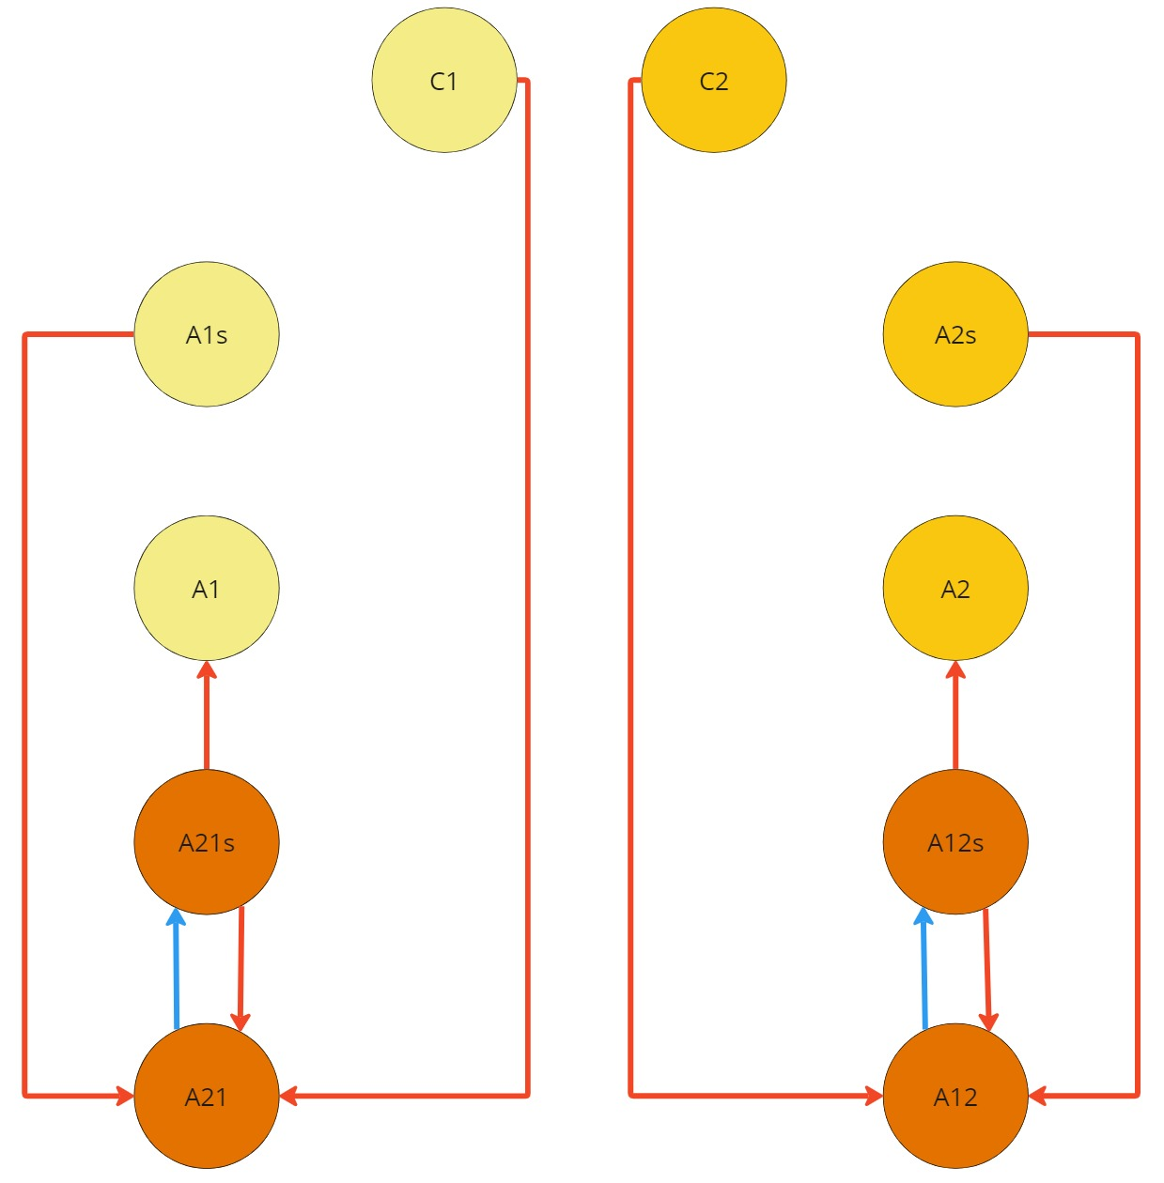



















$$C_{1}$$
$$C_{2}$$
$$A_{1s}$$
$$A_{2s}$$
$$A_{1}$$
$$α_{2}\frac{C_{1}}{v}A_{21}$$
$$α_{2}\frac{C_{2}}{v}A_{12}$$
$$A_{2}$$
$$α_{3}P_{1}A_{21}$$
$$α_{3}P_{2}A_{12}$$
$$α_{3}P_{1}A_{1}$$
$$α_{3}P_{2}A_{2}$$
$$A_{21s}$$
$$A_{12s}$$
$${α_{2}\frac{C_{1}}{v}A_{21}+α}_{3}P_{1}A_{21}$$
$$α_{3}P_{1}A_{21}$$
$${α_{2}\frac{C_{2}}{v}A_{12}+α}_{3}P_{2}A_{12}$$
$$α_{3}P_{2}A_{12}$$
$$A_{21}$$
$$A_{12}$$

