Slide 1
Embeddings (Feature Learning)
28.5.2020

Slide 2
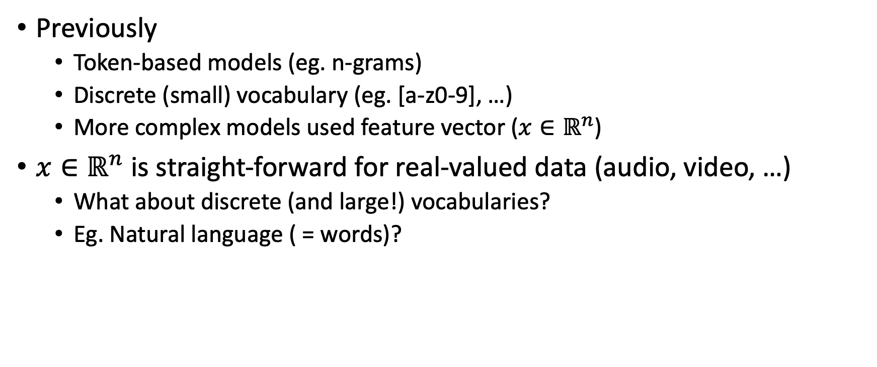
Motivation
Previously
Token-based models (eg. n-grams)
Discrete (small) vocabulary (eg. [a-z0-9], …)
More complex models used feature vector ($x∈ℝ^{n}$)
$x∈ℝ^{n}$ is straight-forward for real-valued data (audio, video, …)
What about discrete (and large!) vocabularies?
Eg. Natural language ( = words)?

Slide 3
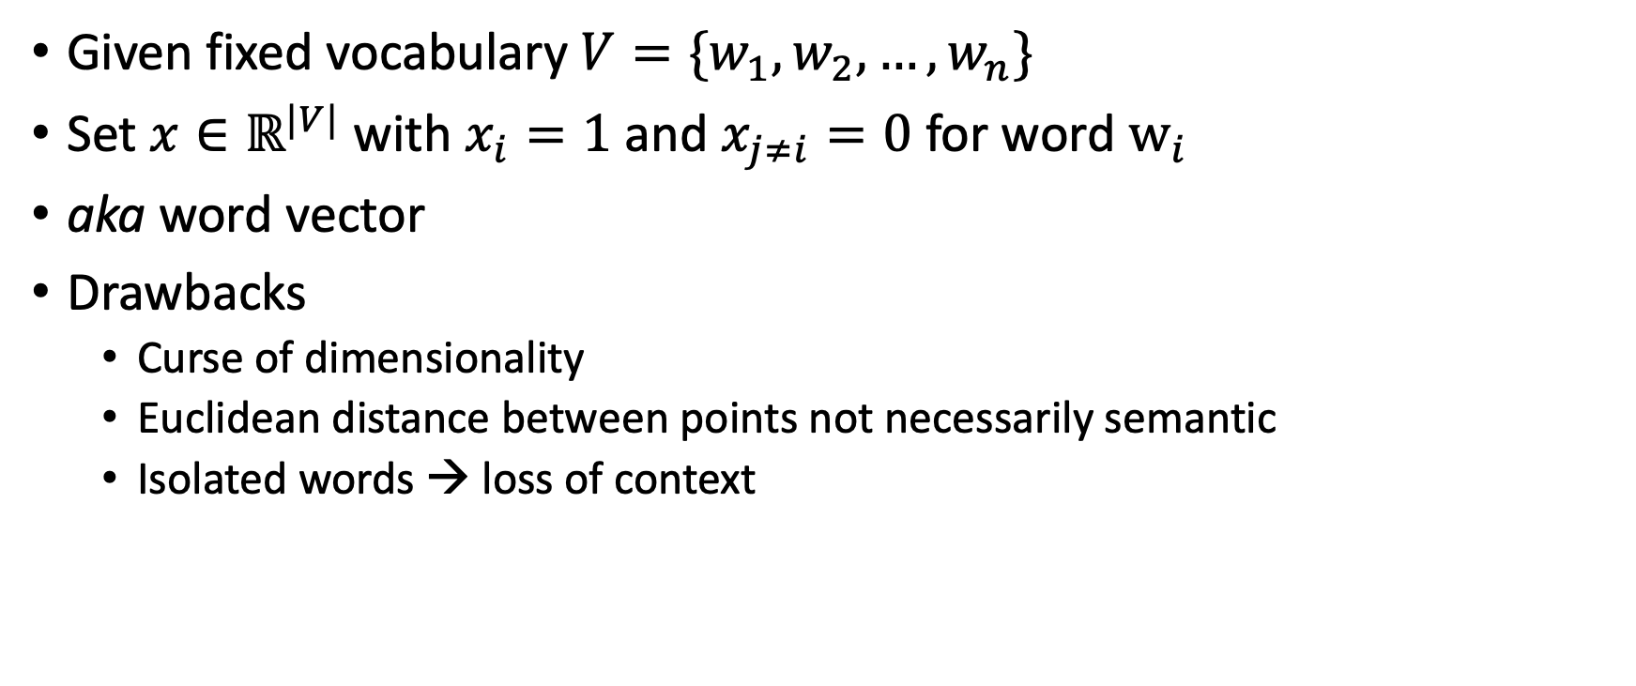
One-Hot Encoding
Given fixed vocabulary $V=\{w_{1},w_{2},…, w_{n}\}$
Set $x∈ℝ^{|V|}$ with $x_{i}=1$ and $x_{j≠i}=0$ for word $w_{i}$
aka word vector
Drawbacks
Curse of dimensionality
Euclidean distance between points not necessarily semantic
Isolated words → loss of context

Slide 4
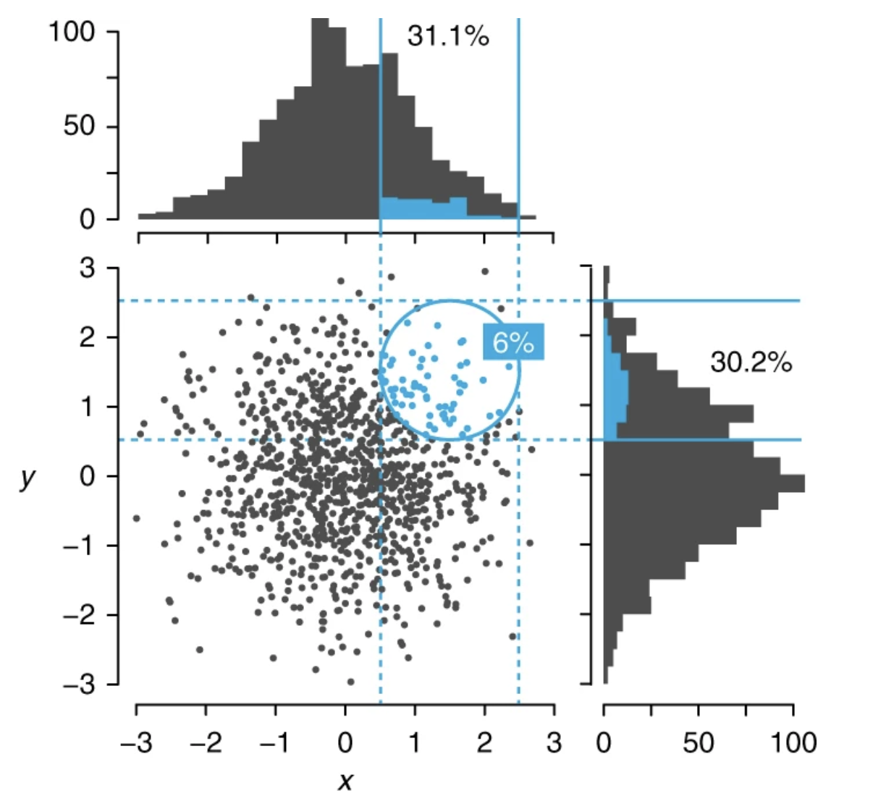
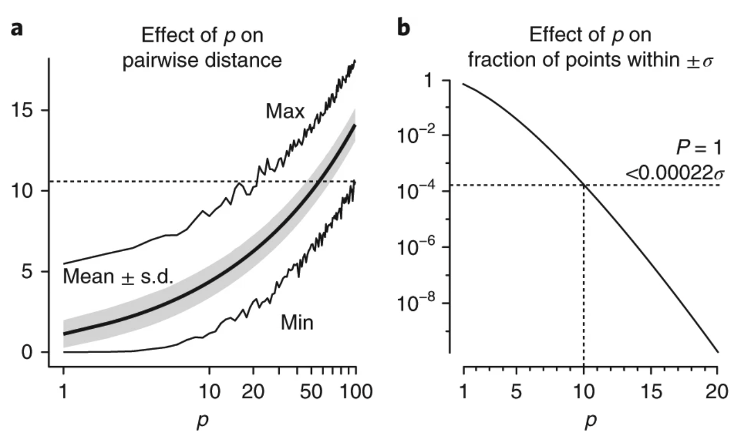
Curse of Dimensionality [1]
[1] Bellman, R. E. Adaptive Control Processes: A Guided Tour, Ch. 5.16 (Princeton Univ. Press, Princeton, NJ, 1961)
[2] Altman, N., Krzywinski, M. The curse(s) of dimensionality. Nat Methods 15, 399–400 (2018). https://doi.org/10.1038/s41592-018-0019-x

Slide 5
Wanted: A mapping that…
Can handle a large vocabulary
Has a rather small output dimension
Ideally…
Produces output values where (Euclidean) distances correlate with semantic distances
Incorporates the context of each token

Slide 6
Latent Semantic Indexing (1990)
Key idea: Terms that occur in the same document should relate to each other
Construct a term-occurrence matrix
Find principal components using singular value decomposition
Apply rank-reduction (ie. discard dimensions relating to smaller singular values)
Use resulting matrix to map term vectors to lower-dim space
Works reasonably well for spam/ham, etc.
Context modelling limited to plain co-occurrence
Scott Deerwester, Susan Dumais, George Furnas, Thomas Landauer, Richard Harshman: Indexing by Latent Semantic Analysis. In: Journal of the American society for information science. 1990.

Slide 7
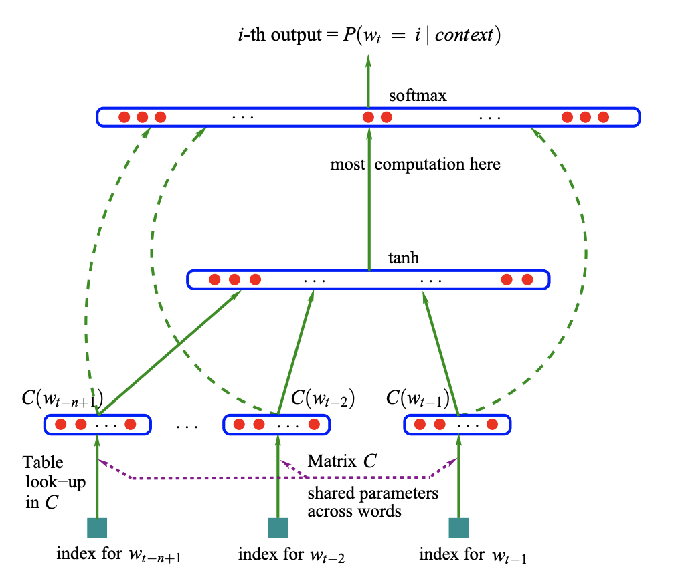
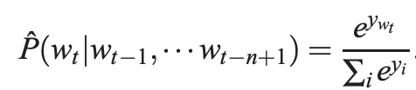


Word Embeddings (2003)
Key idea: Use NN to predict next word
Use shared “embedding” layer
Bengio, Y., Ducharme, R., Vincent, P., & Janvin, C. (2003). A Neural Probabilistic Language Model. The Journal of Machine Learning Research, 3, 1137–1155.

Slide 8
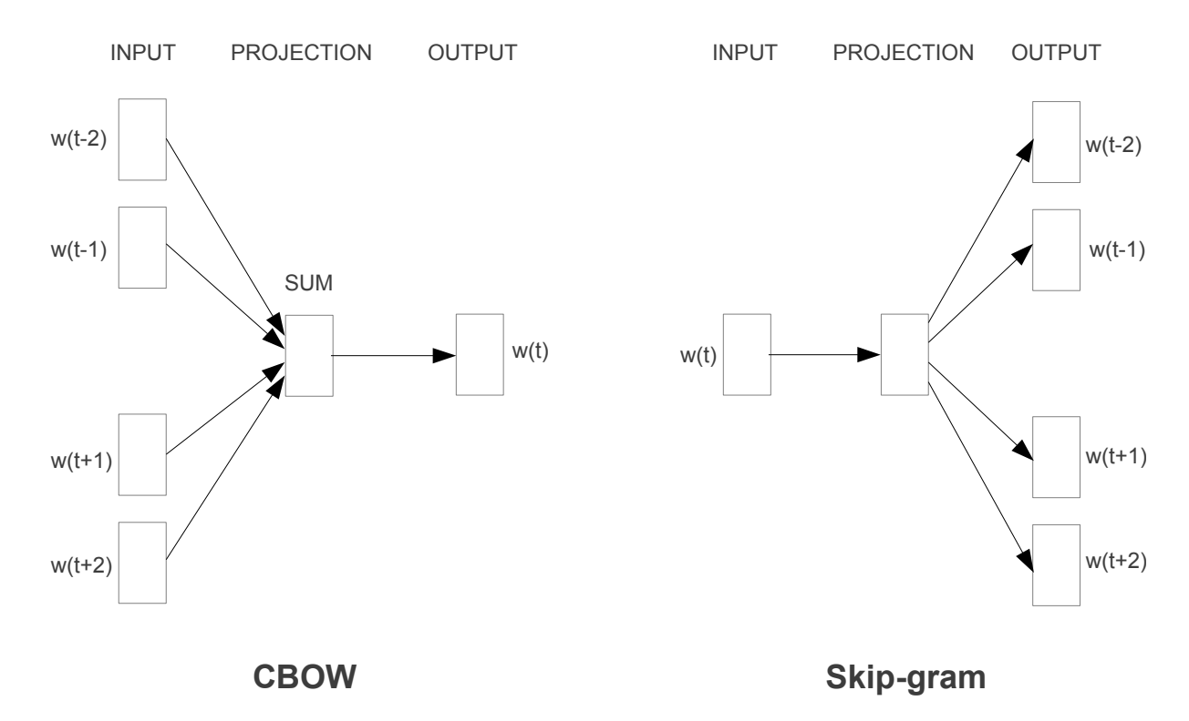
Word2Vec (2013)
Avoid costly hidden layer
Allow for more context
Continuous Bag-of-Words (CBOW) uses context to predict center word
Skip-gram predicts context from center word
Mikolov, T., Corrado, G., Chen, K., & Dean, J. (2013). Efficient Estimation of Word Representations in Vector Space. Proceedings of the International Conference on Learning Representations (ICLR 2013), 1–12.

Slide 9
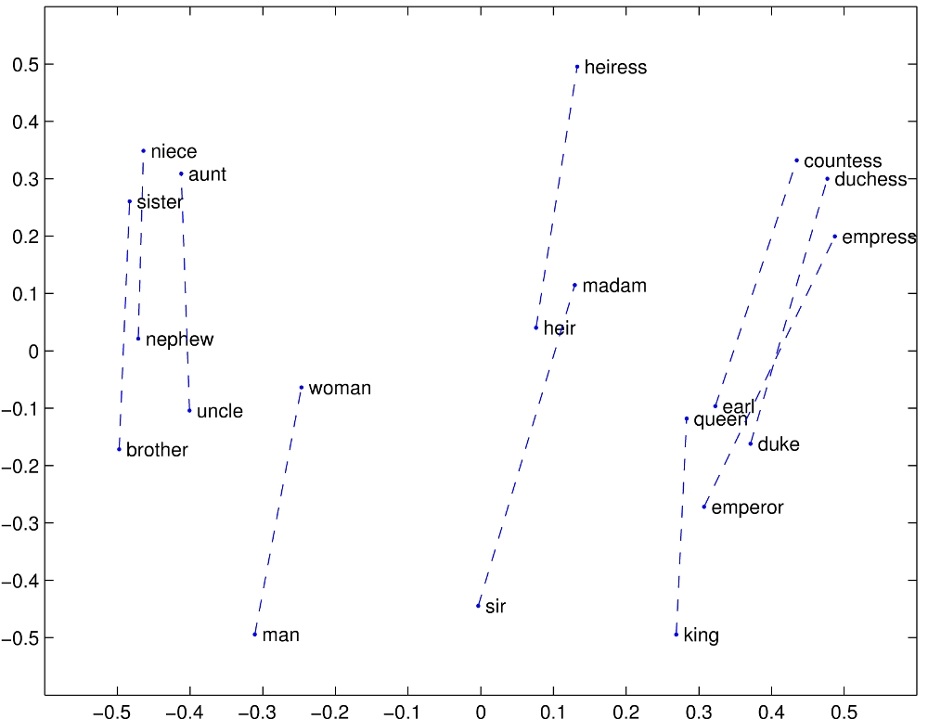
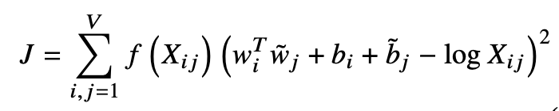
GloVe (2014)
Based on word-word co-occurrence
Minimize
word vectors
co-occurrence count
Pennington, J., Socher, R., & Manning, C. D. (2014). Glove: Global Vectors for Word Representation. Proceedings of the 2014 Conference on Empirical Methods in Natural Language Processing, 1532–1543.

Slide 10
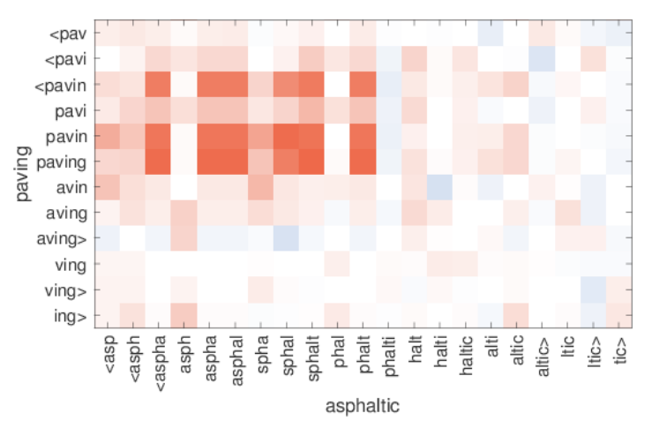
FastText
Previous word-based models struggle with OOV What to do, if an observed word is not in the vocabulary?
Alternative:
Train on character n-grams instead
Use skip-gram approach
Can handle OOV by averaging over known n-grams
Piotr Bojanowski, Edouard Grave, Armand Joulin and Tomas Mikolov. Enriching Word Vectors with Subword Information. 2016

Slide 11
Transfer Learning vs. Deep Learning
Word2Vec, FastText, etc. can be trained on large amounts of unlabeled data
Ready-to-go models avaliable to map Words to feature vectors
Statistics can be updated using more (in-domain) data
Most approaches can be modeled as computational graph → integrate models into training routines (with backprop)
Most basic form: (single) embedding layer to map one-hot to smaller dimension (eg. Sparse layer in pytorch: https://pytorch.org/docs/stable/nn.html#embedding)

