Slide 1
Support Vector Machines Sequence Kernels Embeddings
13.6.2019

Slide 2
Agenda Today
Support Vector Machines
Sequence Kernels
Learning Feature Representations: Embeddings
Autoencoders
Embedding Layers
NLP: Word2Vec, Doc2Vec, GloVe, ELMo, ULMFit, BERT, ELMo

Slide 3
Motivation
Text-independent speaker identification (verification, recognition)
Large number of target speakers (hundreds of thousands)
Very little data per speaker (4-10 seconds)
Often just 1 sample for enrollment (training)
Age estimation from speech (today‘s exercise!)
Regression problem
Sparse data

Slide 4
SVM
Slides by Martin Law

Slide 5
Sequence Kernels
Slides by Elmar Nöth (FAU-INF5)

Slide 6
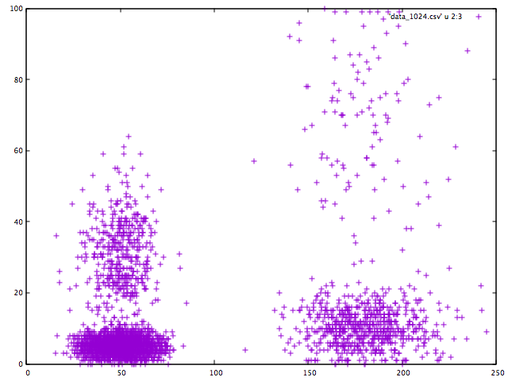
Modelling Speakers for SVM
Sequences may differ in length
Single decision for whole sequence (many-to-one)
Use Gaussian mixture models to represent speakers

Slide 7
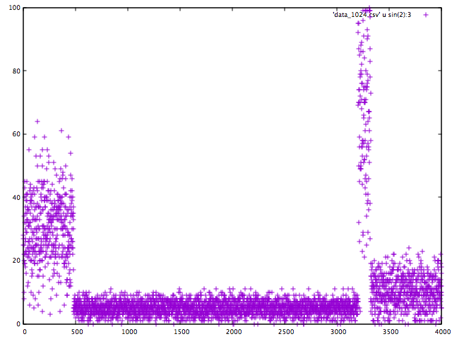
GMM Supervectors
Train a „background“ model with many speakers – unsupervised!
Adapt a „target“ model for every speaker (or class), eg. max-a-posteriori
Use GMM parameters as features to SVM
UBM
Target

Slide 8


Bhattacharyya based Kernel
You can use any kernel with the supervectors, however…
Since all SV are derived from the same UBM, you can compute the „distance“ of the components based on Bhattacharyya distance
You et al. 2008: An SVM Kernel With GMM-Supervector Based on the Bhattacharyya Distance for Speaker Recognition (https://ieeexplore.ieee.org/document/4734326)

Slide 9
Learning Feature Representations
MFCC etc. are spectral/cepstral speech features, motivated by how the source signal is produced
For text, we resorted to one-hot encoding
It is often better to learn the feature representations instead
Convolutional layers learn to extract structural (temporal) information
Embedding layer learns a (typically compressed) representation of the one-hot input.
…randomly initialized, trained as part of the network (supervised!)

Slide 10
Learning Feature Representations cont‘d
Leverage unlabeled data to learn feature representations
Learn how observations relate to their surroundings, hence the name „embedding“
Most embeddings are some sort of auto-encoder (AE)
…they learn about the structure by by first encoding the data to an intermediate representation x -> h,
…then decoding/reconstructing it h -> r, where r should match x.
Undercomplete AE: dim(h) < dim(x)
Overcomplete AE: dim(h) > dim(x)

Slide 11
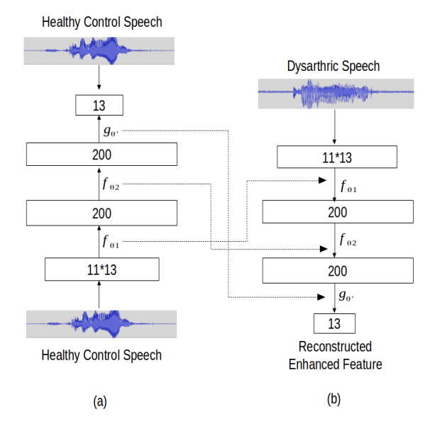
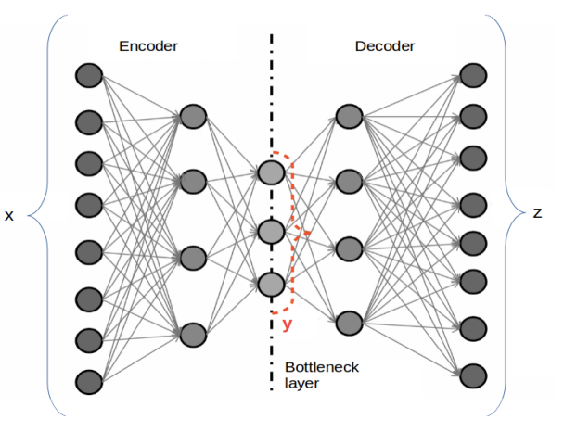
AE for Speech Tasks
Vachhani et al., 2017: Deep Autoencoder based Speech Features for Improved Dysarthric Speech Recognition
Input (x): 11 Frames of MFCC
Output (z): center MFCC frame

Slide 12
Embeddings for NLP How to represent words in Context?
Bag-of-words (BOW)
Word2Vec: Continuous bag of words (CBOW) and skip-gram
GloVe
FastText
CoVe
Higher-level embeddings: ULMfit, ELMo, BERT

Slide 13
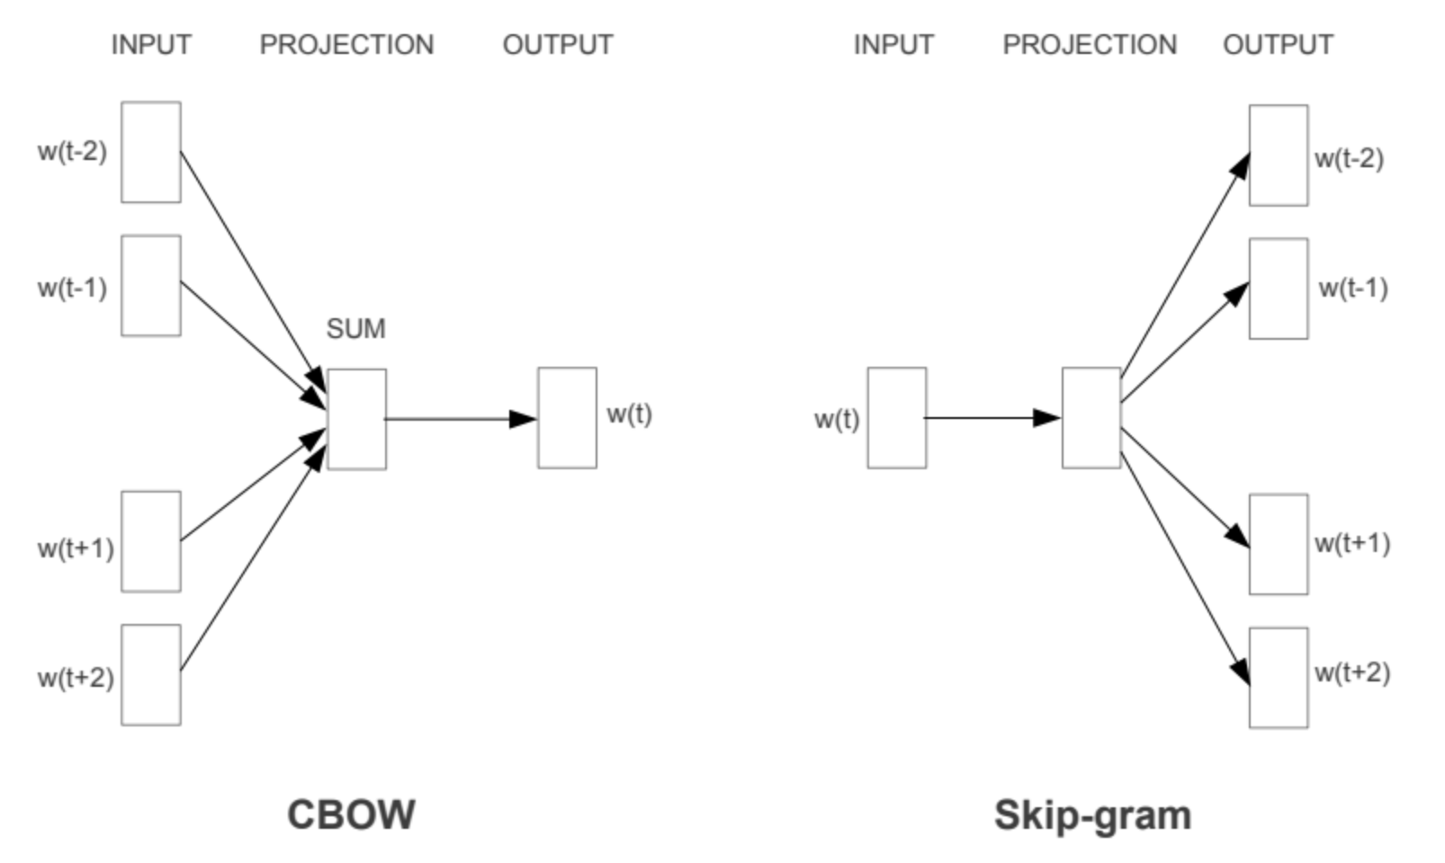
Word2Vec: CBOW and Skip-Gram
Predictive model using trained feed-forward network
Mikolov et al., 2013: Efficient Estimation of Word Representations in Vector Space
https://github.com/tmikolov/word2vec

Slide 14
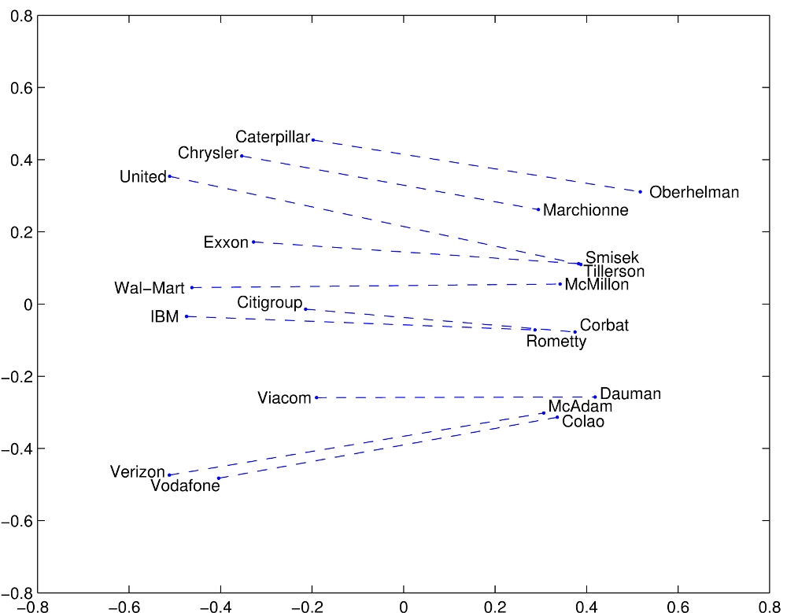
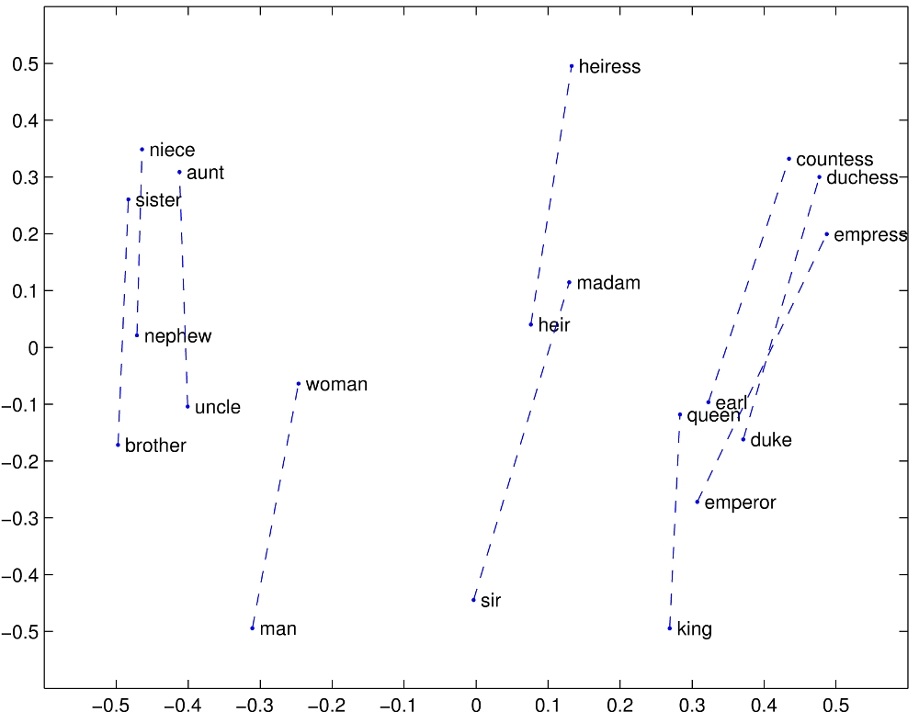
GloVe
Jeffrey Pennington, Richard Socher, and Christopher D. Manning. 2014. GloVe: Global Vectors for Word Representation.
Co-occurrence count-based, analytically reduce dimensionality
Linear substructures
https://nlp.stanford.edu/projects/glove/

Slide 15
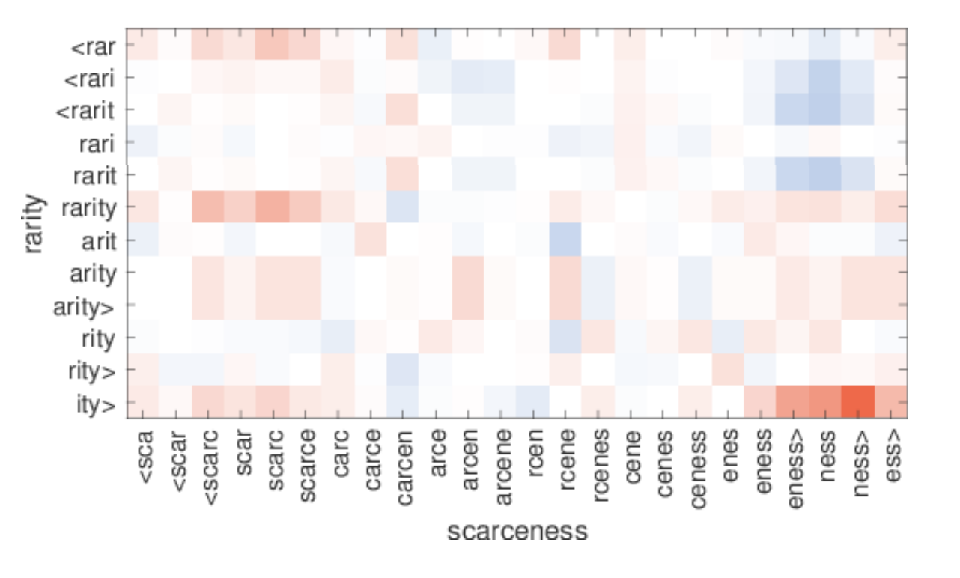
FastText (Facebook AI)
Bojanowski et al., 2016: Enriching Word Vectors with Subword Information
Use character n-grams instead of words to be able to predict representations for unseen words
Example: high similarity between
scarce and rare
-ness and -ity
https://fasttext.cc/

Slide 16
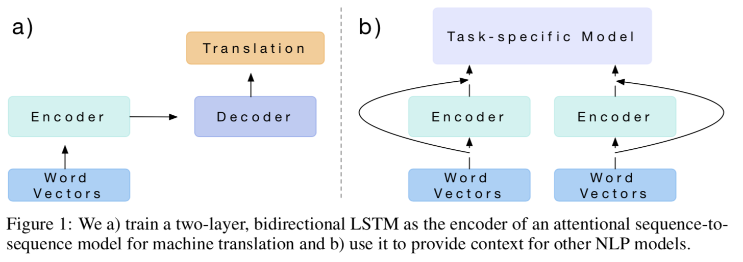
CoVe
McCann et al. 2017: Learned in Translation: Contextualized Word Vectors
Use LSTM from (unrelated) machine translation task as embedding

Slide 17
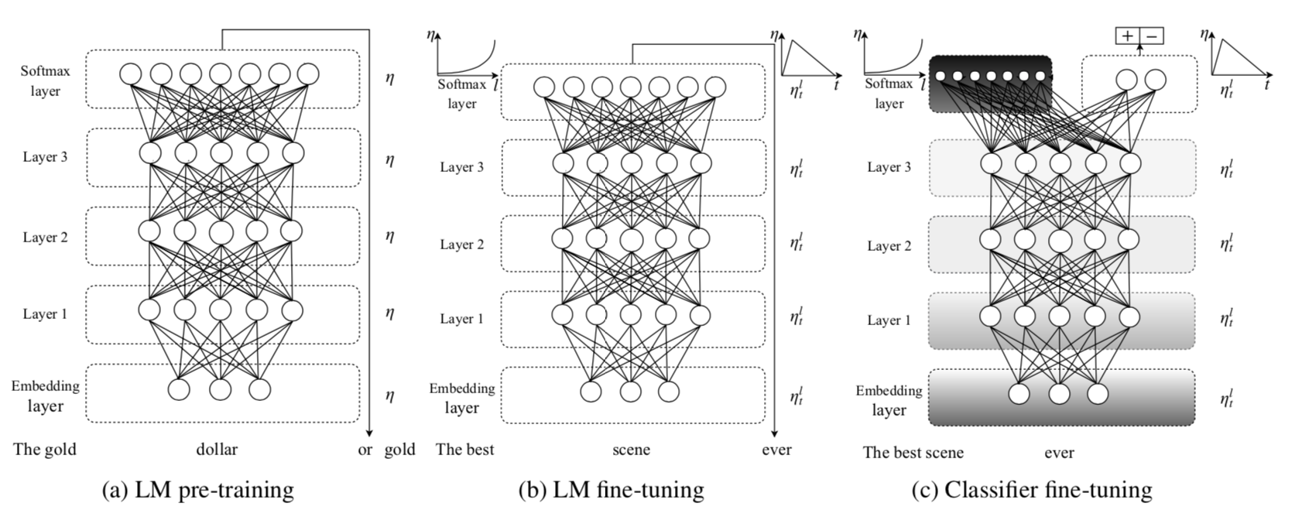
ULMFiT
Howard and Ruder, 2018: Universal Language Model Fine-tuning for Text Classification
Multi-purpose: sentiment, question classification, topic classification
3 stages for Training
General domain LM training
Fine-tuning on target domain
Train actual task with gradual unfreezing

Slide 18
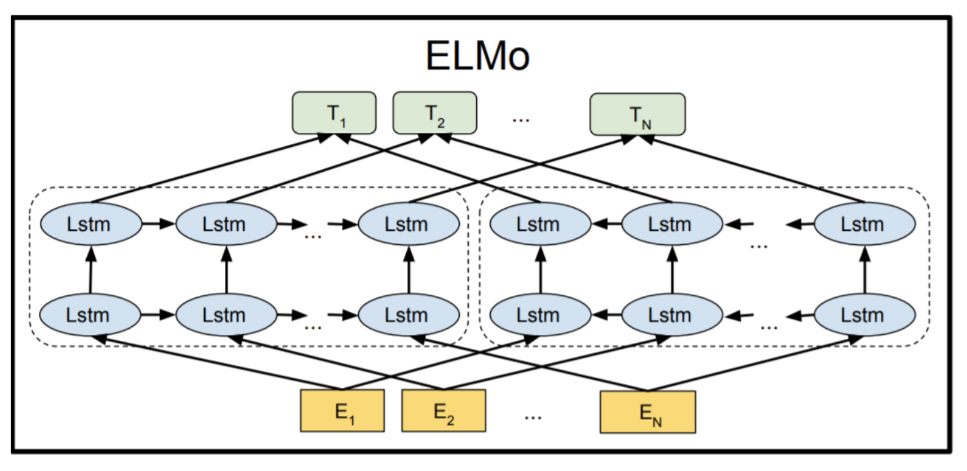
ELMo
Peters et al. 2018: Deep contextualized word representations
Train forward and backward LM to learn surroundings
Embeddings are context-dependent (non-static)

Slide 19
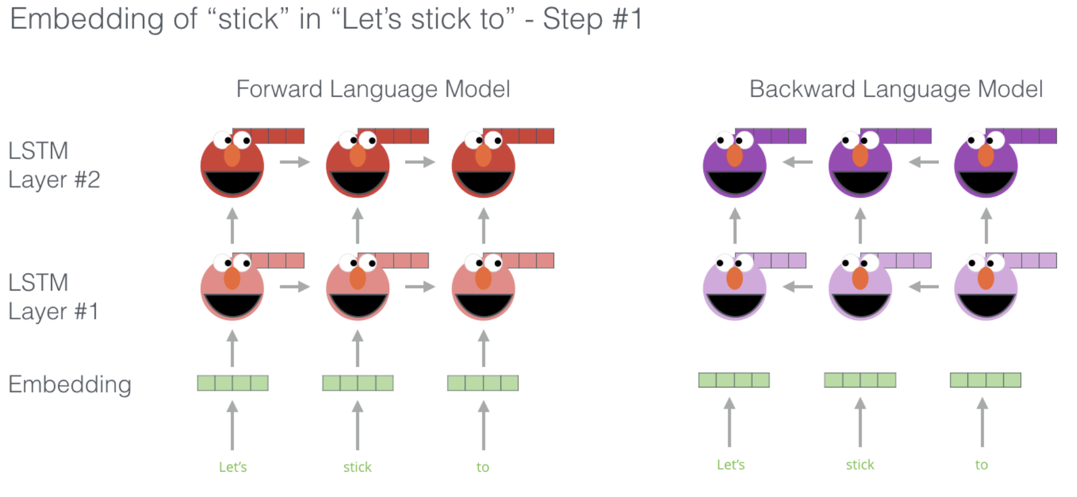
ELMo
http://jalammar.github.io/illustrated-bert/

Slide 20
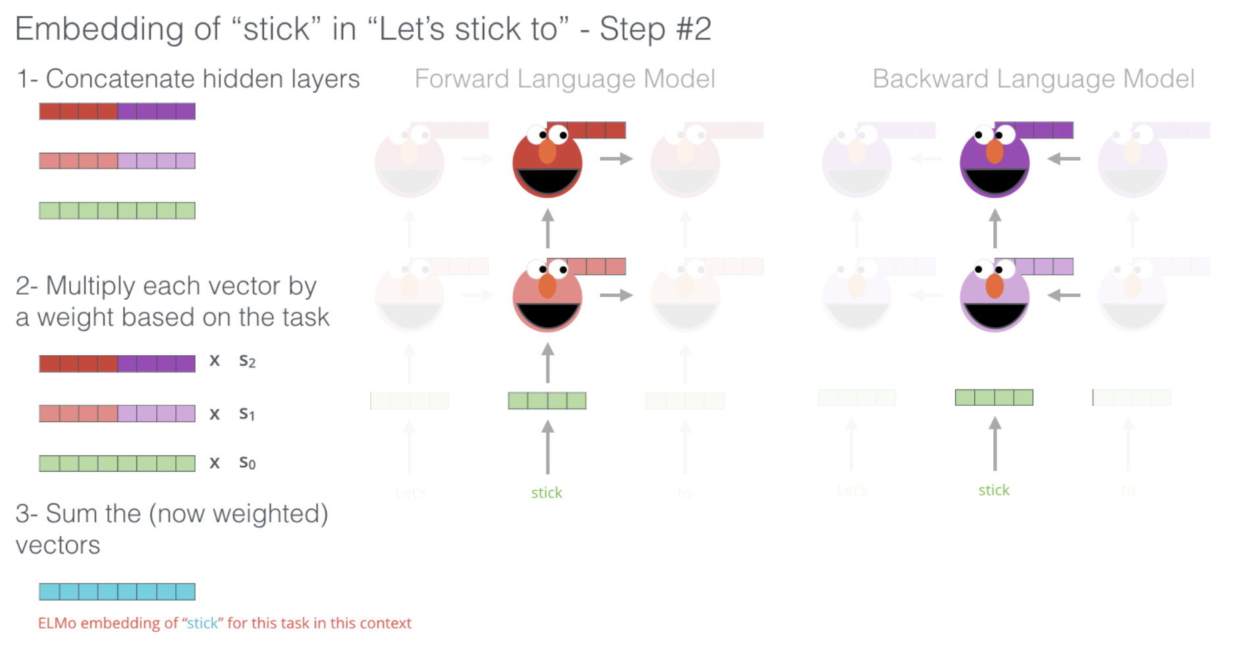
ELMo
http://jalammar.github.io/illustrated-bert/

Slide 21
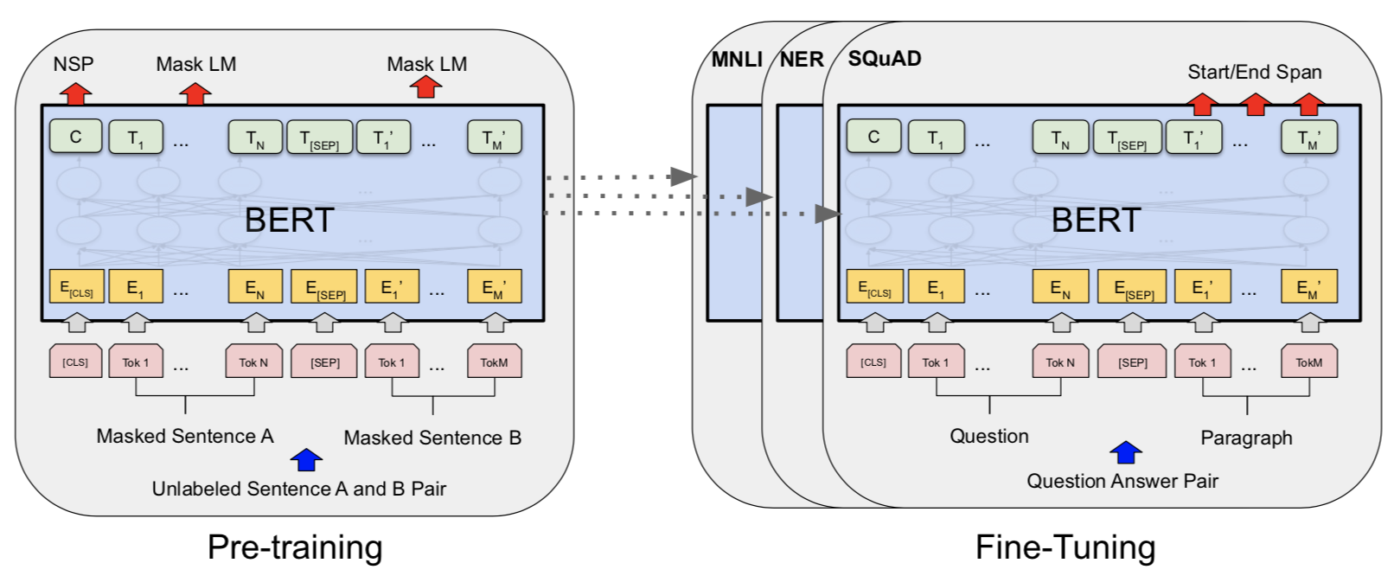
BERT
Devlin et al. 2018: BERT: Pre-training of Deep Bidirectional Transformers for Language Understanding
Bidirectional Transformer, using masking during training

Slide 22
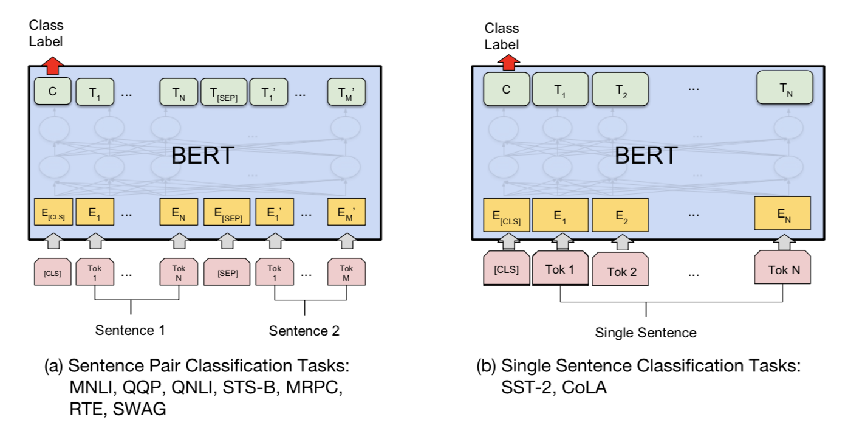
BERT – multi-task!

Slide 23
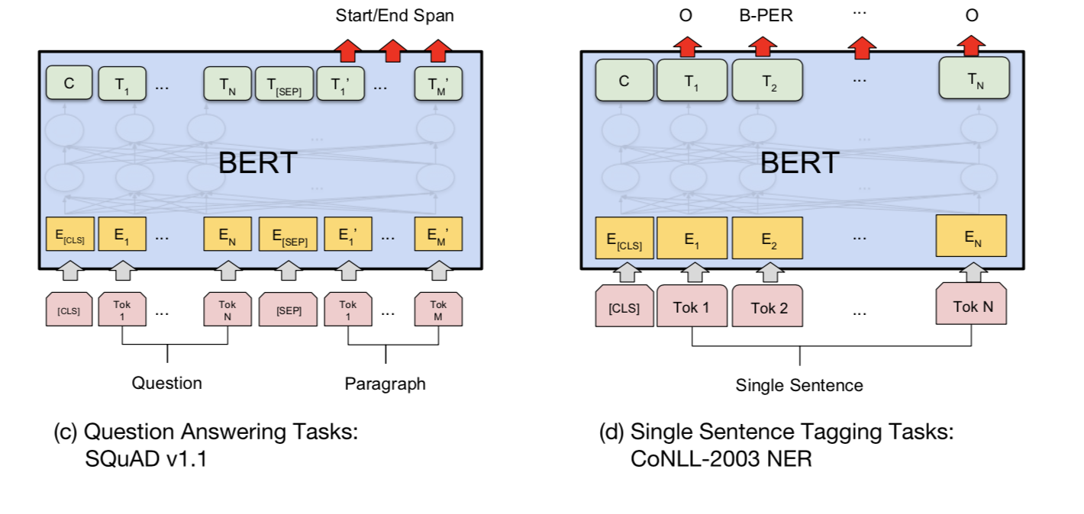
BERT

Slide 24
BERT
https://colab.research.google.com/github/tensorflow/tpu/blob/master/tools/colab/bert_finetuning_with_cloud_tpus.ipynb
https://github.com/google-research/bert
Use embeddings from intermediate layers
Fine-tune to specific task in few minutes

