Slide 1
MODULE 1
Introduction to Feedback Control

Slide 2
Open-loop Control
Switch
Furnace
Heater
Power

Slide 3

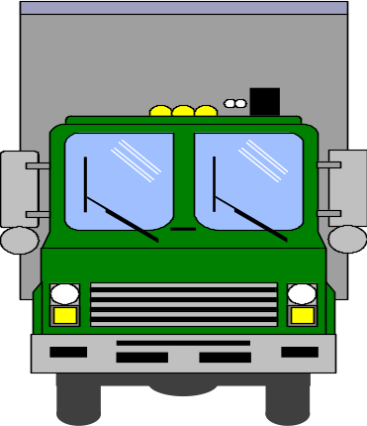
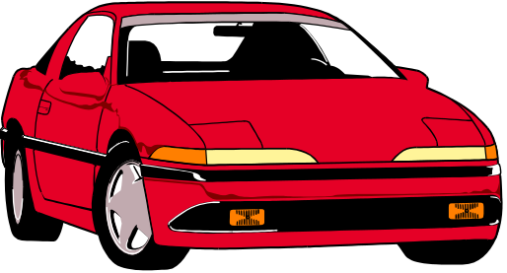


Control of Traffic Lights

