Slide 1

C语言概述
C Language Overview

Slide 2
General Aspect of ‘C’
C was originally developed in the 1970s, by Dennis Ritchie at AT&T Bell Telephone Laboratories, Inc.
C is a High level , general –purpose structured programming language. Instructions of C consists of terms that are very closely same to algebraic expressions, consisting of certain English keywords such as if, else, for ,do and while
C contains certain additional features that allows it to be used at a lower level , acting as bridge between machine language and the high level languages.
This allows C to be used for system programming as well as for applications programming

Slide 3
Overview of C
C is developed by Dennis Ritchie
C is a structured programming language
C supports functions that enables easy maintainability of code, by breaking large file into smaller modules
Comments in C provides easy readability
C is a powerful language

Slide 4
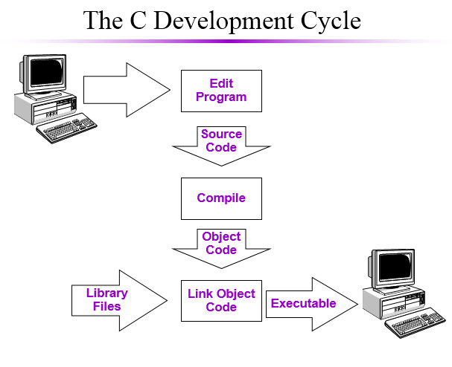
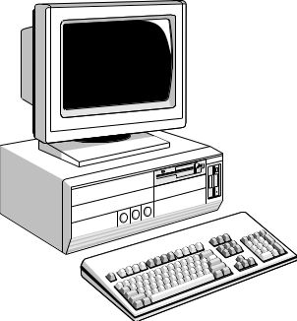
The C Development Cycle
Edit
Program
Source
Code
Compile
Object
Code
Library
Files
Executable
Link Object
Code

Slide 5
The Character set of ‘C’
C language consist of some characters set, numbers and some special symbols. The character set of C consist of all the alphabets of English language. C consist of
  Alphabets a to z, A to Z
  Numeric 0,1 to 9
  Special Symbols {,},[,],?,+,-,*,/,%,!,;,and more
The words formed from the character set are building blocks of C and are sometimes known as tokens. These tokens represent the individual entity of language. The following different types of token are used in C
1) Identifiers 2)Keywords 3)Constants
4) Operators 5)Punctuation Symbols

Slide 6
C语言程序设计 第1章 C语言概述
程序设计语言及其发展
Programming language and its development
  程序设计语言的发展
  development of programming language
机器语言
汇编语言
高级语言
分为解释类和编译类 Divided into interpreted classes and compiled classes
CPU指令系统，由0、1序列构成的指令码组成
如：10000000 加
10010000 减
用助记符号描述的指令系统
如 ADD A, B
<
>
Notes:
1946年，第一台电子计算机问世，应用领域迅速扩大，软硬件飞速发展，程序设计语言相继问世。
程序设计语言:将自然语言形式化为有格式的语言
1。机器语言：
计算机能够认识的语言
计算机的基础是数字电路
机器语言就是数字电路里的电信号
将在《计算机组成》课程中学习
都是二进制文件
一条机器语言成为一条指令
指令是不可分割的最小功能单元
定义：一种CPU的指令系统，由该CPU可识别的0、1序列构成的指令码组成。
特点：
执行效率高
不直观，不易查错，生产效率低。
2。汇编语言
定义：用助记符号描述的指令系统
特点：
生产效率高，质量好，执行效率较高；
要经汇编程序汇编成目标程序（机器语言）才能执行，依赖硬件。
（面向机器的语言----依CPU不同而异）
3。高级语言
特点：
编程效率高，不必考虑硬件；
执行效率低，要经编译、连接后才能执行。
面向过程的程序设计语言
认为解题过程是数据被加工的过程
程序=数据结构+算法
C语言是面向过程的高级语言
面向对象的程序设计语言
一种结构模拟方法。认为：现实世界由对象组成，对象是数据和方法的封装体；客观世界可以分类，每个对象是类的一个实例。
特点：比面向过程的语言更清晰、易懂，适宜编更大规模程序，是程序设计的主流
程序设计语言基本成分：
。数据成分
。运算成分
。控制成分
。传输成分
程序设计语言定义：用于书写计算机程序的语言。通常指实现高级语言。
语言的基础是一组记号与一组规则。
程序设计语言包括：
语法：记号的组合规则
语义：记号的特定意义
语用：程序与使用者的关系

Slide 7
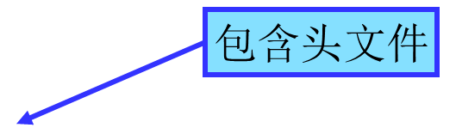
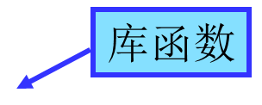
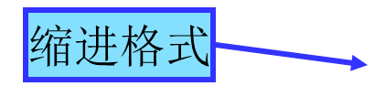
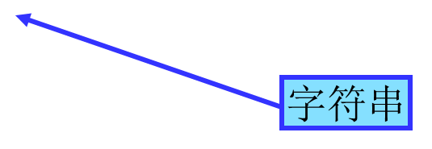
C语言程序设计 第1章 C语言概述
C语言的程序结构 C language program structure
输出字符串 Output string
#include <stdio.h>
main()
{
printf(“hello,world \n”);
}
主函数 Main function
运行结果：
Hello,world
<
>

Slide 8
C语言程序设计 第1章 C语言概述
求两个整数10和20的和并输出结果 Find the sum of two integers 10 and 20 and output the result
注释语句 Comment statement
/*功能：计算两个数的和，并输出*/
#include <stdio.h> /* 包含头文件stdio.h */
main( )
{
int a, b, sum; /* 定义变量 */
a=10; /* 给变量a赋整数值10 */
b=20; /* 给变量b赋整数值20 */
sum=a＋b; /* 求和 */
printf("sum=%d\n", sum); /* 输出sum的值 */
}
运行结果：
sum=30
<
>

Slide 9
Header files
The files that are specified in the include section is called as header file
These are precompiled files that has some functions defined in them
We can call those functions in our program by supplying parameters
Header file is given an extension .h
C Source file is given an extension .c

Slide 10
Main function
This is the entry point of a program
When a file is executed, the start point is the main function
From main function the flow goes as per the programmers choice.
There may or may not be other functions written by user in a program
Main function is compulsory for any c program

Slide 11
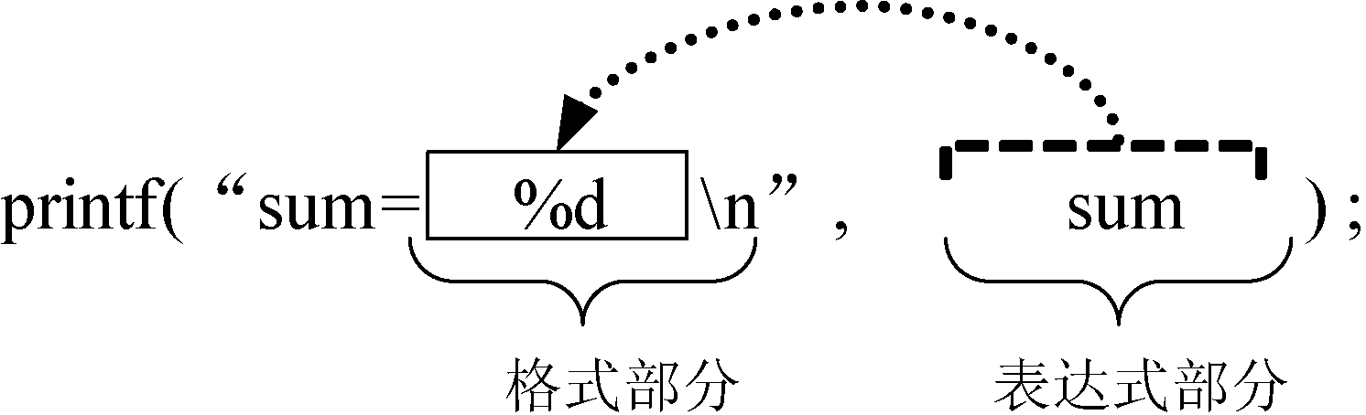
C语言程序设计 第1章 C语言概述
若输出 If the output
10＋20=30
则程序中的printf语句可改写为：The printf statement in the program can be rewritten as:
printf("%d＋%d=%d\n", 10,20,sum);
<
>

Slide 12
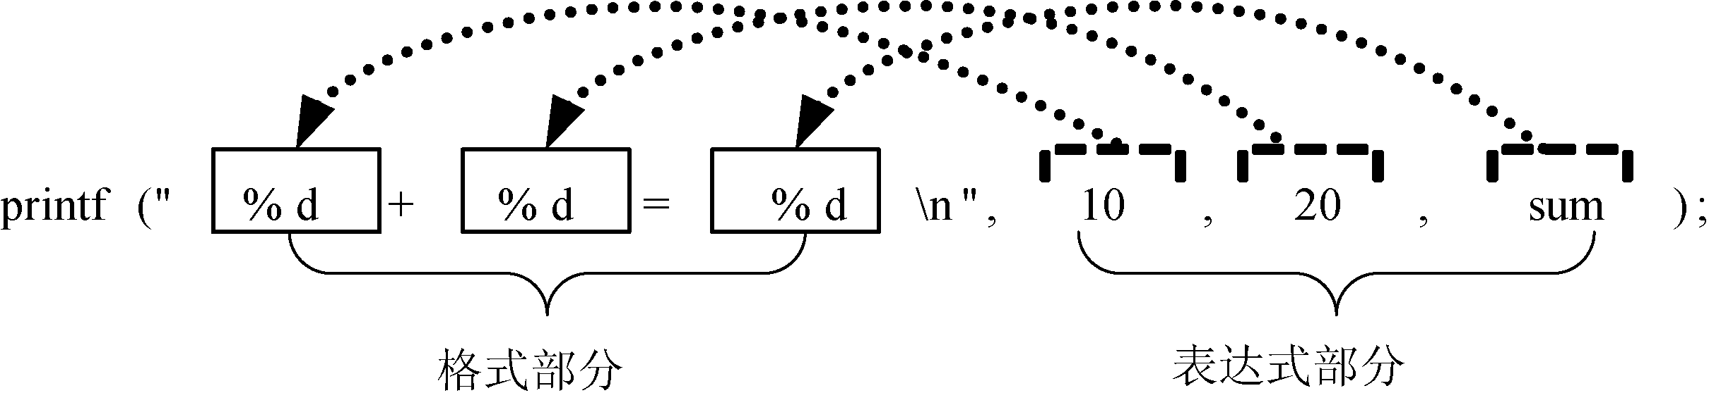
C语言程序设计 第1章 C语言概述
<
>

Slide 13
C语言程序设计 第1章 C语言概述
求任意两个整数的和并输出结果 Find the sum of any two integers and output the result.
#include <stdio.h>
main( )
{
int a, b, sum; /* 定义变量 */
scanf("%d", &a); /* 输入第一个整数 */
scanf("%d", &b); /* 输入第二个整数 */
sum=a＋b; /* 计算和 */
/* 输出和 */
printf("The sum of %d and %d is %d.\n", a,b,sum);
}
scanf获得键盘输入 Get keyboard input
<
>

Slide 14
C语言程序设计 第1章 C语言概述
C语言程序结构特点 C language program structure characteristics
  C语言程序由函数组成 C language program consists of functions
    程序由一个或多个函数组成。program consists of one or more functions
    必须有且只能有一个主函数main()。Must have and can only have a main function main ()
    程序执行从main开始，在main中结束。The program execution starts from main and ends in main.
    源程序中的预处理通常放在程序的最前面。Preprocessing in the source program is usually placed at the top of the program
<
>

Slide 15
C语言程序设计 第1章 C语言概述
C语言程序结构特点 C language program structure characteristics
  程序语句 Program statement
    C语言源程序由语句组成 C language source program consists of statements
    第条语句用分号“;”作为语句终止符 sentence uses the semicolon ";" as the terminator
  注释 Annotations
    /* */为注释,不能嵌套 annotations that can not be nested
  采用缩进格式 Using indentation format
<
>

Slide 16
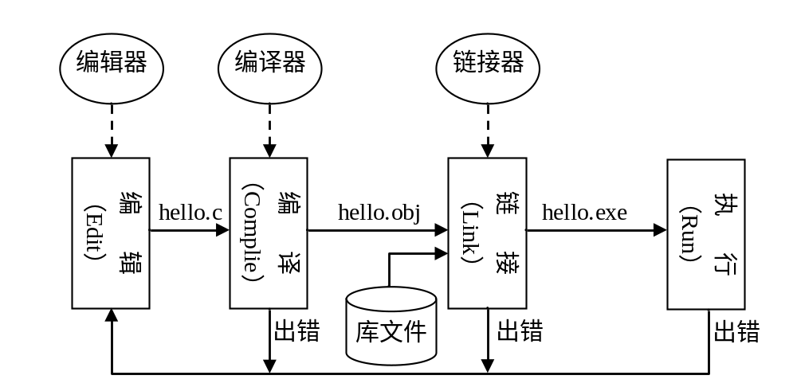
C语言程序设计 第1章 C语言概述
C程序的运行 C program running
<
>

