Slide 1
指 针Pointer

Slide 2
Pointer :指针
A pointer is a variable containing the address of
another variable.
指针是包含另一个变量地址的变量
A pointer is a memory address.
指针是一个内存地址

Slide 3
What is meant by Data type? 数据类型是什么意思？
Data Type is type of data 数据类型是数据的类型
Ex: int, char, float, double
What is a variable?什么是变量？
A variable is a place to store some data
变量是存储一些数据的地方
Ex:

Slide 4
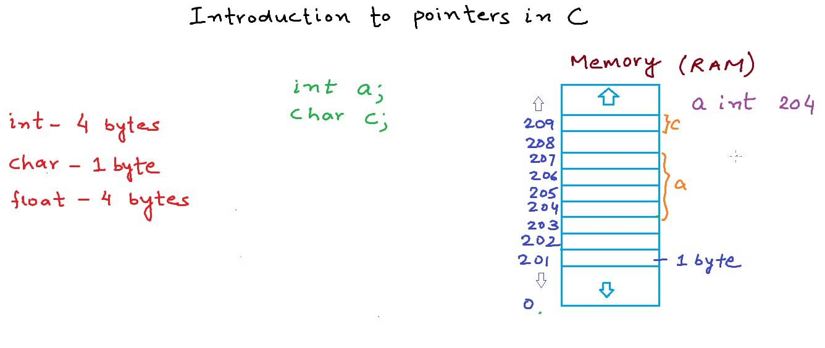
To understand pointers, we should know how data types or variables
are stored in computer memory
为了理解指针，我们应该知道数据类型或变量是如何存储在计算机
内存中的

Slide 5
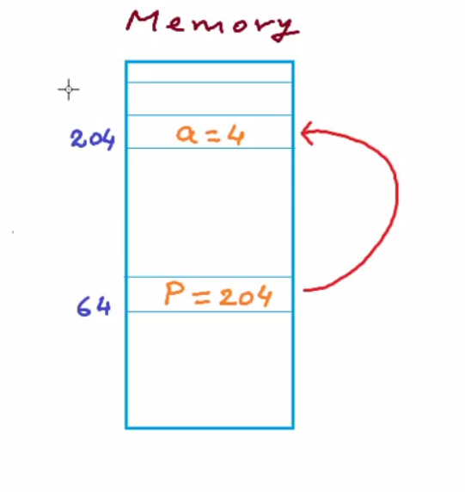
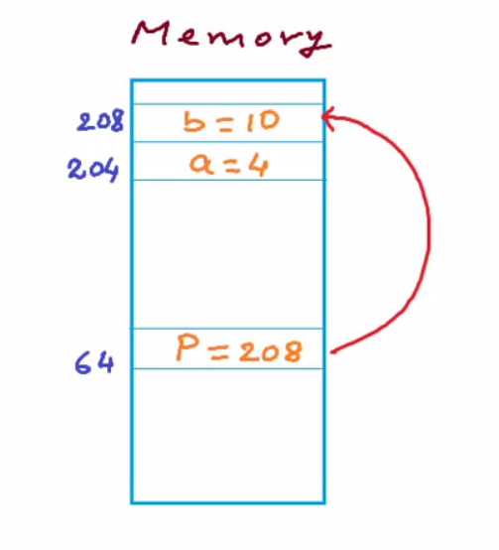
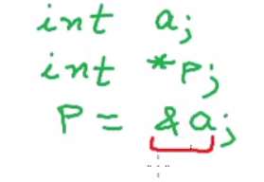
Pointer to integer指向整数
Pointer can store address of the integer variable
指针可以存储整型变量的地址

Slide 6
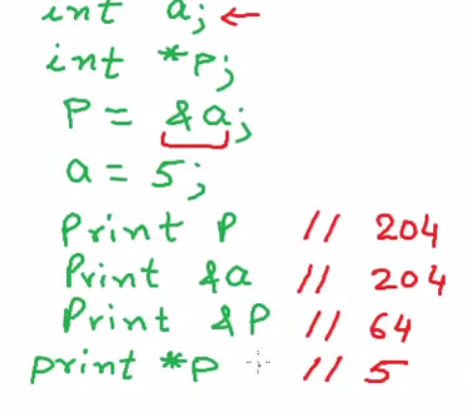
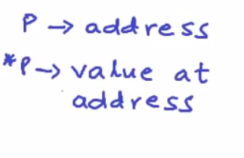
Dereferencing pointer解引用指针

Slide 7
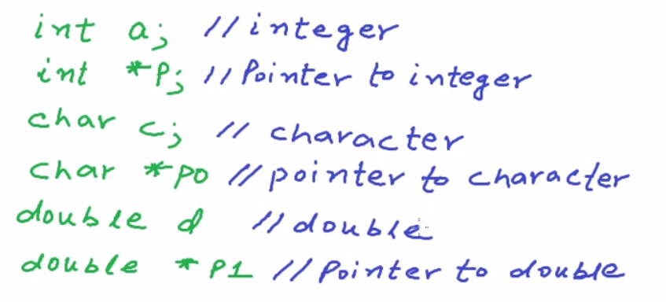
Working with pointers

Slide 8
Working with pointers
#include<stdio.h>
main()
{
int a;
int *p;
a= 10;
p=&a;
printf("%d\n",p);
printf("%d\n",*p);
printf("%d\n",&a);
}

Slide 9
dereferencing with pointers
#include<stdio.h>
main()
{
int a;
int *p;
a= 10;
p=&a;
printf("a=%d\n",a);
*p=8; //dereferencing
printf("a=%d\n",a);
}

Slide 10
Pointer Arithmetic
#include<stdio.h>
main()
{
int a;
int *p;
a= 10;
p=&a;
printf("Address of p is %d\n",p);
printf("Size of integer is %d bytes\n",sizeof(int));
printf("Value at p is %d\n",p+1);
}

Slide 11
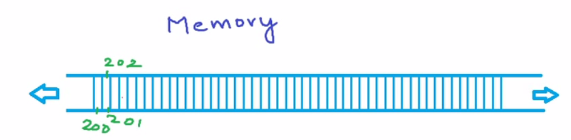
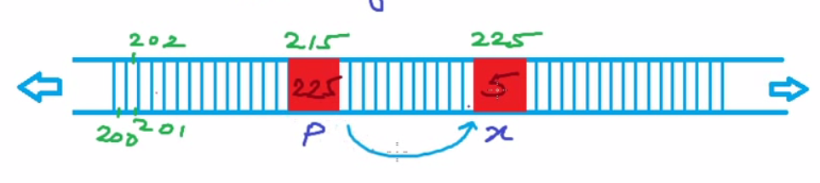
Pointer to Pointer
Memory Space
Ex: int x=5; int *p; p = &x;

Slide 12
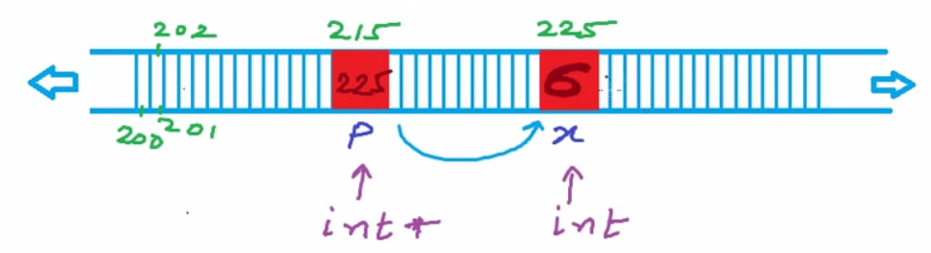
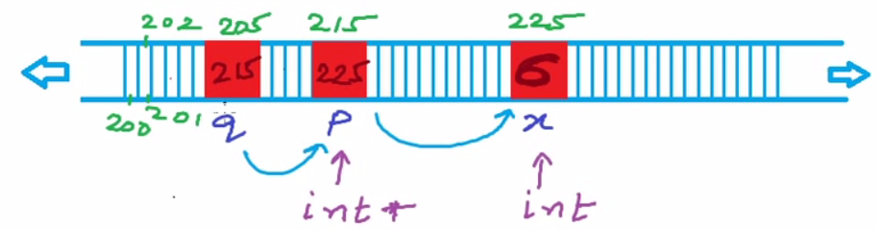
Pointer to Pointer
Dereferencing : *p = 6;
Ex: int **q; q=&p;

Slide 13
Pointer to Pointer
#include <stdio.h>
int main()
{
int x, *p, **q;
x=5 ;
p = &x;
*p =6;
q = &p;
printf("%d\n",*p);
printf("%d\n",*q);
printf("%d\n",*(*q));
}

Slide 14
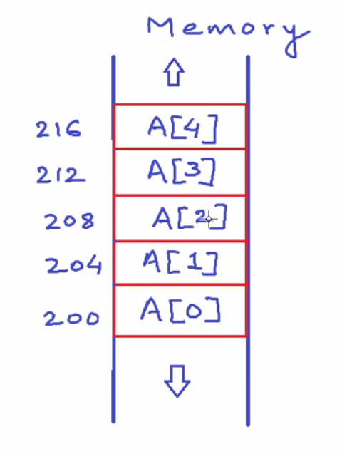
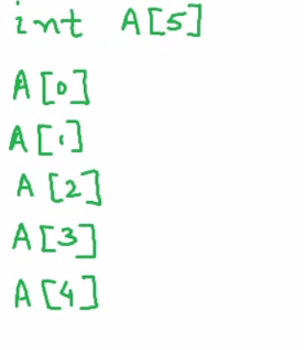
Pointers and Array

Slide 15
Pointers and Array
#include <stdio.h>
main()
{
int A[]= {2,3,4,5,6};
printf("%d\n", A);
printf("%d\n", &A[0]);
printf("%d\n", A[0]);
printf("%d\n", *A);
}

Slide 16
Pointers and Array
#include <stdio.h>
main()
{
int A[]= {2,3,4,5,6};
int i;
for(i=0; i< 5;i++)
{
printf("Address=%d\n", &A[i]);
printf("value=%d\n", A[i]);
printf("value=%d\n", *(A+i));
}
}

Slide 17


指针与字符串
string
I
string[0]
例 main( )
{
char string[]=“I love China!”;
printf(“%s\n”,string);
printf(“%s\n”,string+7);
}
string[1]
l
string[2]
o
string[3]
v
string[4]
e
string[5]
string[6]
C
string[7]
h
string[8]
  字符数组名表示字符串首地址
i
string[9]
n
string[10]
a
string[11]
!
string[12]
\0
string[13]

Slide 18
    用字符指针实现
#include <stdio.h>
const int MAX = 4;
int main () {
char *names[] = {
"Wang Hui Jia",
"Wang Hui Jia",
"Wang Hui Jia",
"Wang Hui Jia"
};
int i = 0;
for ( i = 0; i < MAX; i++) {
printf("Value of names[%d] = %s\n", i, names[i] );
}
return 0;
}

Slide 19
void指针
允许使用基类型为void的指针类型。可以定义一个基类型为void的指针变量。如void *p;。指向void的指针是一种不与某种基类型相关联的通用类型；也即，它并不是一个字符、整数、实数或其他任何类型的地址。
#include <stdio.h>
int main(){
void *voidPointer; int a=10; float b=1.234f;
char c='x';
voidPointer=&a;
printf("value of a: %d\n",*(int*)voidPointer);
voidPointer=&b;
printf("value of b: %f\n",*(float*)voidPointer);
voidPointer=&c;
printf("value of c: %c\n",*(char*)voidPointer);
return 0;
}

