Slide 1
编译预处理Compile preprocessing
概述
宏定义Macro definition
文件包含
条件编译Conditional compilation

Slide 2
.dsp – project file项目文件
.dsw – workspace file工作区文件
.ncb – no compile browser file – can be regenerated if deleted also如果删除也可以重新生成
.opt – options file to show the options in the window
选项文件来显示选项

Slide 3
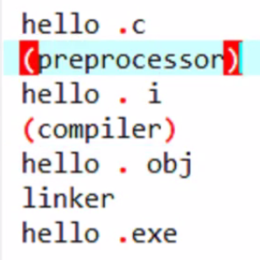

Slide 4
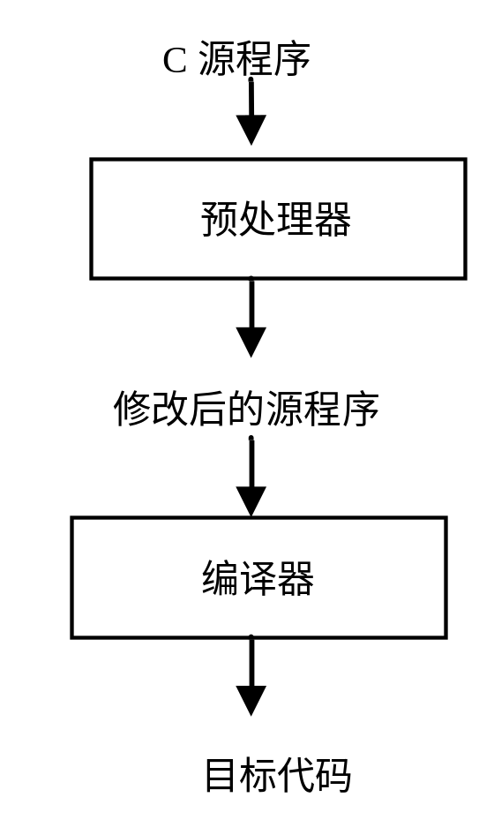
概述
预处理的工作方式preconditioning work
  作用：对源程序编译之前，对#开头的命令做一些预处理Compile the source before the beginning of the # order to do some pretreatment

Slide 5
预处理命令Preprocess command
  种类：
    宏定义 #define Macro definition
    文件包含 #include file inclusion
    条件编译 #if--#else--#endif等 Conditional compilation
    Miscellaneous directives 杂项指令

Slide 6
Simple macros example
#include<stdio.h>
#define NUMBER 07
#define NAME "MANI"
main()
{
printf("my number is %d and my name is %s\n", NUMBER,NAME);
}

Slide 7
Operators for macros
#include<stdio.h>
#define AND &&
#define OR ||
main()
{
int a, b;
a=1;
b=0;
if(a>0 AND b==0)
printf("AND\n");
if (a>0 OR b>0)
printf("OR\n");
}

Slide 8
Condition using macros
#include<stdio.h>
#define AND &&
#define OR ||
#define CON1 (a>0 AND b==0)
#define CON2 (a>0 OR b>0)
main()
{
int a, b;
a=1;
b=0;
if(CON1)
printf("AND\n");
if (CON2)
printf("OR\n");
}

Slide 9
Statements using macros
#include<stdio.h>
#define AND &&
#define OR ||
#define CON1 (a>0 AND b==0)
#define CON2 (a>0 OR b>0)
#define OUT printf("AND\n");
main()
{
int a, b;
a=1;
b=0;
if(CON1)
OUT
if (CON2)
OUT
}

Slide 10
Macros expansion with multiple lines
#include<stdio.h>
#define FOR for(i=0;i<10;i++)\
{\
printf("i=%d\n",i);\
}
main()
{
int i;
FOR
}

Slide 11
preprocessor as function
#include<stdio.h>
#define SQUARE(x) x*x
void main()
{
int num;
printf("Enter any number : ");
scanf("%d",&num);
printf("\nThe square is : %d\n",SQUARE(num));
}

Slide 12
文件包含
  功能：一个源文件可将另一个源文件的内容全部包含
  一般形式： #include “文件名”
  或 #include <文件名>
< > 直接按标准目录搜索
“ ” 先在当前目录搜索，再搜索标准目录
#include “file2.c”
file2.c
B
A
A
file2.c
file1.c
file1.c

Slide 13
  文件包含可嵌套
#include “file2.c”
#include “file3.c”
C
A
B
file3.c
file1.c
file2.c
file3.c
file2.c
file1.c
A

Slide 14
Preprocessor file inclusion
#include<stdio.h>
#include"second.c"
main()
{
display();
}

Slide 15
void display()
{
printf("Hi");
}

Slide 16
/* fun.c */
long int fac(int n)
{
int i;
long int s=1;
for(i=1;i<=n;i++)
s*=i;
return s;
}
例 文件包含举例
#include <stdio.h>
#define N 8
#include "fun.c"
int main()
{
printf("%ld\n",fac(N));
}

Slide 17
条件编译
  功能：根据指定的标识符是否被定义过，确定在程序编译阶段编译哪一段程序段。
  形式1：#if 表达式
  程序段1
  #else
  程序段2
  #endif
  形式3： #ifndef 标识符
  程序段1
  #else
  程序段2
  #endif
  形式2：#ifdef 标识符
  程序段1
  #else
  程序段2
  #endif

Slide 18
#if-#else-#endif Preprocessor Directive
#include<stdio.h>
#define MAX 45
void main()
{
#if MAX > 40
printf("Yes, MAX is greater then 40.\n");
#else
printf("No, MAX is not greater then 40.\n");
#endif
}

Slide 19
Ifdef
#include<stdio.h>
main()
{
printf("one\n");
#ifdef AVOID
printf("two\n");
printf("three\n");
printf("four\n");
#endif
printf("five\n");
}

Slide 20
#include<stdio.h>
#define AVOID
main()
{
printf("one\n");
#ifdef AVOID
printf("two\n");
printf("three\n");
printf("four\n");
#endif
printf("five\n");
}

Slide 21
ifndef
#include<stdio.h>
#define AVOID
main()
{
printf("one\n");
#ifndef AVOID
printf("two\n");
printf("three\n");
printf("four\n");
#endif
printf("five\n");
}

