Slide 1
Predicting FIFA World Cup Outcomes
Using player attributes, team composition, rankings, and match-level analysis
Senior Capstone | Interactive Streamlit predictor and 2026 simulator

Slide 2
Research Question
Goal: move from raw football data to an interactive, reproducible prediction system.
Can player attributes and team composition explain international match outcomes?
Can the same model power a forward-looking 2026 World Cup simulation?
How do multiple model families compare on the same connected feature set?

Slide 3
Data Foundation
Key limitation: possession, shots, fouls, and exact 2018 squad files are not present locally.
FIFA18 player attributes provide player-level strength and position signals.
International match results provide outcomes and goal difference.
FIFA rankings add external performance context.
World Cup history supports tournament-success modeling.
2026 group data powers the simulator.

Slide 4
Feature Engineering
Pipeline: players -> team features -> match differences -> model targets.
Player data is aggregated into national-team features.
Features include overall, attack, midfield, defense, goalkeeper, age, balance, player count, elite players, rank, and points.
Match rows use differences between Team A and Team B for consistency.

Slide 5
Modeling Tests
Best match model: SVM
Accuracy: 72.6%
Training rows: 4,951
Tournament rows: 126
Match outcome: Logistic Regression, Random Forest, SVM, Naive Bayes, MLP.
Goal difference: Linear, Ridge, Lasso, Random Forest, SVR, MLP.
Tournament success: Logistic Regression, Decision Tree, Random Forest, MLP.

Slide 6
Match Model Results
SVM
72.5%
The SVM performs best on the held-out test set, improving about 20 percentage points over the dummy baseline.
Naive Bayes
71.9%
Logistic
71.0%
MLP
68.0%
Random Forest
66.9%
Baseline
52.6%

Slide 7
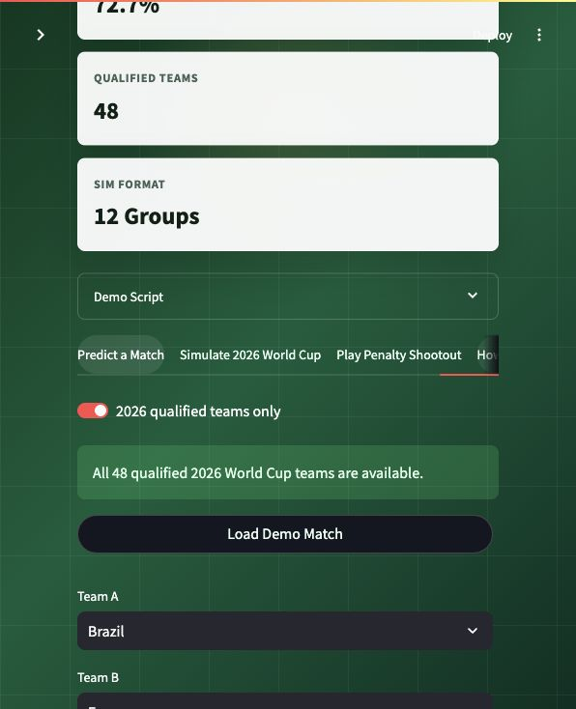
Interactive Match Predictor
The app lets users select two teams and generate real-time win probabilities from the saved model artifacts.

Slide 8
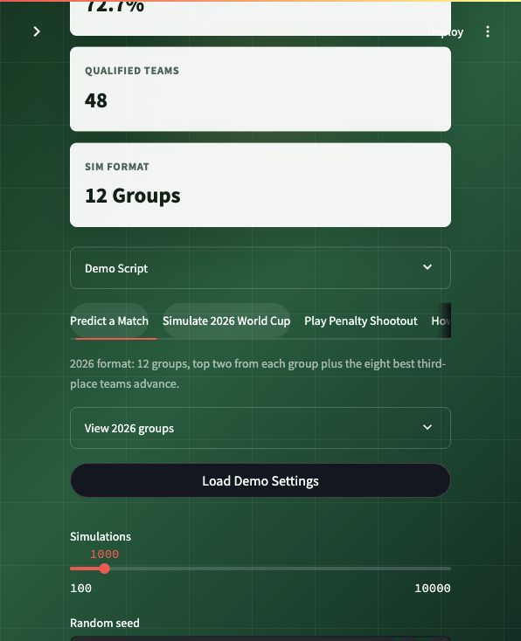
2026 World Cup Simulation
The simulator runs repeated tournaments across the 48-team, 12-group format and summarizes advancement and champion probabilities.

Slide 9
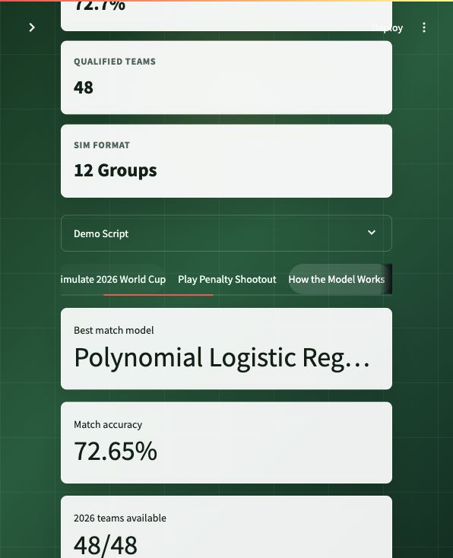
Model Report Evidence
The report tab documents the full pipeline, model comparisons, confusion matrix, feature importance, and known data gaps.

Slide 10
Conclusion
Final deliverables: code pipeline, Streamlit app, report draft, screenshots, and presentation deck.
The project now runs end to end from raw data to an interactive dashboard.
The model performs meaningfully better than baseline.
The 2026 simulation demonstrates how probability outputs can support tournament forecasting.
Future work should add exact squad rosters and richer in-game match statistics.

