Slide 1
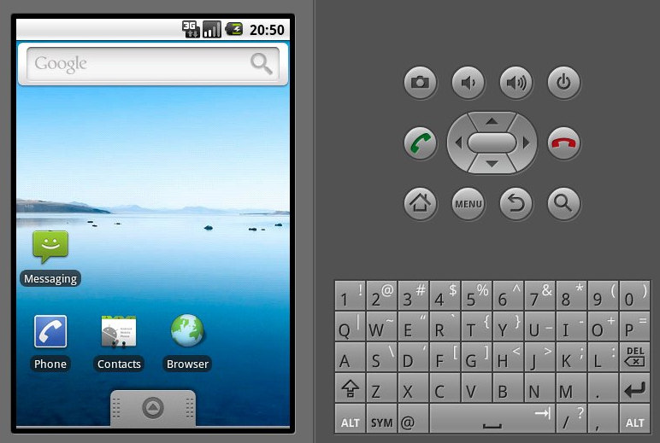
CLICK

Slide 2
CLICK

Slide 3
CLICK

