Slide 1
Hello World

Slide 2
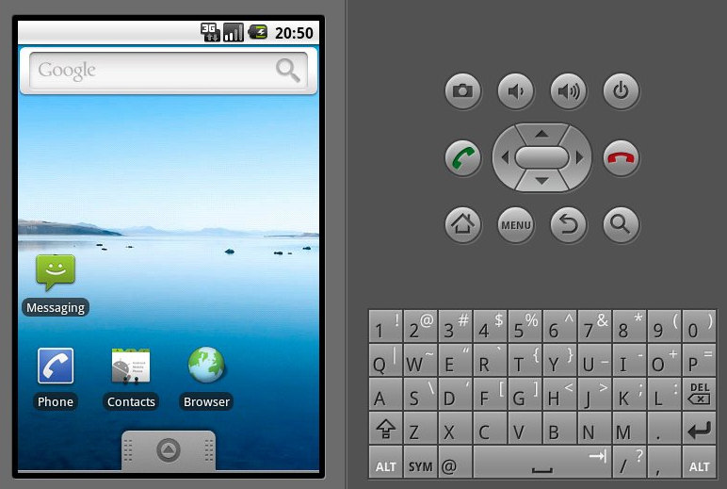
CLICK

