Slide 1

CLICK

Slide 2
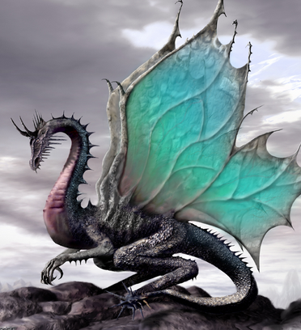
CLICK

