Slide 1
Open https://www.wikipedia.org/

Slide 2
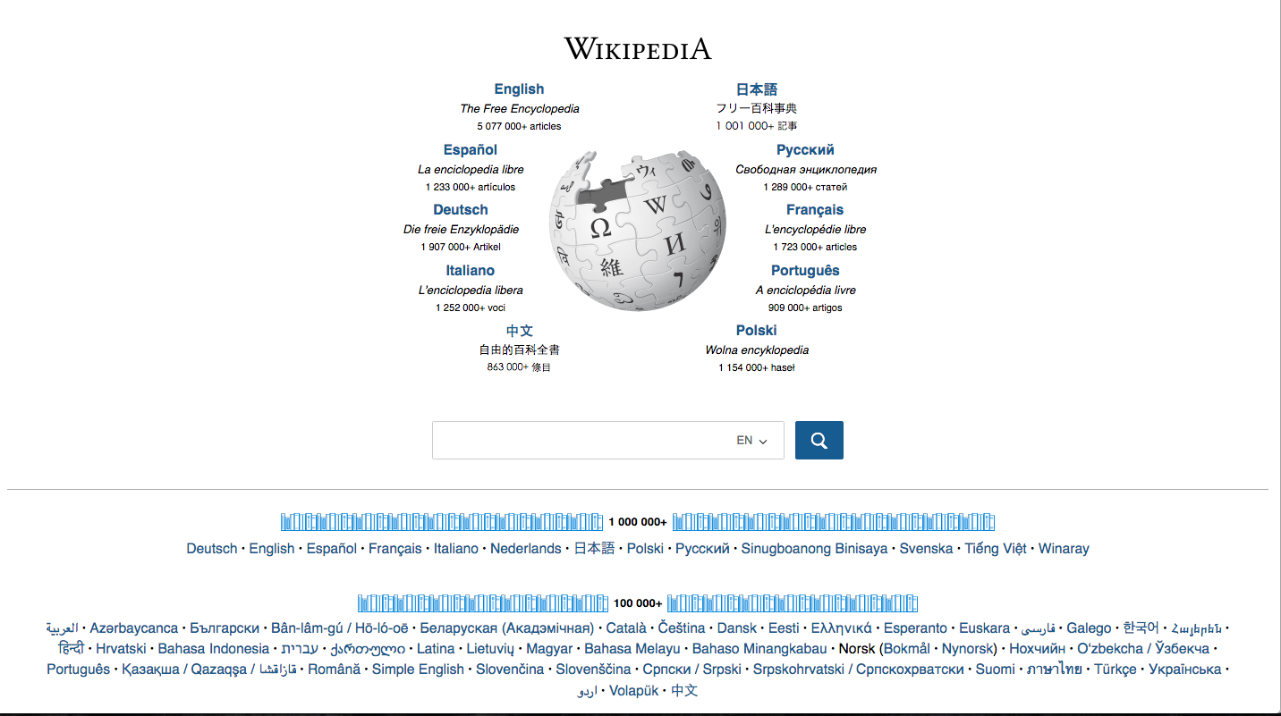
Click

