Slide 1
Open https://www.wikipedia.org/
Notes:
Action with no screenshot

Slide 2
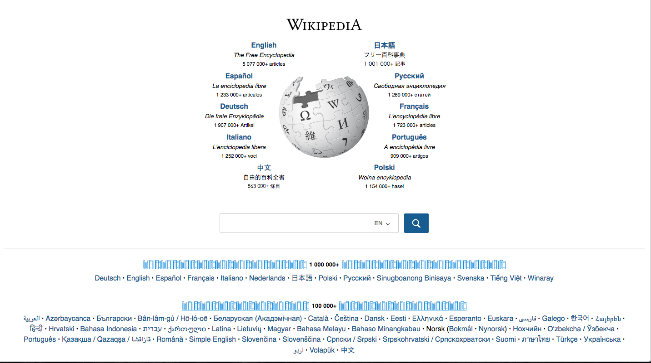
Click
Notes:
Action with a screenshot and a target

Slide 3
Wikipedia
Click
Notes:
Action with a screenshot, a target, and a caption

Slide 4
Notes:
A blank slide with title and body boxes

Slide 5
Label-1
label-1
Label-2
label-2
Notes:
A slide with only two labels

