Slide 1

Intro to Bootstrap
Notes:
NOTE:
To change the image on this slide, select the picture and delete it. Then click the Pictures icon in the placeholder to insert your own image.

Slide 2
Introduction to HTML
Covered in this Session:
Introduction to Bootstrap
Why to use Bootstrap
Installation
Layout
Containers
Grid
Content
Tables
Components
Alerts
Breadcrumb
Buttons
Card
Forms
Pagination
Progress
Modal
Carousel
Utilities
Border
Colors
Display
Shadows
Float

Slide 3
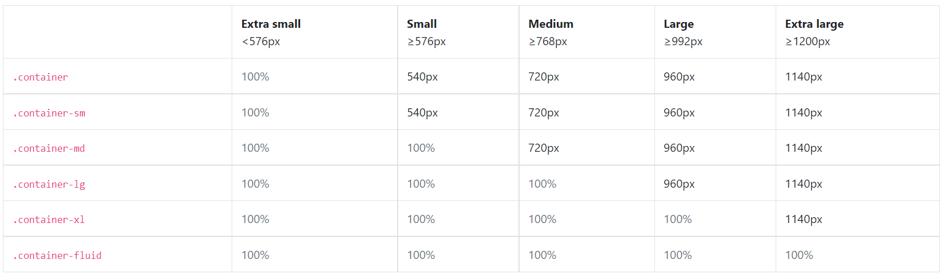
Layout

Slide 4
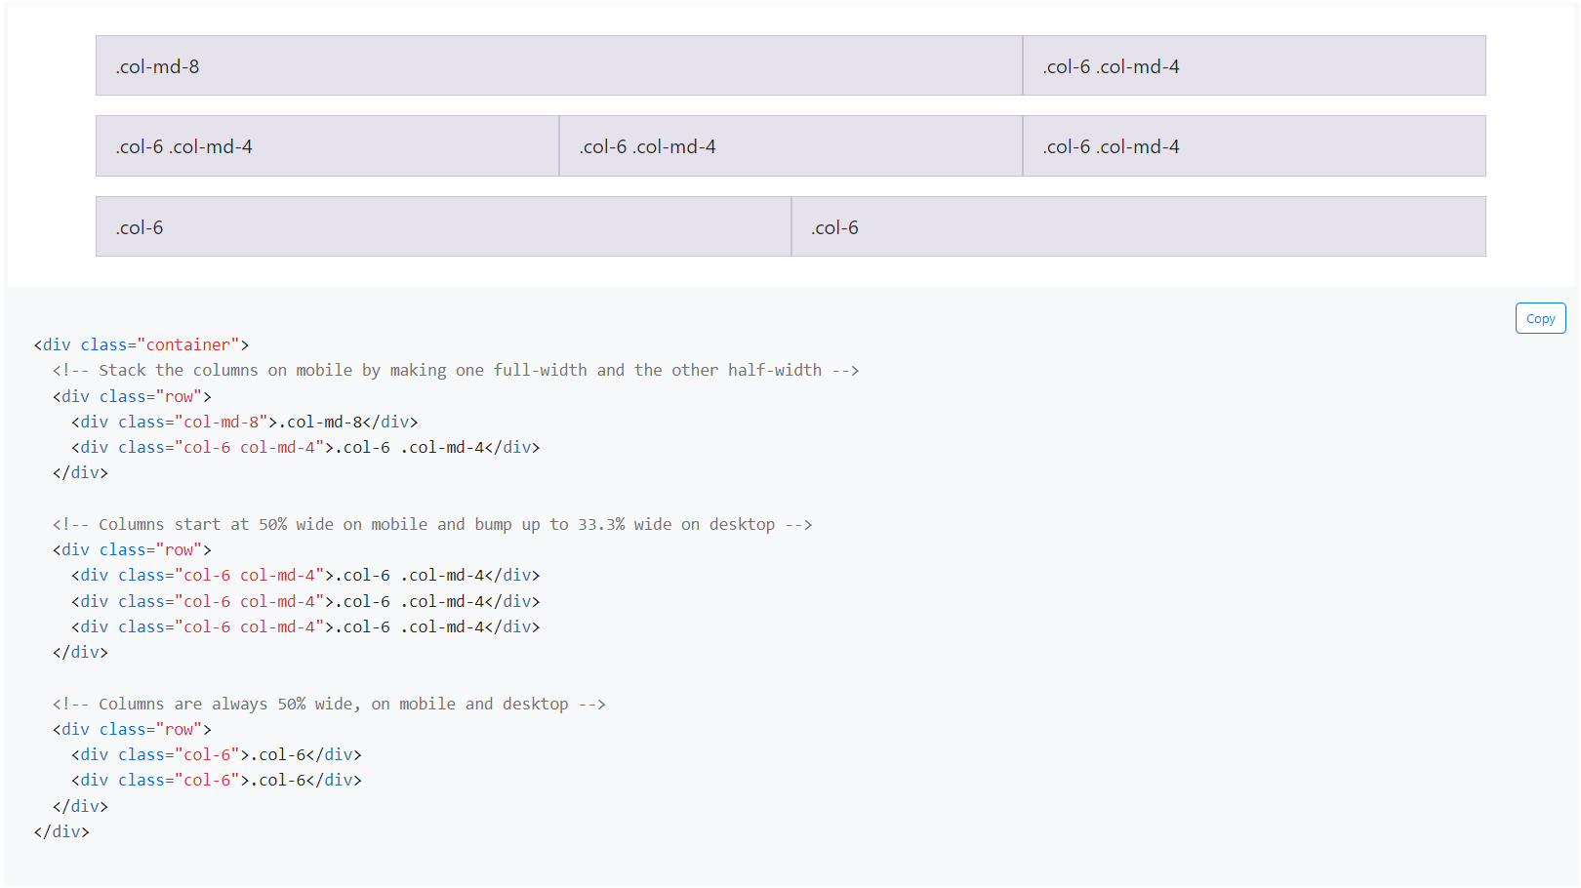
Grid system
How it works
Bootstrap’s grid system uses a series of containers, rows, and columns to layout and align content. It’s built with flexbox and is fully responsive. Below is an example and an in-depth look at how the grid comes together.

Slide 5
Content
Table
We’ve designed our tables to be opt-in. Just add the base class .table to any <table>, then extend with custom styles or our various included modifier classes.
<table class="table">
<thead>
<tr>
<th>#</th>
<th>First</th>
<th>Last</th>
<th>Handle</th>
</tr>
</thead>
<tbody>
<tr>
<th>3</th>
<td>Larry</td>
<td>the Bird</td>
<td>@twitter</td>
</tr>
</tbody>
</table>

Slide 6
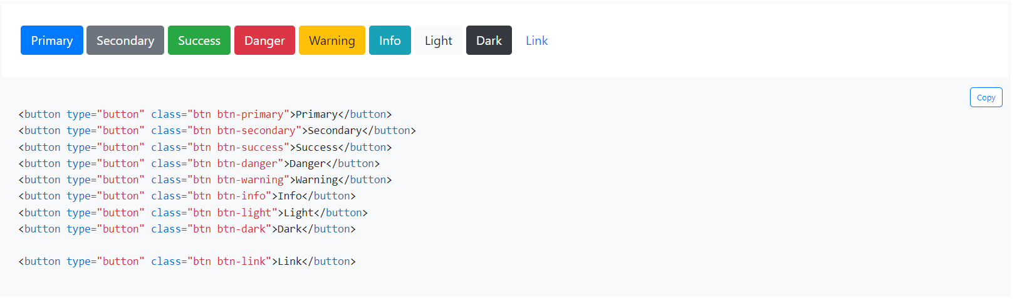
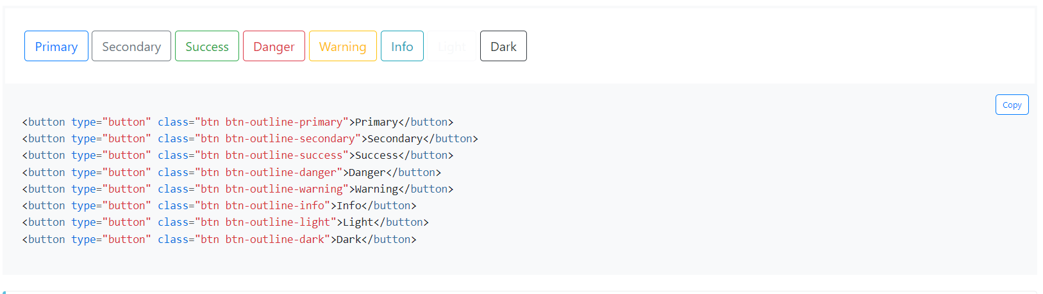
Components
Buttons
Bootstrap includes several predefined button styles, each serving its own semantic purpose, with a few extras thrown in for more control.

Slide 7
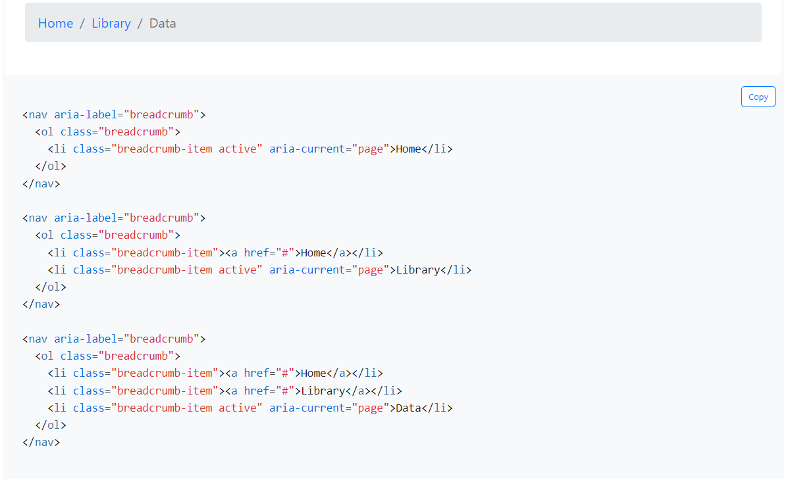
Breadcrumb
Indicate the current page’s location within a navigational hierarchy that automatically adds separators via CSS.

Slide 8
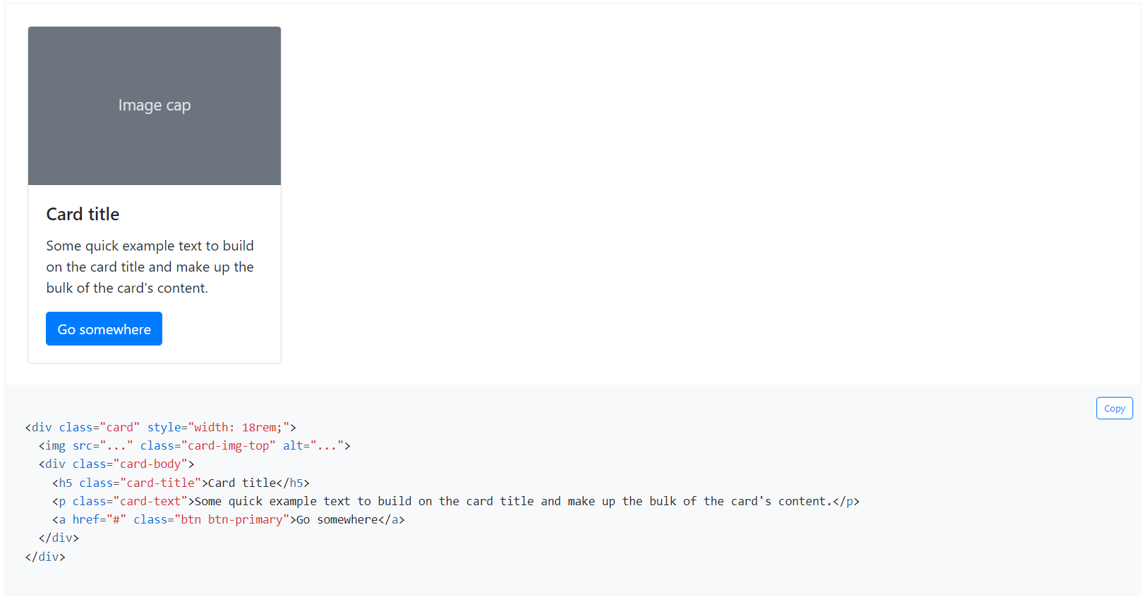
Card
A card is a flexible and extensible content container. It includes options for headers and footers, a wide variety of content, contextual background colors, and powerful display options.

Slide 9
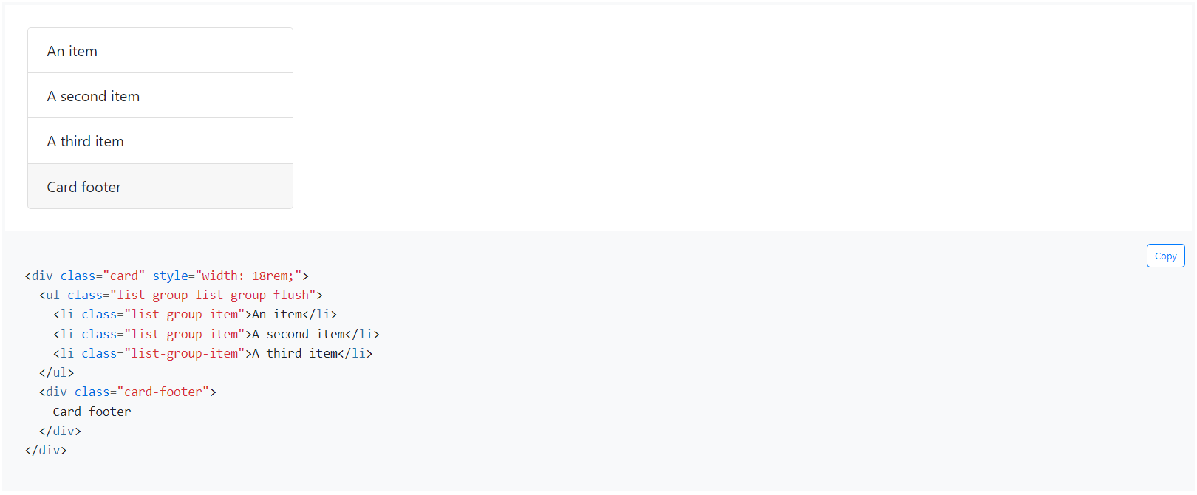
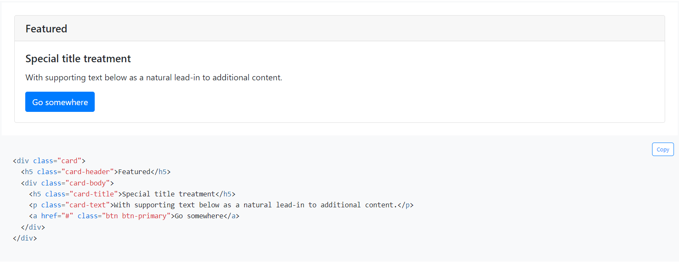
Card

Slide 10
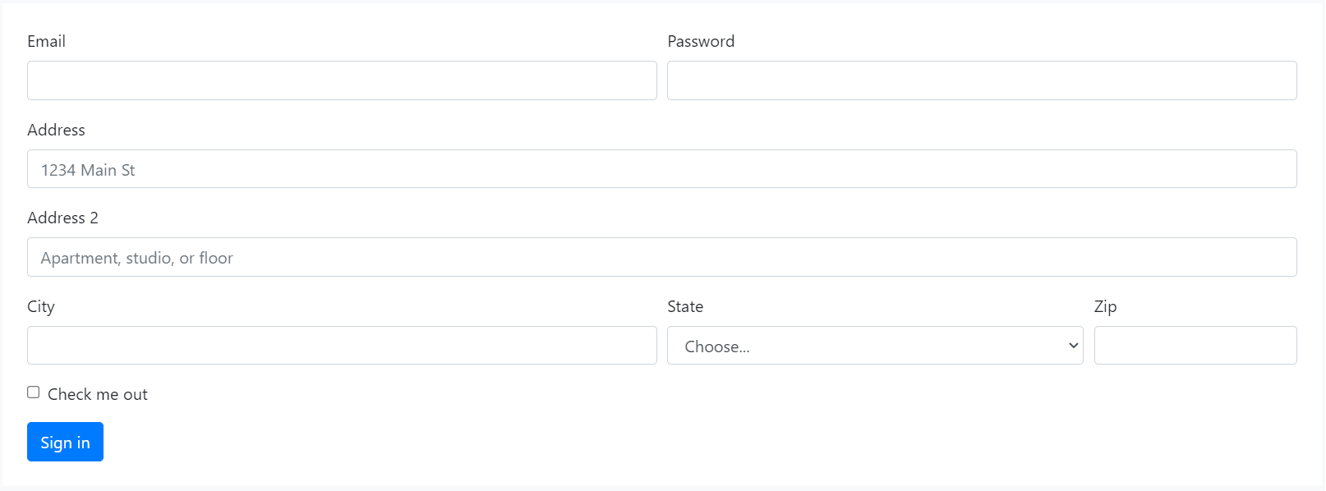
Forms
Bootstrap’s form controls expand on our Rebooted form styles with classes. Use these classes to opt into their customized displays for a more consistent rendering across browsers and devices.
Be sure to use an appropriate type attribute on all inputs (e.g., email for email address or number for numerical information) to take advantage of newer input controls like email verification, number selection, and more.

Slide 11
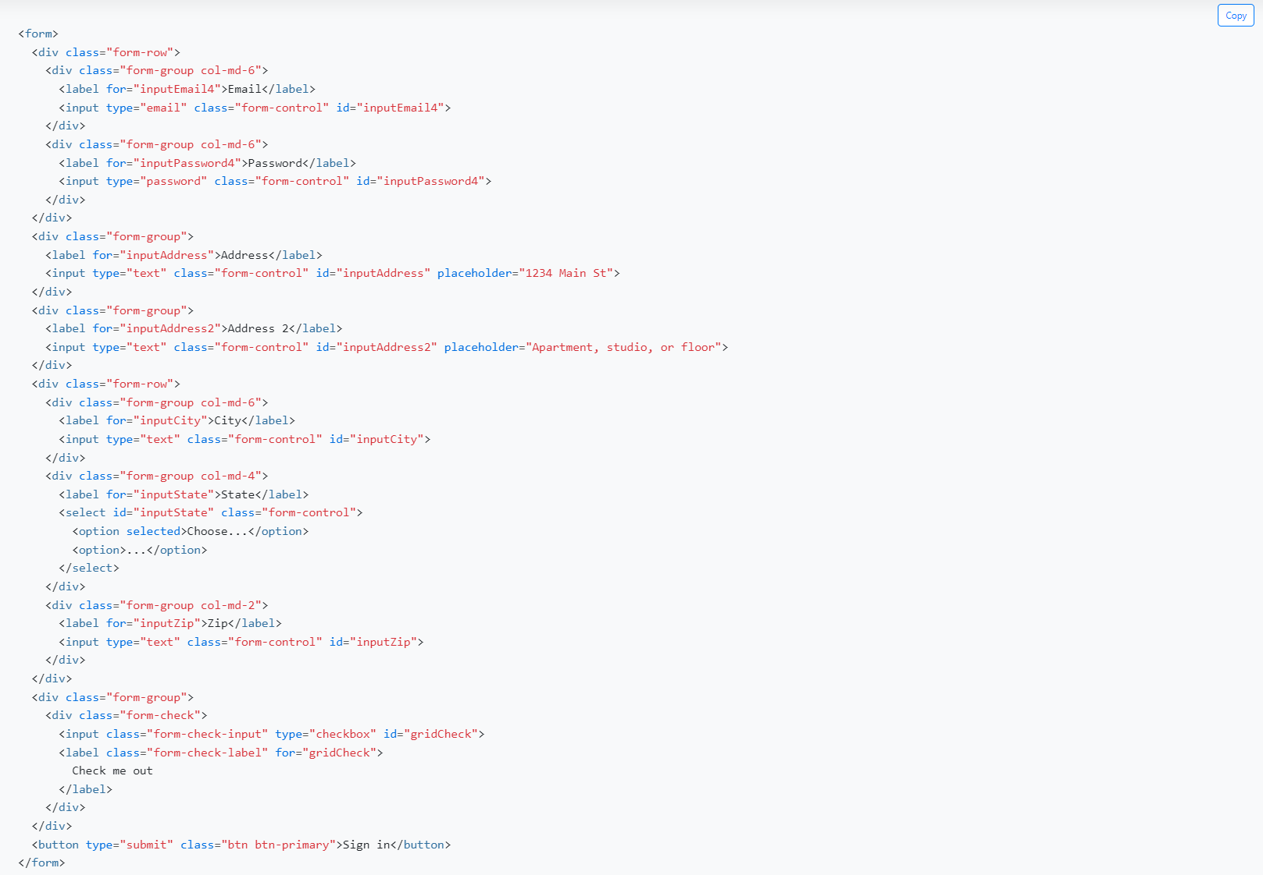
Forms

Slide 12
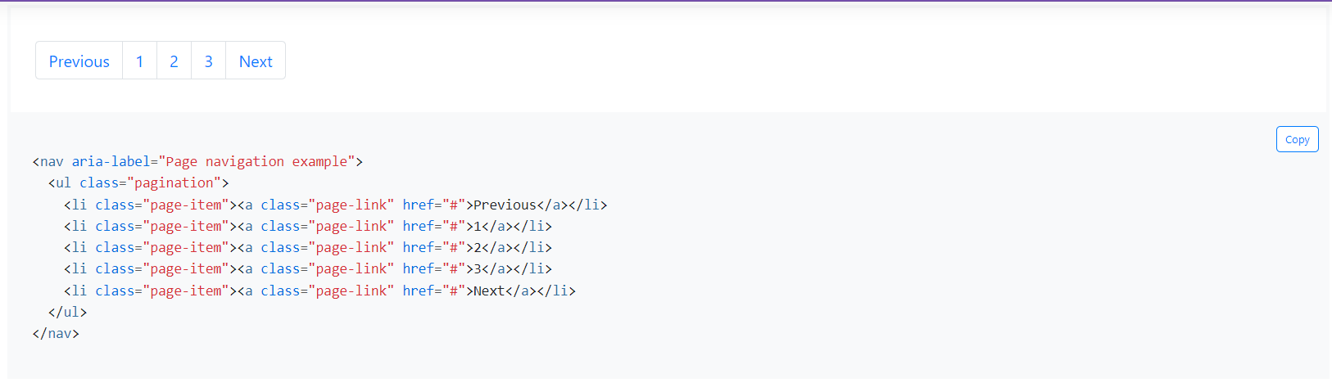
Pagination
We use a large block of connected links for our pagination, making links hard to miss and easily scalable—all while providing large hit areas. Pagination is built with list HTML elements so screen readers can announce the number of available links. Use a wrapping <nav> element to identify it as a navigation section to screen readers and other assistive technologies.

Slide 13
Progress
Documentation and examples for using Bootstrap custom progress bars featuring support for stacked bars, animated backgrounds, and text labels.
How it works
Progress components are built with two HTML elements, some CSS to set the width, and a few attributes. We don’t use the HTML5 <progress> element, ensuring you can stack progress bars, animate them, and place text labels over them.
We use the .progress as a wrapper to indicate the max value of the progress bar.
We use the inner .progress-bar to indicate the progress so far.
The .progress-bar requires an inline style, utility class, or custom CSS to set their width.
The .progress-bar also requires some role and aria attributes to make it accessible.

Slide 14
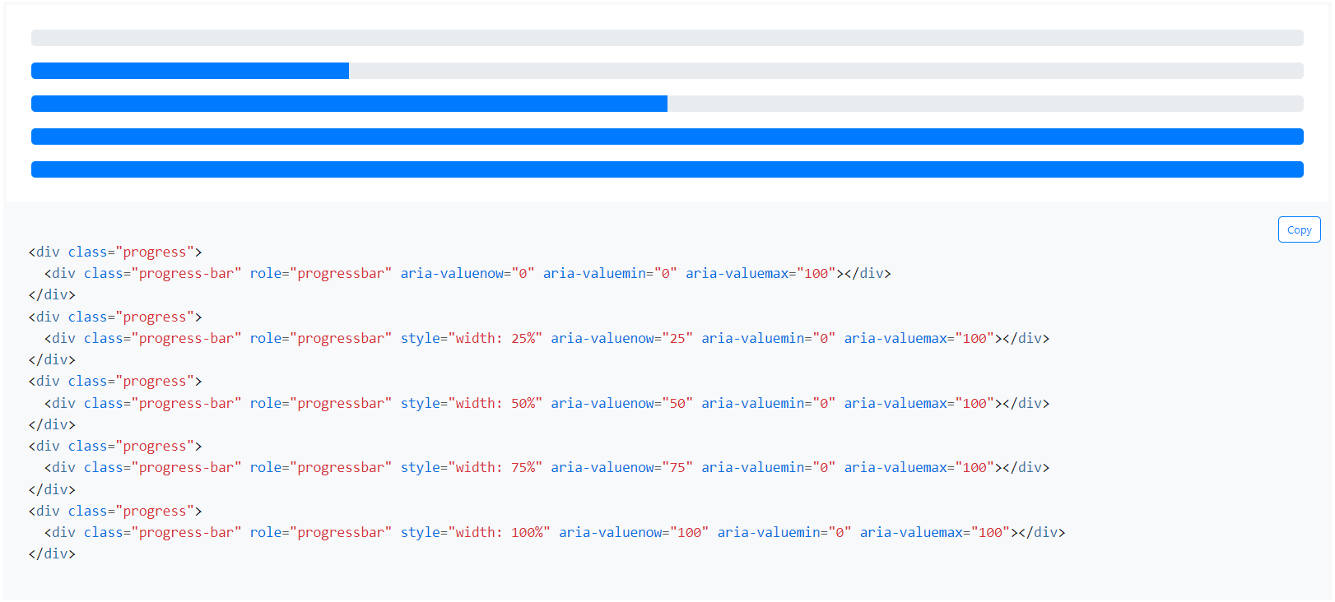
Progress

Slide 15
Model
Modals are built with HTML, CSS, and JavaScript. They’re positioned over everything else in the document and remove scroll from the <body> so that modal content scrolls instead.
Clicking on the modal “backdrop” will automatically close the modal.
Bootstrap only supports one modal window at a time. Nested modals aren’t supported as we believe them to be poor user experiences.
Modals use position: fixed, which can sometimes be a bit particular about its rendering. Whenever possible, place your modal HTML in a top-level position to avoid potential interference from other elements. You’ll likely run into issues when nesting a .modal within another fixed element.

Slide 16
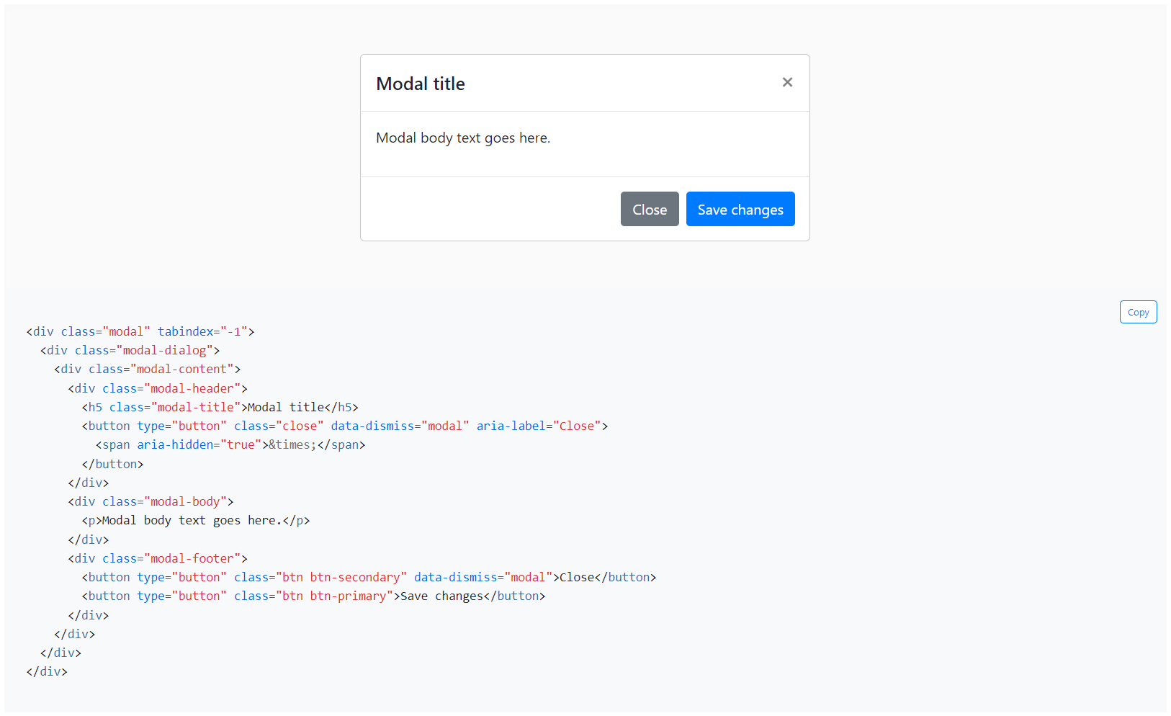
Model

Slide 17
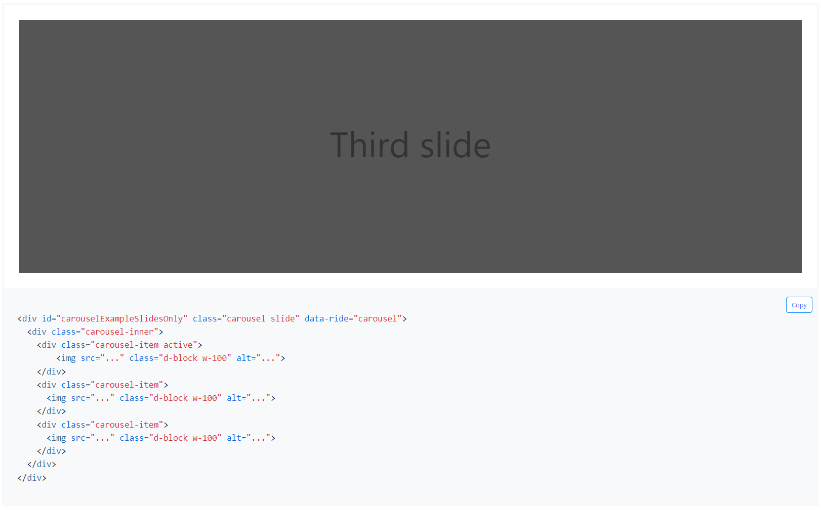
Carousel
A slideshow component for cycling through elements—images or slides of text—like a carousel.

Slide 18
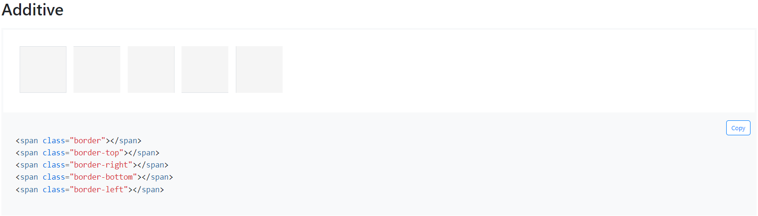
Border
Use border utilities to quickly style the border and border-radius of an element. Great for images, buttons, or any other element.

Slide 19
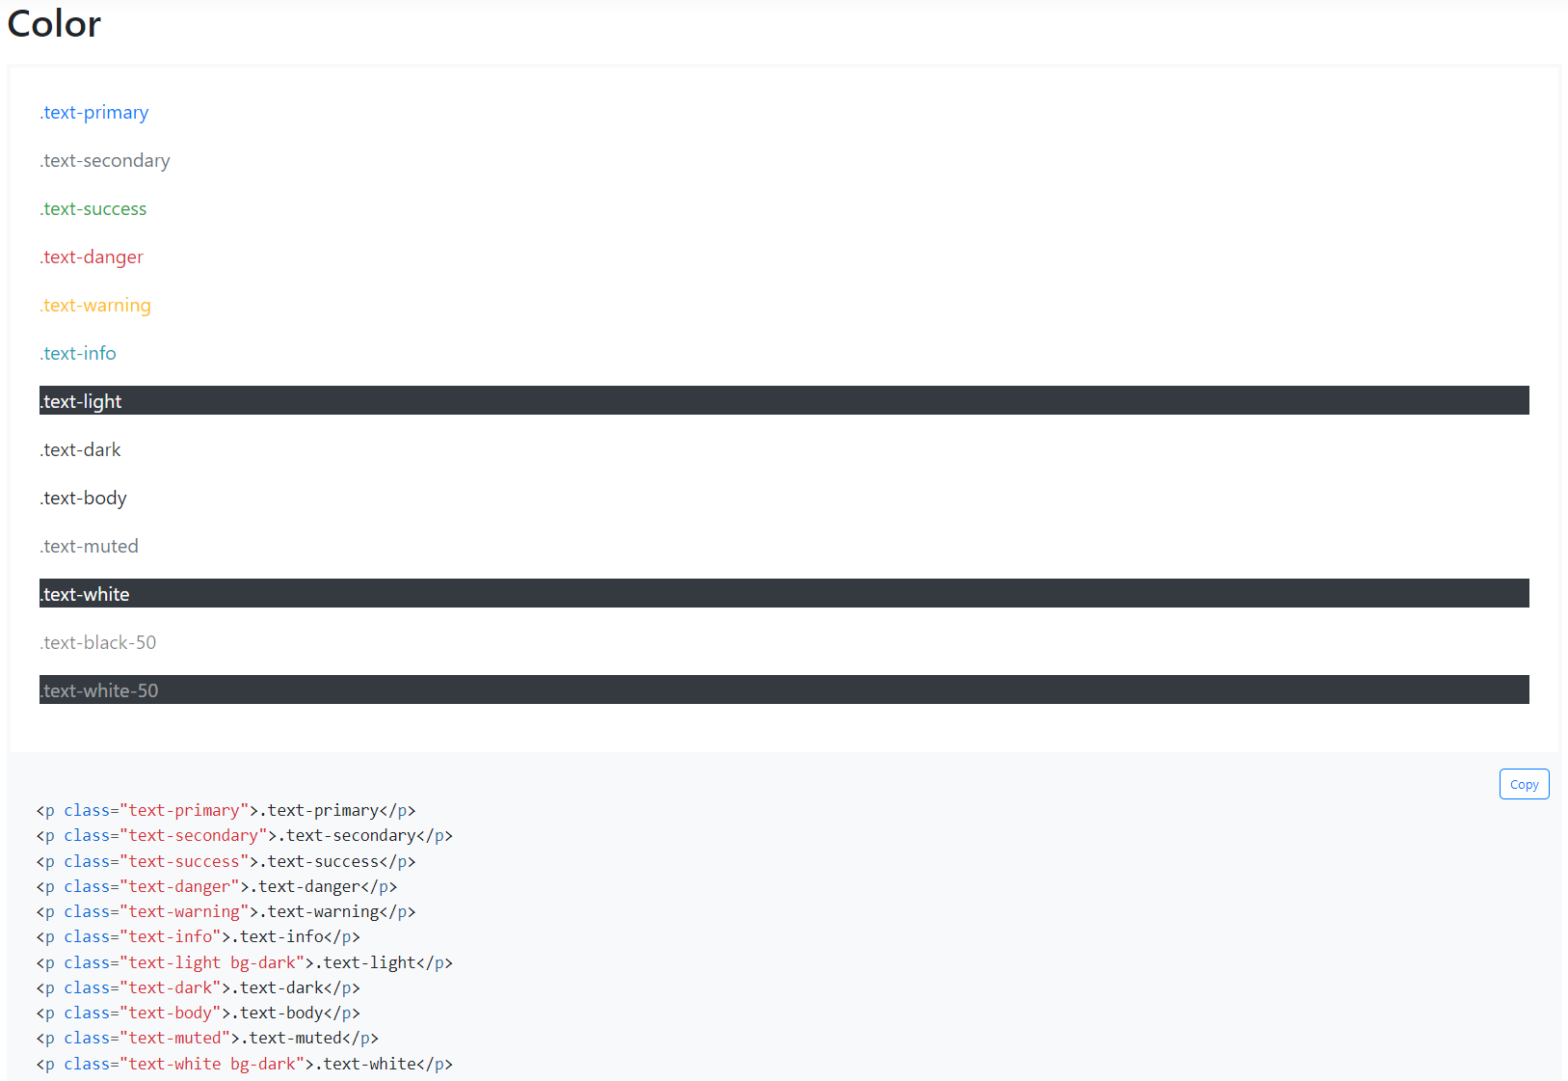
Colors
Convey meaning through color with a handful of color utility classes. Includes support for styling links with hover states, too.

Slide 20
Display
Quickly and responsively toggle the display value of components and more with our display utilities. Includes support for some of the more common values, as well as some extras for controlling display when printing.
Display utility classes that apply to all breakpoints, from xs to xl, have no breakpoint abbreviation in them. This is because those classes are applied from min-width: 0; and up, and thus are not bound by a media query. The remaining breakpoints, however, do include a breakpoint abbreviation.
none
inline
inline-block
block
table
table-cell
table-row
flex
inline-flex

Slide 21
Display
Hiding elements
For faster mobile-friendly development, use responsive display classes for showing and hiding elements by device. Avoid creating entirely different versions of the same site, instead hide elements responsively for each screen size.
To hide elements simply use the .d-none class or one of the .d-{sm,md,lg,xl}-none classes for any responsive screen variation.
To show an element only on a given interval of screen sizes you can combine one .d-*-none class with a .d-*-* class, for example .d-none .d-md-block .d-xl-none will hide the element for all screen sizes except on medium and large devices.
Hidden on all .d-none
Hidden only on xs .d-none .d-sm-block
Hidden only on sm .d-sm-none .d-md-block
Hidden only on md .d-md-none .d-lg-block
Hidden only on lg .d-lg-none .d-xl-block
Hidden only on xl .d-xl-none
Visible on all .d-block
Visible only on xs .d-block .d-sm-none
Visible only on sm .d-none .d-sm-block .d-md-none
Visible only on md .d-none .d-md-block .d-lg-none
Visible only on lg .d-none .d-lg-block .d-xl-none
Visible only on xl .d-none .d-xl-block

Slide 22
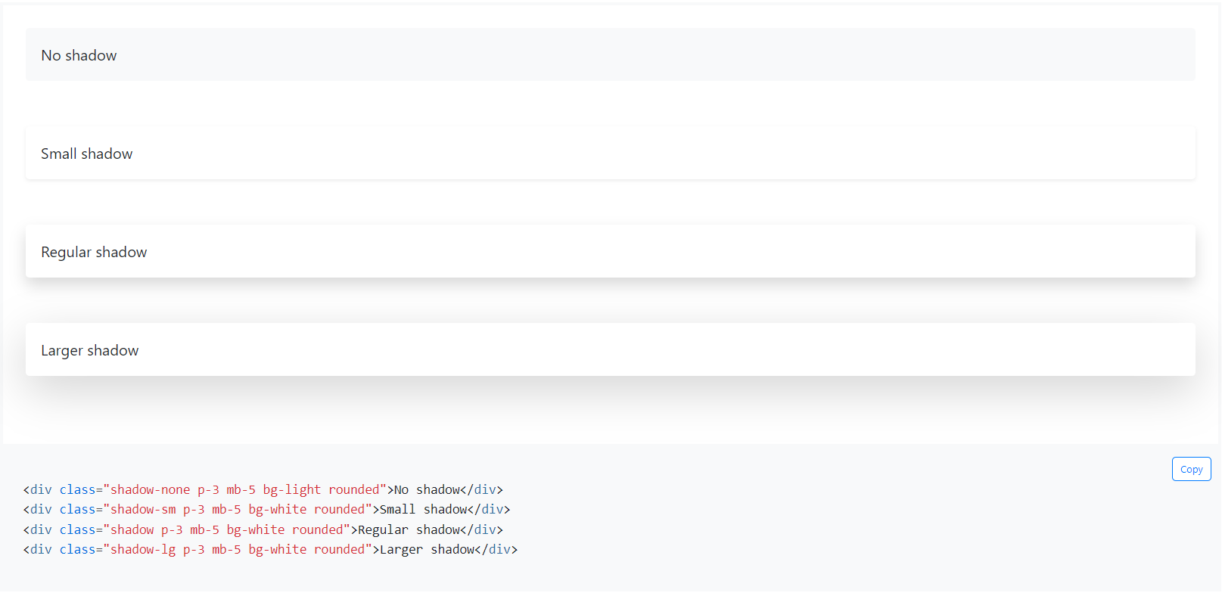
Shadows
Add or remove shadows to elements with box-shadow utilities.

Slide 23
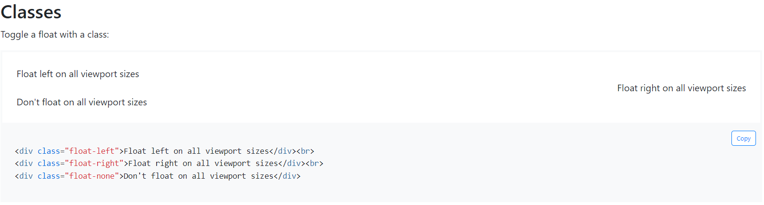
Float
Toggle floats on any element, across any breakpoint, using our responsive float utilities.
These utility classes float an element to the left or right, or disable floating, based on the current viewport size using the CSS float property. !important is included to avoid specificity issues. These use the same viewport breakpoints as our grid system. Please be aware float utilities have no effect on flex items.

Slide 24
Thank you
&
Any Questions.

