Slide 1

Exploratory Data Analysis of MTA Turnstiles
WomenTechWomanYes
SILA KAZAN
JUNE – 13 – 2021

Slide 2
INTRODUCTION
GOAL
Finding station with the highest weekly traffic
Optimizing the placement of Street Teams subway entrances.
APPROACH
Using MTA turnstile Data for Street Teams about find busiest entrances
OBJECTIVES
Finding most busiest subway stations
Reserch on the busiest day

Slide 3



METHODOLOGY
STEPS
Collect the data we need
Review data
Analysis of data
Visualization of data

Slide 4
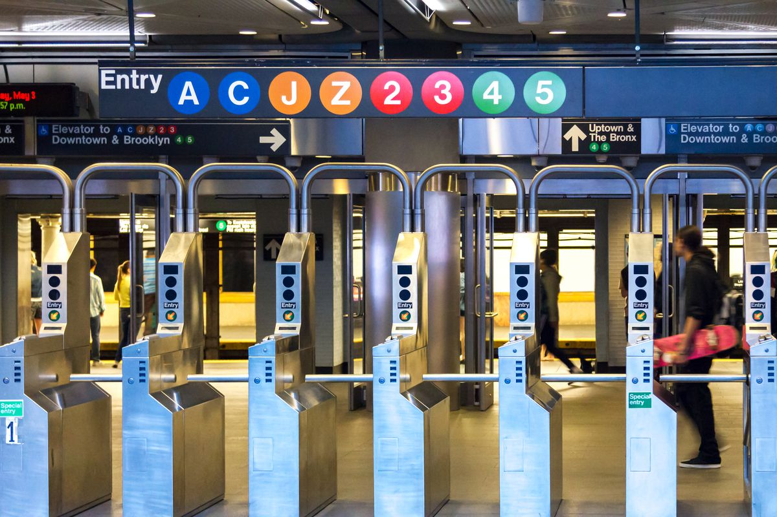

METHODOLOGY
Data set
MTA turnstile Data
Date: January 2019
TOOLS
Numpy, pandas, matplotlib, seaborn, python, jupyter

Slide 5
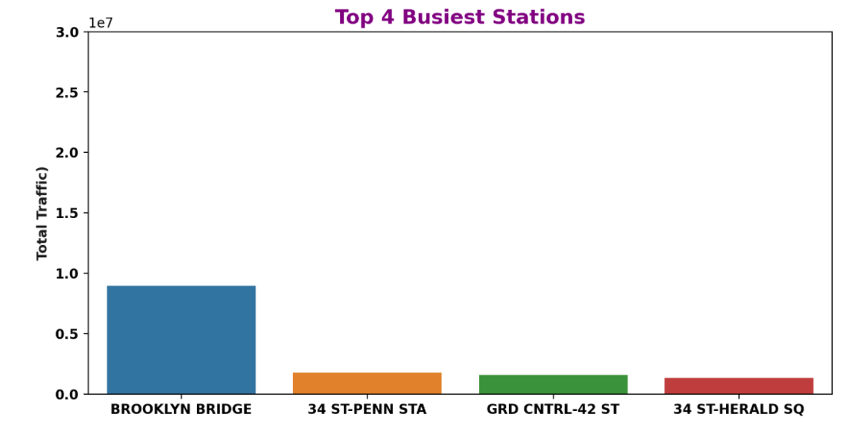
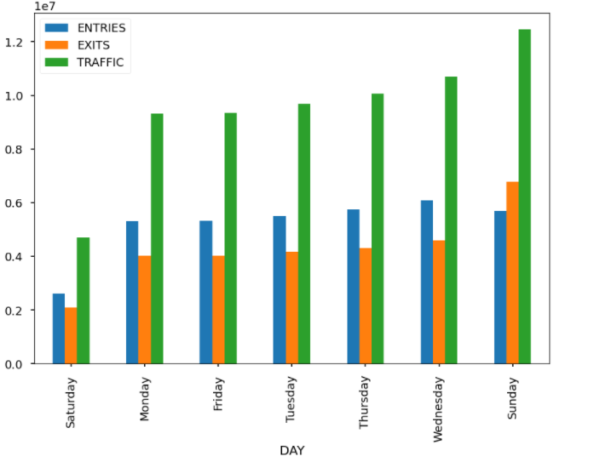
RESULTS
Result from the data
Most busiest station:
BROOKLYN BRIDGE
Most busiest day :
Sunday

Slide 6
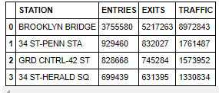
CONCLUSIONS
Busy 4 STATION

Slide 7
FUTURE WORK
More work can be worked on this project
Can be analyzed based on census data
(Using social media data)Social network : Meetup, Linkedin vb.
Locations of technology centers

Slide 8


THANK YOU….
https://github.com/silakazan
https://sila-kazan0626.medium.com/

