Slide 1
Safe aircrafts for expansion into aviation business

Slide 2
Overview
The presentation summarizes the findings from an analysis done of aviation accidents. The analysis aims to provide insights on which aircrafts are high risk and therefore a bad investment.
The insights can inform the organization on certain variables that make aircrafts safe and thus good investments.

Slide 3
Business questions
The analysis was based on the following questions:
Which aircraft is associated with the most accidents
During which phase of flight do most accidents occur?
Does the number of engines correlate with accident and severity of accidents?
What weather conditions are associated with most accidents?

Slide 4
Data understanding
Data source: National Transport Safety Board Dataset from 1962-2023
Data size: The data contained 88,889 records of aviation incidents
Key Variables included
Broad phase of accident
Weather conditions
Make and model of aircrafts
Number of engines

Slide 5
Data analysis
The data was loaded onto Jupyter Notebook for data cleaning and analysis
Data cleaning done by:
Removing columns with >50% missing data
Dropping columns not needed for analysis
Dropping duplicates

Slide 6
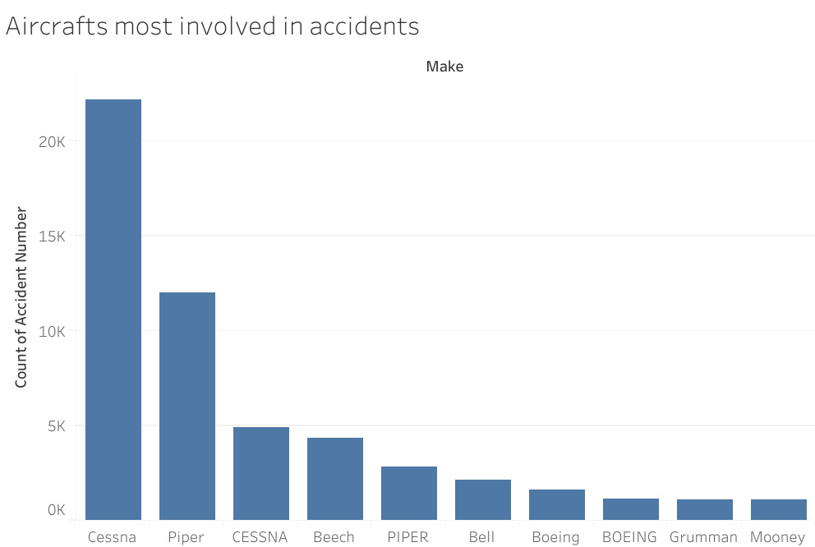
Aircrafts most involved in accidents
Cessna Aircrafts were the most accident prone when compared to other makes

Slide 7
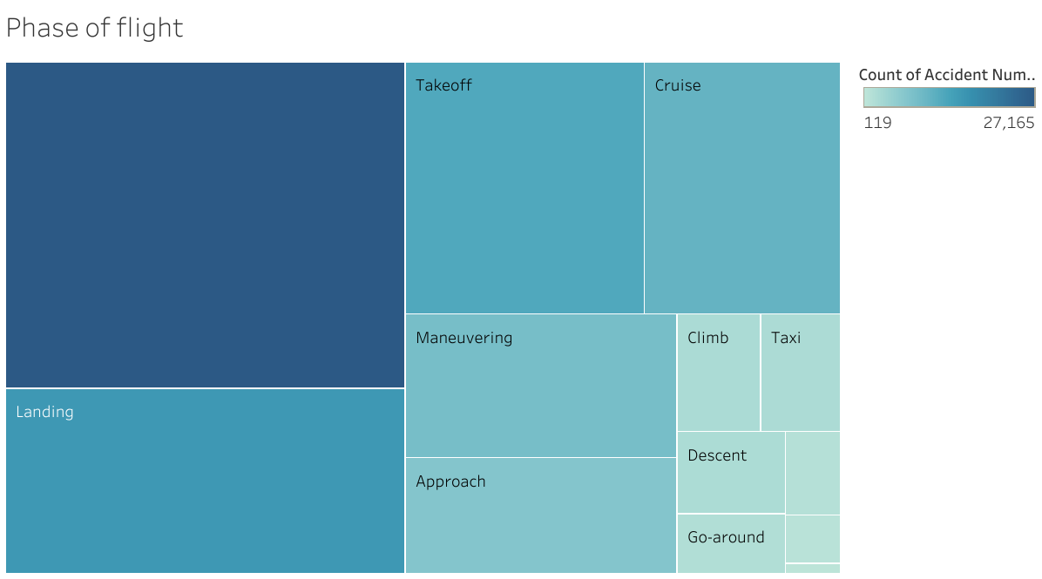
Phase of flight associated with most accidents
Notes:
The take off and landing stages were associated with high numbers of accidents. Null had the most accidents and points to poor data entry or inconclusive information to make a determination on the stage of flight.

Slide 8
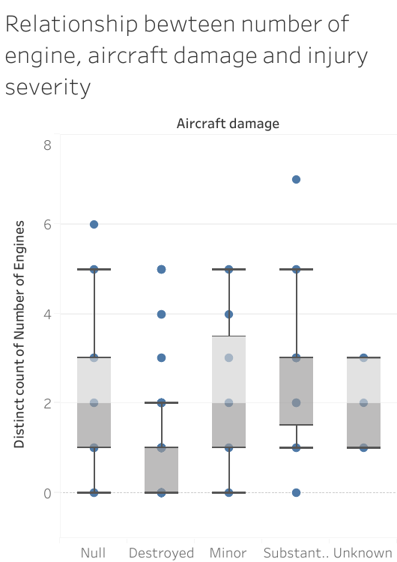
Is there a relationship between engine number, aircraft damage and injury severity
Notes:
In general, aircrafts with higher more engines were associated with less aircraft damage as well as severe injuries.

Slide 9
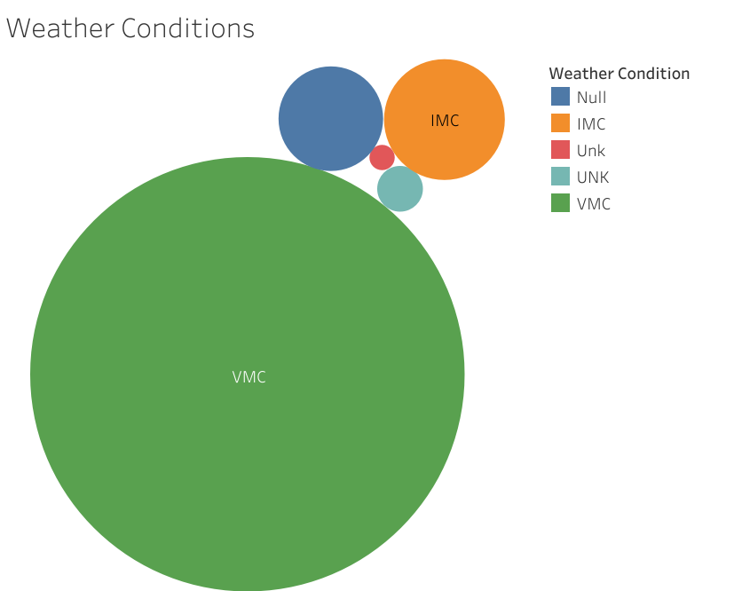
Weather conditions associated with accidents
Notes:
Most accidents occurred when pilots relied on visual cues to navigate as opposed to using the cockpit instruments for navigation.

Slide 10
Recommendations
The following are recommendations based on the data analysis done
Invest in reinforcing pilot training especially drills for take off, maneuvering and landing, where accidents tend to occur.
Purchase larger aircrafts with more engines as they are safer compared to single engines
Invest in installing the most UpToDate meteorological instruments to reinforces the use of IMC for navigation

Slide 11
Next steps
Next steps could include
Conducting a feasibility study of best airports to set up the business

Slide 12
THANK YOU
Any Questions?
Find me at:
Email: sila.j.monthe@gmail.com
LinkedIn: Sila Monthe

