Slide 1
GlucoTwin AI 2.0
Personalized Diabetes Digital Twin · Happiest Health Digital Twin Challenge 2026
Project owner / team leader: SILAMBARASAN C
Muthayammal Engineering College · Tamil Nadu, India
Research prototype · all included demo data is synthetic
Not a medical device; not for diagnosis or care decisions
GLUCOTWIN AI · RESEARCH PROTOTYPE · SYNTHETIC DATA · 01 / 15

Slide 2
The healthcare problem
Glucose varies over time; retrospective review may not express a near-term individualized pattern.
Historical health context and current readings are often reviewed separately.
A useful prototype should make time, data freshness, and missingness visible.
This project demonstrates a technical workflow, not proven patient benefit.
GLUCOTWIN AI · RESEARCH PROTOTYPE · SYNTHETIC DATA · 02 / 15

Slide 3
Proposed solution
Link an anonymous profile to historical context and a dynamic observation timeline.
Store age, BMI, diabetes duration, and HbA1c only when available.
Append timestamped glucose, heart rate, sleep, and step counts.
Estimate a bounded future event and return input timestamp, warnings, and a safety disclaimer.
GLUCOTWIN AI · RESEARCH PROTOTYPE · SYNTHETIC DATA · 03 / 15

Slide 4
Why a digital twin?
An inspectable, updateable representation of a person's stored state.
Historical attributes and changing observations remain linked by anonymous patient ID.
Clinicians/evaluators can inspect the records behind a model output.
This is a data twin proof of concept, not a full physiological replica.
GLUCOTWIN AI · RESEARCH PROTOTYPE · SYNTHETIC DATA · 04 / 15

Slide 5
Two data streams
Static context + dynamic time-series observations.
Static: age, BMI, optional HbA1c and diabetes duration.
Dynamic: timezone-aware glucose and optional heart rate, sleep, and activity.
Synthetic trajectories are generated reproducibly and explicitly marked; no public or patient data is bundled.
GLUCOTWIN AI · RESEARCH PROTOTYPE · SYNTHETIC DATA · 05 / 15

Slide 6
System architecture
Validate → persist → engineer past-only features → infer → inspect.
FastAPI request schemas validate units, ranges, timestamps, and duplicate source records.
SQLite stores anonymous profiles, readings, and predictions.
A separate offline pipeline saves a trusted joblib artifact and held-out evaluation report.
See docs/architecture_diagram.pdf and editable docs/architecture_diagram.svg.
GLUCOTWIN AI · RESEARCH PROTOTYPE · SYNTHETIC DATA · 06 / 15

Slide 7
Dataset and ethics
48,384 synthetic readings · 36 generated profiles · 14 days · 15-minute intervals.
Fixed seed 20260626; simplified meal pulses, circadian variation, noise, activity, sleep, and static attributes.
Assumptions are software-test fixtures, not a clinical simulator.
No external/public dataset was supplied or used; all demo records are labelled synthetic.
GLUCOTWIN AI · RESEARCH PROTOTYPE · SYNTHETIC DATA · 07 / 15

Slide 8
Past-only feature engineering
Use current and earlier observations as inputs; reserve future glucose for labels only.
Current glucose, 15- and 60-minute changes, 60-minute mean, and 120-minute variability.
Heart rate, sleep, trailing steps, optional BMI/HbA1c, and time-of-day encoding.
Training-fitted median imputation; irregular 15-minute training cadence is rejected.
GLUCOTWIN AI · RESEARCH PROTOTYPE · SYNTHETIC DATA · 08 / 15

Slide 9
Target and training design
Prototype label: any of the next eight 15-minute glucose readings reaches ≥180 mg/dL.
This is an explicit project target, not a universal medical standard.
Patient-group holdout: 21 train, 7 validation, 8 test profiles.
Prior baseline, Logistic Regression, and Random Forest compared; selected on validation PR-AUC.
Training-only class weighting; no test-set tuning; default threshold 0.5 is reported.
GLUCOTWIN AI · RESEARCH PROTOTYPE · SYNTHETIC DATA · 09 / 15

Slide 10
Model selection and results
Actual generated results are reported only when the evaluation artifact exists.
Validation PR-AUC: prior 0.2630; logistic 0.6577; Random Forest 0.8548.
Selected by validation PR-AUC: random_forest.
Held-out test at fixed 0.5: precision 0.7781; recall 0.5590; F1 0.6506.
PR-AUC 0.7983; ROC-AUC 0.9339; n=10,688 rows from 8 held-out synthetic profiles.
Confusion matrix [[TN, FP], [FN, TP]]: [[8106, 355], [982, 1245]].
These are synthetic-only results, not clinical validation; the test was not used for model selection.
GLUCOTWIN AI · RESEARCH PROTOTYPE · SYNTHETIC DATA · 10 / 15

Slide 11
Prediction workflow
Latest readings → past-only feature row → model score → persisted response.
API returns patient ID, prediction time, 120-minute horizon, event definition, and model version.
Response includes uncalibrated raw score, input timestamp, observed signals, global model ranking, quality warnings, and disclaimer.
If training was not completed, inference returns a clear service error and training command.
GLUCOTWIN AI · RESEARCH PROTOTYPE · SYNTHETIC DATA · 11 / 15

Slide 12
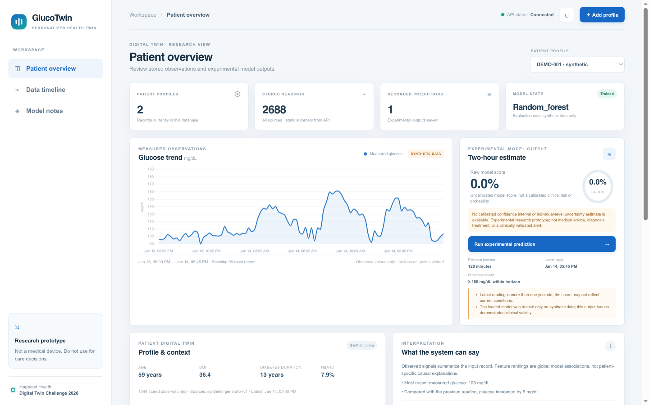
Dashboard walkthrough
The browser dashboard reads patient, observations, score history, and evaluation from FastAPI.
Select backend-returned profiles; inspect measured-only glucose chart and source timeline.
Add a manual observation without a fake sensor connection.
Review stale/missing context, synthetic labels, score limitations, and backend evaluation.
Actual prototype UI · synthetic demo records · local capture
GLUCOTWIN AI · RESEARCH PROTOTYPE · SYNTHETIC DATA · 12 / 15

Slide 13
Synthetic patient example
A generated synthetic profile; the prediction is an experimental model output.
Generated synthetic profile SYN-033; measured input at 2025-01-10T13:00:00Z was 176.5 mg/dL.
Actual saved model returned raw score 0.9916; uncalibrated, not an individual clinical probability.
The simulated next-eight-row target is positive at this point. This historical synthetic example is stale and is not a current reading or care recommendation.
GLUCOTWIN AI · RESEARCH PROTOTYPE · SYNTHETIC DATA · 13 / 15

Slide 14
Limitations and next steps
The current score does not establish safety, usefulness, or generalization.
Only synthetic data; simplified generator; one project-defined threshold; small number of held-out synthetic profiles.
No external validation, calibration, confidence interval, subgroup analysis, clinical review, or prospective evaluation.
No authentication or production security; SQLite is local demonstration storage.
Next: licensed representative data, ethics/clinical review, external validation, calibration, subgroup evaluation, and security controls.
GLUCOTWIN AI · RESEARCH PROTOTYPE · SYNTHETIC DATA · 14 / 15

Slide 15
Conclusion and references
A reproducible full-stack technical proof of concept, not a clinical product.
Project documentation: README, model card, data dictionary, limitations, and 21-minute demo script.
References: FastAPI documentation; scikit-learn documentation; SQLite documentation; Chart.js documentation.
Team leader must verify submission rules, add only confirmed team details, and insert actual repository/video links.
Thank you · Happiest Health Digital Twin Challenge 2026
GLUCOTWIN AI · RESEARCH PROTOTYPE · SYNTHETIC DATA · 15 / 15

