Slide 1
THE BEST PLACE TO OPEN A GYM IN FLORIDA
Author: Boris Silantev

Slide 2
STAKEHOLDERS
Investors of any size who wants to find a place to open a new gym
Owners and managers of fitness clubs chains in Florida
Other stakeholders related to fitness business

Slide 3
DATA
Demographics and business information according to Census 2010 and Business Census 2011
Individual income tax statistics for 2016
Information about the venues from Foursquare
In total 151 features of 917 zip code areas

Slide 4
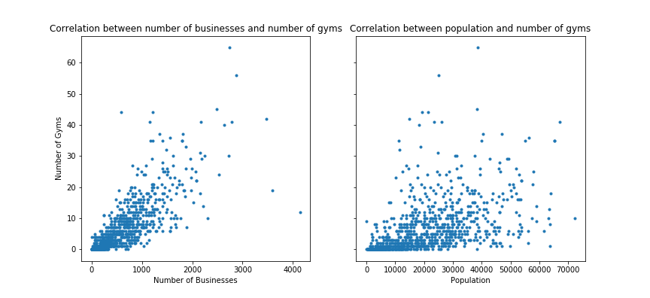
THE NUMBER OF BUSINESSES IMPACTS ON THE NUMBER OF GYMS MORE THAN POPULATION

Slide 5
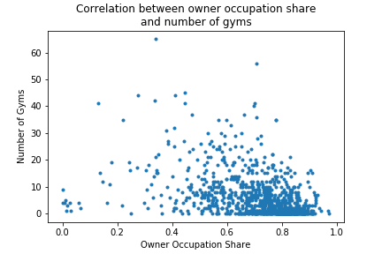
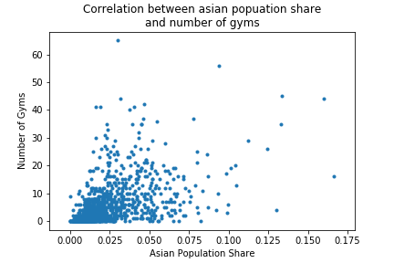
THE MORE ASIAN POPULATION SHARE THE MORE NUMBER OF GYMS
WHERE PEOPLE PREFER TO LIVE RATHER TO RENT THERE ARE LESS GYMS

Slide 6
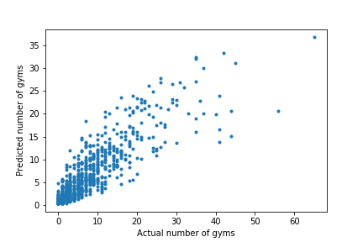
PREDICTIVE MODEL
Applied types of models: gradient boosting regressor, random forest regressor, blending of two models
Final choice:
gradient boosting regressor
learning_rate=0.0085
subsample=0.22
max_features=0.63
max_depth=7
n_folds=4
n_splits=5

Slide 7
THE FEATURES THAT HAVE THE GREATEST INFLUENCE ON THE NUMBER OF GYM
Number of businesses (as well as related Number of Employees, Annual Payroll, Number of Business Mailboxes etc.)
Number of restaurants
Asian population share
Owner occupation share
Land area
Number of residents with annual income over $ 200,000

Slide 8

THE INDEX
$$Index=\frac{Predicted number}{Actual number +1}$$
Index is a numerical evaluation of the area potential to open the fitness/gym. The higher index the higher potential.
“+1” in the denominator is used because any new opening will change the actual number of gyms

Slide 9
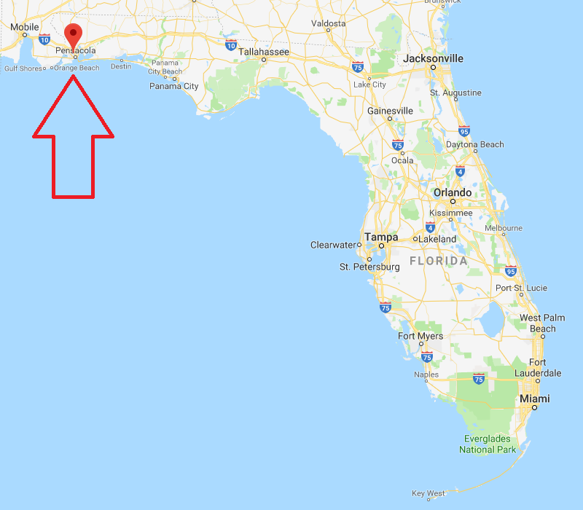
ZIP CODE 32505
City: Pensacola
Population: 30,559
Number of Businesses: 724
Number of Employees: 8,416
8 resturants: Greek Restaurant, Indian Grill, Fishing Hole, Mexican Restaurant, 2 Captain D's and 2 McDonald's
Golf Course, Bowling Alley, SUBWAY and Ross Dress for Less
Number of Gyms: 0
Index: 4,69
Best place in Florida to open a new fitness club or gym

Slide 10
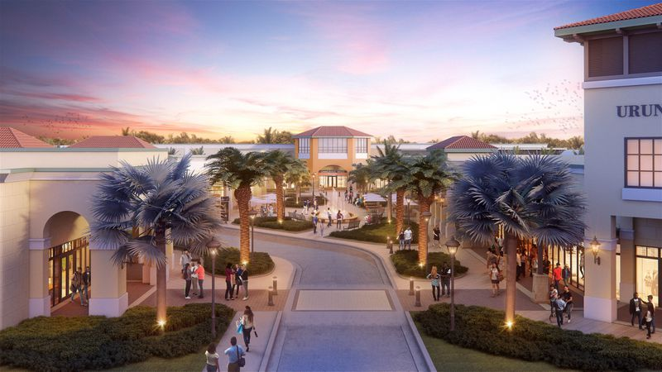
ZIP CODE 33323
City: Fort Lauderdale
Population: 24,455
Number of Businesses: 1,141
Number of Employees: 31,564
3 shopping malls: The Colonnade Outlets, Oasis At Sawgrass and Sawgrass Mills
A lot of resturants and stores
Number of Gyms: 3
Expected number of Gyms: 12
Index: 3,01
Place with great opportunities to open a new gym

Slide 11
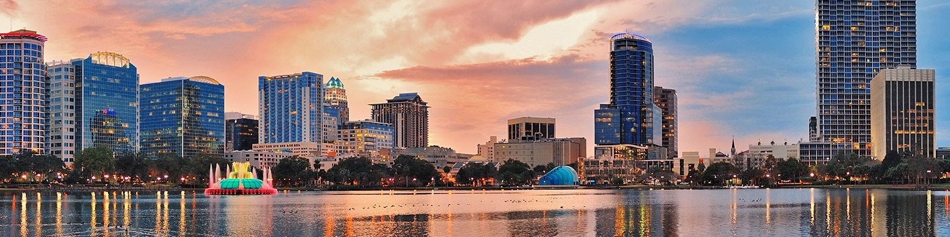
ZIP CODE 32801
City: Orlando (Downtown)
Population: 16,028
Number of Businesses: 1,845
Number of Employees: 30,464
Number of Gyms: 19
Expected number of Gyms: 24
Index: 1,20
Good place to open the new gym or fitness club

Slide 12
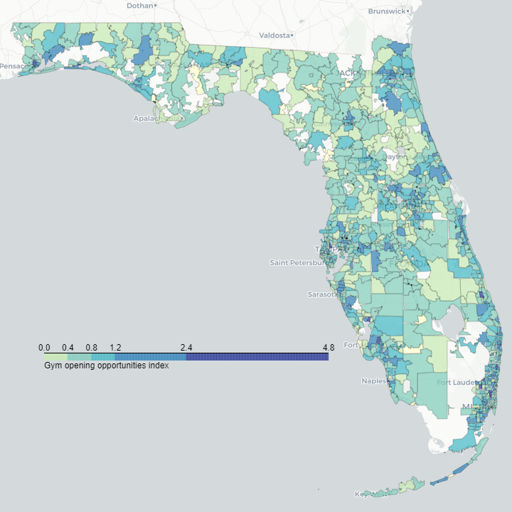
Florida Map
There are enough places in Florida with a lack of gyms
The zones of opportunities are distributed throughout the state
Choosing the place for gym you can numerically evaluate the potential of this area

Slide 13
CONCLUSION
I collected information about Florida by zip codes
I created the model that predicts the number of gyms based on the demographics, taxes statistics and other information
I calculated gym opening potential index by zip codes
There are enough ideas to improve this research

