Slide 1
The Turbulent Journey: How COVID-19 Reshaped the U.S. Domestic Airline Industry
AI Boot Camp Project 1
Team Members:
Silas Philips
Christoph Guenther
Ava Lee
Jed Murphy

Slide 2
Covid-19 and Domestic Air Travel
Purpose:
The U.S. domestic airline industry experienced an unprecedented crisis during the COVID-19 pandemic. Our analysis of flight data from January 2018 to September 2023 reveals the profound impact of the pandemic on air travel.
Background:
As the virus spread globally in early 2020, travel restrictions and fear of infection led to a drastic decline in the number of flights and passengers. The data showcases that the enplaned passengers and number of flights reached record lows during the peak of the pandemic. We will also demonstrate the impact of canceled flights and the relationship between average delay and enplaned passengers. Additionally, we will provide insights into what passenger traffic has been like post-pandemic.

Slide 3
Our Goal:
Our goal is to determine how Covid 19 impacted the domestic airline market.
Can We Measure the Impact?
Questions to be Addressed:
How did Covid 19 impact the 10 largest US airports in terms of passenger volume?
How long did it take for passenger volume to normalize after Covid 19 at the 10 largest US airports?
Did average airfare change at the 10 largest US airports during Covid?
If it changed, when did it change as compared to when passenger volume changed?
If it changed when did average airfare normalize?
Can we define Covid19 by the drop off in passenger volume?
Is there a correlation between Covid19 and the number of flights?

Slide 4
Data Collection
Where Did We Source Our Data?
Bureau of Transportation Statistics (BTS):
Provides extensive data on US flights, including on-time performance, delays, cancellations, and more.
Aviation Edge:
Offers a suite of APIs providing access to various aviation-related data, including flight schedules, tracking, airport, and aircraft data.
Aviationstack:
Provides a powerful flight data API offering real-time and historical flight information, including tracking, status, routes, and airline details.
FAA:
Offers a comprehensive dataset of airline routes, airports, and schedules freely available for download, useful for researchers and developers.
Transportation.gov:
Offers multiple data sets.

Slide 5
How Did We Prepare the Data?
Cleanup and Exploration Approach
Clean up missing values, outliers, and duplicates data.
Normalize or scale numerical features for diagrams.
Calculate summary statistics for numerical features.
Explore the distribution of numerical features using histograms, box plots, or violin plots.
Examine the frequency distribution of categorical features using bar plots or count plots.
Correlate analysis to detect patterns within time series data.
Create geographical visualizations using maps to analyze spatial data.
Use advanced plotting libraries like Plotly or Seaborn for more customized visualizations.

Slide 6
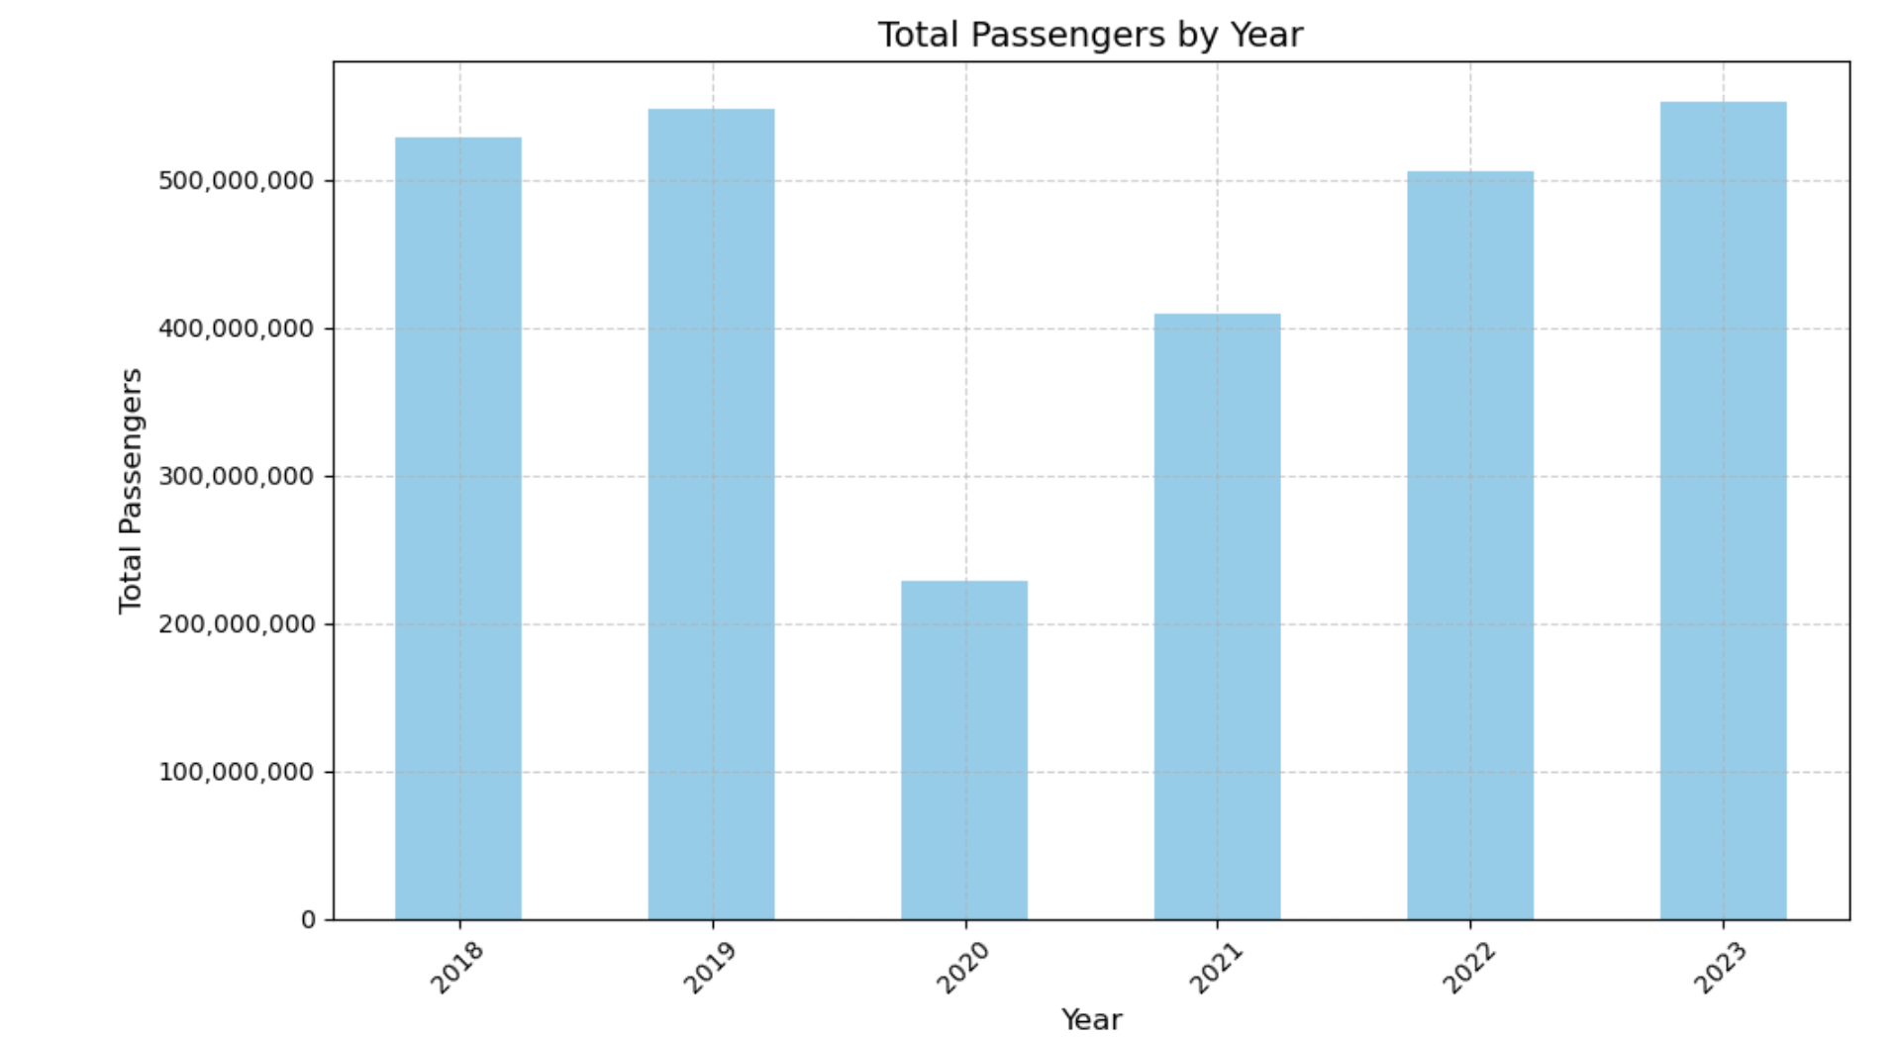
Passenger Volume
2020 saw a drastic cut in the total number of passengers taking flights
According to data from the Bureau of Transportation Statistics (BTS), the total number of passengers flying on U.S. airlines plummeted from (X) million in January 2020 to a mere (X) million in April 2020 – a staggering ()% decline.

Slide 7
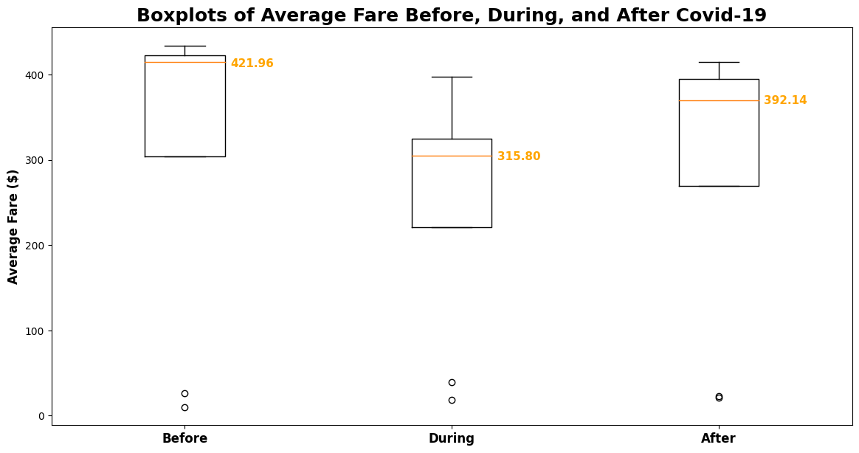
Changes to Airfare
The price of airfare dropped during the Covid pandemic but rebounded in 2021
In the initial months of the pandemic, airfares dropped significantly as airlines tried to stimulate demand and fill empty seats. According to data from the BTS, the average domestic airfare in the second quarter of 2020 was $(X), a (X) % decrease from the same quarter in 2019.

Slide 8
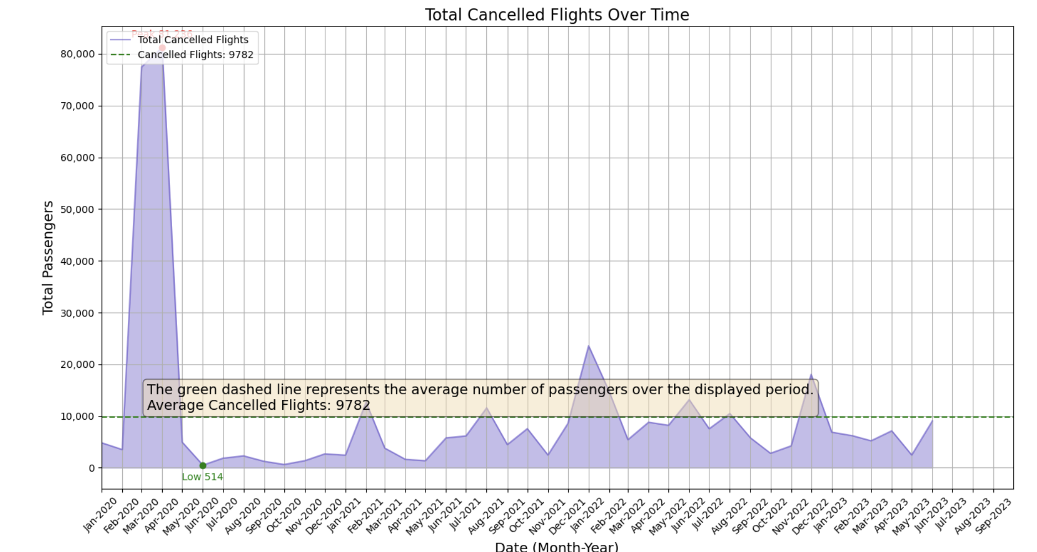
Cancellations
As the lockdown went into effect flight cancellations grew
In the early months of the pandemic, airlines were forced to cancel a substantial number of flights due to the abrupt decline in passenger demand and the implementation of travel restrictions. According to BTS data, the cancellation rate for U.S. domestic flights reached % in April 2020, compared to just % in April 2019.

Slide 9
First
Summary
Second

Slide 10
Main Issues While Conducting Research
What Problems Did We Encounter?
Storage issues with GitHub. GitHub has 1G storage limitation. Because the amount of data we are working with is well beyond that, we believed that the data was corrupted. This resulted in hours spent finding what turned out to be a simple solution.
The datasets were so large we had issues downloading them to our local machines.
Airline dataset specifics are not available unless we wanted to pay. Airfare information is only available by quarter. All additional information is available by month.

Slide 11

What Additional Questions Arose During Our Research? What Would We Do With More Time?
Where Do We Go From Here?
How were the industry adjustments made during Covid reflected in customer satisfaction?
Is there a correlation between how fast an airport recovered and how heavy the local Covid restrictions were?
How would this same analysis reflect being conducted internationally?
Of the profits lost during Covid, how much was recouped by the 2020 government bailout and subsequent PPP loans?

