Slide 1

melding data with social justice in undergraduate statistics and data science courses
Silas Bergen
Winona State University; Winona, MN, USA
IASE Roundtable 2016
Berlin, Germany

Slide 2
SOCIAL JUSTICE
“justice in terms of the distribution of wealth, opportunities, and privileges within a society.”

Slide 3
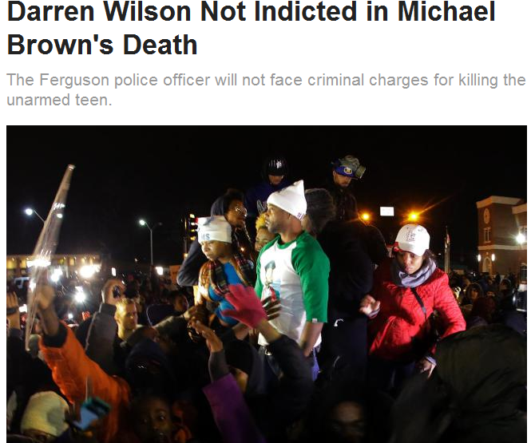
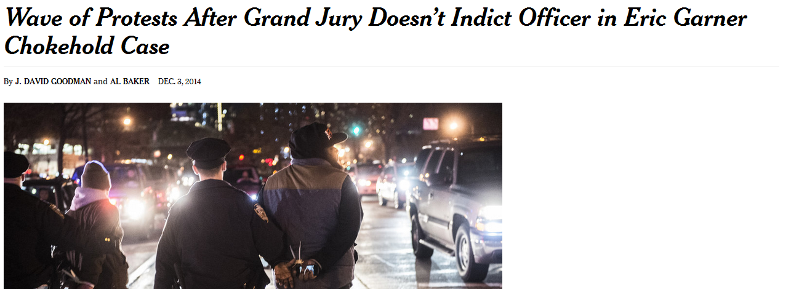
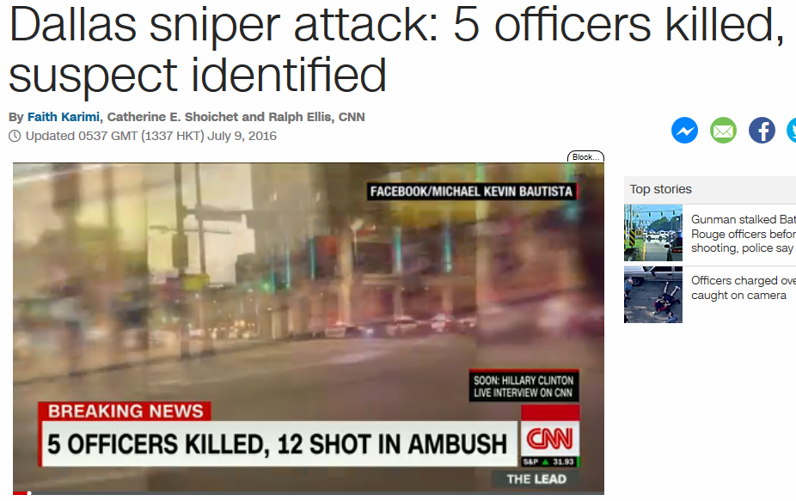
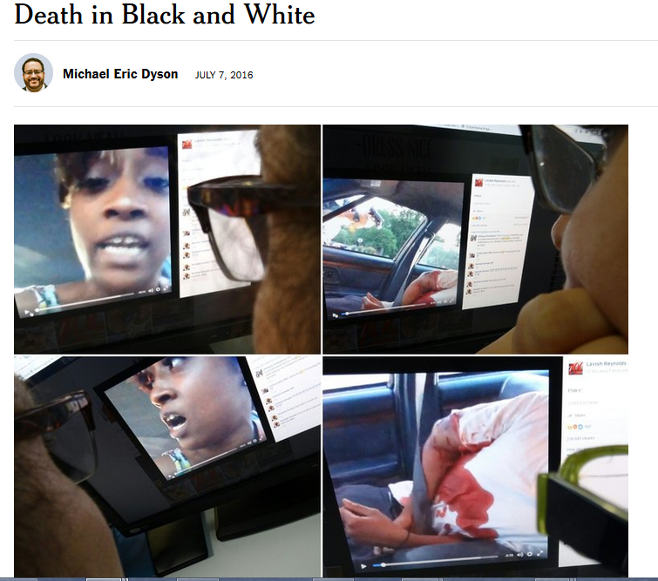
#BlackLivesMatter
#AllLivesMatter

Slide 4
Class description
Introductory statistics course:
Graphical methods
Fisher’s Exact Test
Chi-square test of association
Two-sample t-test
~37 students per section

Slide 5
Goals:
Promote growth in quantitative proficiency
Always using real, publicly-available data
Educate about social inequity
Foster reflection on learning…
…for both students and myself!

Slide 6
Introductory statistics: Project #1
Promote growth in quantitative proficiency
Graphical procedures
Chi-square test of association
Two-sample t-test
95% Confidence intervals for differences in means and proportions
Educate about social inequity
Learn about the “Life-course framework” and structural racial inequity
Reflect on findings…
…through pre- and post- project questions

Slide 7
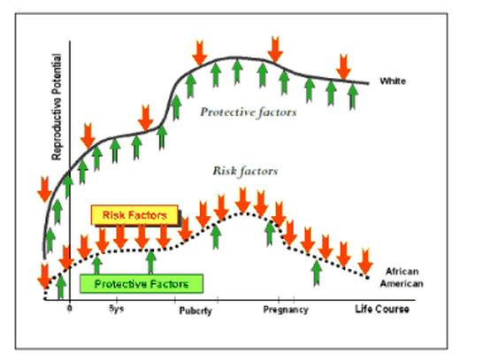
Introductory statistics: Project #1
Life-course framework: Differences in protective and risk factors across race associated with differences in health outcomes
Protective/risk factors:
Nutrition
Social support
Income
Health care
Stress
Marital status
Health outcomes:
Infant birth weight
Infant gestational age
Michael C. Lu, MD, MPH and Neal Halfon, MD, MPH, “Racial and Ethnic Disparities in Birth Outcomes: A Life-Course Perspective,” Maternal and Child Health Journal 7, no. 1 (March 2003): 13–30 http://mchb.hrsa.gov/infantmortalitysummit/disparitieslifecourse.pdf

Slide 8
2 Parts
A. Snapshot (cross-sectional)
B. Historic (longitudinal)

Slide 9
Part A: Snapshot (cross-sectional)
Formal statistical tests (chi-square, 2-sample t-test) to examine racial disparity across:
Employment status
Income
Risk of having a low birth weight infant
Number of prenatal care visits
Data from American Community Survey using Data Ferrett
Data from North Carolina Vital Statistics Dataverse

Slide 10
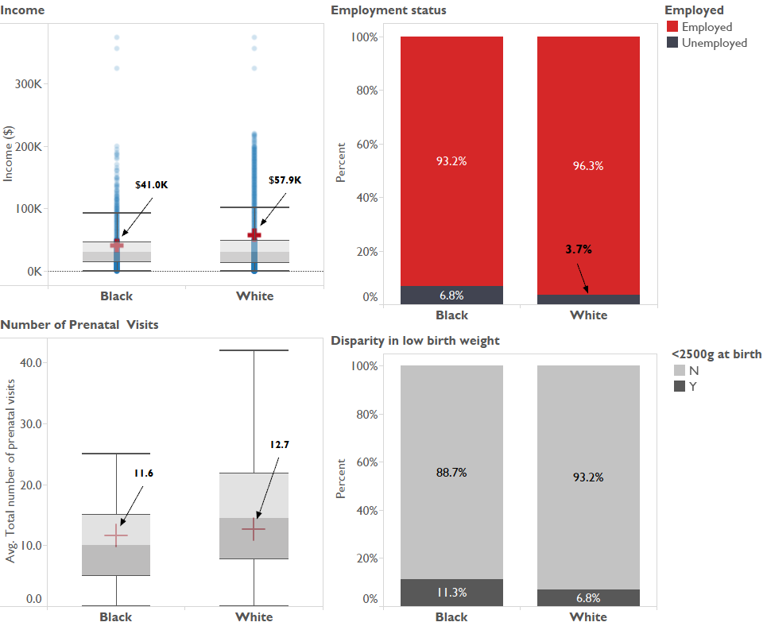

Slide 11
Part B: Historic (longitudinal)
Graphical procedures to examine changes over time in racial disparity across:
Poverty Rate
Median household income
High-school completion rate
Low birth weight rate
Teenage childbearing rate
Life expectancy at birth
IPUMS data from Current Population Survey Annual Social and Economic Supplement
Data from National Center for Health Statistics

Slide 12
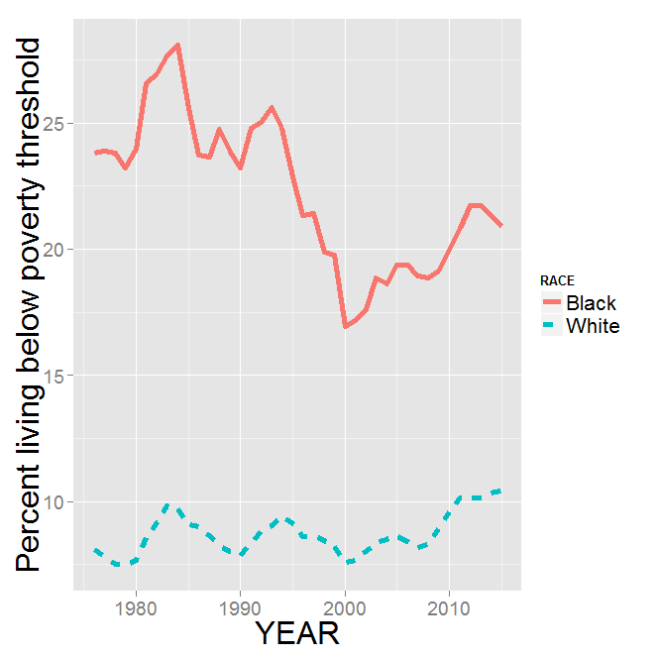
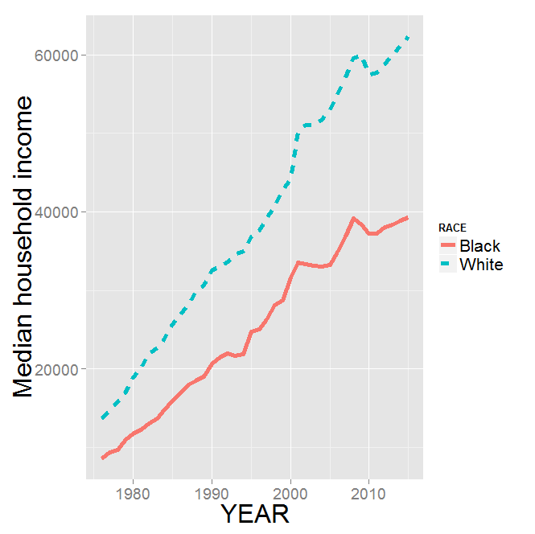
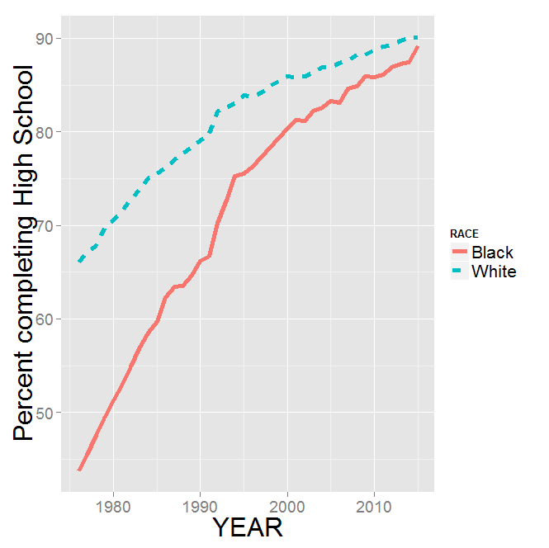
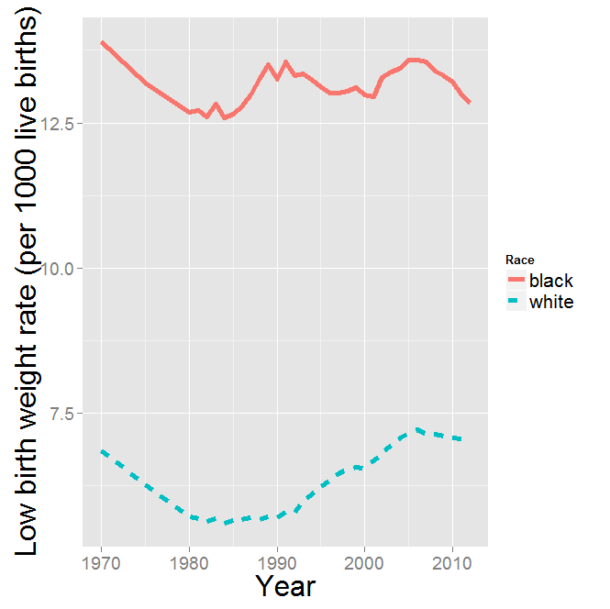
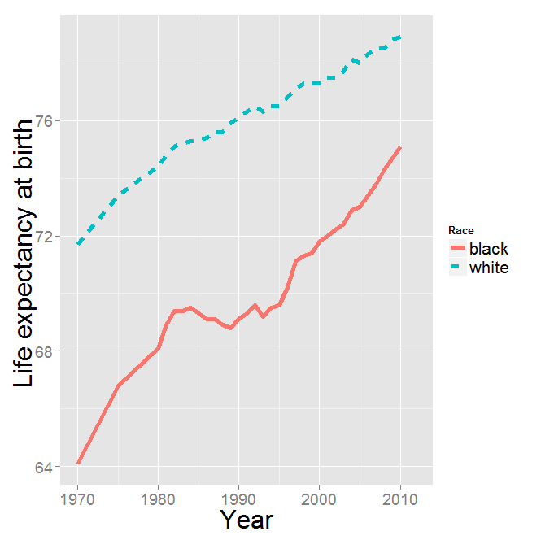
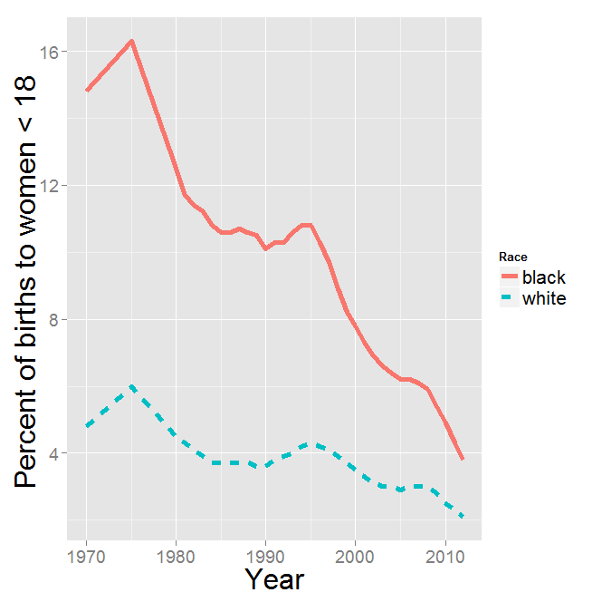

Slide 13
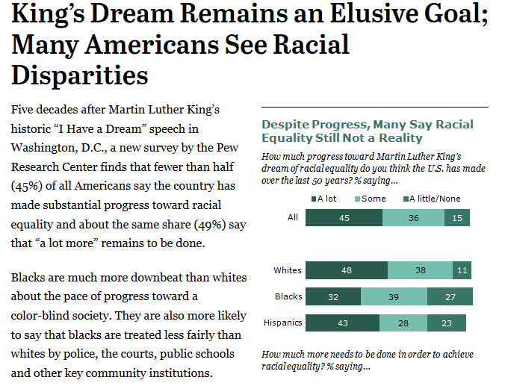
4 Reflection Questions
2 questions asked pre- and post- project
Taken from Pew Research article “King’s Dream Remains an Elusive Goal”
http://pewrsr.ch/1aorx1c
2 questions asked post-project only

Slide 14
Question #1 (pre- and post-project)
How much progress toward Martin Luther King’s dream of racial equality do you think the U.S. has made over the last 50 years?
A lot
Some
A little
None at all

Slide 15
Question #2 (pre- and post-project)
How much more needs to be done in order to achieve racial equality?
A lot
Some
A little
None at all

Slide 16
Question #3 (post-project only)
I am more informed about the nature of racial inequality having completed this project
Strongly agree
Agree
Disagree
Strongly disagree

Slide 17
Question #4 (post-project only)
The nature of racial inequality seems more complex after completing the project
Strongly agree
Agree
Disagree
Strongly disagree

Slide 18
Question #1 (pre- and post-project)
How much progress toward Martin Luther King’s dream of racial equality do you think the U.S. has made over the last 50 years?
No change: 25
“Pessimistic” change: 13
“Optimistic” change: 2
 | Post-project responses
Pre-project responses | None at all | A little | Some | A lot
None at all | 0 | 0 | 0 | 0
A little | 0 | 0 | 1 | 0
Some | 0 | 5 | 14 | 1
A lot | 0 | 1 | 7 | 9

Slide 19
Question #2 (pre- and post-project)
How much more needs to be done in order to achieve racial equality?
No change: 21
“Pessimistic” change: 13
“Optimistic” change: 4
 | Post-project responses
Pre-project responses | None at all | A little | Some | A lot
None at all | 0 | 0 | 0 | 1
A little | 0 | 0 | 4 | 0
Some | 0 | 2 | 8 | 8
A lot | 0 | 1 | 1 | 13

Slide 20
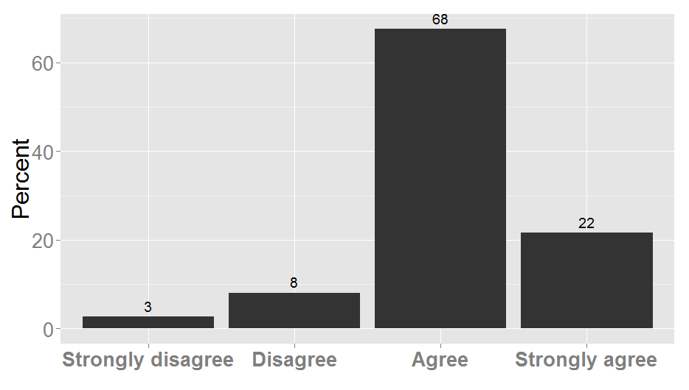
Question #3 (post-project only)
I am more informed about the nature of racial inequality having completed this project

Slide 21
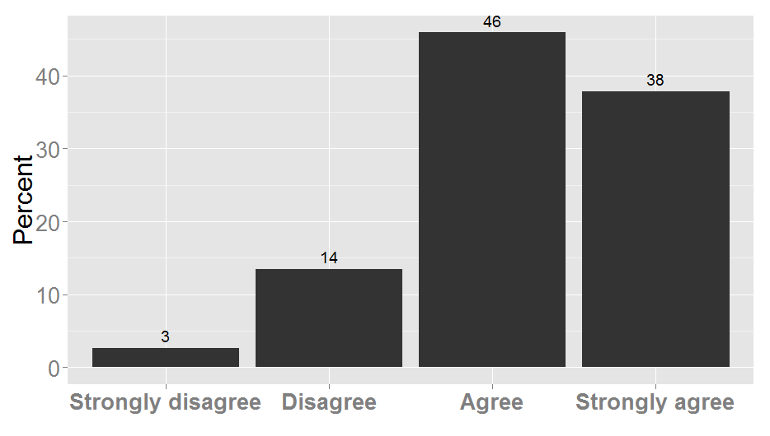
Question #4 (post-project only)
The nature of racial inequality seems more complex after completing the project

Slide 22
Introductory statistics: Project #2
Promote growth in quantitative proficiency
Example of Fisher’s Exact Test
Educate about social inequity
Learn about the “School-to-prison pipeline”
Reflect on findings…
…through open-ended essay-type questions

Slide 23


Introductory statistics: Project #2
School-to-prison pipeline
Children pushed out of school more likely to end up in criminal justice system
Black children are more likely than white children to be disciplined with out-of-school suspensions

Slide 24

Introductory statistics: Project #2
Data from U.S. Department of Education Office of Civil Rights
http://ocrdata.ed.gov
Suspension status for all black and white students at Winona Senior High School

Slide 25
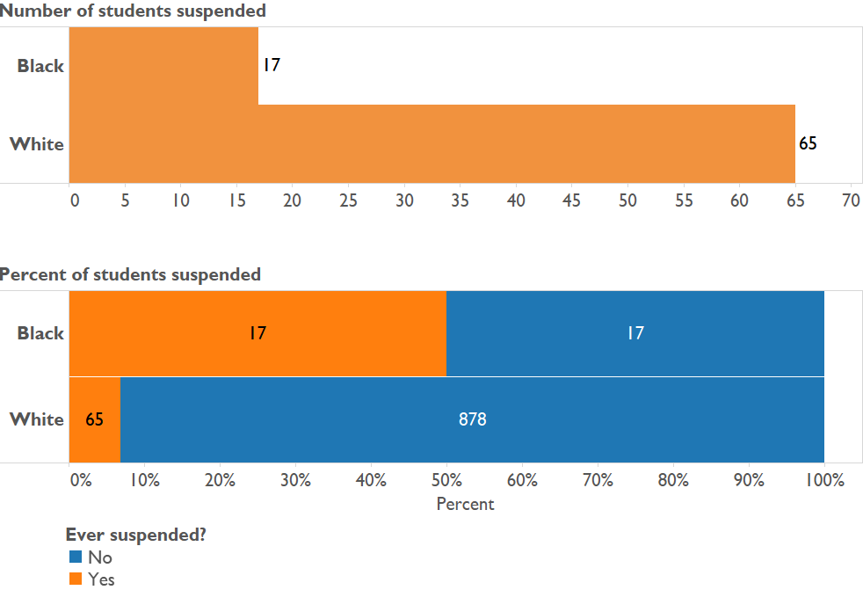
Introductory statistics: Project #2

Slide 26
Introductory statistics: Project #2
Write 3-4 sentences summarizing your findings, as if you were reporting them to a WSHS administrator or at a parent-teacher meeting. What “action steps” might you recommend to school administrators and teachers as a result of your findings?
What do you think about using suspension as a method of disciplining bad behavior?

Slide 27
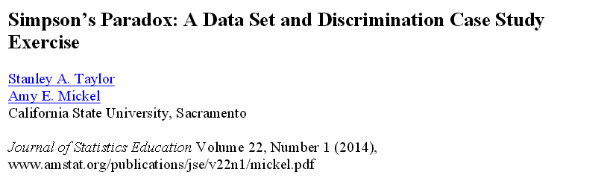
Project 3: State expenditure on developmentally disabled Californians

Slide 28
Project #2
Promote growth in quantitative proficiency
Importance of the “third variable”
Educate about social inequity
Discrimination is not always what it seems
Reflect on findings…
…through one “synthesis paragraph”

Slide 29
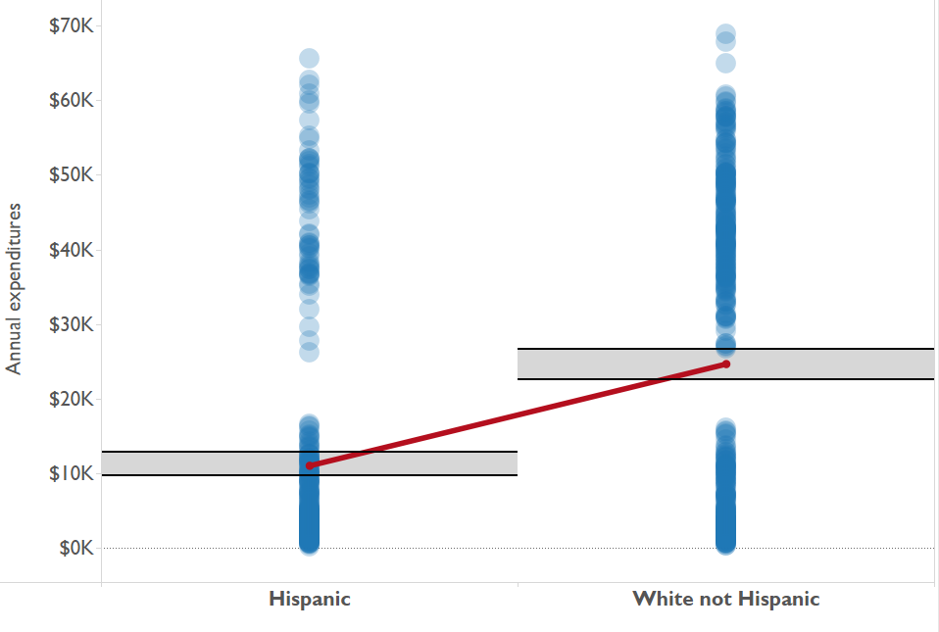

Slide 30
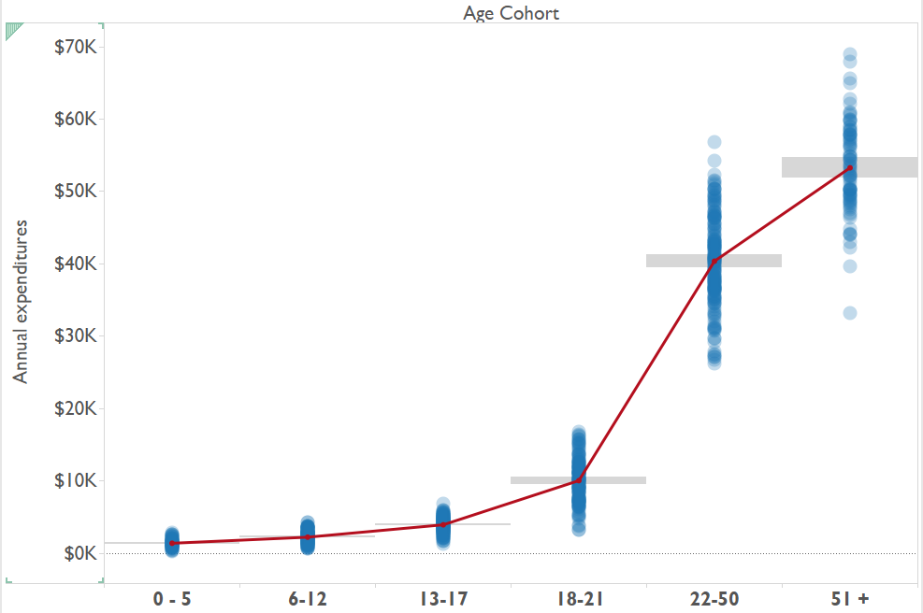

Slide 31
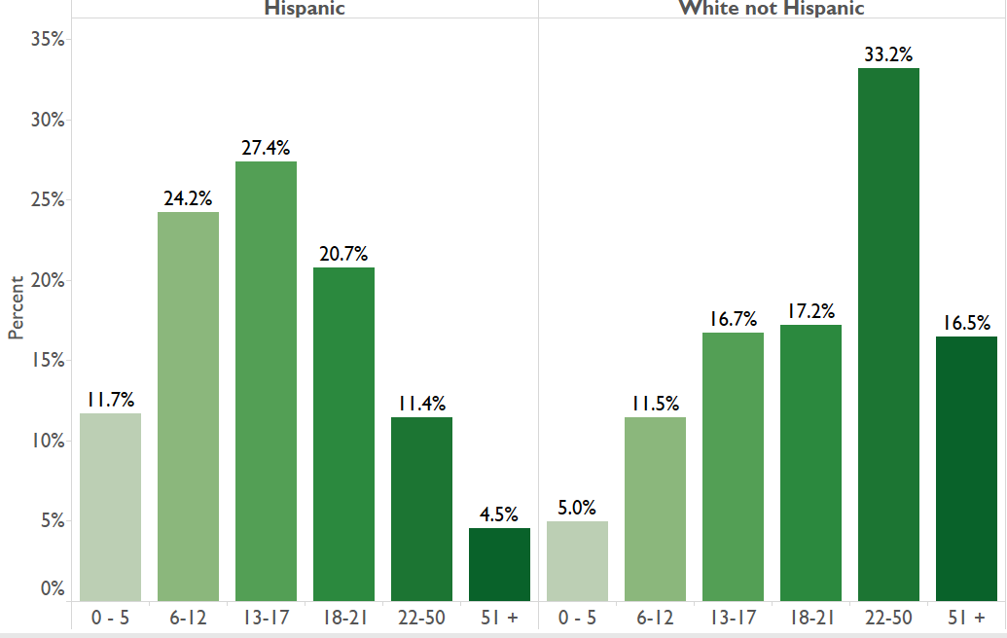

Slide 32
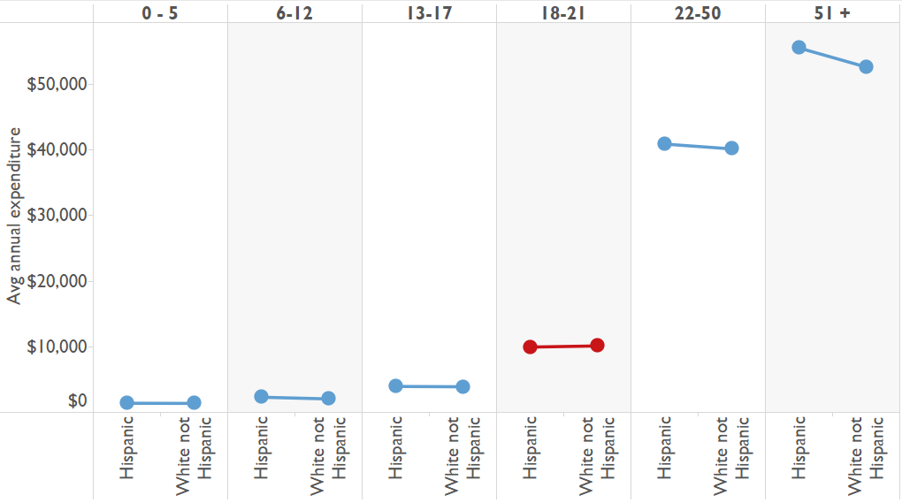

Slide 33
Write a paragraph clearly summarizing your “big picture” findings, and stating whether you believe these data provide evidence of discrimination. If you think there is discrimination, describe the nature of the discrimination. If you do not, clearly explain why not.

Slide 34
Future work
Move from the “what” to the “why”, i.e. WHY DOES THE OBSERVED INEQUITY EXIST?
Lesser (2007): “….social justice, however, does not necessarily require or guarantee equal outcomes”. Are inequities due to…
Confounding factors?
Systemic discrimination?
Help students to reflect on the “what’s next”/ “so what”
Attempt to better understand how student definitions of “racial inequity” change as a result of quantitative treatment of racial inequity across an entire course
Change pre-/post-project approach to pre-/post-course?

Slide 35
THANK YOU!!

