Slide 1
Great public data sources with examples of ‘social justice’ applications
Dr. Silas Bergen
St. Olaf College
3/14/18

Slide 2

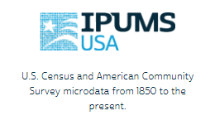
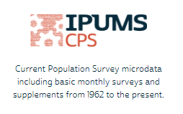

Integrated Public Use Microdata Series (ipums.org)
Integrated, harmonized data on a variety of topics with standardized data request system
Account creation required
Beware the PERWT!

Slide 3
Example topics relevant for ‘social justice’:
STEM, income, education and sex (ACS)
Poverty, median income, high school completion inequality (CPS)
Mental health inequality (NHIS)

Slide 4
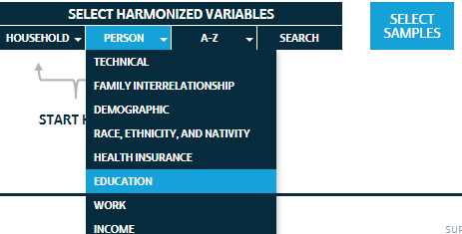
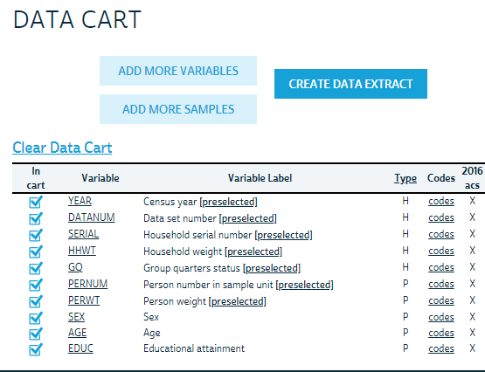
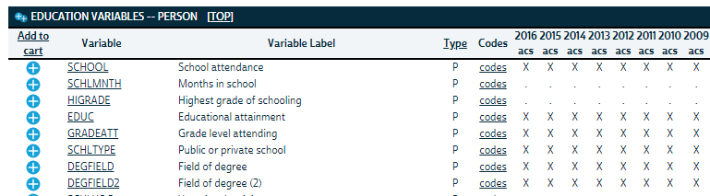

Slide 5
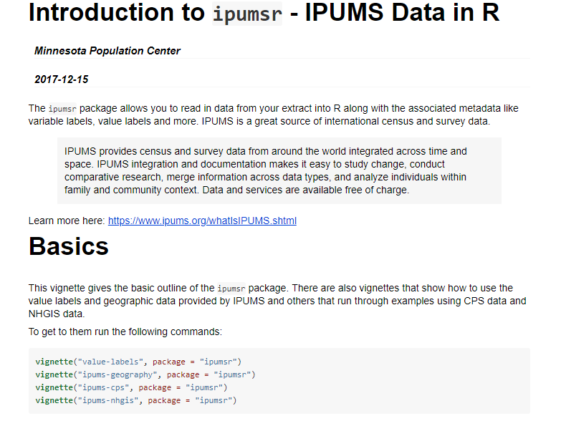
https://cran.r-project.org/web/packages/ipumsr/vignettes/ipums.html

Slide 6

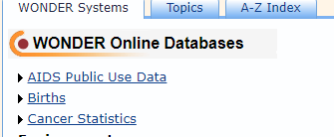
CDC Wonder (https://wonder.cdc.gov/)
“Reproducible” query linking e.g.:
Fertility rates for single mothers 15-19 by race, year, state:
https://wonder.cdc.gov/controller/saved/D66/D32F342
.csv file easily downloaded

Slide 7
Topics relevant for ‘social justice’; e.g. explore following by time, race, geography:
Neonatal mortality rate
Teenage fertility rate
Low birth weight rate
Deaths by suicide

Slide 8
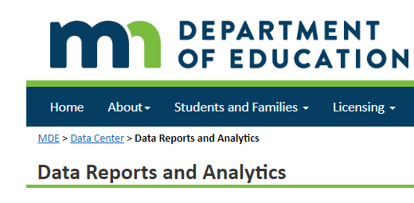
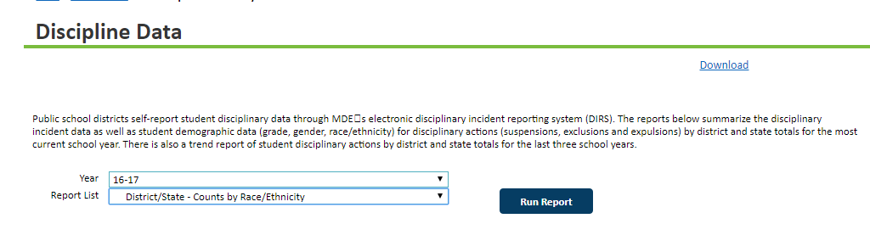
Minnesota Department of Education Data Center (http://w20.education.state.mn.us/MDEAnalytics/Data.jsp)
Cumbersome dropdown menus
Individual Excel files for each year

Slide 9
Topics relevant for ‘social justice’:
Disciplinary actions by race
ACT scores by school district
Relationship with race (merge with demographic data from IPUMS?)

Slide 10
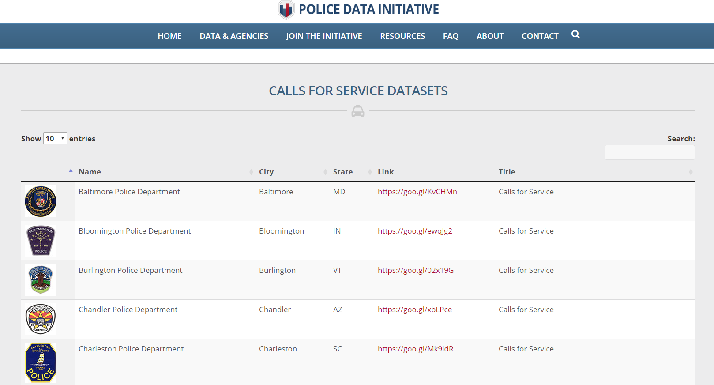
Police Data Initiative (https://www.policedatainitiative.org/datasets/calls-for-service/)
911 calls for 29 U.S. Cities
Variable reporting

Slide 11
Topics relevant for ‘social justice’:
Geographic discrepancies in calls?
Relationship between calls and demographic information on census tract (merge with IPUMS data?)

Slide 12
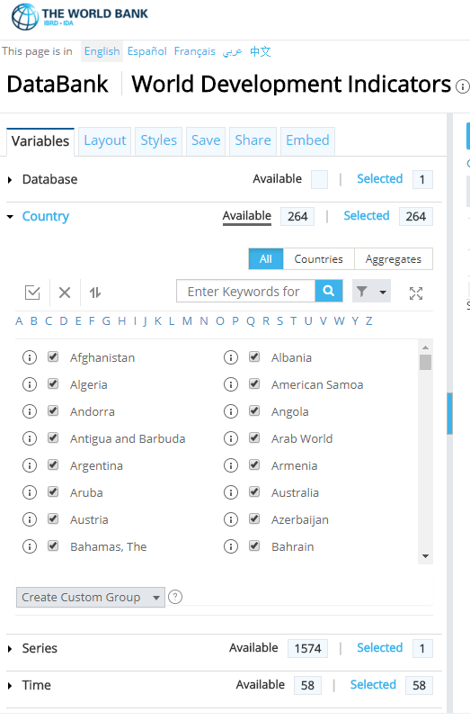
World Development Indicators from the World Bank
http://databank.worldbank.org/data/reports.aspx?source=world-development-indicators
Host of indicators by country, and year e.g.:
Life expectancy
Infant mortality rate
Internet usage
CO₂ emissions
Child education
Explore economic/gender inequality by world region over time

