Slide 1

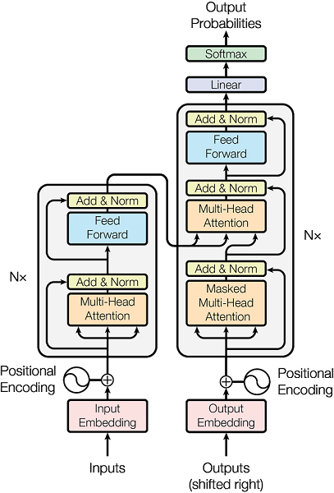
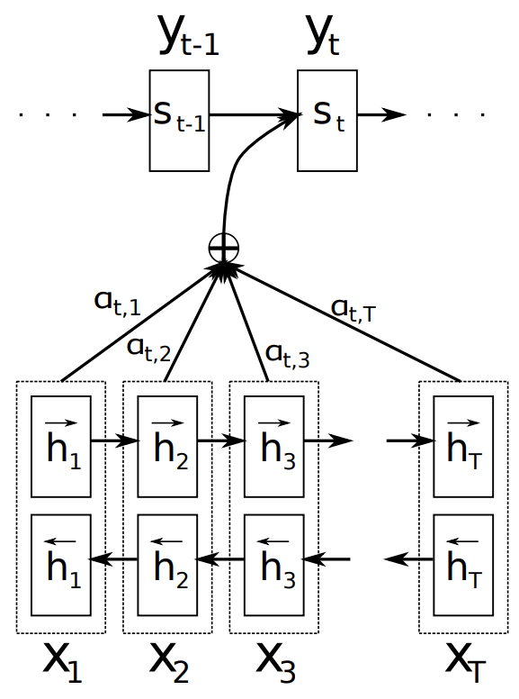
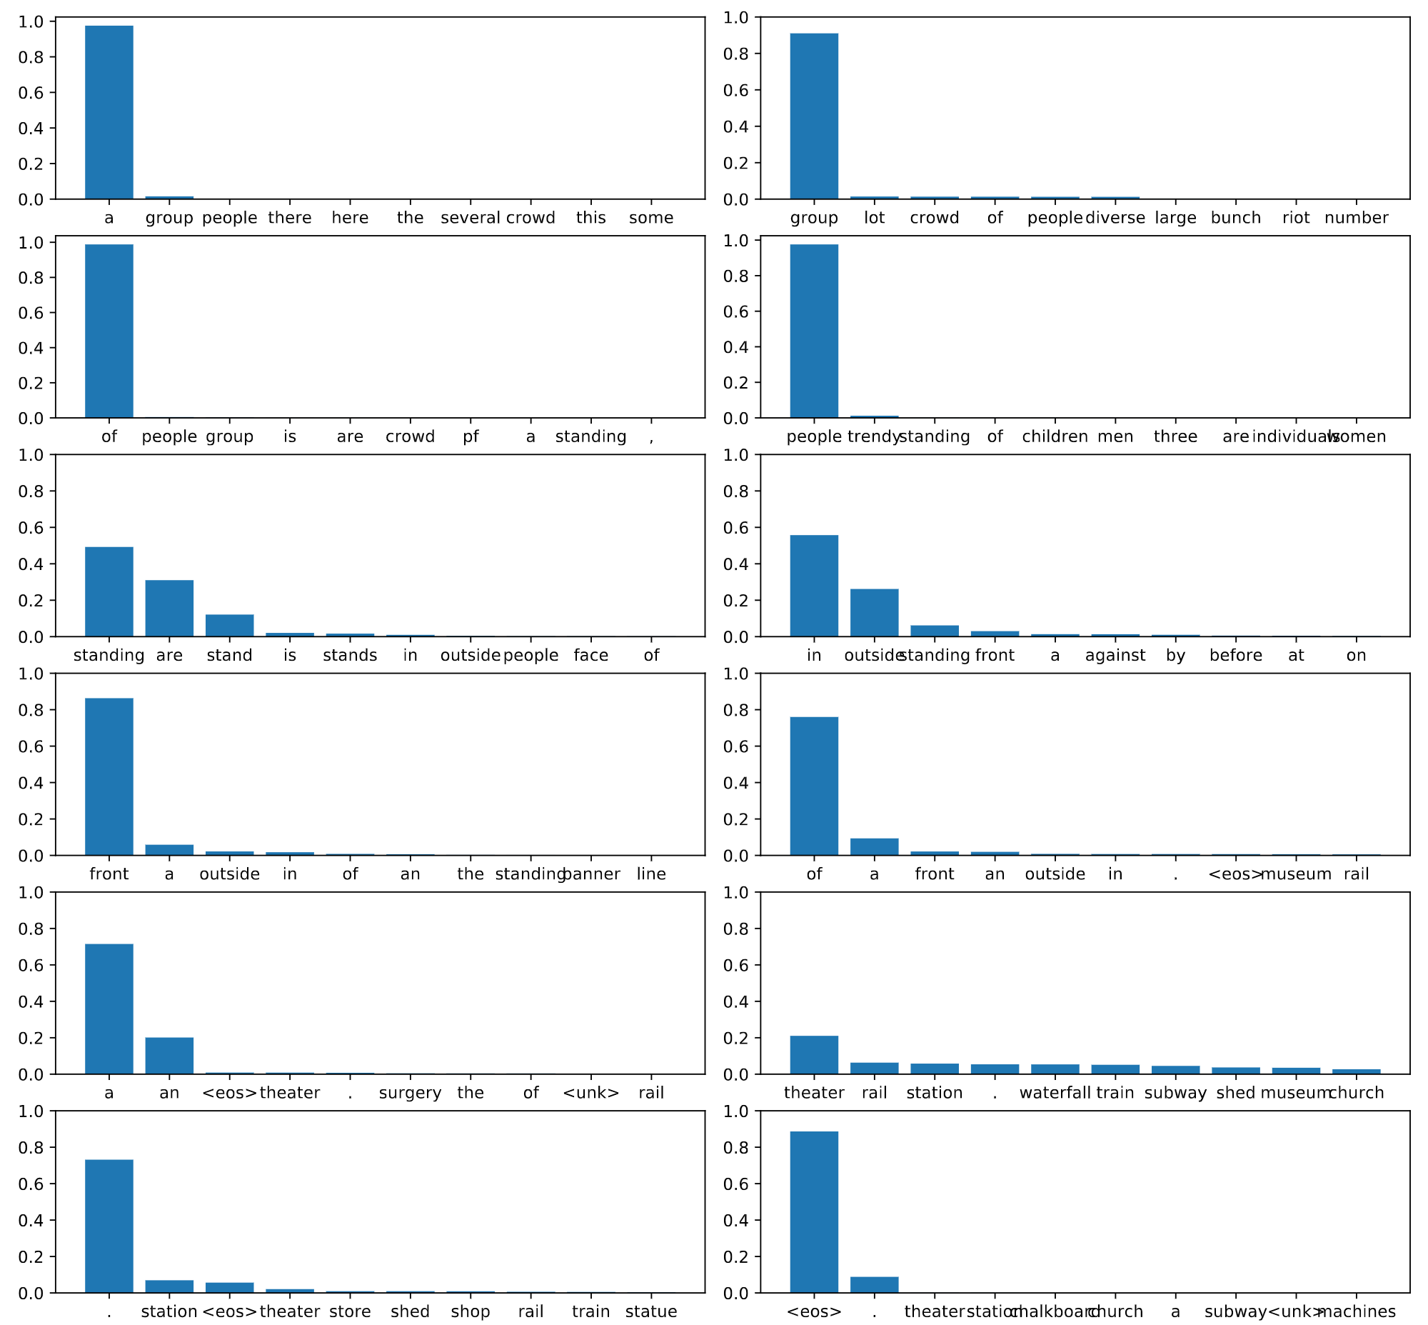
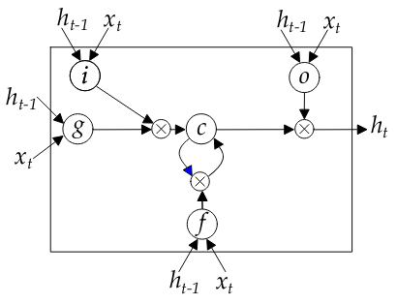


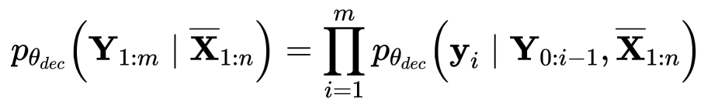
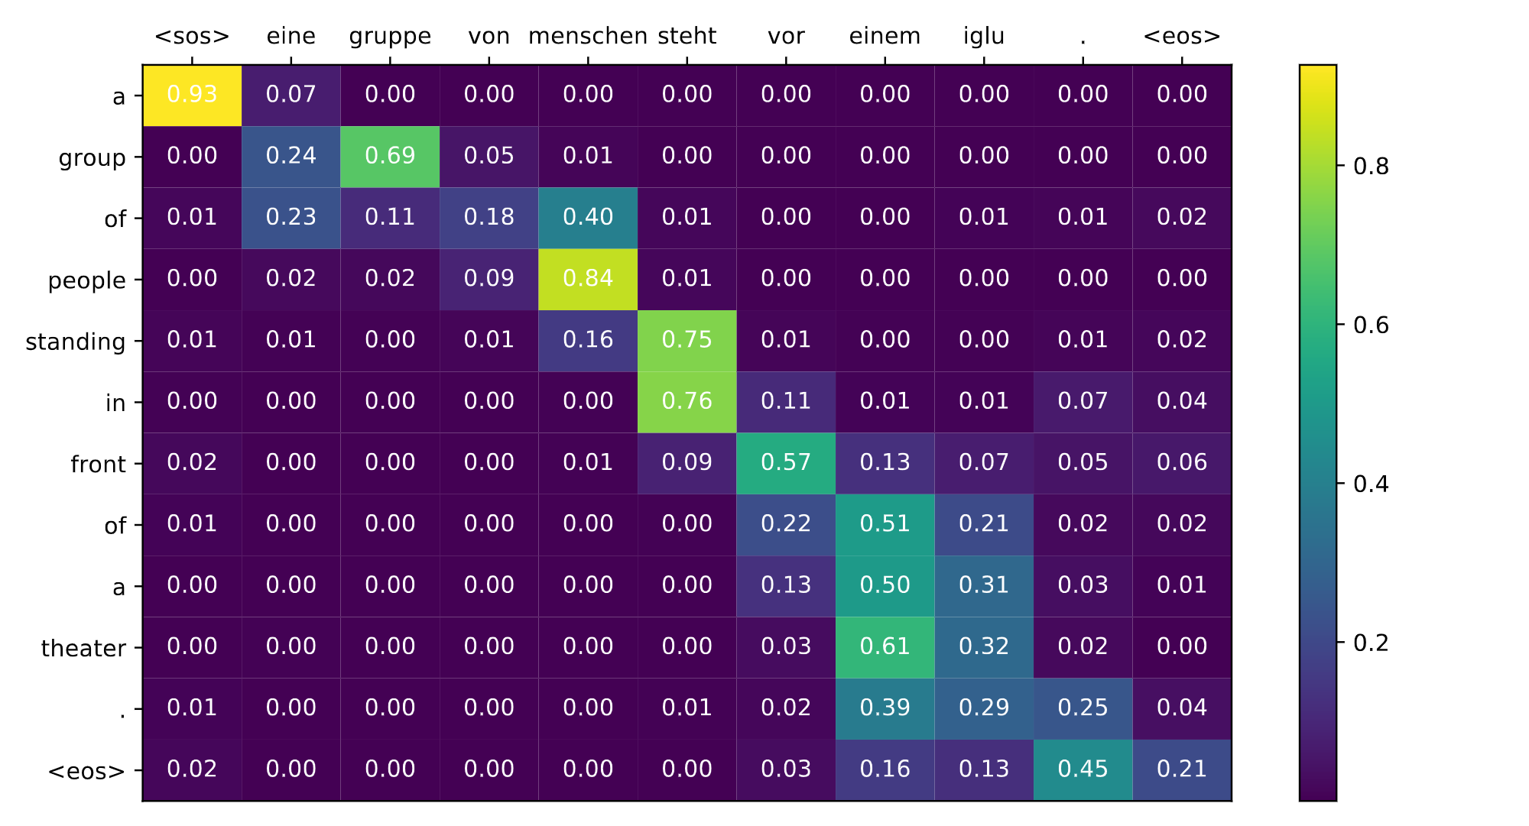
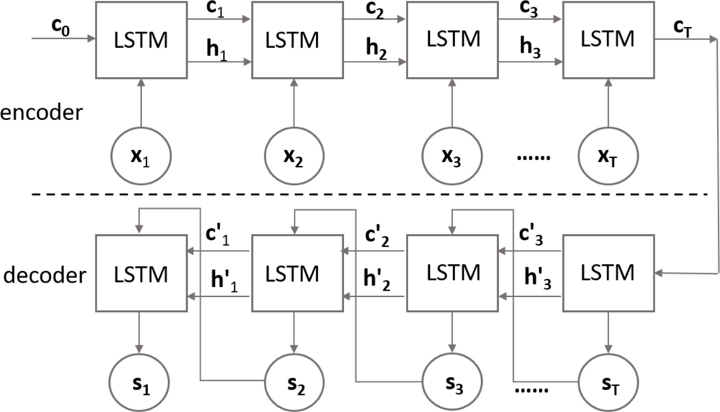
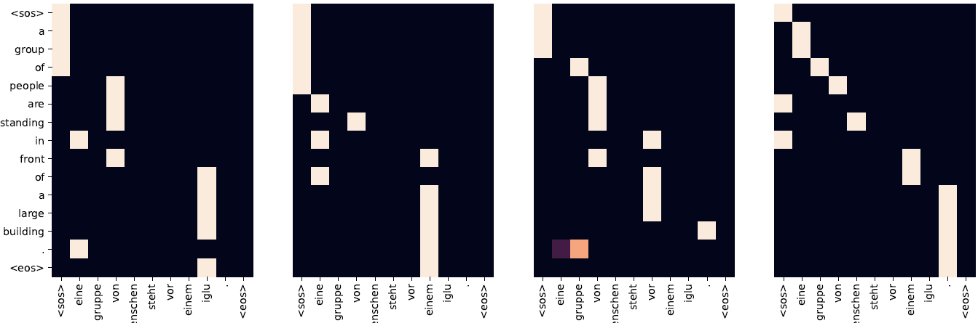
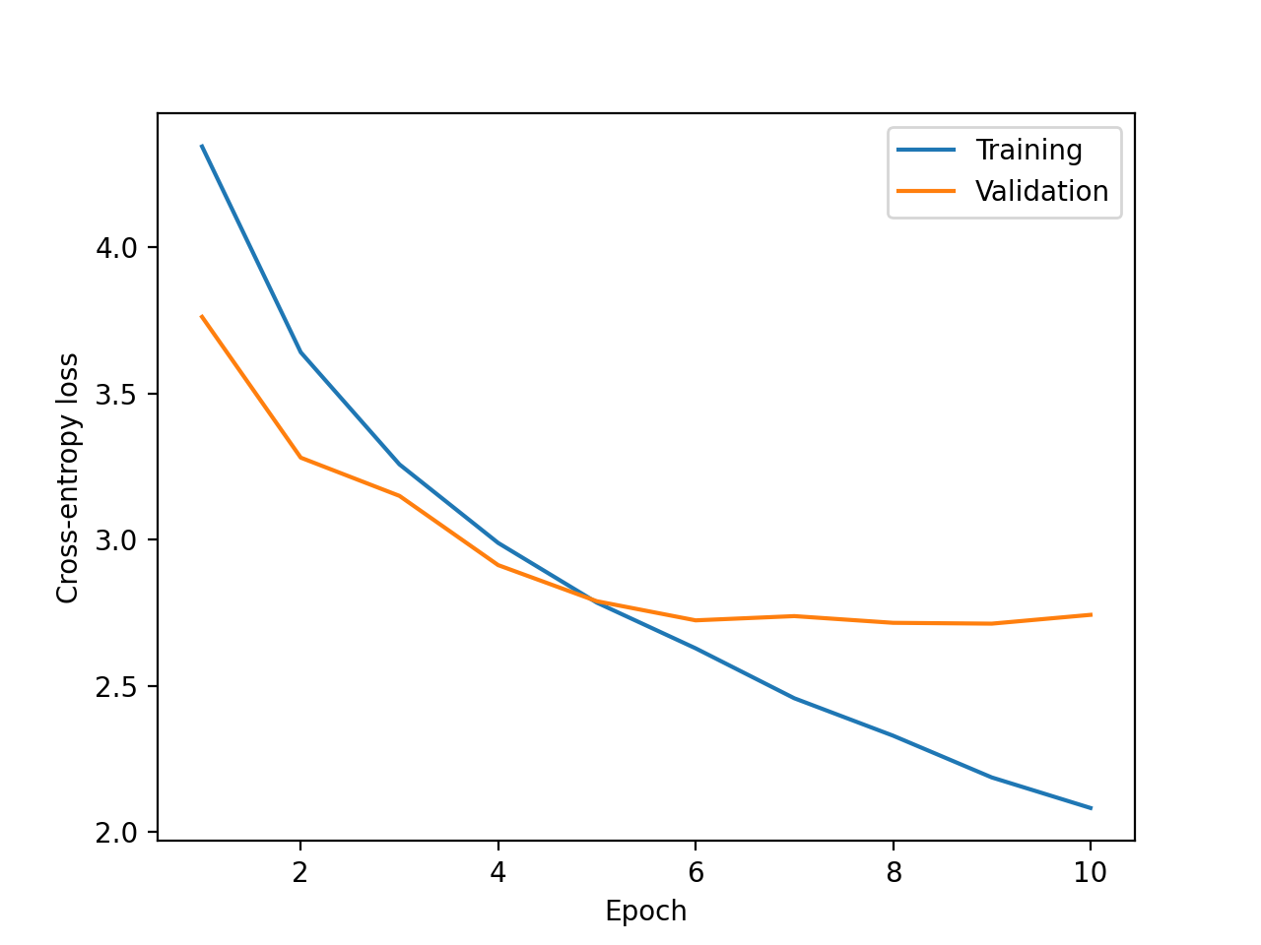
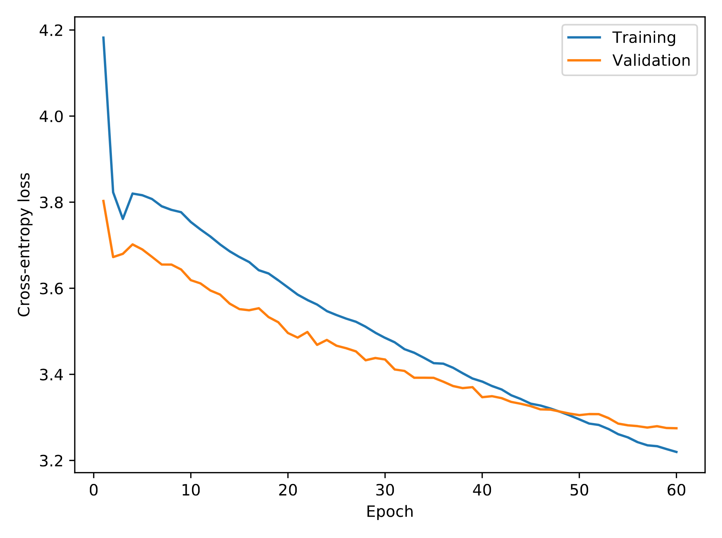
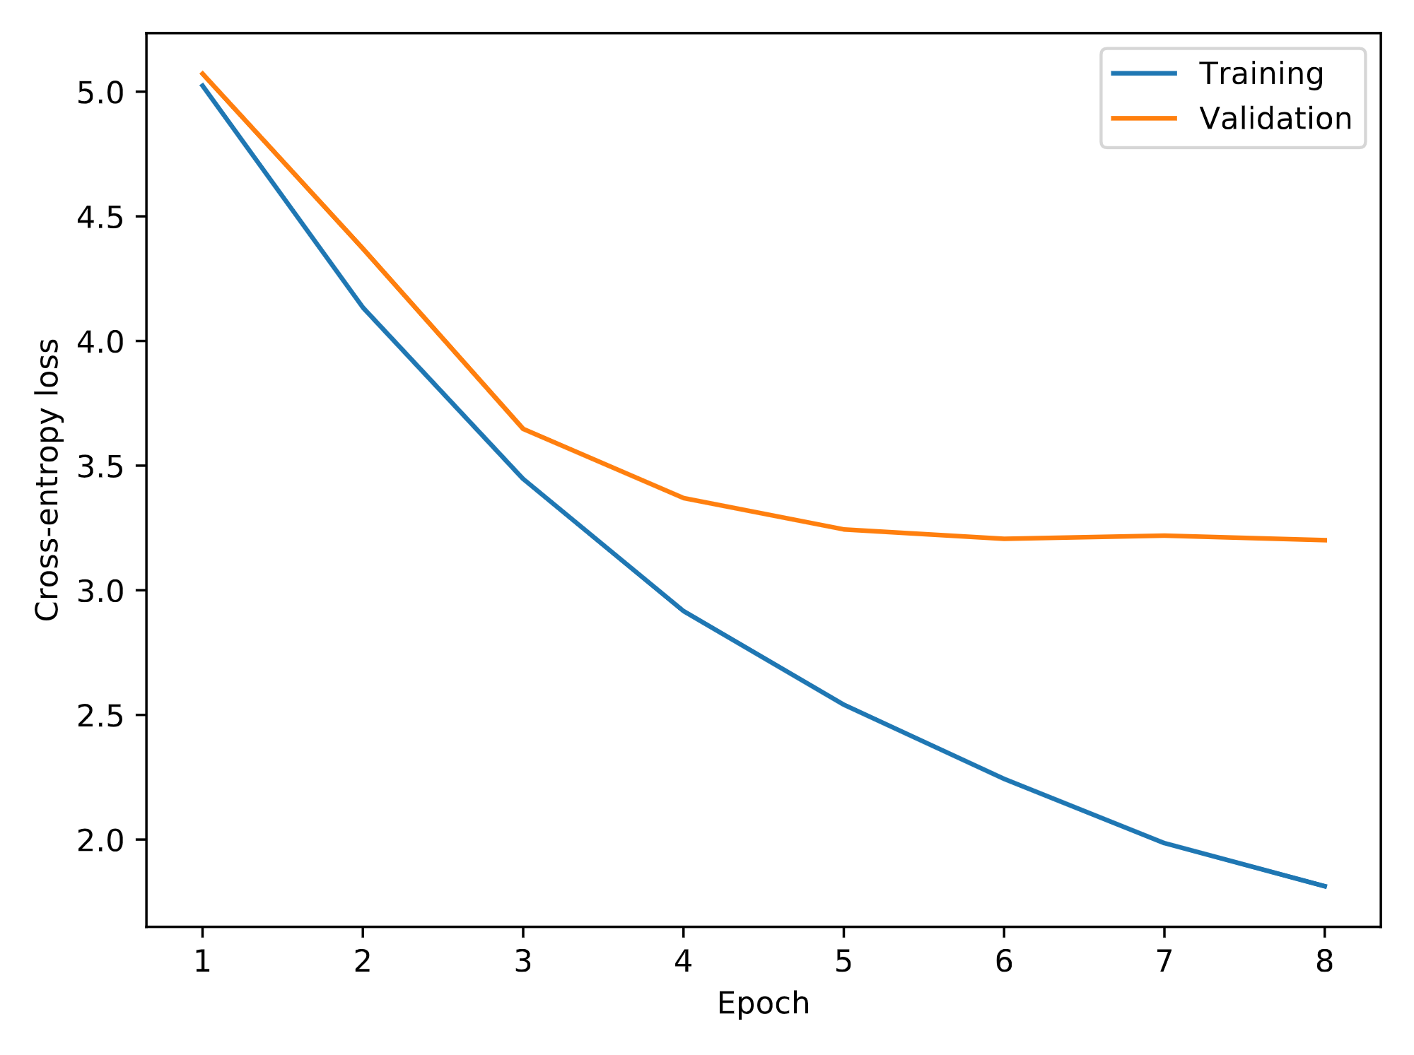

Carlos Ventura s202450, Jakub Reha s184478, Silas Brack s174433 DTU Compute, Technical University of Denmark Deep Learning 02456
State-of-the-art Neural Translation
Introduction
Seq2seq GRU w attn [3]
Seq2seq LSTM
Transformer
[1][2]
Machine translation German to English using three different Sequence2Sequence models with encoder-decoder architectures with two different datasets. We analyze the influence of attention. For every architecture word-level embeddings were used.
GRU w attn Model
LSTM cell architecture
Theory
Attention heat map, GRU
Transformer Model
Above we can see the probabilistic definition of these models, where $X$ is the input sequence, $\overline{X}$ the context vector and $Y$ the target sequence.
Attention heat map, Transformer decoder layer 6 (source)
Example translation
LSTM Model
Original: eine gruppe von menschen steht vor einem iglu .
Translation: a group of people stands in front of an igloo .
Seq2Seq LSTM: a group of people standing in front of a <unk> booth .
Seq2Seq GRU w/ Attn: a group of people standing in front of a theater .
Transformer: a group of people are standing in front of a large building .
Candidates probabilities
Seq2seq GRU w/ attn
Seq2seq LSTM
Transformer
Comparisons
*evaluated on Multi30k unless stated otherwise
Future work
Knowledge destillation
 | Seq2seq LSTM | Seq2seq GRU | Transformer | Bert2Bert
CE Train* | 2.19 | 1.81 | 3.28 | ---
CE Val* | 2.71 | 3.20 | 3.31 | ---
CE Test* | 2.84 | 3.25 | 3.287 | ---
Perplexity* | 17.116 | 25.774 | 26.751 | ---
BLEU* | 21.7 | 29.3 | 10.5 | 27.7
Params | ~35M | ~20M | ~50M | ~770M
BLEU WMT14 | 0.13 | 0.21 | 2.8 | 17
References
[1] Ashish Vaswani, Noam Shazeer, Niki Parmar, Jakob Uszkoreit, Llion Jones, Aidan N. Gomez, Lukasz Kaiser, and Illia Polosukhin, “Attention is all you need,” CoRR, vol. abs/1706.03762, 2017.
[2] Guillaume Klein, Yoon Kim, Yuntian Deng, Jean Senellart, and Alexander M. Rush, “Opennmt: Open-source toolkit for neural machine translation,” in Proc. ACL, 2017.
[3] Dzmitry Bahdanau, Kyunghyun Cho, and Yoshua Bengio, “Neural machine translation by jointly learning to align and translate,” 2016.
Notes:
1

