Slide 1

Detection of Depression Symptoms using Social Media Data
Silas P. Lima Filho
silasfilho@ufrj.br
Jonice Oliveira
jonice@dcc.ufrj.br
Monica Ferreira da Silva
monica.silva@ppgi.ufrj.br
Programa de Pós-Graduação em Informática, UFRJ
1

Slide 2
Summary
Context/Problem
Initial Research Questions
Methodology
1st Cycle
Systematic Literature Review
Literature Gaps
2nd Cycle
Next Steps
Limitations

Slide 3
Context/Problem
Depression is one of the most reported mental diseases in the world. Sometimes called century illness a and the third lead cause of disability.
World Health Organization (WHO) presents that around 300 mi people suffer from some level of depression.
Health Ministry in Brazil presents that 11.5 million people are affected by depression.
1

Slide 4
Context/Problem
Horvitz report infodemiology as the use of digital information to inform the population about health policies, earlier epidemics identification and identify potentially affected individuals.
Lech & Eds present two main challenges in mental health informatics. Provide health care services to remote and non-assisted populations, and turn health services more effective on cost[22].

Slide 5
Context/Problem
People share with other users their social interests and preferences on Social Media.
• Plenty of data about behaviour, habits, interests, friendship and so on.

Slide 6
Initial Research Questions
Is it possible to identify psychological diseases symptoms,
more specifically depression symptoms, from social media
users content?
The collected information from social media is sufficiently robust to determine if a user has depression or its symptoms?
Which computational methods and efforts were created or
used to understand emotional behavior from a social media
user?

Slide 7
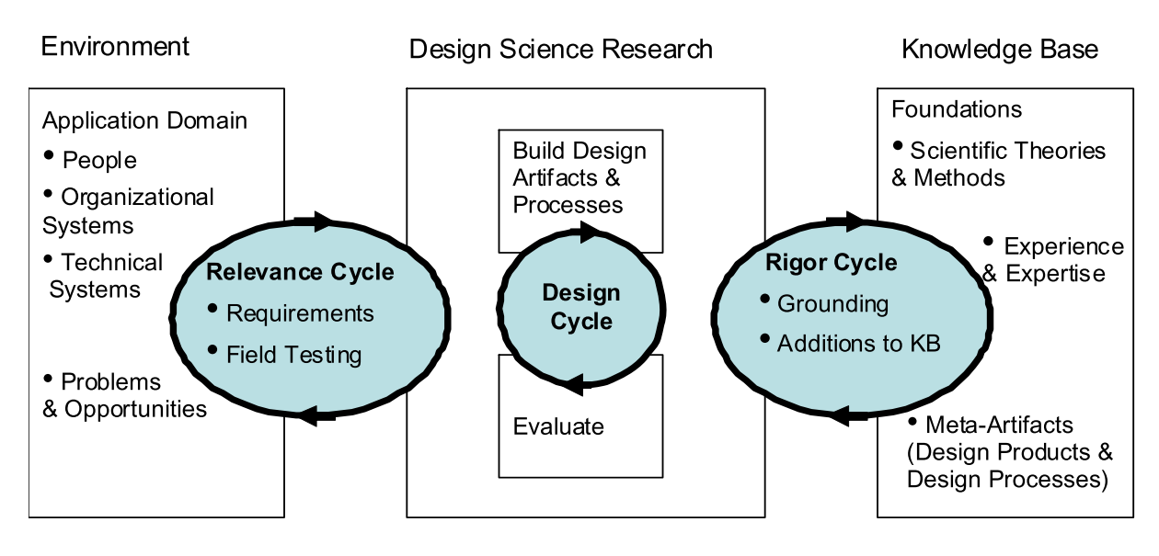
Methodology
Design Science Research (DSR) was selected due to its pragmatical approach for a given context. Based on [15], we can identify the three cycles in order to create at the end, an relevant artifact. Pimentel et al. [31] has presented an overview of different aspects of DSR from many authors. Moreover the authors suggest a framework to implement DSR in a research topic.
Figure: DSR Cycles by Hevner.

Slide 8
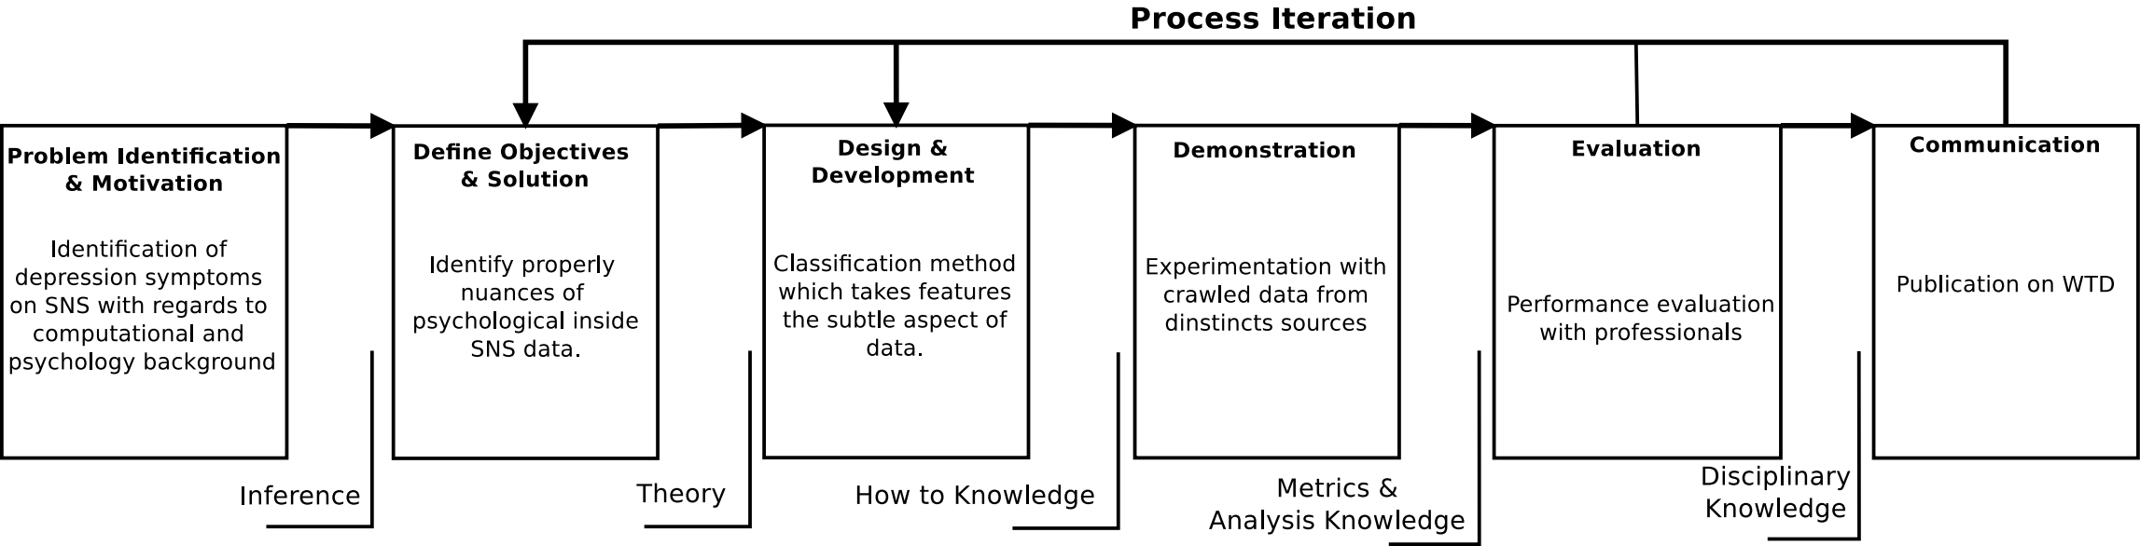
Methodology
Peffers states the research process in six stages. The author specifically proposes a Design Science Research Methodology (DSRM).
Figure: Research stages based on DSRM from Peffers.

Slide 9
Methodology
We establish which cycles will comprehend each component to fullfill DSR requirements. Taking into account Wieringa approach [40]:
Systematic Literature Review (SLR) - Related to Empirical Cycle
Experiments to test and validate initial classification models - Related to Design/Engineering Cycle.

Slide 10
1st Cycle
Systematic Literature Review
Still in progress.
(“Social Media” OR “Social Network” OR “Complex Network”) AND (Depression OR
“Major Depressive Disorder”)
2013 ≥ published ≤ 2018
22 from ACM and 25 from IEEE bases
Inclusion | Exclusion
Directly tackles depression | Out of 2013-2018 scope
Have computational approach | Not written in english or portuguese
Attend both approaches | It is not a primary study
- | It does not have abstract
- | It does not have CS contribution
- | It has less than 4 pages

Slide 11
 | Textual |  |  |  | Content Metadata | User Profile | Interactions Data |  |  | Group Charac. | Long. Variation
Reference | Emotion/Sent. | Linguis. | Topic | Other |  |  | Platform | Other Users | Both
Fang, 2014 | x
Nguyen, 2014 | x | x | x
Larsen, 2015 | x | x
Nambisan, 2015 |  |  |  |  |  |  | X
Chomutare, 2015 |  |  | x | x
Dao, 2015 | x |  | x
Dao, 2016 | x |  |  |  |  |  | x
Dao, 2016 | x | x | x
Saha, 2016 | x | x | x
Akay, 2016 | x | x |  |  |  |  |  | x |  | x
Simms, 2017 | x | x
Oyong, 2018 |  | x |  | x
Katchapakirin, 2018 | x | x |  |  | x | x |  |  | x
Silveira, 2018 |  |  |  | x |  |  |  |  | x | x
Wongkoblap, 2018 | x | x |  |  | x | x |  |  | x
Trotzek, 2018 | x | x |  |  | x

Slide 12
 | Textual |  |  |  | Content Metadata | User Profile | Interactions Data |  |  | Group Charac. | Long. Variation
Reference | Emotion/Sent. | Linguis. | Topic | Other |  |  | Platform | Other Users | Both
DeChoudhury, 2013 | X | X |  |  |  |  |  |  | X
DeChoudhury, 2013 | X | X |  | X | X |  |  |  | X
DeChoudhury, 2013 | X | X |  |  |  |  | X |  |  |  | X
Homan, 2014 |  |  |  |  |  |  |  | X |  | X
Wilson, 2014 |  | X
Tsugawa, 2015 | X |  | X | X | X |  |  |  | X
Kavuluru, 2016 | X |  |  | X
DeChoudhury, 2017 | X | X | X
Vedula, 2017 | X | X |  |  |  |  |  |  | X | X
Yazdavar, 2017 | X | X | X |  |  |  |  |  |  |  | X
Bagroy, 2017 |  |  |  | X |  |  |  |  |  |  | X
Nobles, 2018 | X | X |  | X
Chen, 2018 | X |  |  |  |  |  |  |  |  |  | X
Sadeque, 2018 |  | X |  | X
Zhao, 2018 |  |  |  | X | X

Slide 13
Questions from SLR
Not all the analyzed researches take into account the psychology point of view. (11 papers)
Would the screening of depressive users be more robust and reliable if they take
others psychology approaches?
Is it possible to identify the same symptoms from clinical using computational
techniques?
Few amount of papers which analyse the value of features variation over time.

Slide 14
2nd Cycle
Experimental Aproach
Develop an initial classification model based
Use of different types of data in identification task
Analyze variation of data over time
1

Slide 15
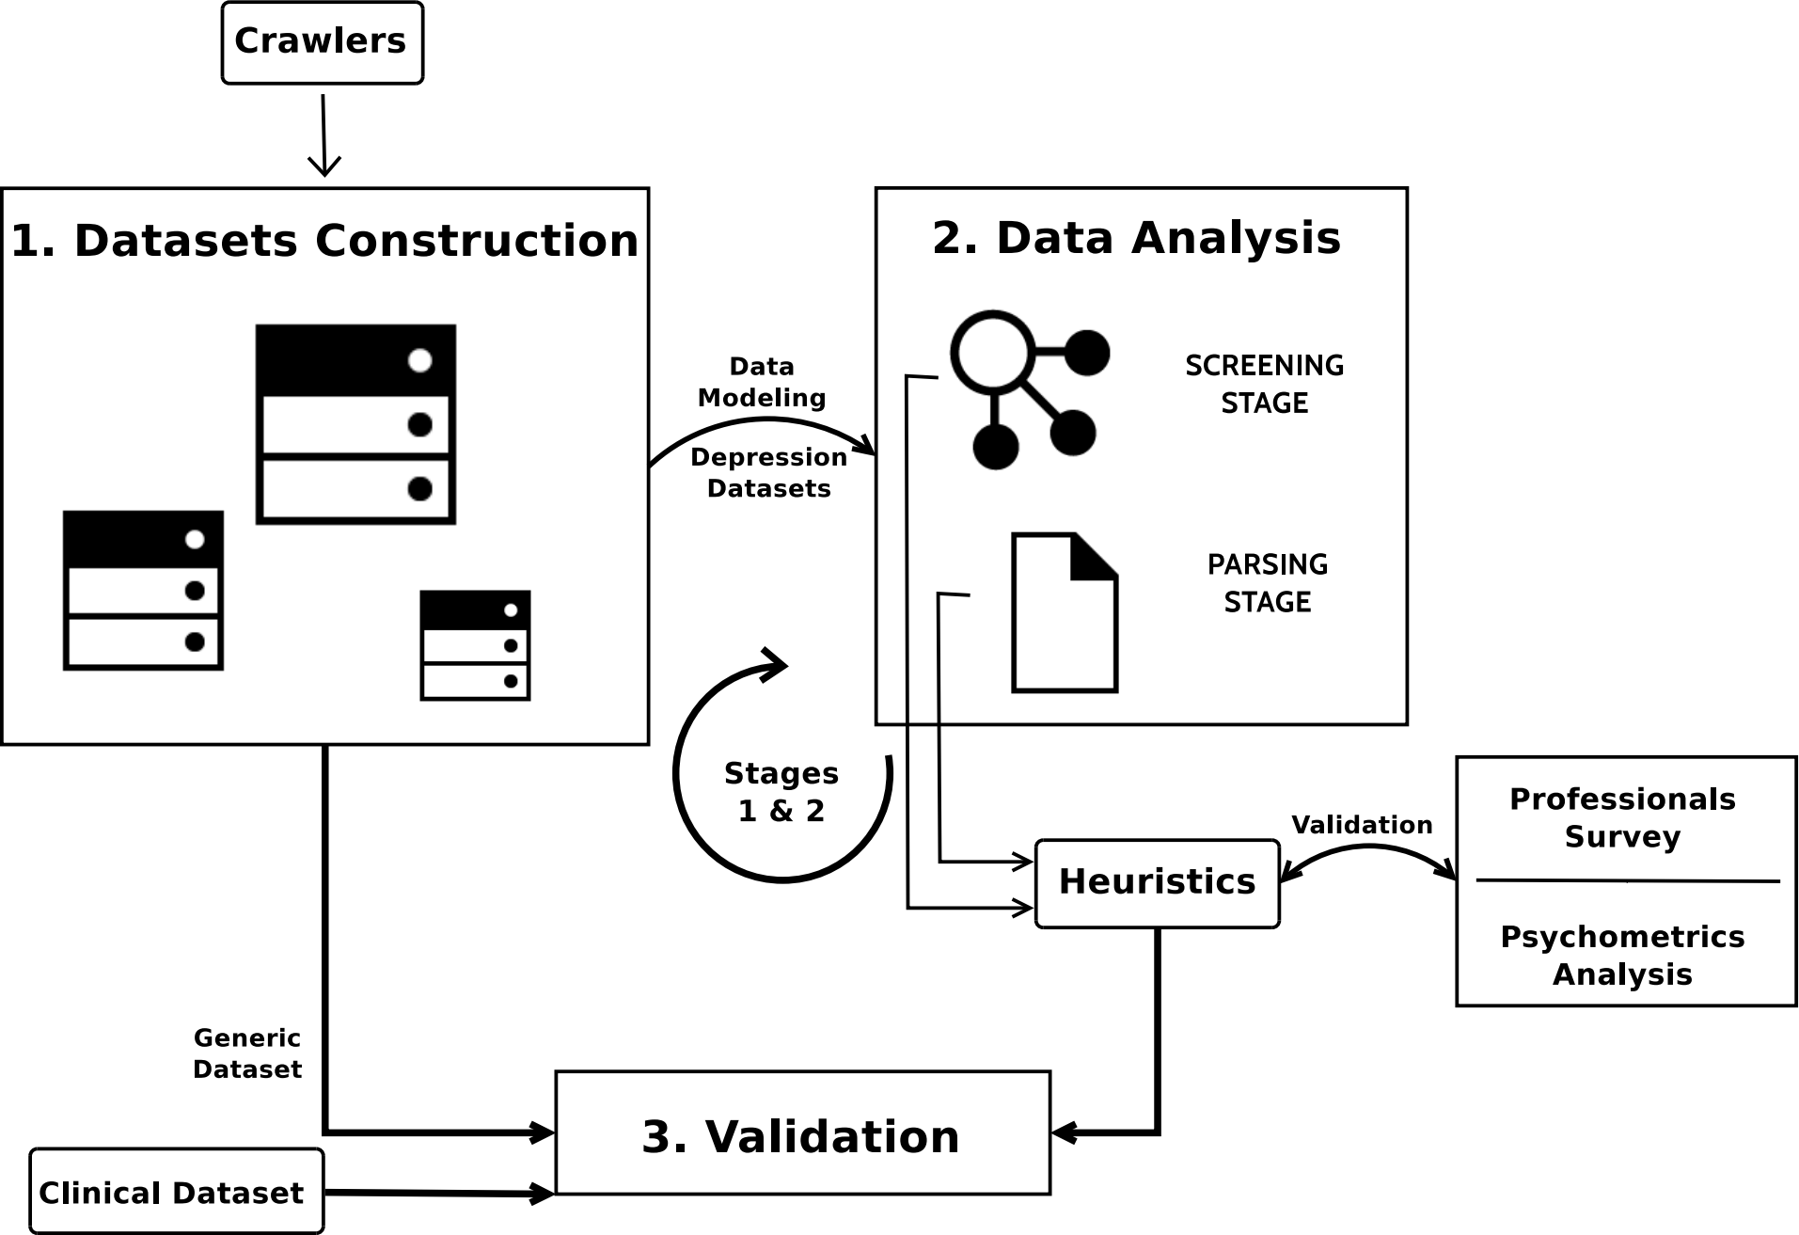
2nd Cycle
Experimental Aproach
1
Figure: Proposal Concept for Experiment Cycle.
4 | 1

Slide 16
Next Steps
Rerun and validate 1st Cycle with one more source.
Rerun and validate 2nd Cycle.
Qualification – This year yet.
Measure implications of COVID-19 in mental health using Social Media Data. CAPES pandemics project.
1

Slide 17
Limitations – Work in progress
Metrics and algorithms are not well defined yet.
Time limitation. Probably will be extended.
Problem still not clear yet. Although the longitudinal analysis is not well covered by literature.
Ethical Aspects of Experiments
It is not a diagnosis solution.

Slide 18
Limitations – Work in progress
We have at the moment a dataset with around 1.5 GB of collected information. The first dataset is related to the depression forum from HealingWell website. We have collected 3075 posted topics andtheir respective posts summing a total of 18450 replying posts.
Datasets from Reddit and HeallingWell forum.

Slide 19
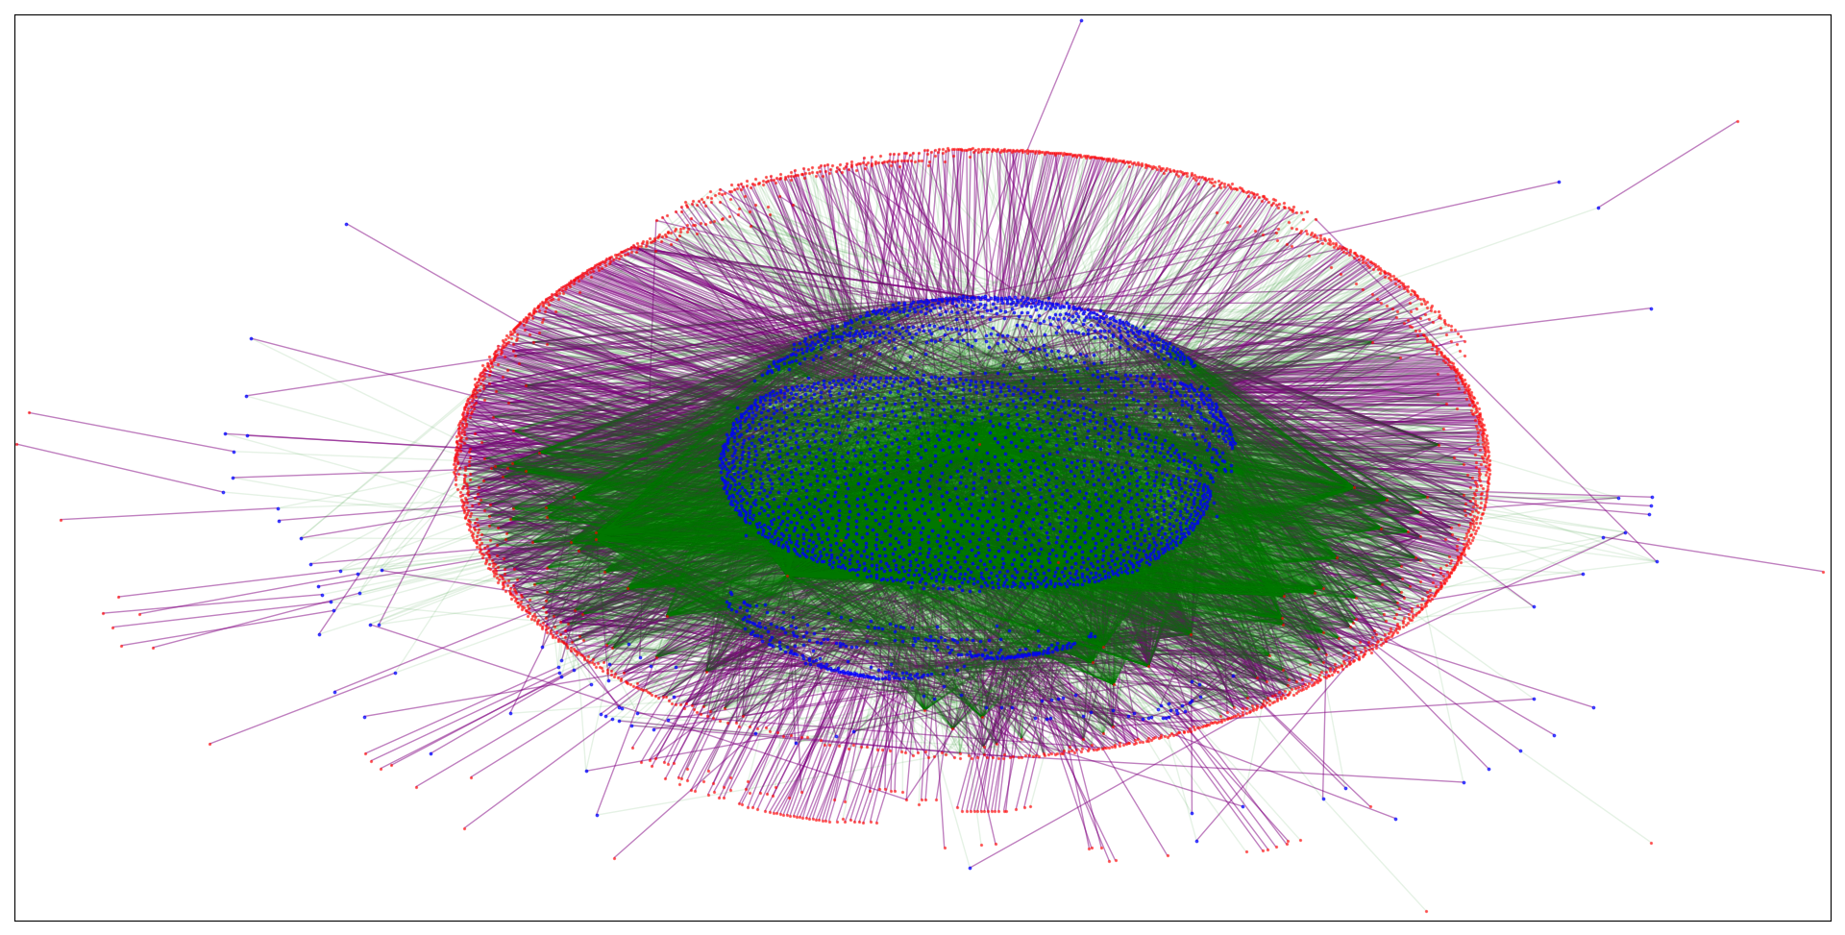
Backup

