Slide 1
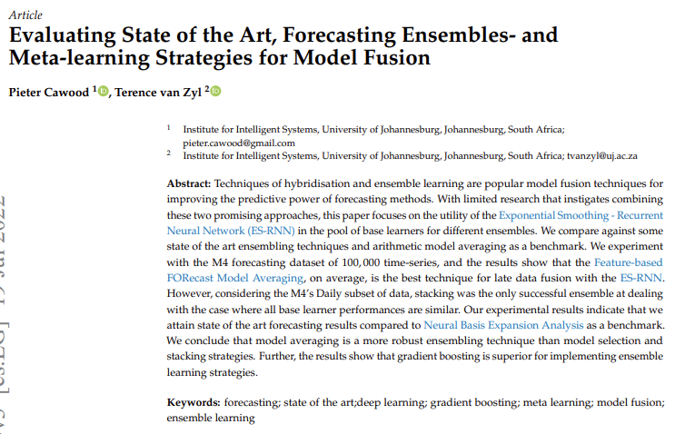
Notes:
Evaluating State of the Art, Forecasting Ensembles- and Meta-learning Strategies for Model Fusion (arxiv.org)

Slide 2
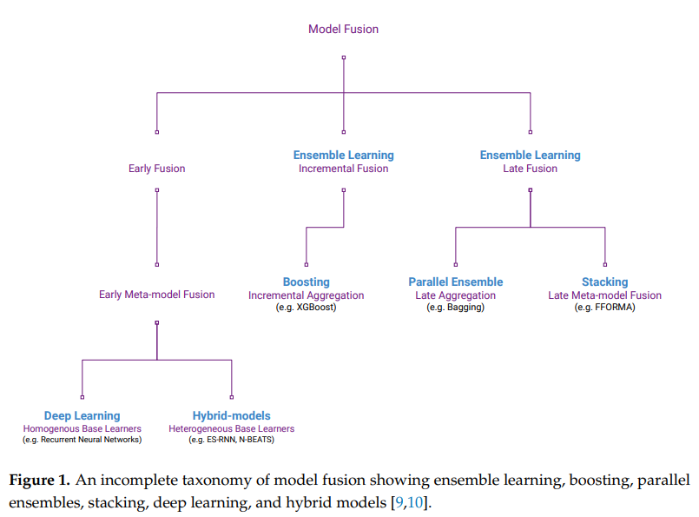
Figure taken from Evaluating State of the Art, Forecasting Ensembles- and Meta-learning Strategies for Model Fusion (arxiv.org).
Data fusion
integrating data sources
Model fusion
Combining base-level learners into a more robust and consistent model.
Base-learners
Homogeneous (decision trees in Random Forest)
Heterogeneous (Neural network)
Early fusion
Integrates base-learners before training
Combined model trained as a single fused model
Late fusion
First train base-learners individually
Pre-trained base-learners integrated without further modification
Incremental fusion (=step-by-step)
Performs model integration while training base learners
Notes:
Figure taken from Evaluating State of the Art, Forecasting Ensembles- and Meta-learning Strategies for Model Fusion (arxiv.org).
Data fusion
Data fusion is the multimodal, multiresolution, multitemporal process of integrating data sources to produce more consistent, accurate and useful information than the sources individually. Traditional multimodal data fusion approaches can be grouped into early fusion or data-level fusion, late fusion or decision-level fusion and intermediate fusion which combines both approaches.
Model fusion
This is different from model fusion, where we combine base-level learners to combine them into a model with a lower bias and variance, being more robust and consistent. These base-learners can be either homogeneous (decision trees in a random forest) or heterogeneous (a neural network and a SVM).
Different types of model fusion
Definitions for early, late and incremental model fusion. Early model fusion integrates the base learners before training. The combined model is then trained as a single fused model. Late model fusion first trains the base learners individually. The now pretrained base learners are then integrated without further modification. Incremental (=step-by-step) model fusion performs model integration while training the base learners incrementally. Each combined base learner’s parameters remain fixed once trained.

Slide 3
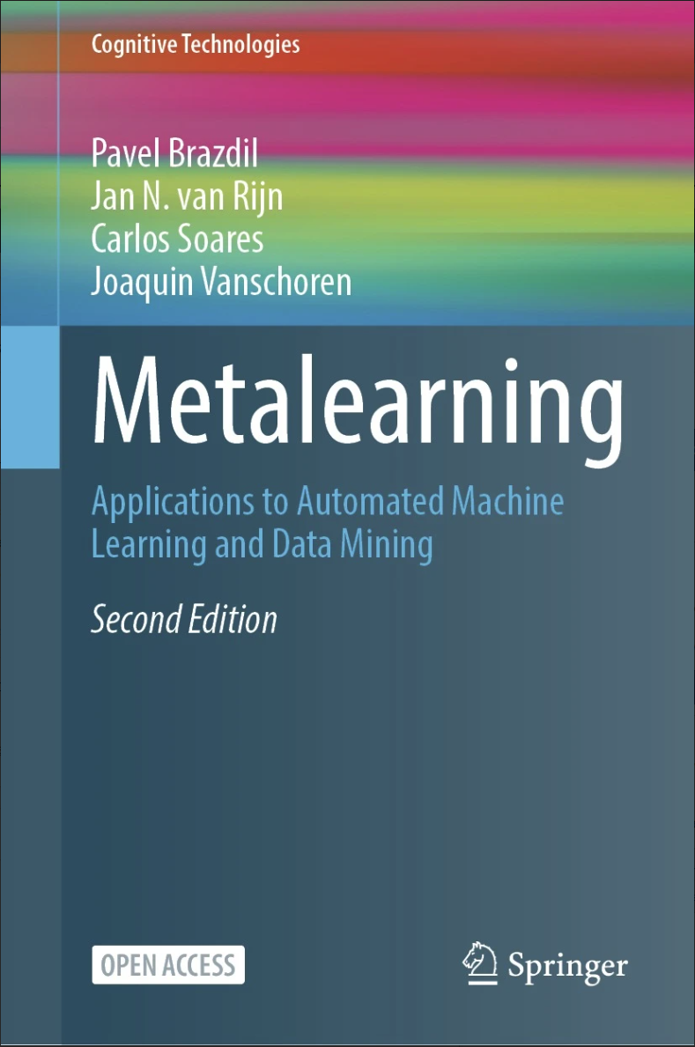
Notes:
Metalearning: Applications to Automated Machine Learning and Data Mining | SpringerLink

Slide 4
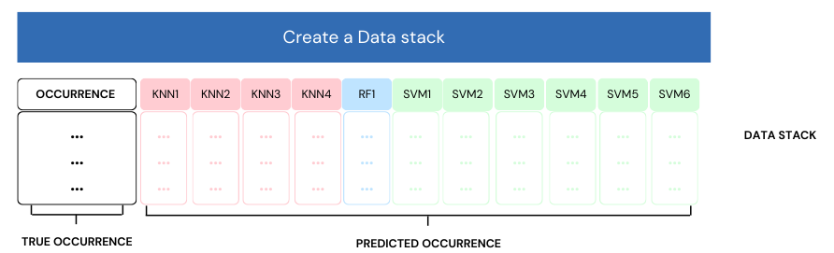
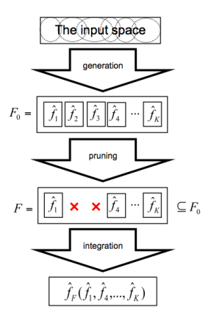
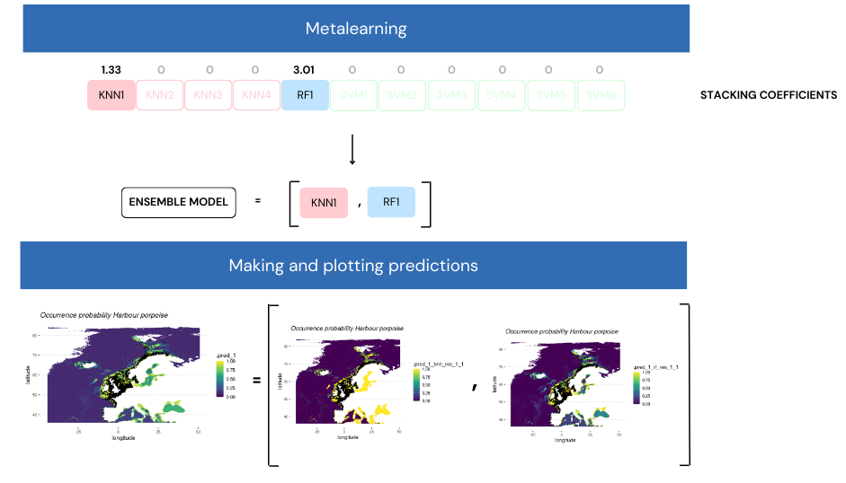
Notes:
There are 3 distinct phases: generation, pruning and integration (Mendes-Moreira et al., 2012). Generation and pruning is concerned with obtaining a pool of diverse and sufficiently accurate models (Dietterich, 2000). This involves selecting the data, ML algorithms, and training them. Pruning removes some of the models which are not considered useful (Mendes-Moreira et al., 2012). In order for the ensemble to be better than the models included in it, the models need to be diverse (Kuncheva and Whitaker, 2003).
Integration , the contribution of a single model to the ensemble depends on the other models in the ensemble (Pinto et al., 2016) so every model that is integrated or eliminated from the ensemble affects not only the total performance of the ensemble but also the contribution of each individual model.
Ensemble models or ensembles are combinations of base-level classifiers. Due to their superior performance they are very popular. Typically the predictions of these ensembles are generated by combining predictions of multiple and diverse models. The best algorithm for different problems may vary, we can assume the best algorithm for different spaces of the data may vary too. Ensemble learning can decrease misclassifications by increasing the system's area of expertise through combination of the (typically more localized) expertise of multiple models. The process of learning and using an ensemble involves two-levels: base-level models obtained by analyzing the data, the combination of those models is a meta-level operation. In some cases it's simple (i.e., voting or averaging).

Slide 5
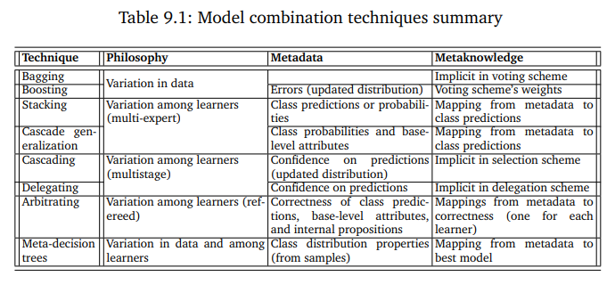
Notes:
Let us start with a definition of metalearning, as it is viewed in this book: Metalearning is the study of principled methods that exploit metaknowledge to obtain efficient models and solutions by adapting machine learning processes. The metaknowledge referred to above typically includes any sort of information obtained from previous tasks, such as descriptions of prior tasks, the pipelines and neural architectures tried, or the resulting models themselves. In many cases, it also includes knowledge that is obtained during the search for the best model on a new task, and that can be leveraged to guide the search for better learning models. Lemke et al. (2015) describe this from a systems point of view: A metalearning system must include a learning subsystem, which adapts with experience. Experience is gained by exploiting meta-knowledge extracted: a) in a previous learning episode on a single dataset and/or b) from different domains or problems. Currently, the aim of many is to exploit the metadata gathered both on the past and the target dataset.

Slide 6
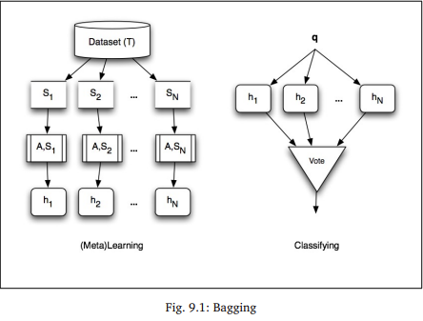
Bagging
Notes:
Training data T gets sampled to Samples S, go through algorithms A to form models h. Then go through voting.
Bagging and boosting combine multiple models built from a single learning algorithm by systematically varying the training data. Bagging (=Bootstrap aggregating), fits multiple models based on different subsets of the training data, then classification done based on majority voting. Bagging extremely effective if used on instable models (= models highly dependent on data). However, the interpretability of models is lost when bagging.

Slide 7
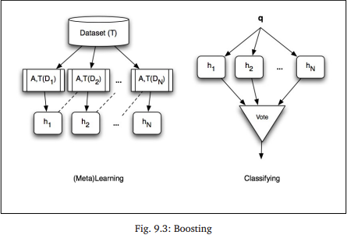
Boosting
Notes:
The initial distribution D1 over the dataset T is uniform, with each instance assigned a constant weight, i.e., probability of being selected for training, of 1/|T|, and a first model is induced. At each subsequent iteration, the weights of misclassified instances are increased, thus focusing the next model’s attention on them. This procedure goes on until either a fixed number of iterations has been performed or the total weight of the misclassified instances exceeds 0.5.
Bagging and boosting combine multiple models built from a single learning algorithm by systematically varying the training data. Boosting tends to exploit a learner’s weakness, by finding many weak learners and combine them into a single classifier.

Slide 8
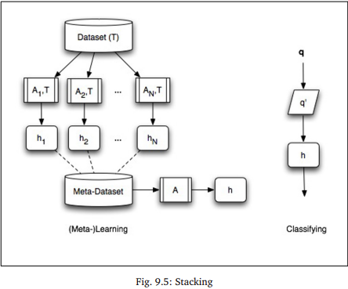
Stacking
Notes:
new dataset T is constructed by replacing the description of each instance in the baselevel dataset by the predictions of each base-level model for that instance.2 This new metadataset is in turn presented to a new learner Ameta that builds a metamodel hmeta. A new query instance q is first run through all the base-level learners to compose the corresponding query meta-instance q 0 , which serves as input to the metamodel to produce the final classification for q.
Stacking takes a number of algorithms and runs them against the dataset to produce a series of models, the predictions of each base-level model is than used as input to train a new model. Sometimes the predictions are just appended to the base-level description, making a hybrid meta-example.

Slide 9
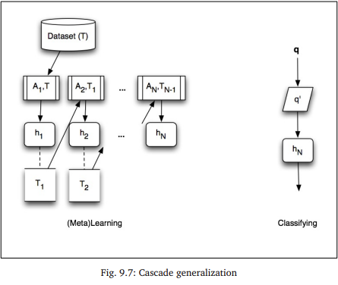
Cascade generalization
Notes:
the classifiers are used in sequence rather than in parallel as in stacking. Instead of the data from the base-level learners feeding into a single meta-level learner, each base-level learner Ai+1 (except for the first one, i.e., i > 0) also acts as a kind of meta-level learner for the base-level learner Ai that precedes it. Indeed, the inputs to Ai+1 consist of the inputs to Ai together with the class probabilities produced by hi, the model induced by Ai. A new query instance q is first extended into a meta-instance q 0 as it gathers metadata through the steps of the cascade. The final classification is then given by the output of the last model in the cascade on q 0 .
Cascade generalization exploits differences among learners, here the classifiers are used in sequence, opposed to in parallel as in stacking. It can be seen as a kind of multi-learner version of boosting and has as main benefit that the classification time is reduced as not all base classifiers need to be consulted when predicting the class of a new query instance.
So at each step it generates new features by using the output of the previous model.

Slide 10
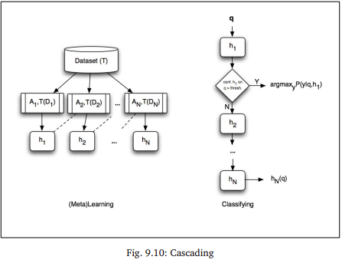
Cascading
Notes:
kind of multilearner version of boosting. Like boosting, cascading varies the distribution over the training instances, here as a function of the confidence of the previously generated models. Unlike boosting, however, cascading does not strengthen a single learner but uses a small number of different classifiers of increasing complexity, in a cascade-like fashion.
Each model is trained on the same dataset but with a distribution based on the confidence of the previous model.
A query q is given to all the different models and looks for the first model which goes over the confidence threshold.

Slide 11
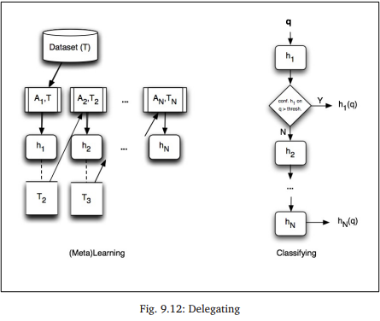
Delegating
Notes:
In cascading, however, all instances are (re)weighted and processed at each step. In delegating, the next classifier is specialized to only those instances for which the previous one lacks confidence, through training only on the delegated instances, as illustrated in Figure 9.12. The delegation stops either when there are no instances left to delegate or when a predefined number of delegation steps has been performed.
Delegating classifier is a classifier that provides only classifications for instances above a predefined confidence threshold, and passes other instances to another classifier.

Slide 12
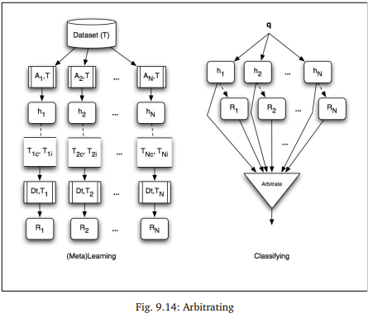
Arbitrating
Notes:
, all classifiers in arbitrating are trained on the full dataset T and specialization is performed at run time when a query instance is presented to the system. At that time, the classifier whose confidence is highest in the area of input space close to the query instance is selected to produce the classification. The area of expertise of each classifier is learned by its corresponding referee. The referee, although it can be any learned model, is typically a decision tree which predicts whether the associated classifier is correct or incorrect on some subset of the data, and with what reliability.
Arbitrating is like delegating but the classifiers are trained on the full dataset and the delegating only happens when a new query is given, then the classifier for which the confidence is the highest will produce the prediction.

Slide 13
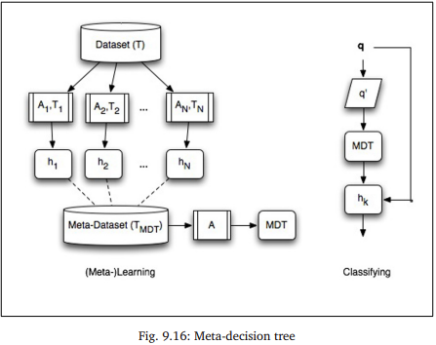
Meta-decision tree
Notes:
The general idea in MDT is similar to stacking in that a metamodel is induced from information obtained using the results of base-level learning, as shown in Figure 9.16. However, MDTs differ from stacking in the choice of what information to use, as well as in the metalearning task. In particular, MDTs build decision trees where each leaf node corresponds to a classifier rather than a classification. Hence, given a new query example, a meta-decision tree indicates the classifier that appears most suitable for predicting the example’s class label. The MDT building algorithm is shown in Figure 9.17.
Meta-decision trees is like stacking but here every classifier is a leaf in the decision tree.
So the metadataset is used to determine the best model that is build with a specific algorithm and part of the dataset, this model is then used to make the classification. So the Metadatamodel is actually used to determine which classifier to use.

