Slide 1
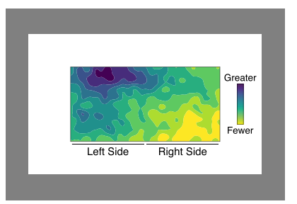
The relationship between color and spatial structure for interpreting colormap data visualizations (Sibrel et al., 2020)
dark-is-more bias
hotspot-is-more bias

Slide 2
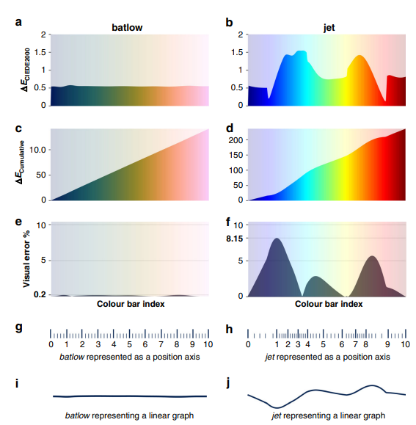
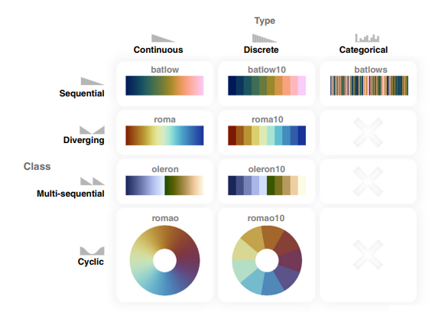
The misuse of colour in science communication (Crameri et al., 2020)
Manipulation of data (highlighting certain data)
Oversight needs of colour vision deficiencies
Removal of meaning
Data should be shown in universal manner

Slide 3
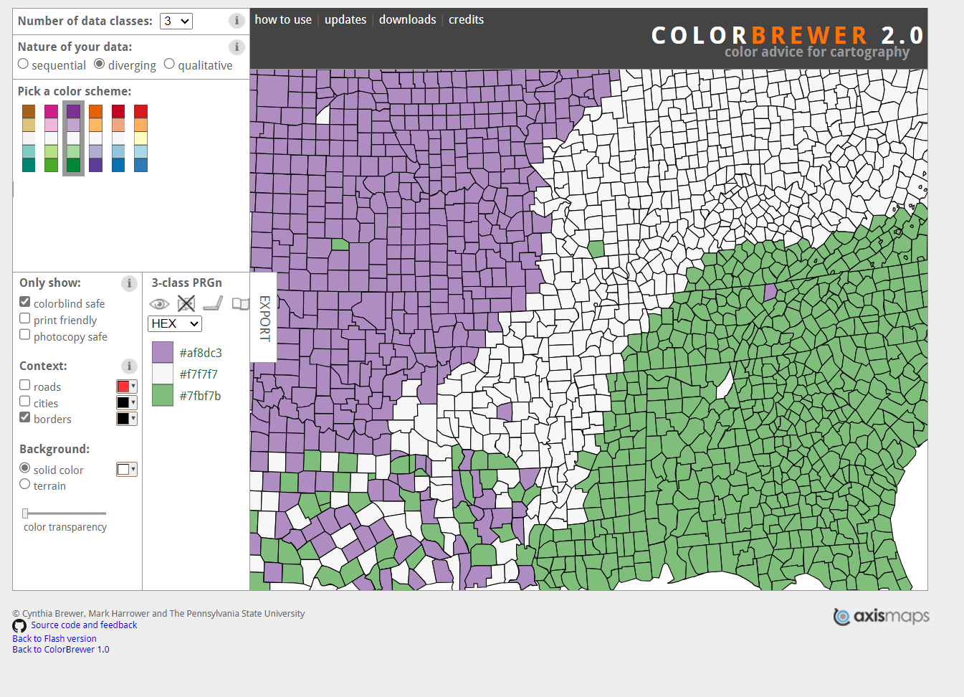
Examples: Colorbrewer2.0
https://colorbrewer2.org/#type=sequential&scheme=BuGn&n=3
Helps you choose the right colors

Slide 4
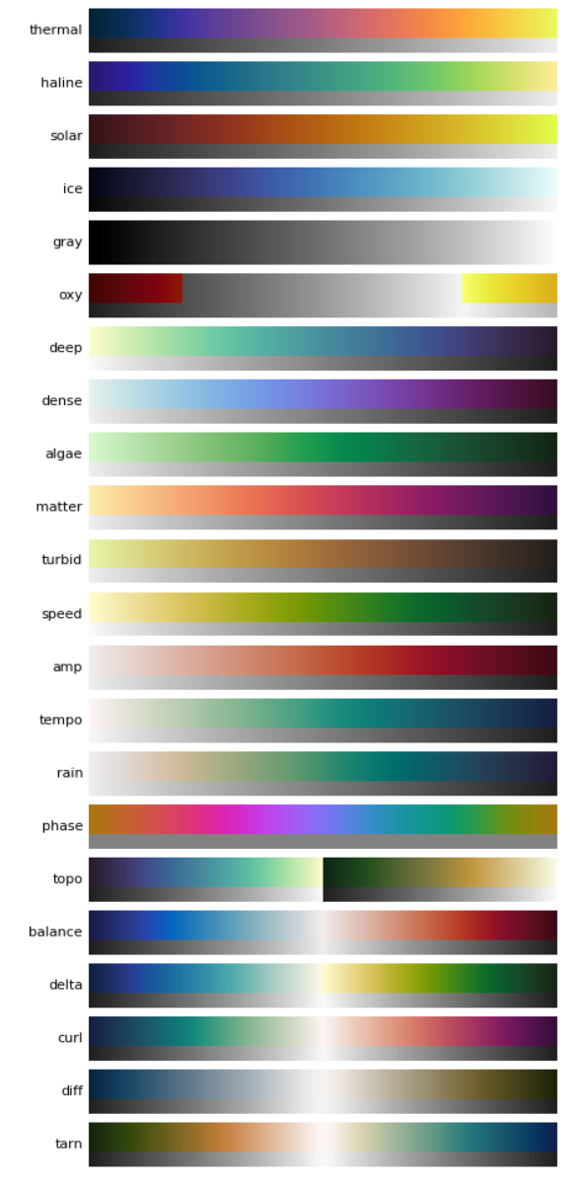
Examples: CMocean
https://matplotlib.org/cmocean/
Colormaps for commonly-used oceanographic variables
Lot of other resources about use of color in science

Slide 5
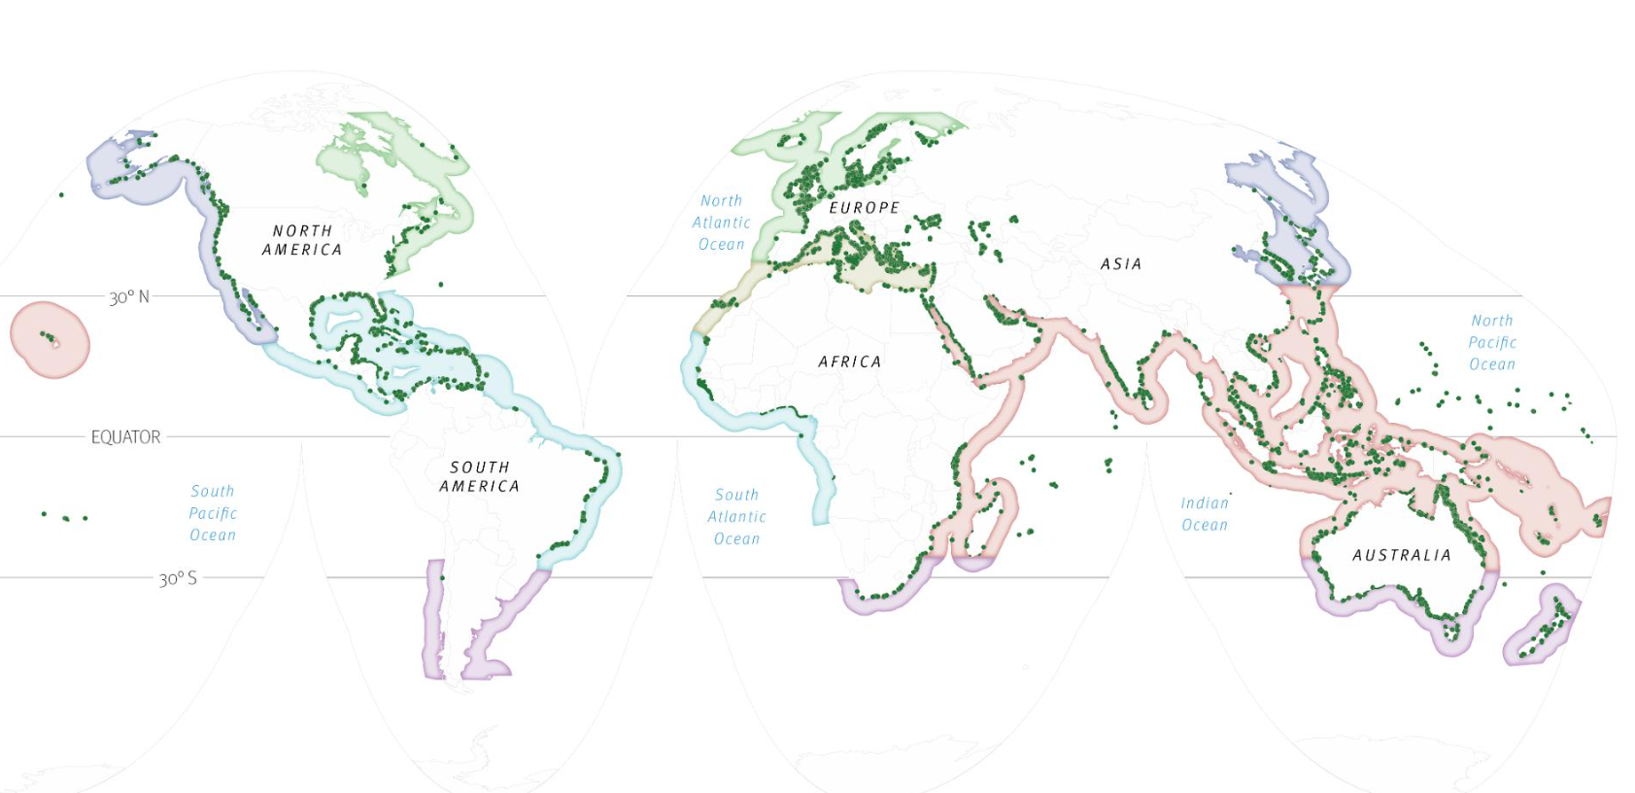
Examples: Storymaps
https://storymaps.arcgis.com/stories/098c795b5afc4beca9ab6417b32e5bac
Another way of visualizing spatial data

Slide 6
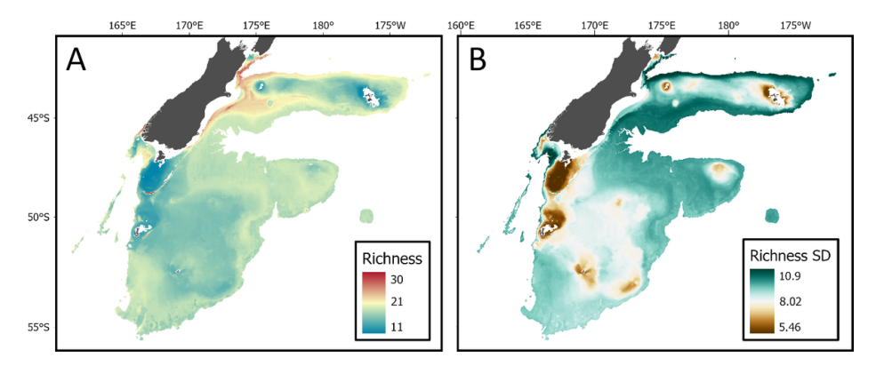
Uncertainty and extrapolation
Using joint species distribution modelling to predict distributions of seafloor taxa and identify vulnerable marine ecosystems in New Zealand waters (Stephenson et al., 2023)
Multivariate environmental similarity surfaces (MESS) R package

Slide 7
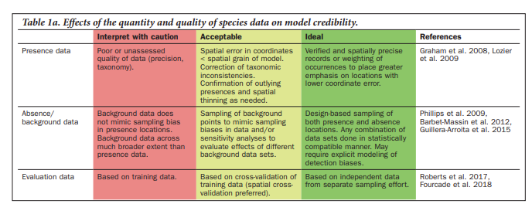
Uncertainty
Concerning uncertainty and trust in models, discussed grouping models into tiers (like IPCC does)
Maybe based on categories suggested in Sofaer et al. (2019)
Development and Delivery of Species Distribution Models to Inform Decision-Making | BioScience | Oxford Academic (oup.com)

