Slide 1
Occupancy modelling
Modelling study group

Slide 2
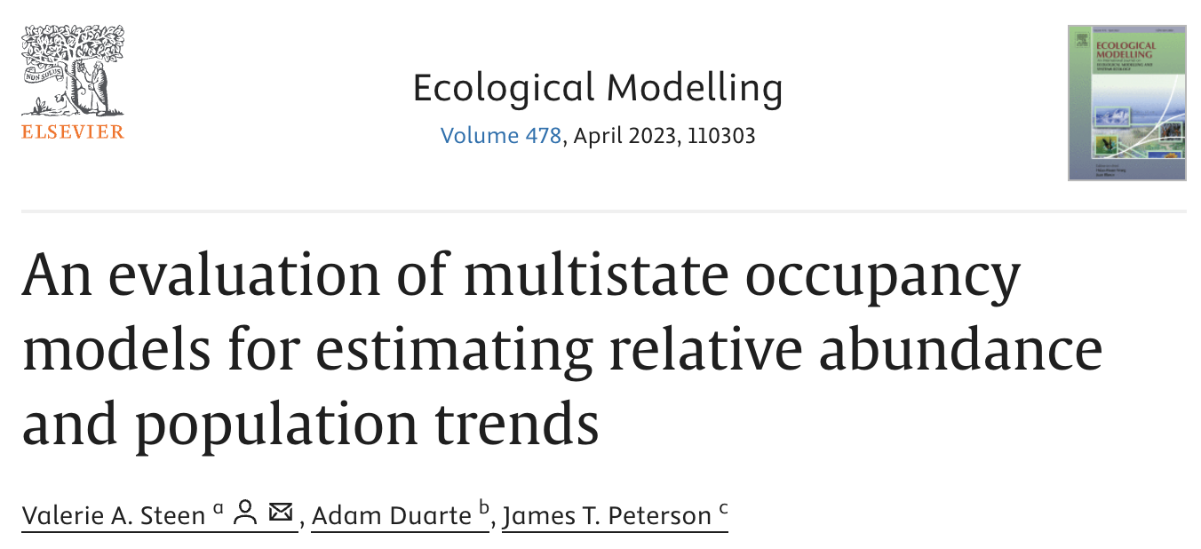

Slide 3
Multistate occupancy models
Multistate occupancy models estimate multiple states across space and sometimes through time (e.g., species absent, species present but not breeding, species present and breeding).

Slide 4
There are at least three states being modeled, one of which is always “species absence.” The interpretation of the remaining states depends on the model & data, but these states are always related to species presence in one form or another.
There is a separate probability of ‘success’ for each state, including species absence.
The sum of the probabilities across all states must sum to unity (i.e., sum to 1).

Slide 5
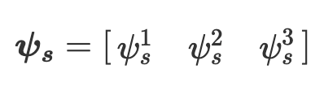
No detection of an owl
Detection of an adult owl but no detection of a young owl
Detection of a young owl (i.e., reproductive success)
Source: https://masonfidino.com/intro_2_multistate_occupancy/

Slide 6
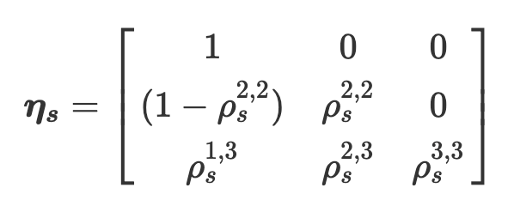

Slide 7
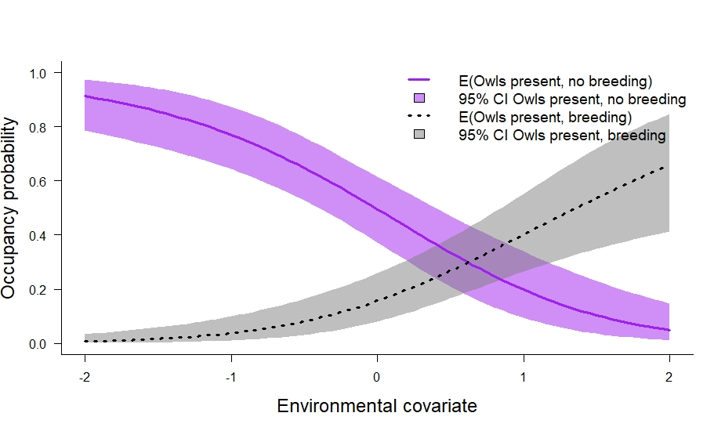

Slide 8
ψ¹ the probability of occupancy regardless of abundance state, ψ² the probability of abundant given that the site is occupied, p¹ the probability of detecting occupancy given it is not in the abundant state, p² the probability of detecting occupancy given it is in the abundant state, and δ the probability of detecting the abundant state given that the species was detected and the true state was abundant.
We calculated the probability of a site being in the abundant state as ψ¹ × ψ², and the probability of being unoccupied as 1 - ψ¹.

Slide 9
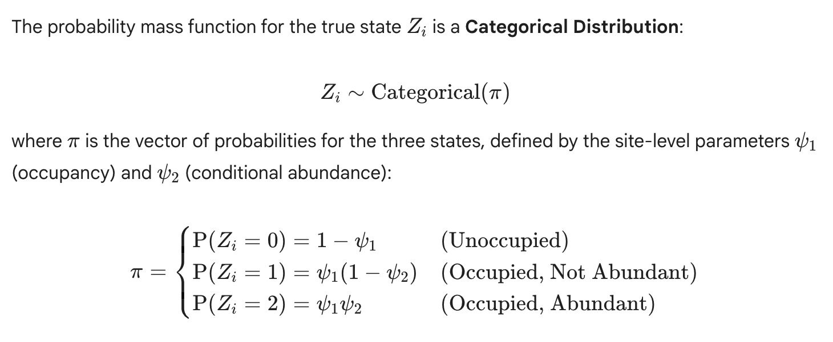

Slide 10
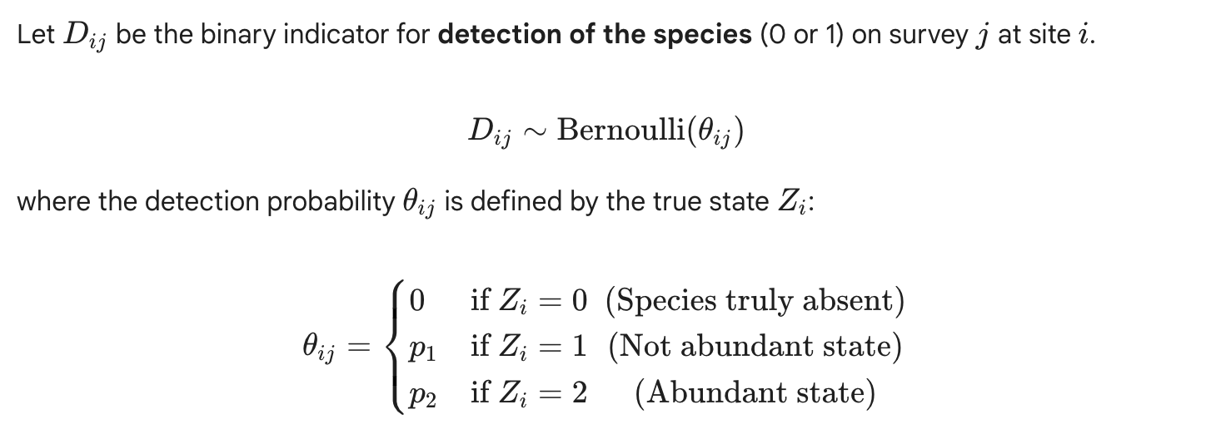

Slide 11
We found, not surprisingly, that this approach would not be appropriate if sites differ little in their true abundance levels. We otherwise found that this approach could be used to differentiate sites with relatively high abundance from sites with relatively low abundance even in the face of high levels of individual movement, deaths, or recruitment among visits. Multistate occupancy models also had a good ability to detect a declining trend if the same sites were surveyed each year (i.e., the fixed site design), especially when more sites were surveyed.

Slide 12
