Slide 1
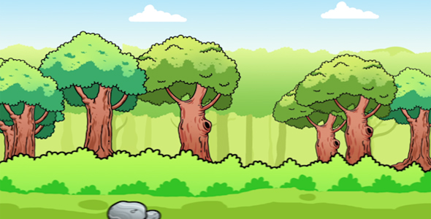
A Deep Dive into Random Forests
By: Ari Silburt
https://github.com/silburt/RF_DeepDive

Slide 2
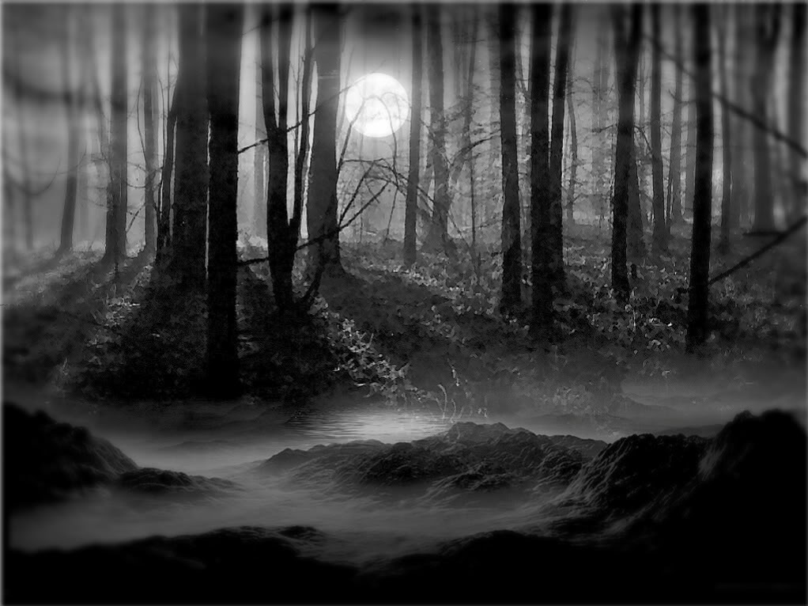
Random Forests May Seem Scary…

Slide 3
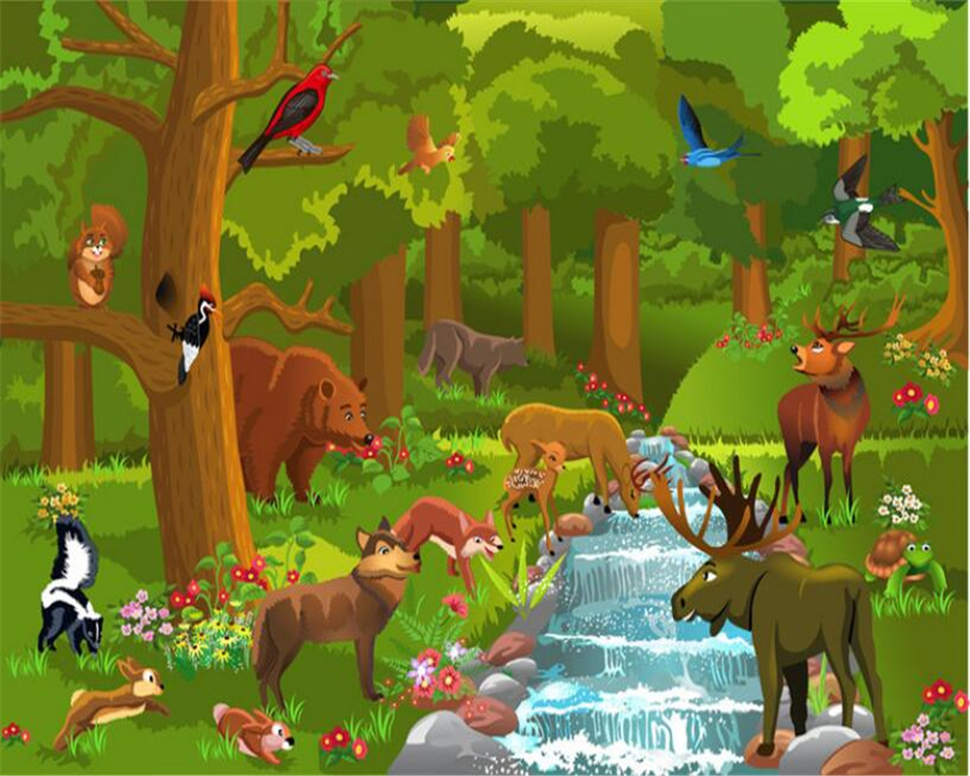
But They’re Actually Not Too Bad!

Slide 4
Plan
Decision Tree
Random Forests (+ Bagging)
Tree Optimization and Feature Importance (Gini Criterion)
Model Regularization
Closing Notes

Slide 5
Decision Tree

Slide 6
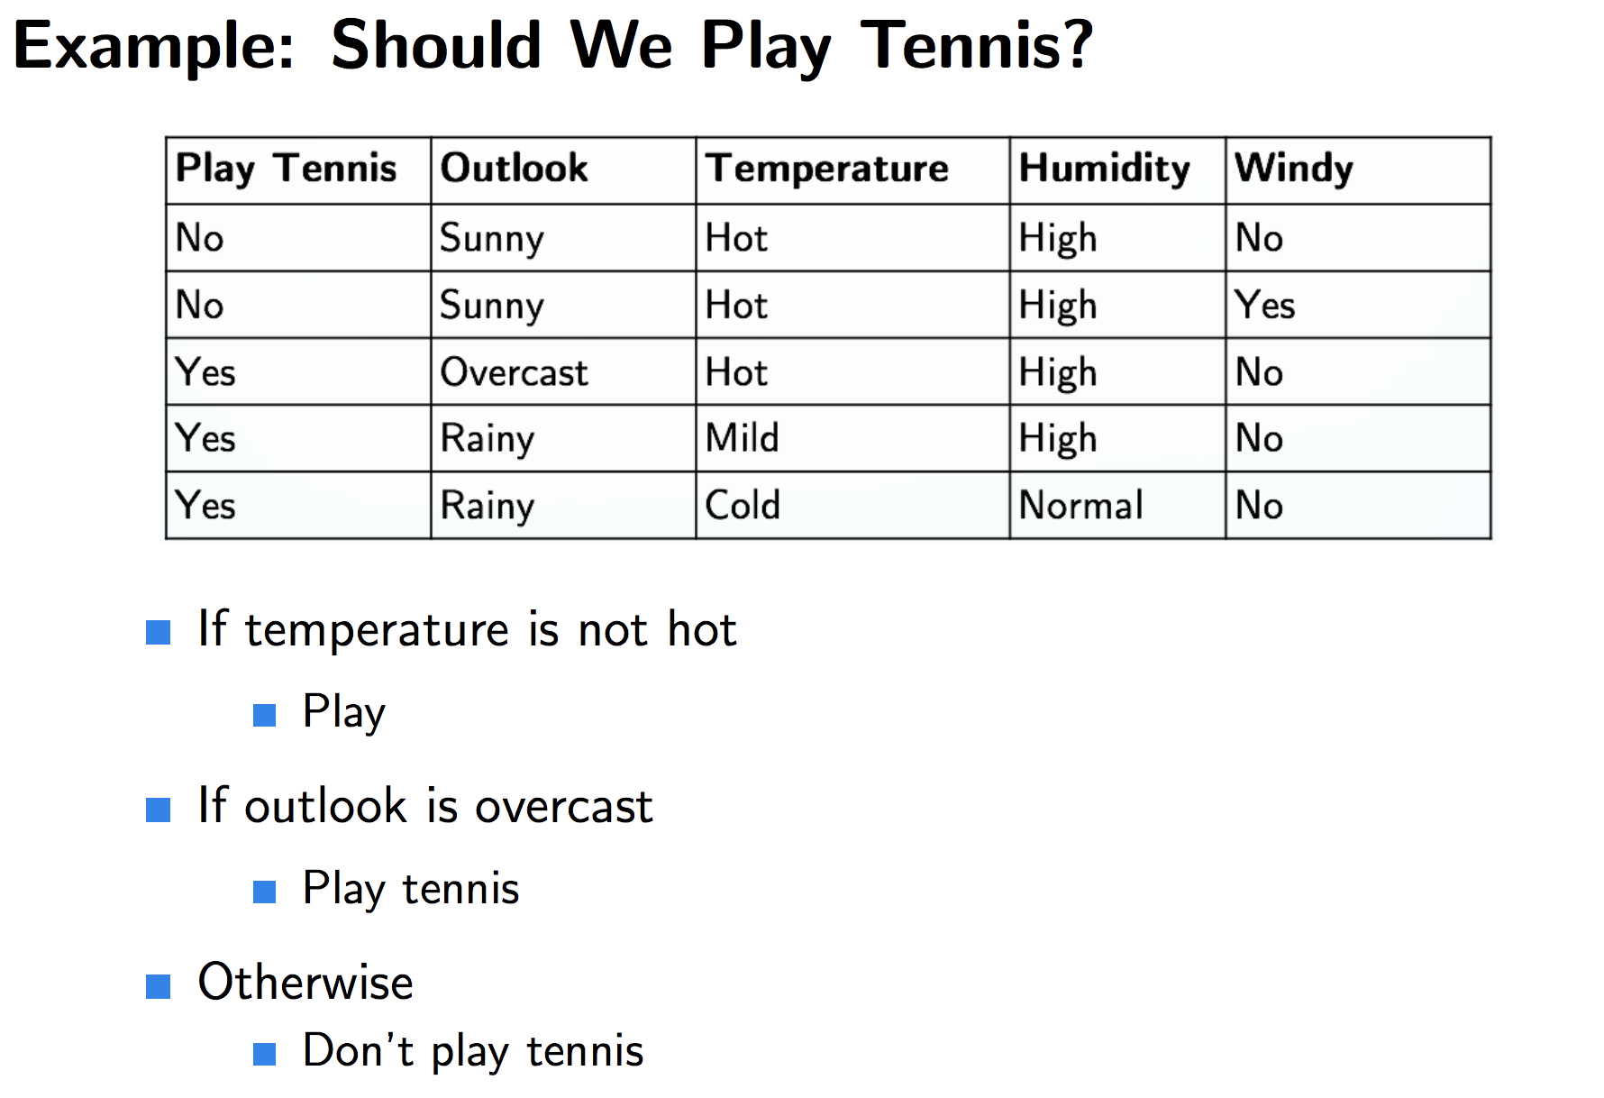
Decision Tree

Slide 7
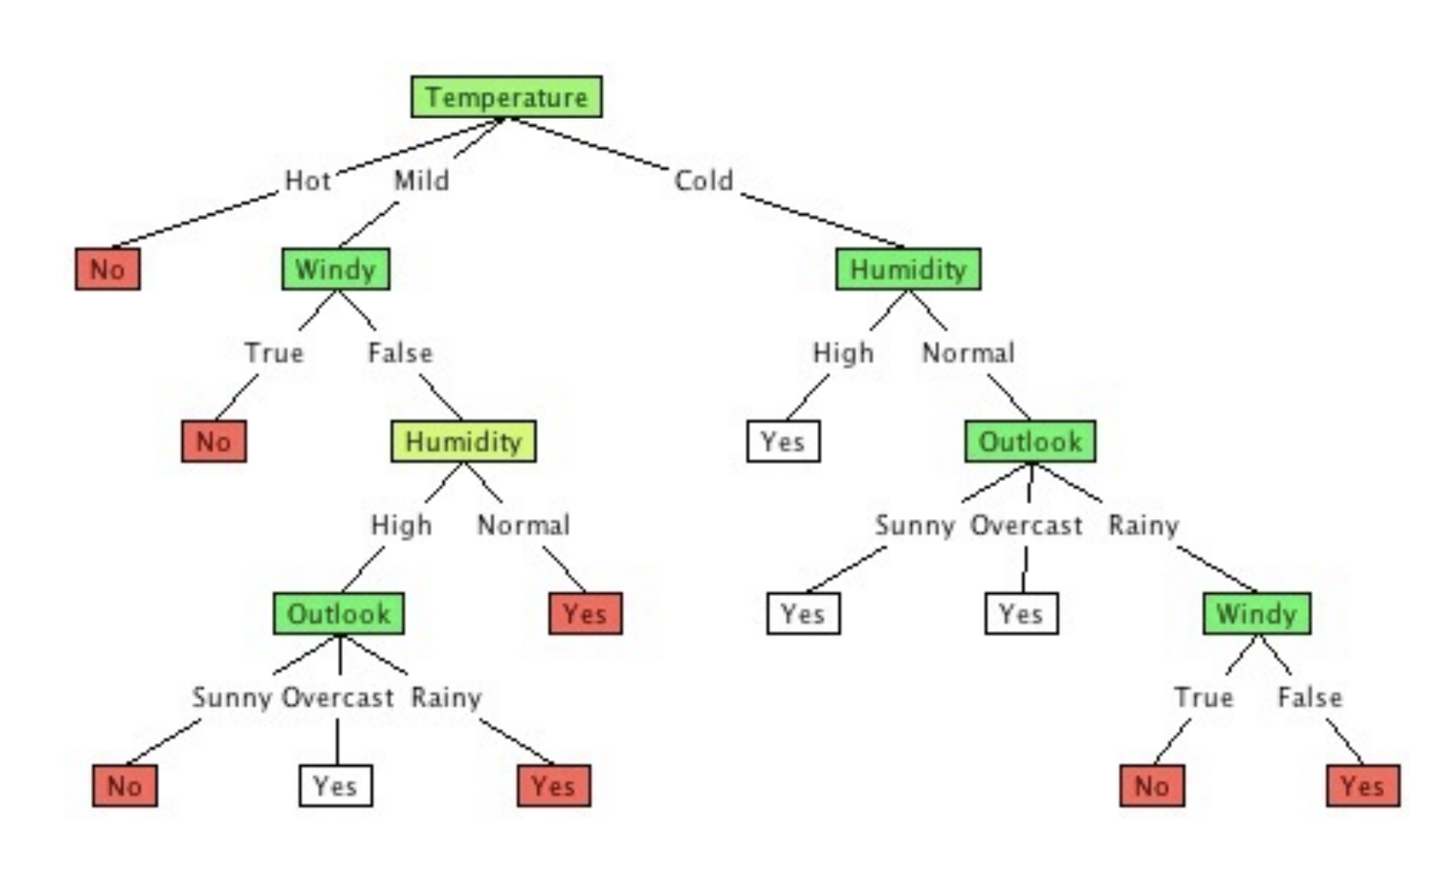
Decision Tree
Properties
Feature can show up more than once in different branches (e.g. windy).
Node can have both a branch and leaf stemming from it.

Slide 8
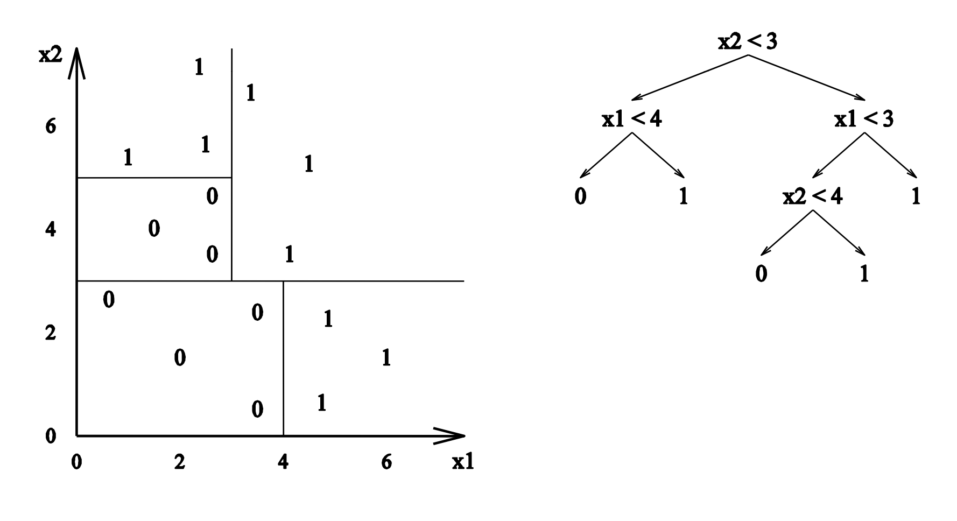
Decision Tree – Pros and Cons
Pros:
Non-linear decision boundaries
Easy to interpret
Numerical & Categorical Data
Notes:
Each split draws a single decision boundary through the data – through multiple splits and aggregating decision boundaries you can make some pretty complex choices!

Slide 9
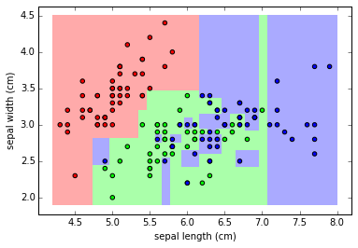
Decision Tree – Pros and Cons
Cons:
Easy to Overfit
High Variance (i.e. unstable).

Slide 10
Random Forests

Slide 11
Random Forests – Many Decision Trees
We can guess that a Random Forest = many decision trees. But how?
Many copies of the exact same tree is useless…

Slide 12
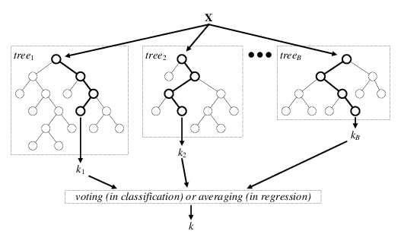

Random Forests – Many Decision Trees
OK, so we want some tree variation, but how…
Notes:
Take a minute to talk with your neighbor, think about how the trees could be varied, and why. Some teaching workshops I took in my PhD stated that people will learn a concept better if they think first then get the answer vs. I just tell you.

Slide 13
Random Forests – Many Decision Trees
Remember: Decision Tree
We want tree variation, but how…
Vary trees such that overall variance is reduced:
Notes:
Remember the original

Slide 14
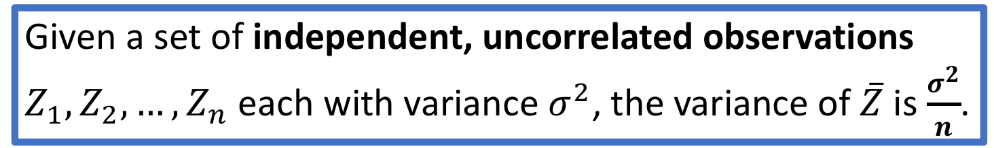
Random Forests – Many Decision Trees
Remember: Decision Tree
We want tree variation, but how…
Vary trees such that overall variance is reduced:
STATS101:
Given a set of independent, uncorrelated observations $Z_{1},Z_{2}, …, Z_{n}$ each with variance $σ^{2}$, the variance of $\overline{Z}$ is $\frac{σ^{2}}{n}$.

Slide 15
Random Forests – Many Decision Trees
Remember: Decision Tree
We want tree variation, but how…
Vary trees such that overall variance is reduced:
STATS101:
Given a set of independent, uncorrelated observations $Z_{1},Z_{2}, …, Z_{n}$ each with variance $σ^{2}$, the variance of $\overline{Z}$ is $\frac{σ^{2}}{n}$.
This is why a forest of identical trees is useless.

Slide 16
Random Forests – Many Decision Trees
Remember: Decision Tree
We want tree variation, but how…
Vary trees such that overall variance is reduced:
STATS101:
Given a set of independent, uncorrelated observations $Z_{1},Z_{2}, …, Z_{n}$ each with variance $σ^{2}$, the variance of $\overline{Z}$ is $\frac{σ^{2}}{n}$.
This is why a forest of identical trees is useless.
This is why ensembling many models together always improves results.
Notes:
So how do we make the trees uncorrelated and independent?

Slide 17
Random Forests – Many Decision Trees
How do we make trees as independent and uncorrelated as possible?
Notes:
So how do we make the trees uncorrelated and independent?

Slide 18
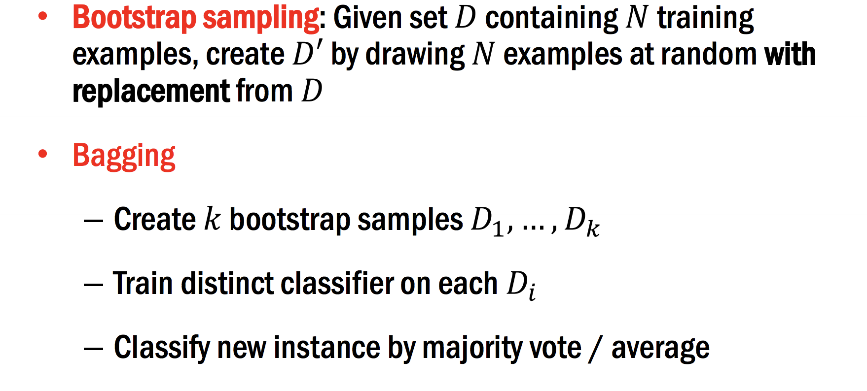
Random Forests – Randomize Data

Slide 19
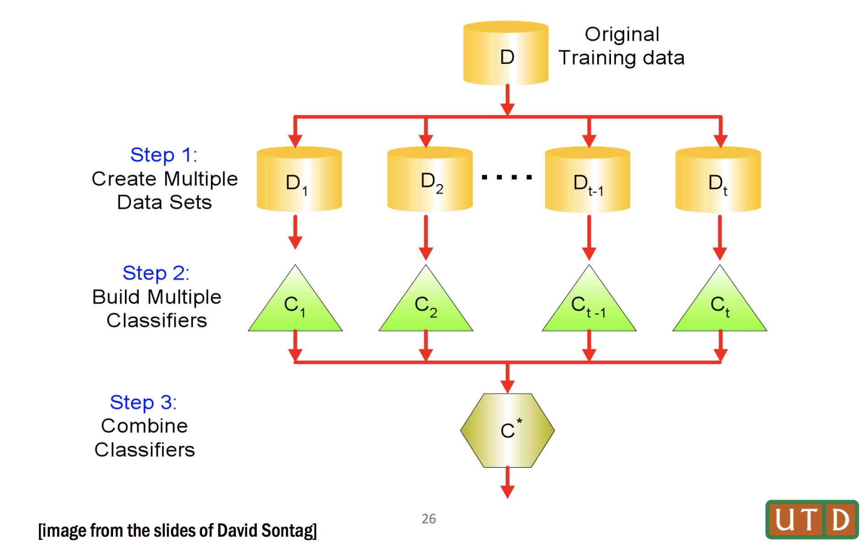
Random Forests – Randomize Data

Slide 20
Random Forests – Randomize Features
Tree 1
Tree 2
Tree 3
Feature 1
Feature 3
Feature 5
Feature 7
Feature 2
Feature 4
Feature 6

Slide 21
Random Forests – Intuition Check
What happens if you assign more/less data per tree?
What happens if you select more/less of the total features per tree:

Slide 22
Random Forests – Intuition Check
What happens if you assign more/less data per tree?
Less: Trees more uncorrelated, but at some point too little data hurts training.
More: Trees become more correlated, but training of each tree improved.
What happens if you select more/less of the total features per tree:
Less: Trees more uncorrelated, but at some point many trees become “dead”, i.e. fitting entire trees on unimportant features.
More: Trees become more correlated, but training of each tree improved.

Slide 23
Tree Optimization and Feature Importance

Slide 24
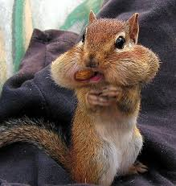
Tree Optimization – Greedy Criterion
Trees grown according to what the local best option is.
Criterion: Gini, Information Gain.

Slide 25
Short Aside - Greedy Algorithm Example
Example: Find largest path.

Slide 26
Tree Optimization – Greedy Criterion
Note: The criterion governing tree growth is different than your global cost function (e.g. precision-recall, accuracy, etc.), which determines how well your entire model is doing.

Slide 27
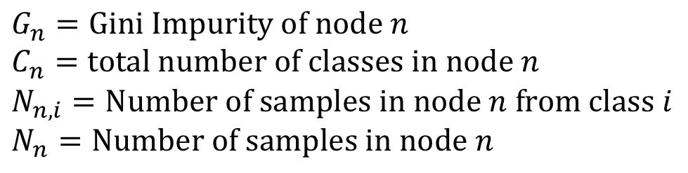
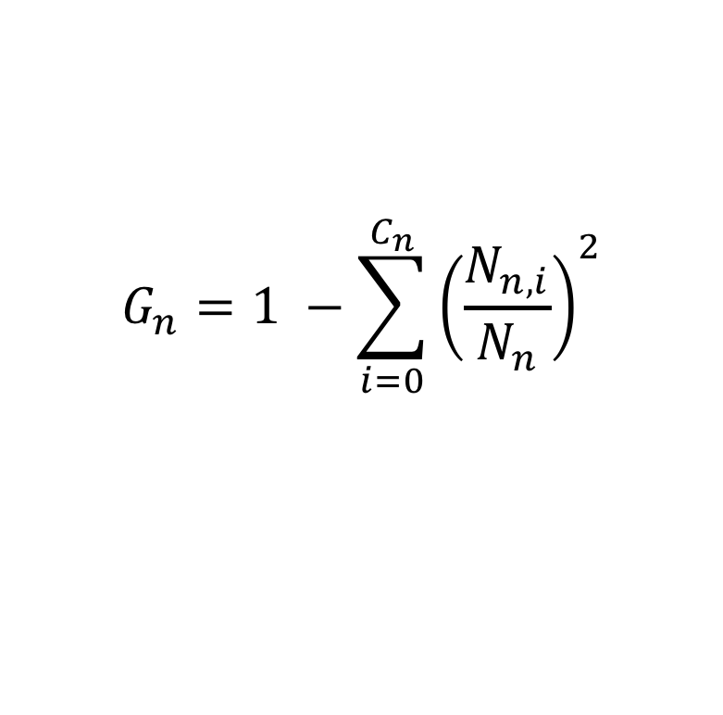
Tree Optimization – Gini Impurity
“Gini impurity is a measure of how often a randomly chosen element from the set would be incorrectly labeled if it was randomly labeled according to the distribution of labels in the subset.”
$$G_{n}=1 −\sum_{i=0}^{C_{n}}{{\left(\frac{N_{n,i}}{N_{n}}\right)}^{2}}$$
$$G_{n}=Gini Impurity of node n$$
$$C_{n}=total number of classes in node n$$
$$N_{n,i}=Number of samples in node n from class i$$
$$N_{n}=Number of samples in node n$$

Slide 28
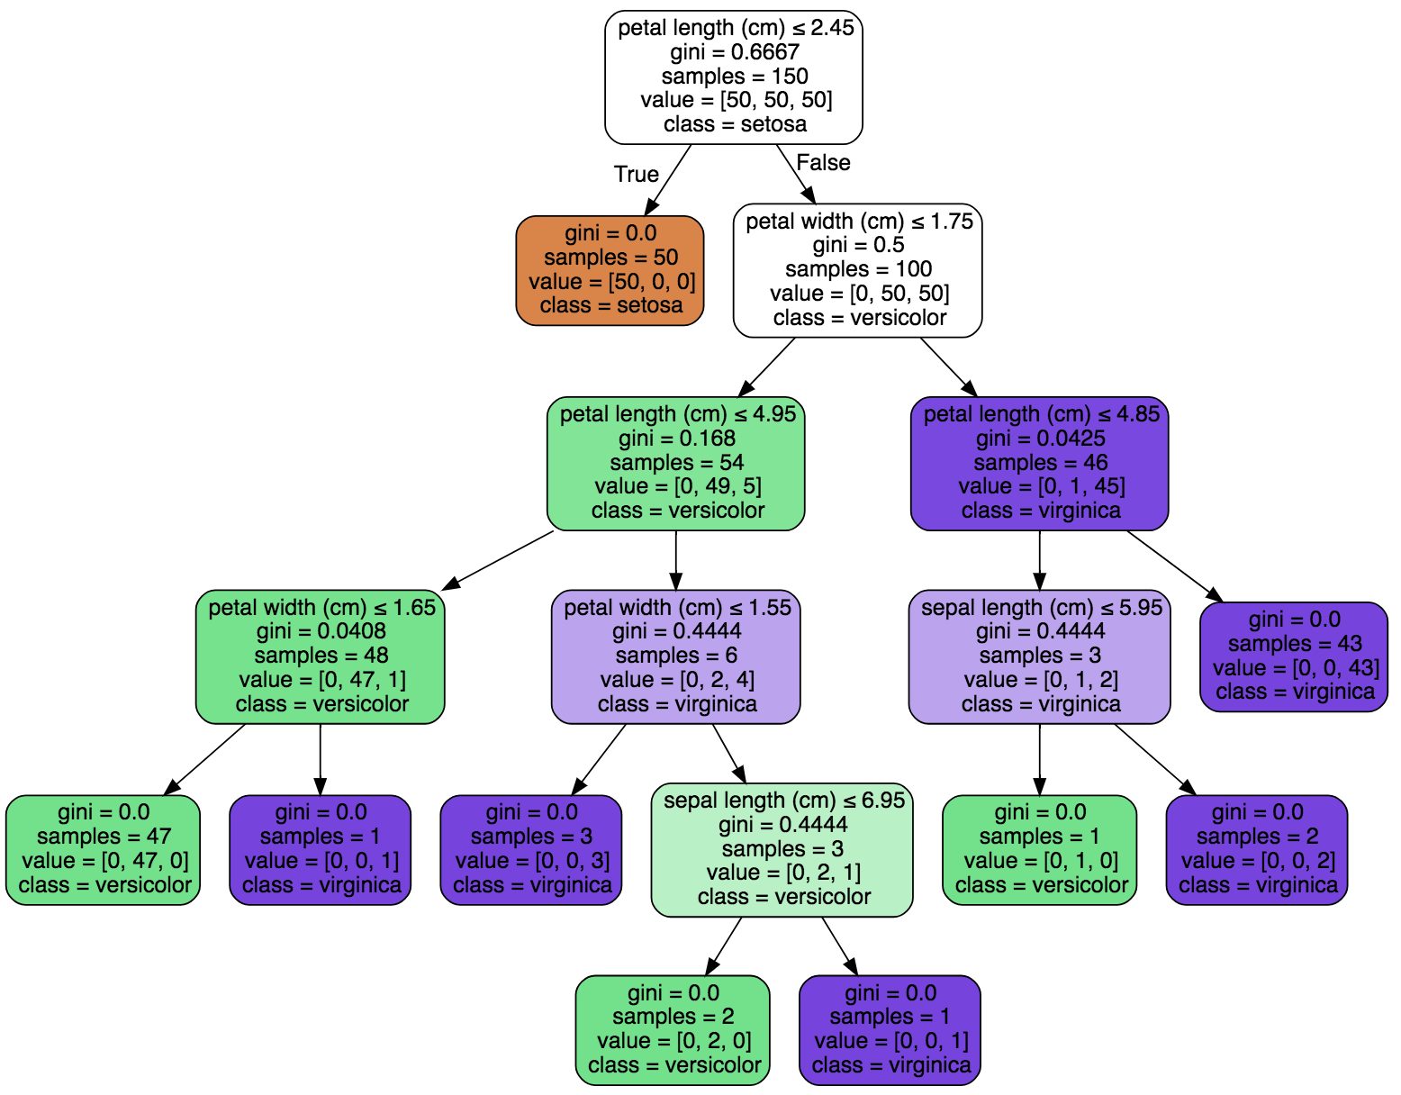
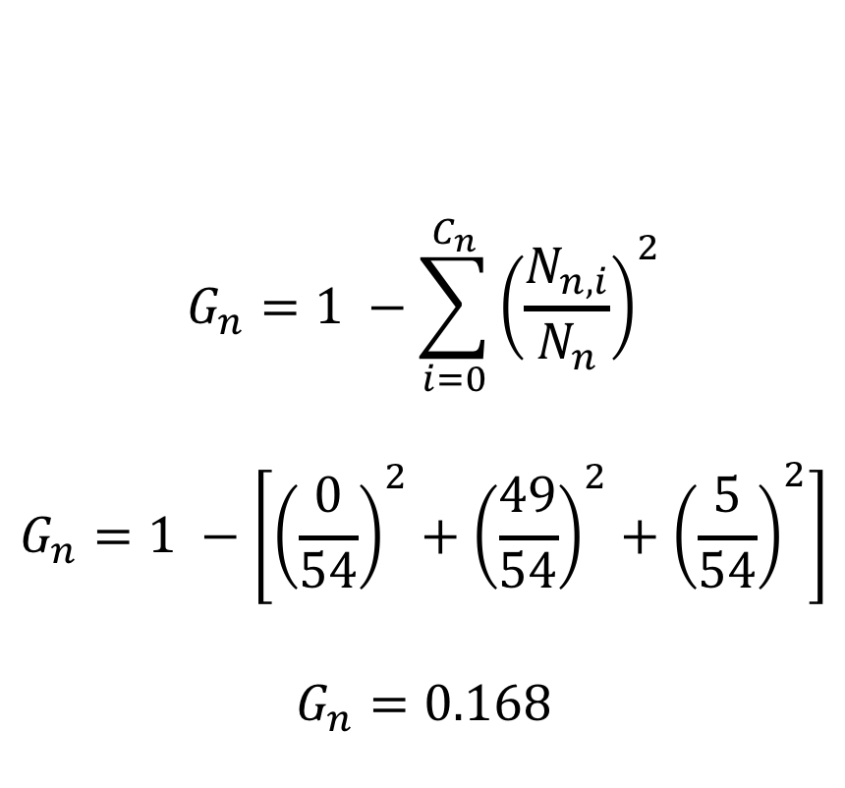
Tree Optimization – Gini Impurity Example
$$G_{n}=1 −\sum_{i=0}^{C_{n}}{{\left(\frac{N_{n,i}}{N_{n}}\right)}^{2}}$$
$$G_{n}=1 −\left[{\left(\frac{0}{54}\right)}^{2}+{\left(\frac{49}{54}\right)}^{2}+{\left(\frac{5}{54}\right)}^{2}\right]$$
$$G_{n}=0.168$$
Splits decided such that the gini impurity is locally minimized

Slide 29
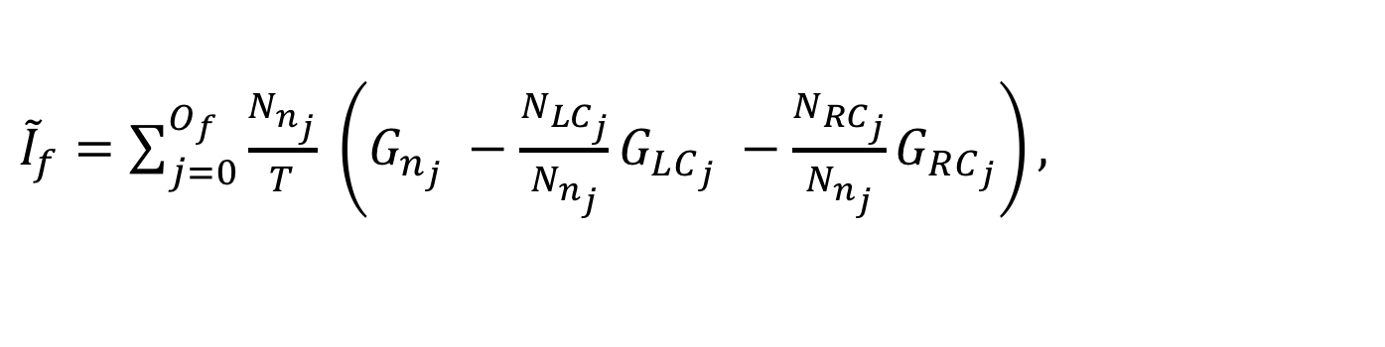
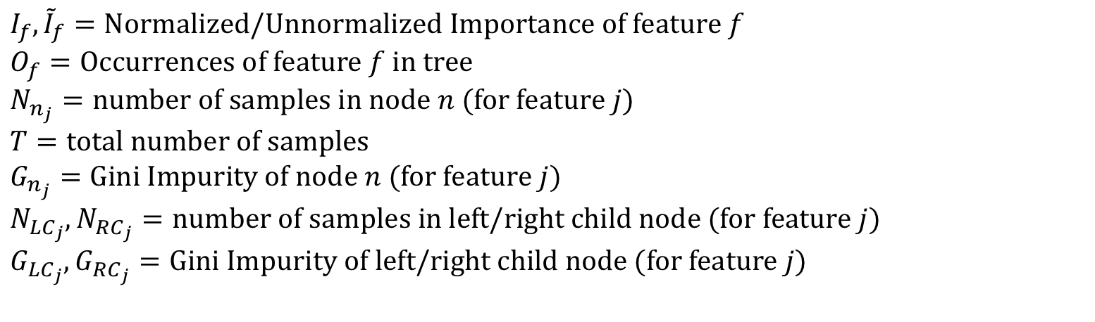
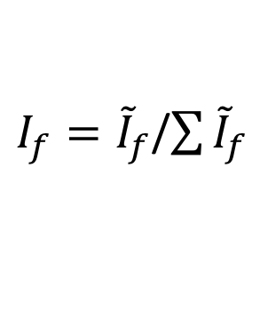
Feature Importance – Gini Impurity
“The importance of a feature is computed as the (normalized) total reduction of the criterion brought by that feature. It is also known as the Gini importance.”
${\tilde{I}}_{f}=\sum_{j=0}^{O_{f}}{\frac{N_{n_{j}}}{T} \left(G_{n_{j}} −\frac{N_{LC_{j}}}{N_{n_{j}}}G_{LC_{j}} −\frac{N_{RC_{j}}}{N_{n_{j}}}G_{RC_{j}}\right)},$
$I_{f}={\tilde{I}}_{f}$/$\sum{{\tilde{I}}_{f}}$
$$I_{f},{\tilde{I}}_{f}=Normalized/Unnormalized Importance of feature f$$
$$O_{f}=Occurrences of feature f in tree$$
$$N_{n_{j}}=number of samples in node n (for feature j)$$
$T=total number of samples$
$$G_{n_{j}}=Gini Impurity of node n (for feature j)$$
$$N_{LC_{j}},N_{RC_{j}}=number of samples in left/right child node (for feature j)$$
$$G_{LC_{j}},G_{RC_{j}}=Gini Impurity of left/right child node (for feature j)$$

Slide 30
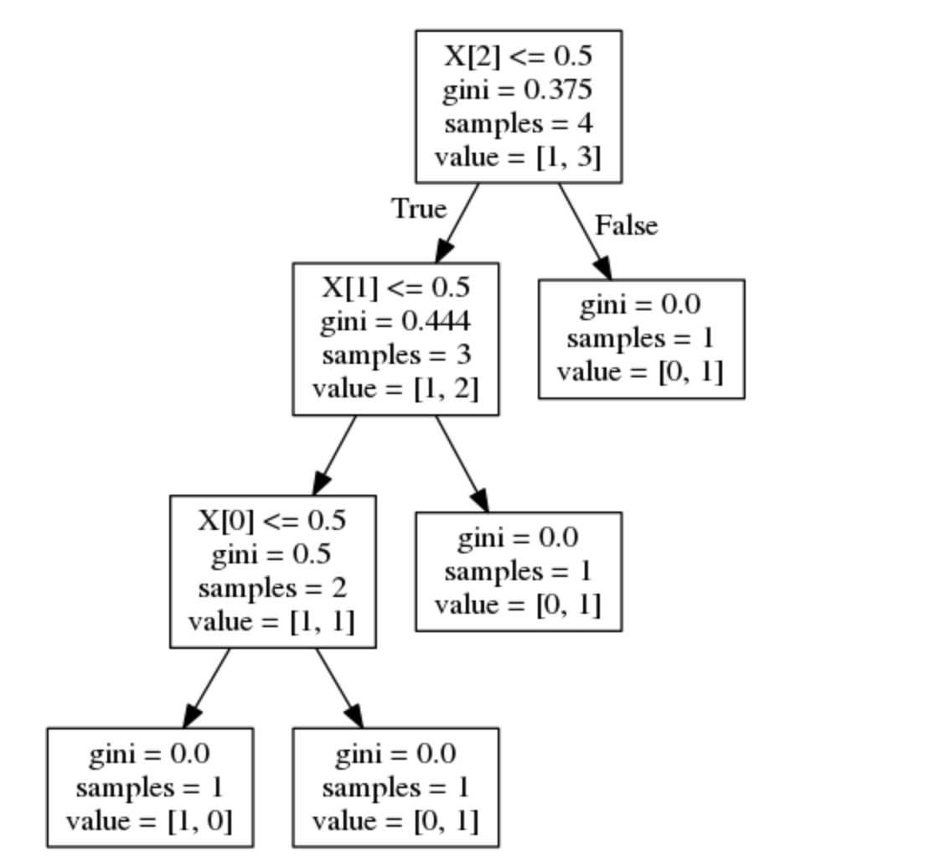
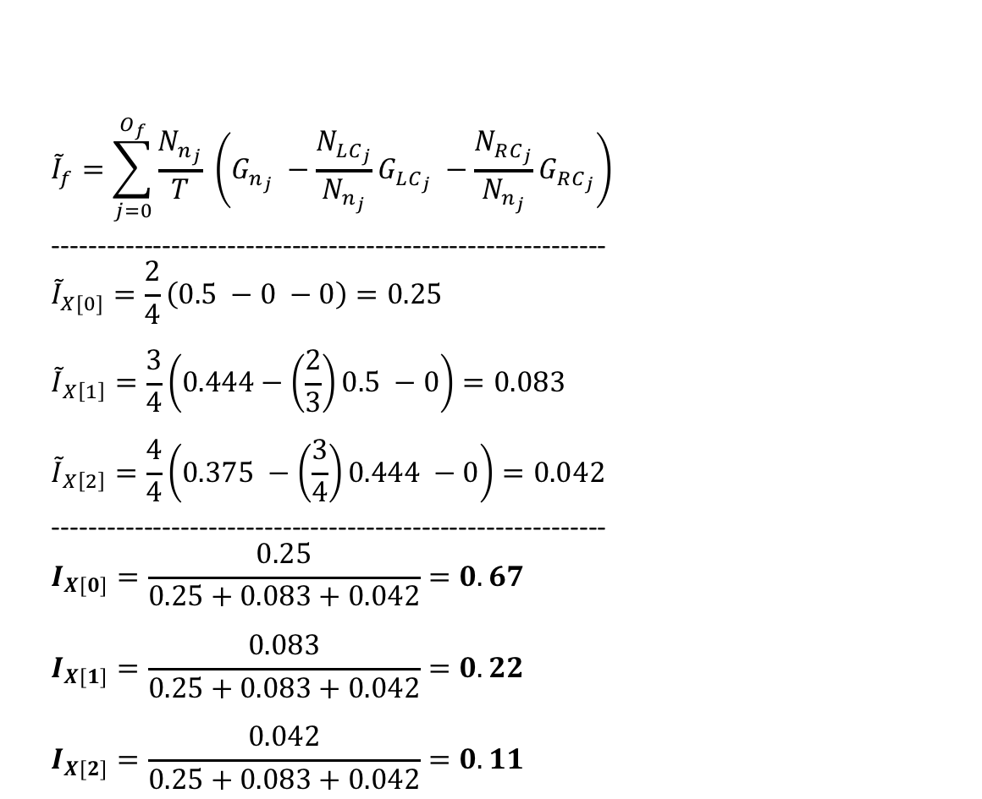
Feature Importance – Gini Impurity Example
$${\tilde{I}}_{f}=\sum_{j=0}^{O_{f}}{\frac{N_{n_{j}}}{T} \left(G_{n_{j}} −\frac{N_{LC_{j}}}{N_{n_{j}}}G_{LC_{j}} −\frac{N_{RC_{j}}}{N_{n_{j}}}G_{RC_{j}}\right)}$$
------------------------------------------------------------
$${\tilde{I}}_{X[0]}=\frac{2}{4}\left(0.5 −0 −0\right)=0.25$$
$${\tilde{I}}_{X\left[1\right]}=\frac{3}{4}\left(0.444−\left(\frac{2}{3}\right)0.5 −0\right)=0.083$$
$${\tilde{I}}_{X\left[2\right]}=\frac{4}{4}\left(0.375 −\left(\frac{3}{4}\right)0.444 −0\right)=0.042$$
------------------------------------------------------------
$$I_{X[0]}=\frac{0.25}{0.25+0.083+0.042}=0.67$$
$$I_{X[1]}=\frac{0.083}{0.25+0.083+0.042}=0.22$$
$$I_{X[2]}=\frac{0.042}{0.25+0.083+0.042}=0.11$$
Notes:
-When feature shows up multiple times, sum over them.
-For Random forest, sum over all trees.
Features used at the top of the tree contribute to the final prediction decision of a larger fraction of the input samples. The expected fraction of the samples they contribute to can thus be used as an estimate of the relative importance of the features.

Slide 31
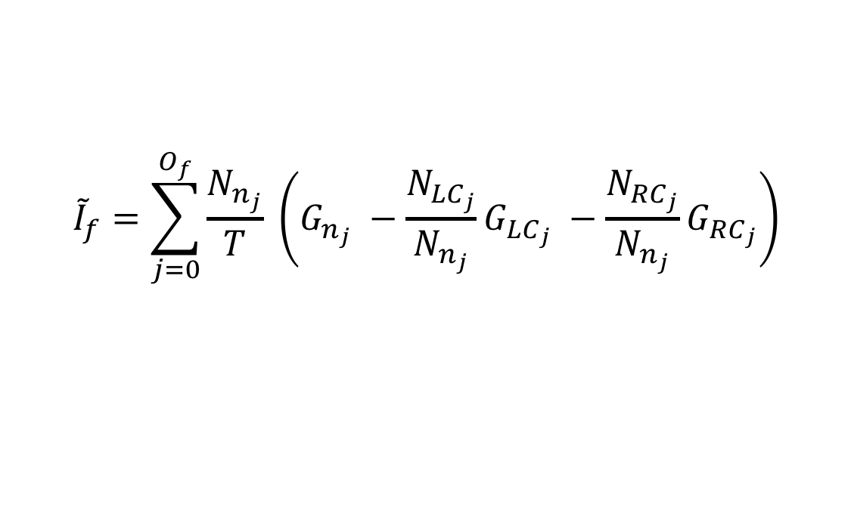
Feature Importance – Intuition Check
$${\tilde{I}}_{f}=\sum_{j=0}^{O_{f}}{\frac{N_{n_{j}}}{T} \left(G_{n_{j}} −\frac{N_{LC_{j}}}{N_{n_{j}}}G_{LC_{j}} −\frac{N_{RC_{j}}}{N_{n_{j}}}G_{RC_{j}}\right)}$$
What factors maximize feature importance?

Slide 32
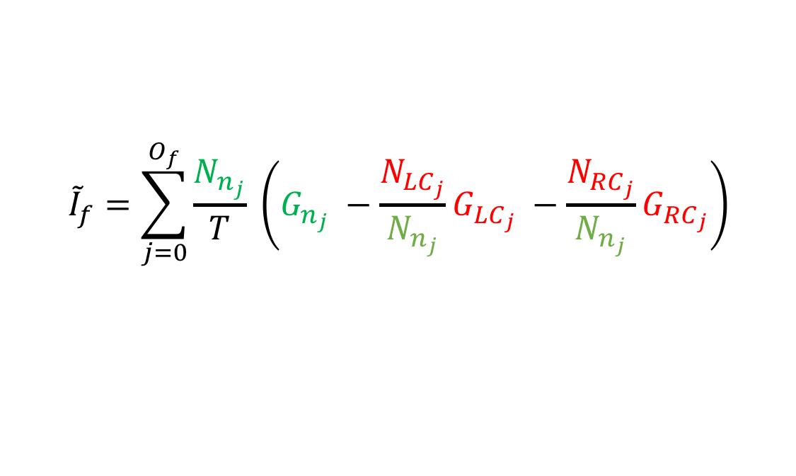
Feature Importance – Intuition Check
$${\tilde{I}}_{f}=\sum_{j=0}^{O_{f}}{\frac{N_{n_{j}}}{T} \left(G_{n_{j}} −\frac{N_{LC_{j}}}{N_{n_{j}}}G_{LC_{j}} −\frac{N_{RC_{j}}}{N_{n_{j}}}G_{RC_{j}}\right)}$$
What factors maximize feature importance?
Features used at the top of the tree contribute to the final prediction decision of a larger fraction of the input samples. The expected fraction of the samples they contribute to can thus be used as an estimate of the relative importance of the features.

Slide 33
Model Regularization

Slide 34
Model Regularization
Main complexity parameter is max_depth of the tree.
Deep trees can split the data up more, leading to overfitting.
Some nodes here have a single sample in it!
Notes:
Can see that some leaves have a single sample in it (out of 150 total samples).

Slide 35
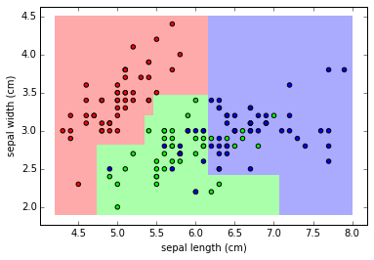
Model Regularization
Deep, Unregularized Tree
Shallower, Regularized Tree

Slide 36
Closing Notes

Slide 37
Great Demo
https://cs.stanford.edu/people/karpathy/svmjs/demo/demoforest.html

Slide 38
Final Nice Attributes - Proof Left as an Exercise to the Student ;)
Get Out Of Bag (OOB) error rate for free, which is equivalent to leave-one-out cross validation.
In theory, Random Forest cannot overfit on the number of trees, i.e. you can’t have too many trees, it’s just more expensive to train more.
Deals with missing values through “surrogate splits”.
Efficiently ignores redundant/irrelevant variables.

Slide 39

The End
$$Insight_Fellow_{i}$$
Watched the clock/dozed off
Paid attention the entire time

Slide 40
Links
https://www2.isye.gatech.edu/~tzhao80/Lectures/Lecture_6.pdf
http://scikit-learn.org/stable/modules/tree.html
https://stackoverflow.com/questions/20224526/how-to-extract-the-decision-rules-from-scikit-learn-decision-tree
http://www.utdallas.edu/~nrr150130/cs7301/2016fa/lects/Lecture_10_Ensemble.pdf
http://www2.stat.duke.edu/~rcs46/lectures_2017/08-trees/08-tree-advanced.pdf
https://stackoverflow.com/questions/49170296/scikit-learn-feature-importance-calculation-in-decision-trees
https://github.com/scikit-learn/scikit-learn/blob/18cdaa69c14a5c84ab03fce4fb5dc6cd77619e35/sklearn/tree/_tree.pyx#L1056
https://github.com/scikit-learn/scikit-learn/blob/master/sklearn/tree/_criterion.pyx
https://medium.com/@srnghn/the-mathematics-of-decision-trees-random-forest-and-feature-importance-in-scikit-learn-and-spark-f2861df67e3

