Slide 1
XCP
eXperimental Compiler design Platform

Slide 2
Introduction
Complex nature of compiler design
Educational platform
Online
Self-sufficient
Minimal expert supervision required

Slide 3
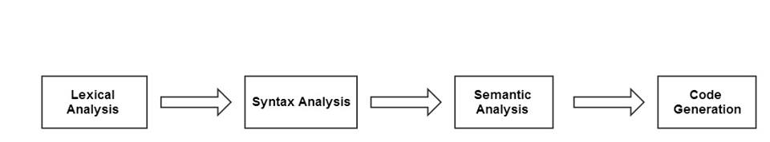
Existing framework

Slide 4
Specifications of the current framework
Source language: SIL
Implementation language: C
Tools: LEX & YACC
Target machine architecture: SIM

Slide 5
Problem statement
In this currently used approach, we found that many students who enrolled
for the compiler laboratory course (including ourselves) faced problems with
correlating the compiler design theory with the implementation process.

Slide 6
Problems we faced as students
Understanding back-end working of tools
Developing for custom specifications
Correlation between stages
Correlation with theory

Slide 7
Proposed solution
To develop an online self-sufficient educational platform for compiler design which can be used to tutor students under minimal expert supervision

Slide 8
Objectives
To design a roadmap which would guide a student along the compiler construction process.
To provide supporting documentation
To assemble an online platform
To provide scope for future development

Slide 9
Prerequisites
Data structures
Basic algorithms
Basic knowledge in Computer Organization
Working proficiency in C

Slide 10
Design components
Compiling the Documentation
Testing Code
Designing a Roadmap
Using Version control
Setting up the Online platform
Assembling the framework

Slide 11
Documentation
In-depth explanation of LEX & YACC
Gradually introduce compiler design concepts
Plenty of examples & sample I/O
Theory-Practice integration

Slide 12
Testing
Code examples
Code in exercises
Existing specifications
Extension to the SIL

Slide 13
Roadmap
Guide the student
Usage of appropriate documents or sections of documents for completing a task

Slide 14
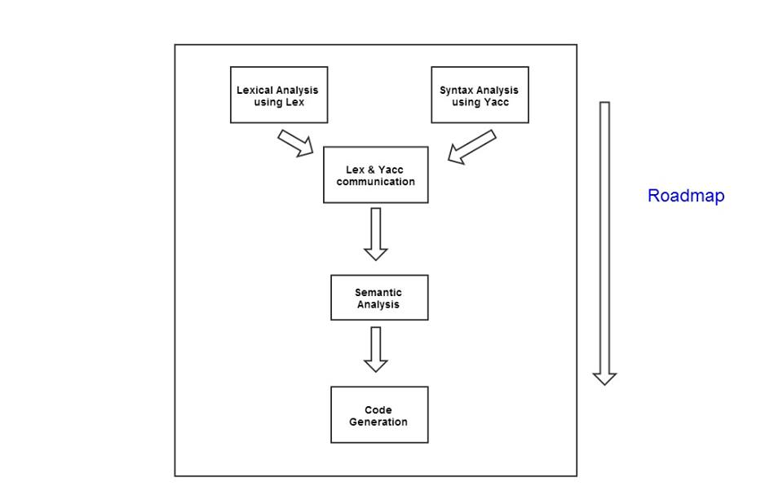

Slide 15
Version control
Multiple components
Various stages
Easy management
Easy maintenance
Git

Slide 16
Online platform
Github
Silcnitc.github.io
HTML5, CSS3 & JavaScript

Slide 17
Assembling the framework
Integrated
Assembled
Tested
Proof read
Published

Slide 18
Current status
LEX documentation
YACC documentation
Online platform

Slide 19
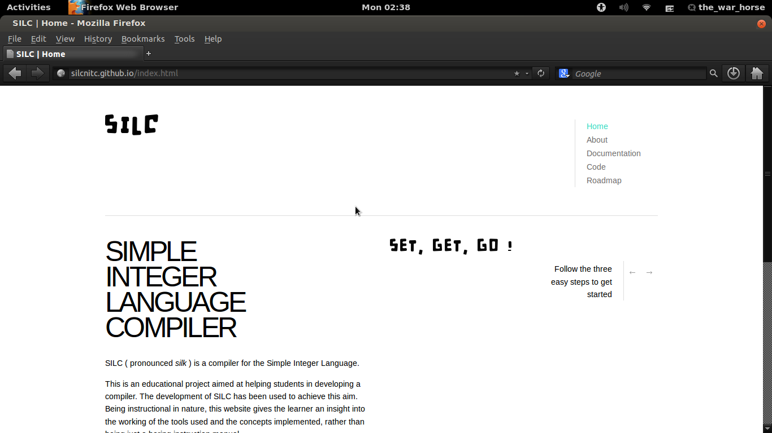

Slide 20
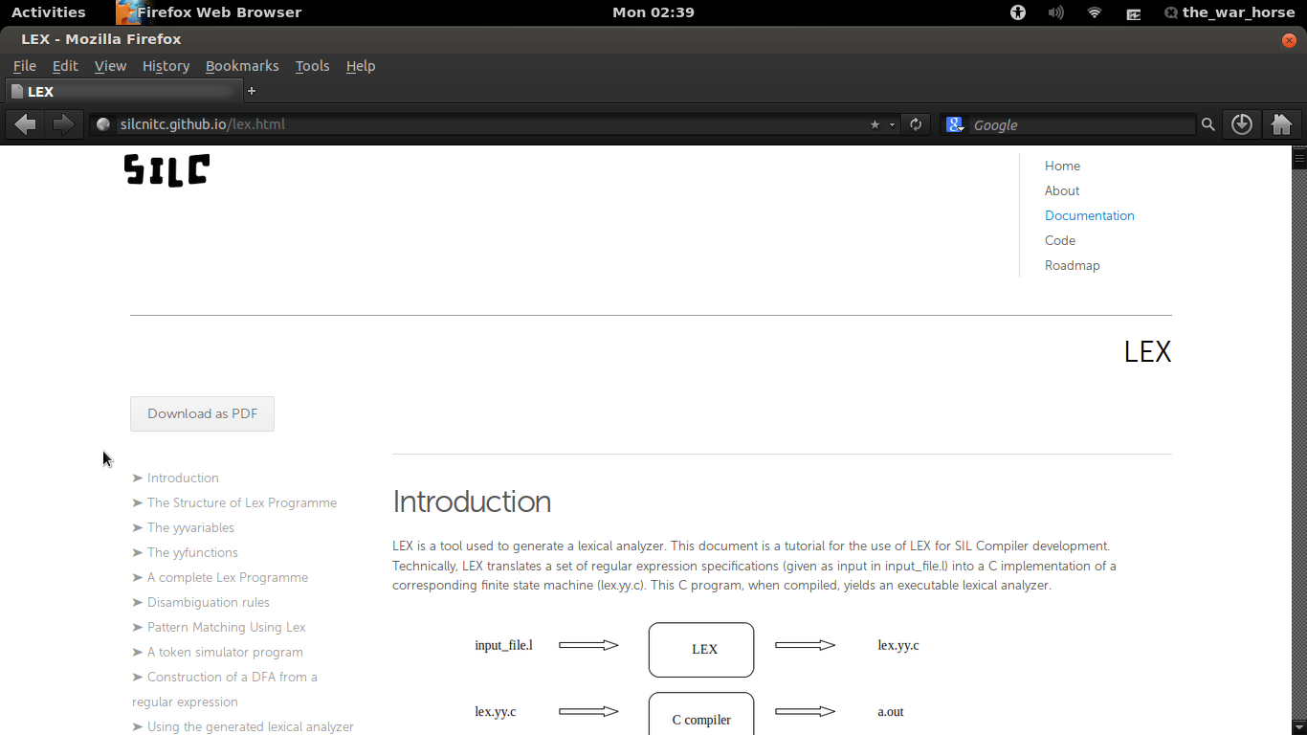

Slide 21
Problems faced
Understanding lex.yy.c
Understanding y.tab.c
Parsing algorithm

Slide 22
Conclusion
This project proposes a new educational platform for compiler design as an improvisation of the currently existing framework being used at the compiler construction laboratory in our institution

