Slide 1







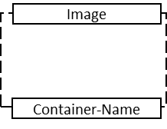
network: niels
Confluentinc/cp-zookeeper
Zookeeper
Twitter API
python
Tweepy
zookeeper
Confluentinc/cp-kafka
tweet-producer
Kafka-Broker
twitter
grafana/grafana
bitnami/spark
Sentiment +
Sliding Window
SparkResult
grafana
spark
Confluentinc/cp-ksql-server
Serialize to AVRO-Format
Confluentinc/cp-kafka-connect-base:6.0.1
influxdb:1.7.9
Legend
KSQL-Server
SentimentResult
Kafka-Connect
InfluxDB
Micro Service (Image-Name + Container-Name)
ksqldb-server
broker
kafka-connect
influxdb
Create stream to serialize data in SparkResult
Confluentinc/cp-schema-registry:6.0.1
Register AVRO-Schema
Schema-Registry
AVRO-Format to Kafka-Connect
Kafka-Topic
Data-Stream
confluentinc/cp-ksql-cli
schema-registry
KSQL-CLI
Create InfluxDB-Connector with Script
Script, meta data
ksql-cli

Slide 2
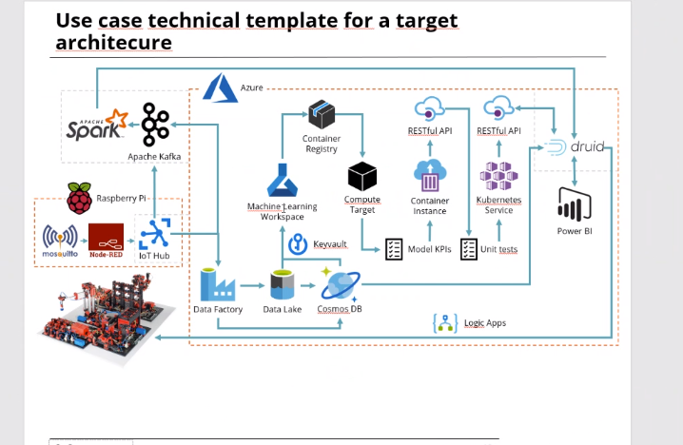
https://thenounproject.com/term/bookmark/3453172/
https://spark.apache.org/docs/latest/streaming-programming-guide.html
https://influxdata.github.io/branding/img/downloads/influxdata-logo--symbol--pool.jpg
https://www.vectorico.com/twitter-logo/
https://blog.knoldus.com/ksql-getting-started-with-streaming-sql-for-apache-kafka/

Slide 3









GyG - Our big data architecture
Collection
Ingestion
Processing
Business Application
Web Apps
Application 1
Flink Batch
Actions
ETL
Application 2
Local DB
Kafka
Kafka
Application n
M2M
Visualize & Reports
M2M
Flink Stream
M2M
Data lake
Data warehouse
IoT Data
See Gupta (2020), Akanbi (2020), Nasiri (2019), Dendane (2019), Cheng (2018)

Slide 4
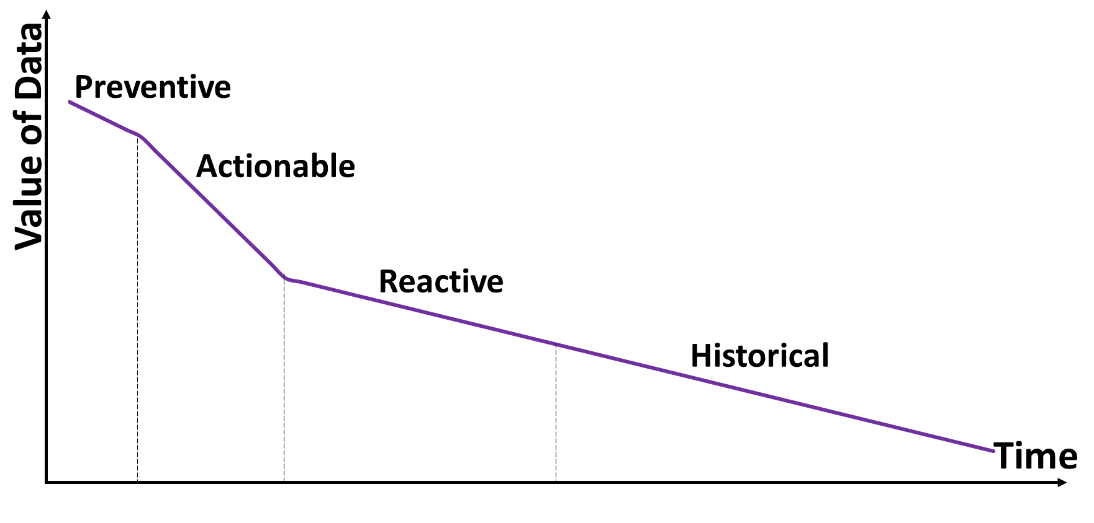

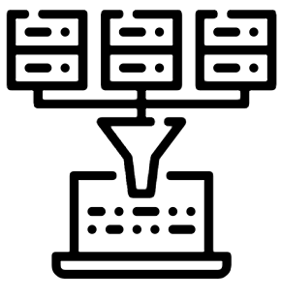
Stream versus Batch processing of big data
Stream processing:
Batch processing:
Actions
Respond
Actions
Data
Data
Request
Real time processing
Visualize & Reports
Database
Batch processing
Visualize & Reports
Storing
Low latency
Up to date data
Large batches of data
Complex analytics & independency
Efficient, cost effective
Expensive
Higher complexity
Normally less complex analysis
High latency
Use Cases:
Realtime inventory tracking system
Recommendation system
Use Cases:
Demand forecasting
See: Gualtiri (2016)
Notes:
Value of data over time → two approaches
Processing the data on the fly (data in motion) to gain valuable near real time invformation for preventive actions
Or process data in rest after the data is stored (more reactive actions)
Differentiation real-time, near real time
Characteristics of stream data:
Real-time arrival of the data
Infinity of the data
Disorder of the data
Burst of the data
Vulnerability of the data
Ideal stream processing framework:
Low latency,
high throughput
Continuous and stabel operation
Flexible scallability
Batch processing:
Processing data periodically but not time critical
For lager datasets ´that have been grouped together within a specific time interval
Involving deeper data analysis
Abgrenzung zu Micro-Batches
Data in motion / data in rest
Metaphere with a lake and a ´river
Data Size:
- Stream: Smaller volume of data since
Lower throughput is possible because the act of processing is repetitive
- Batch Processing: Large batches of data since the troughput is higher because many transaction can be completed at once
Analysis on the status of big data processing framework
The data processing framework is responsible for calculating the data in the data system
Big Data:
Large amount of data, high accuracy and low data value
Stream Processing:
Strict requirements for real-time of data processing
Does not require storage of data before hand
Common stream processing framework
Refers to the sequence of data that is increased indefinitely with time sequence
It can be regarded as a union of historical data and increasing updated data
Characteristics of stream data:
Real-time arrival of the data
Infinity of the data
Disorder of the data
Burst of the data
Vulnerability of the data
Ideal stream processing framework:
Low latency,
high throughput
Continuous and stabel operation
Flexible scallability
Most common used Stream processing frameworks : Storm, Spark, Samza
Comparison of the systems:
When dealing with real-time tasks requiring fast processing speed and using many kinds of programming languages, Storm can be preferred. Typical application scenes are recommendation system, real-time recommendation, financial system, early warning system, website statistics, real-time sales and traffic statistics and so on [41].
The advantage of Spark is that it can be used for micro batch processing, graph computation, iterative computation and interactive query computation. When a project, in addition to real-time processing, involves offline batch processing, graph computing, machine learning, and interactive query, the Spark processing framework should be preferred
When there are many states to be processed in a project, and each partition has many one-billion-byte tuples, Samza can be selected. Typical application scenes include central traffic control, advertising association, news delivery, webpage dynamic tracking and log aggregation.
Why complex systems?
The batch processing frameworks have poor real-time and low execution efficiency. The stream processing frameworks have poor tolerance and poor memory usage.

Slide 5
Library (1/2)
Akanbi, A., Masinde, M. (2020), A distributed Stream Processing Middleware Framework for Real-Time Analysis of Heterogeneous Data on Big Data Platform: Caes of Environmental Monitoring, Central University of Technology, South Africa
Chaudhuri, S., Dayal, U. (n.a.), An Overview of Data Warehousing and OLAP Technology
Cheng, C., Li, S., Ke, H. (2018), Analysis on the Status of Big Data Processing Framework, International Computers, Signals and Systems Conference
Dendane, Y., Petrillo, F., Mcheick, H., Ben Ali, S. (2019), Quality model for evaluating and choosing a stream processing framework architecture, Universit du Qubec de Chicoutimi
Finematics (2019), Apache Kafka Explained; https://finematics.com/apache-kafka-explained/, last access: 13.03.2021
Flink 1 (2020), Flink Architecture, https://ci.apache.org/projects/flink/flink-docs-release-1.12/concepts/flink-architecture.html, last access 14.03.2021 at 11:31
Flink 2(2020), Steteful Stream Processing, https://ci.apache.org/projects/flink/flink-docs-release-1.12/concepts/stateful-stream-processing.html, last access 14.03.2021 at 11:31
Flink 3 (2020), What is Apache Flink?-Architecture, https://flink.apache.org/flink-architecture.html, last access 14.03.2021 at 11:31
Foto 1ste Seite: https://thenounproject.com/photo/pattern-cubes-4dEanb/
Goasduff, L. (2020), Gartner Top 10 Trends in Data and Analytics for 2020, https://www.gartner.com/smarterwithgartner/gartner-top-10-trends-in-data-and-analytics-for-2020/, last access 21.03.2021 at 11:33
Gualtiri, M., Curran, R. (2016). Perishable Insights – Stop wasting money on unactionable analytics. Forrester
Gupta, S. (2020), Architecture for High-Throughput Low-Latency Big Data Pipeline on Cloud, https://towardsdatascience.com/scalable-efficient-big-data-analytics-machine-learning-pipeline-architecture-on-cloud-4d59efc092b5, last access 16.03.2021 at 21:14

