Slide 1


Cloud Computing with MapReduce and Hadoop
Matei Zaharia
UC Berkeley AMP Lab
matei@berkeley.edu
UC BERKELEY
Notes:
About me: I’m a 3rd year grad student, and also a Hadoop committer
Goals: tell you enough about MapReduce that you can do the homework, but also hint at some of the research

Slide 2
What is Cloud Computing?
“Cloud” refers to large Internet services running on 10,000s of machines (Google, Facebook, etc)
“Cloud computing” refers to services by these companies that let external customers rent cycles
  Amazon EC2: virtual machines at 8¢/hour, billed hourly
  Amazon S3: storage at 12.5¢/GB/month
  Windows Azure: applications using Azure API
Attractive features:
  Scale: 100s of nodes available in minutes
  Fine-grained billing: pay only for what you use
  Ease of use: sign up with credit card, get root access

Slide 3
What is MapReduce?
Programming model for data-intensive computing on commodity clusters
Pioneered by Google
  Processes 20 PB of data per day
Popularized by Apache Hadoop project
  Used by Yahoo!, Facebook, Amazon, …

Slide 4
What is MapReduce Used For?
At Google:
  Index building for Google Search
  Article clustering for Google News
  Statistical machine translation
At Yahoo!:
  Index building for Yahoo! Search
  Spam detection for Yahoo! Mail
At Facebook:
  Data mining
  Ad optimization
  Spam detection

Slide 5
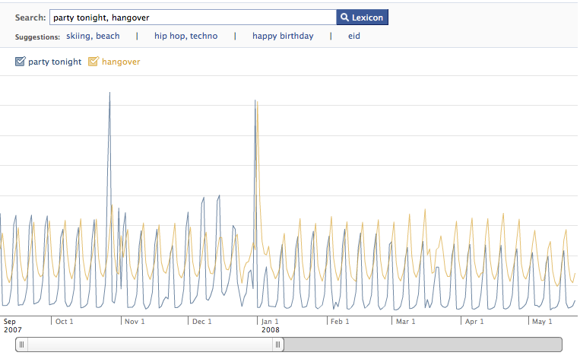
Example: Facebook Lexicon
www.facebook.com/lexicon

Slide 6
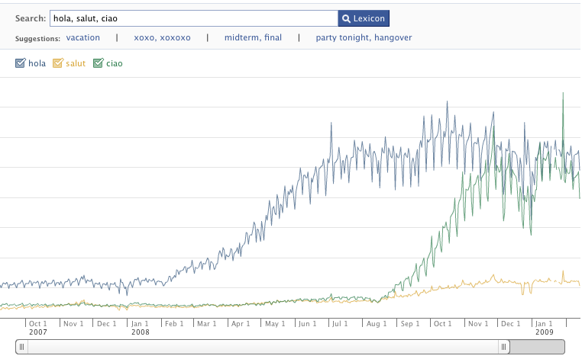
Example: Facebook Lexicon
www.facebook.com/lexicon

Slide 7

What is MapReduce Used For?
In research:
  Analyzing Wikipedia conflicts (PARC)
  Natural language processing (CMU)
  Climate simulation (Washington)
  Bioinformatics (Maryland)
  Particle physics (Nebraska)
  <Your application here>

Slide 8
Outline
MapReduce architecture
Sample applications
Introduction to Hadoop
Higher-level query languages: Pig & Hive
Current research

Slide 9
MapReduce Goals
Scalability to large data volumes:
  Scan 100 TB on 1 node @ 50 MB/s = 24 days
  Scan on 1000-node cluster = 35 minutes
Cost-efficiency:
  Commodity nodes (cheap, but unreliable)
  Commodity network (low bandwidth)
  Automatic fault-tolerance (fewer admins)
  Easy to use (fewer programmers)

Slide 10
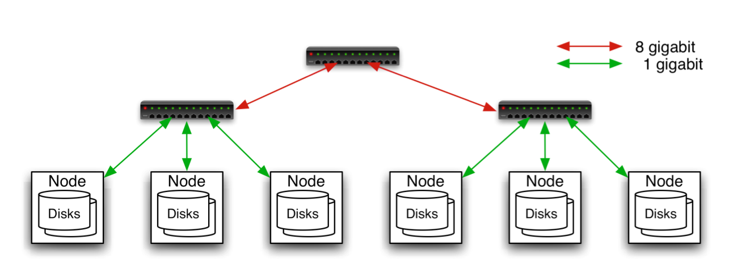
Typical Hadoop Cluster
Aggregation switch
Rack switch
40 nodes/rack, 1000-4000 nodes in cluster
1 Gbps bandwidth in rack, 8 Gbps out of rack
Node specs (Facebook):
8-16 cores, 32 GB RAM, 8×1.5 TB disks, no RAID

Slide 11

Typical Hadoop Cluster

Slide 12
Challenges of Cloud Environment
Cheap nodes fail, especially when you have many
  Mean time between failures for 1 node = 3 years
  MTBF for 1000 nodes = 1 day
  Solution: Build fault tolerance into system
Commodity network = low bandwidth
  Solution: Push computation to the data
Programming distributed systems is hard
  Solution: Restricted programming model: users write data-parallel “map” and “reduce” functions, system handles work distribution and failures

Slide 13

Hadoop Components
Distributed file system (HDFS)
  Single namespace for entire cluster
  Replicates data 3x for fault-tolerance
MapReduce framework
  Runs jobs submitted by users
  Manages work distribution & fault-tolerance
  Colocated with file system

Slide 14

Hadoop Distributed File System
Files split into 128MB blocks
Blocks replicated across several datanodes (often 3)
Namenode stores metadata (file names, locations, etc)
Optimized for large files, sequential reads
Files are append-only
Namenode
File1
1
2
3
4
1
2
1
3
2
1
4
2
4
3
3
4
Datanodes

Slide 15
MapReduce Programming Model
Data type: key-value records
Map function:
(K_{in}, V_{in}) ➔ list(K_{inter}, V_{inter})
Reduce function:
(K_{inter}, list(V_{inter})) ➔ list(K_{out}, V_{out})

Slide 16
Example: Word Count
def mapper(line):
foreach word in line.split():
output(word, 1)
def reducer(key, values):
output(key, sum(values))

Slide 17
Word Count Execution
Input
Map
Shuffle & Sort
Reduce
Output
the, 1
brown, 1
fox, 1
the quick
brown fox
brown, 2
fox, 2
how, 1
now, 1
the, 3
Map
Reduce
the, 1
fox, 1
the, 1
the fox ate the mouse
Map
quick, 1
how, 1
now, 1
brown, 1
ate, 1
cow, 1
mouse, 1
quick, 1
ate, 1
mouse, 1
Reduce
how now
brown cow
Map
cow, 1

Slide 18
An Optimization: The Combiner
Local reduce function for repeated keys produced by same map
For associative ops. like sum, count, max
Decreases amount of intermediate data
Example: local counting for Word Count:
def combiner(key, values):
output(key, sum(values))

Slide 19
Word Count with Combiner
Input
Map
Shuffle & Sort
Reduce
Output
the, 1
brown, 1
fox, 1
the quick
brown fox
brown, 2
fox, 2
how, 1
now, 1
the, 3
Map
Reduce
the, 2
fox, 1
the fox ate the mouse
Map
quick, 1
how, 1
now, 1
brown, 1
ate, 1
cow, 1
mouse, 1
quick, 1
ate, 1
mouse, 1
Reduce
how now
brown cow
Map
cow, 1

Slide 20
MapReduce Execution Details
Mappers preferentially scheduled on same node or same rack as their input block
  Minimize network use to improve performance
Mappers save outputs to local disk before serving to reducers
  Allows recovery if a reducer crashes
  Allows running more reducers than # of nodes

Slide 21
Fault Tolerance in MapReduce
1. If a task crashes:
  Retry on another node
    OK for a map because it had no dependencies
    OK for reduce because map outputs are on disk
  If the same task repeatedly fails, fail the job or ignore that input block
Note: For the fault tolerance to work, user tasks must be deterministic and side-effect-free

Slide 22
Fault Tolerance in MapReduce
2. If a node crashes:
  Relaunch its current tasks on other nodes
  Relaunch any maps the node previously ran
    Necessary because their output files were lost along with the crashed node

Slide 23
Fault Tolerance in MapReduce
3. If a task is going slowly (straggler):
  Launch second copy of task on another node
  Take the output of whichever copy finishes first, and kill the other one
Critical for performance in large clusters (many possible causes of stragglers)

Slide 24
Takeaways
By providing a restricted data-parallel programming model, MapReduce can control job execution in useful ways:
  Automatic division of job into tasks
  Placement of computation near data
  Load balancing
  Recovery from failures & stragglers

Slide 25
Outline
MapReduce architecture
Sample applications
Introduction to Hadoop
Higher-level query languages: Pig & Hive
Current research

Slide 26
1. Search
Input: (lineNumber, line) records
Output: lines matching a given pattern
Map:
if(line matches pattern):
output(line)
Reduce: identity function
  Alternative: no reducer (map-only job)

Slide 27
2. Sort
Input: (key, value) records
Output: same records, sorted by key
Map: identity function
Reduce: identify function
Trick: Pick partitioning
function p such that
k₁ < k₂ => p(k₁) < p(k₂)
Map
ant, bee
Reduce
[A-M]
zebra
aardvark
ant
bee
cow
elephant
cow
Map
pig
Reduce
[N-Z]
aardvark,
elephant
pig
sheep
yak
zebra
Map
sheep, yak

Slide 28
3. Inverted Index
Input: (filename, text) records
Output: list of files containing each word
Map:
foreach word in text.split():
output(word, filename)
Combine: uniquify filenames for each word
Reduce:
def reduce(word, filenames):
output(word, sort(filenames))

Slide 29
Inverted Index Example
hamlet.txt
to, hamlet.txt
be, hamlet.txt
or, hamlet.txt
not, hamlet.txt
to be or not to be
afraid, (12th.txt)
be, (12th.txt, hamlet.txt)
greatness, (12th.txt)
not, (12th.txt, hamlet.txt)
of, (12th.txt)
or, (hamlet.txt)
to, (hamlet.txt)
12th.txt
be, 12th.txt
not, 12th.txt
afraid, 12th.txt
of, 12th.txt
greatness, 12th.txt
be not afraid of greatness

Slide 30
4. Most Popular Words
Input: (filename, text) records
Output: the 100 words occurring in most files
Two-stage solution:
  Job 1:
    Create inverted index, giving (word, list(file)) records
  Job 2:
    Map each (word, list(file)) to (count, word)
    Sort these records by count as in sort job
Optimizations:
  Map to (word, 1) instead of (word, file) in Job 1
  Estimate count distribution in advance by sampling

Slide 31
5. Numerical Integration
Input: (start, end) records for sub-ranges to integrate
  Can implement using custom InputFormat
Output: integral of f(x) over entire range
Map:
def map(start, end):
sum = 0
for(x = start; x < end; x += step):
sum += f(x) * step
output(“”, sum)
Reduce:
def reduce(key, values):
output(key, sum(values))

Slide 32
Outline
MapReduce architecture
Sample applications
Introduction to Hadoop
Higher-level query languages: Pig & Hive
Current research

Slide 33
Introduction to Hadoop
Download from hadoop.apache.org
To install locally, unzip and set JAVA_HOME
Docs: hadoop.apache.org/common/docs/current
Three ways to write jobs:
  Java API
  Hadoop Streaming (for Python, Perl, etc)
  Pipes API (C++)
Notes:
Mention local mode and pseudo-distributed mode

Slide 34
Word Count in Java
public static class MapClass extends MapReduceBase
implements Mapper<LongWritable, Text, Text, IntWritable> {
private final static IntWritable ONE = new IntWritable(1);
public void map(LongWritable key, Text value,
OutputCollector<Text, IntWritable> output,
Reporter reporter) throws IOException {
String line = value.toString();
StringTokenizer itr = new StringTokenizer(line);
while (itr.hasMoreTokens()) {
output.collect(new Text(itr.nextToken()), ONE);
}
}
}

Slide 35
Word Count in Java
public static class Reduce extends MapReduceBase
implements Reducer<Text, IntWritable, Text, IntWritable> {
public void reduce(Text key, Iterator<IntWritable> values,
OutputCollector<Text, IntWritable> output,
Reporter reporter) throws IOException {
int sum = 0;
while (values.hasNext()) {
sum += values.next().get();
}
output.collect(key, new IntWritable(sum));
}
}

Slide 36
Word Count in Java
public static void main(String[] args) throws Exception {
JobConf conf = new JobConf(WordCount.class);
conf.setJobName("wordcount");
conf.setMapperClass(MapClass.class);
conf.setCombinerClass(Reduce.class);
conf.setReducerClass(Reduce.class);
FileInputFormat.setInputPaths(conf, args[0]);
FileOutputFormat.setOutputPath(conf, new Path(args[1]));
conf.setOutputKeyClass(Text.class); // out keys are words (strings)
conf.setOutputValueClass(IntWritable.class); // values are counts
JobClient.runJob(conf);
}

Slide 37
Word Count in Python with
Hadoop Streaming
Mapper.py:
import sys
for line in sys.stdin:
for word in line.split():
print(word.lower() + "\t" + 1)
Reducer.py:
import sys
counts = {}
for line in sys.stdin:
word, count = line.split("\t")
dict[word] = dict.get(word, 0) + int(count)
for word, count in counts:
print(word.lower() + "\t" + 1)

Slide 38
Amazon Elastic MapReduce
Web interface and command-line tools for running Hadoop jobs on EC2
Data stored in Amazon S3
Monitors job and shuts machines after use

Slide 39
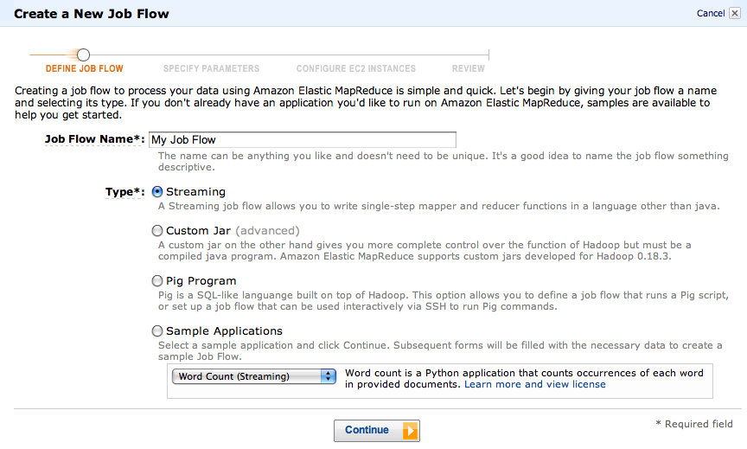
Elastic MapReduce UI

Slide 40
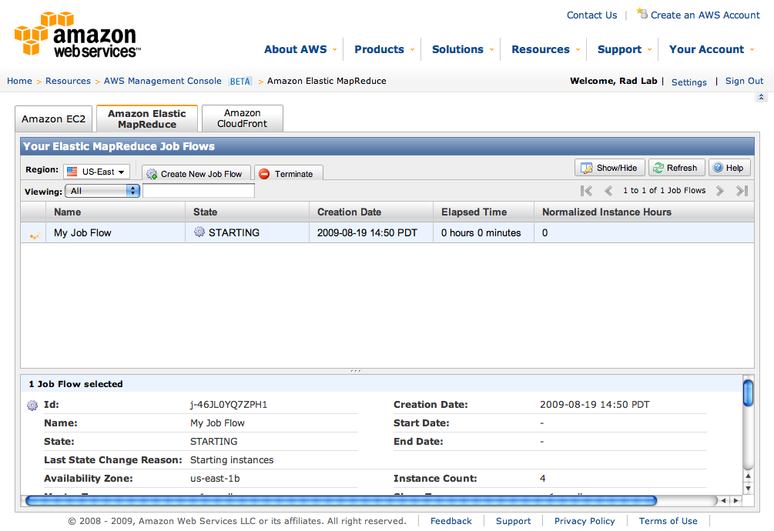
Elastic MapReduce UI

Slide 41
Outline
MapReduce architecture
Sample applications
Introduction to Hadoop
Higher-level query languages: Pig & Hive
Current research

Slide 42
Motivation
MapReduce is powerful: many algorithms
can be expressed as a series of MR jobs
But it’s fairly low-level: must think about keys, values, partitioning, etc.
Can we capture common “job patterns”?

Slide 43

Pig
Started at Yahoo! Research
Runs about 50% of Yahoo!’s jobs
Features:
  Expresses sequences of MapReduce jobs
  Data model: nested “bags” of items
  Provides relational (SQL) operators
  (JOIN, GROUP BY, etc)
  Easy to plug in Java functions

Slide 44
An Example Problem
Suppose you have user data in one file, website data in another, and you need to find the top 5 most visited pages by users aged 18-25.
Load Users
Load Pages
Filter by age
Join on name
Group on url
Count clicks
Order by clicks
Take top 5
Example from http://wiki.apache.org/pig-data/attachments/PigTalksPapers/attachments/ApacheConEurope09.ppt

Slide 45
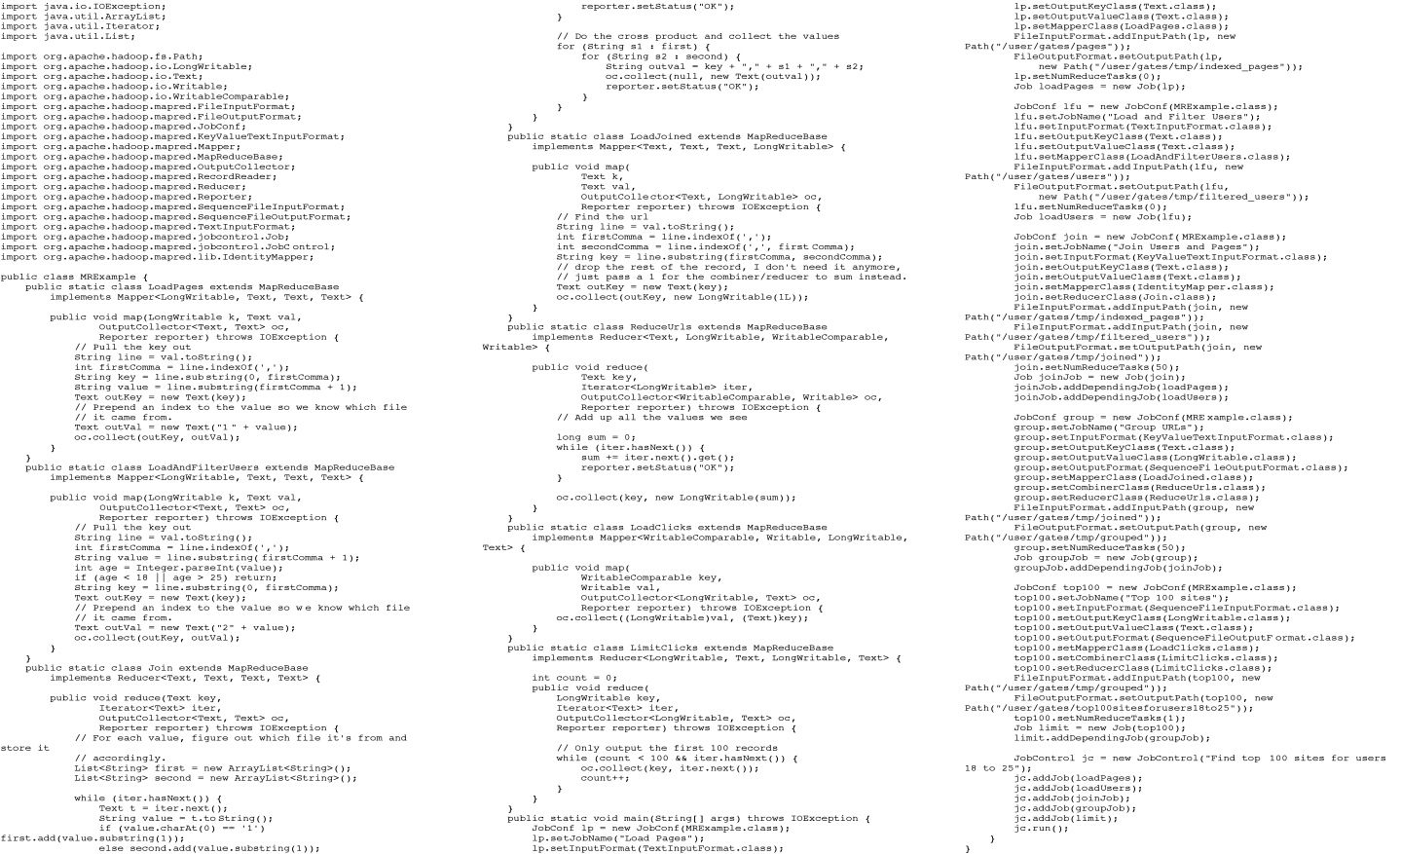
In MapReduce
Example from http://wiki.apache.org/pig-data/attachments/PigTalksPapers/attachments/ApacheConEurope09.ppt
Notes:
My point in putting in the java code isn’t too actually walk through it. It’s just to show that you have to hand code a fair amount of java. That way I can just point and say “look how much java you’d have to write to accomplish this”

Slide 46
In Pig Latin
Users = load ‘users’ as (name, age);
Filtered = filter Users by
age >= 18 and age <= 25;
Pages = load ‘pages’ as (user, url);
Joined = join Filtered by name, Pages by user;
Grouped = group Joined by url;
Summed = foreach Grouped generate group,
count(Joined) as clicks;
Sorted = order Summed by clicks desc;
Top5 = limit Sorted 5;
store Top5 into ‘top5sites’;
Example from http://wiki.apache.org/pig-data/attachments/PigTalksPapers/attachments/ApacheConEurope09.ppt
Notes:
Rather than using capital letters, which makes Pig Latin look like SQL, I added Eclipse style highlighting instead. Hopefully this makes clear what are the key words without making it look like a Matisse painting.

Slide 47
Translation to MapReduce
Notice how naturally the components of the job translate into Pig Latin.
Load Users
Load Pages
Users = load …
Filtered = filter …
Pages = load …
Joined = join …
Grouped = group …
Summed = … count()…
Sorted = order …
Top5 = limit …
Filter by age
Join on name
Group on url
Count clicks
Order by clicks
Take top 5
Example from http://wiki.apache.org/pig-data/attachments/PigTalksPapers/attachments/ApacheConEurope09.ppt
Notes:
No need to think about how many map reduce jobs this decomposes into, or connecting data flows between map reduces jobs, or even that this is taking place on top of map reduce at all.

Slide 48
Translation to MapReduce
Notice how naturally the components of the job translate into Pig Latin.
Load Users
Load Pages
Users = load …
Filtered = filter …
Pages = load …
Joined = join …
Grouped = group …
Summed = … count()…
Sorted = order …
Top5 = limit …
Filter by age
Join on name
Job 1
Group on url
Job 2
Count clicks
Order by clicks
Job 3
Take top 5
Example from http://wiki.apache.org/pig-data/attachments/PigTalksPapers/attachments/ApacheConEurope09.ppt
Notes:
No need to think about how many map reduce jobs this decomposes into, or connecting data flows between map reduces jobs, or even that this is taking place on top of map reduce at all.

Slide 49

Hive
Developed at Facebook
Used for most Facebook jobs
Relational database built on Hadoop
  Maintains table schemas
  SQL-like query language (which can also call Hadoop Streaming scripts)
  Supports table partitioning,
  complex data types, sampling,
  some query optimization

Slide 50
Summary
MapReduce’s data-parallel programming model hides complexity of distribution and fault tolerance
Principal philosophies:
  Make it scale, so you can throw hardware at problems
  Make it cheap, saving hardware, programmer and administration costs (but necessitating fault tolerance)
Hive and Pig further simplify programming
MapReduce is not suitable for all problems, but when it works, it may save you a lot of time

Slide 51
Outline
MapReduce architecture
Sample applications
Introduction to Hadoop
Higher-level query languages: Pig & Hive
Current research

Slide 52
Cloud Programming Research
More general execution engines
  Dryad (Microsoft): general task DAG
  S4 (Yahoo!): streaming computation
  Pregel (Google): in-memory iterative graph algs.
  Spark (Berkeley): general in-memory computing
Language-integrated interfaces
  Run computations directly from host language
  DryadLINQ (MS), FlumeJava (Google), Spark

Slide 53
Spark Motivation
MapReduce simplified “big data” analysis on large, unreliable clusters
But as soon as organizations started using it widely, users wanted more:
  More complex, multi-stage applications
  More interactive queries
  More low-latency online processing

Slide 54





Spark Motivation
Complex jobs, interactive queries and online processing all need one thing that MR lacks:
Efficient primitives for data sharing
Query 1
Query 2
…
Query 3
Iterative job
Interactive mining
Stream processing

Slide 55
Spark Motivation
Complex jobs, interactive queries and online processing all need one thing that MR lacks:
Efficient primitives for data sharing
Query 1
Problem: in MR, only way to share data across jobs is stable storage (e.g. file system) -> slow!
Query 2
…
Query 3
Iterative job
Interactive mining
Stream processing

Slide 56
Examples
HDFS
read
HDFS
write
HDFS
read
HDFS
write
iter. 1
iter. 2
. . .
Input
HDFS
read
query 1
result 1
query 2
result 2
query 3
result 3
Input
. . .
Notes:
Each iteration is, for example, a MapReduce job

Slide 57

Goal: In-Memory Data Sharing
iter. 1
iter. 2
. . .
Input
query 1
one-time
processing
query 2
query 3
Input
Distributed
memory
. . .
10-100× faster than network and disk

Slide 58
Solution: Resilient Distributed Datasets (RDDs)
Partitioned collections of records that can be stored in memory across the cluster
Manipulated through a diverse set of transformations (map, filter, join, etc)
Fault recovery without costly replication
  Remember the series of transformations that built an RDD (its lineage) to recompute lost data

Slide 59

Example: Log Mining
Load error messages from a log into memory, then interactively search for various patterns
Base RDD
Cache 1
lines = spark.textFile(“hdfs://...”)
errors = lines.filter(_.startsWith(“ERROR”))
messages = errors.map(_.split(‘\t’)(2))
messages.cache()
Transformed RDD
Worker
results
tasks
Block 1
Driver
messages.filter(_.contains(“foo”)).count
messages.filter(_.contains(“bar”)).count
Cache 2
Worker
. . .
Cache 3
Result: scaled to 1 TB data in 5-7 sec
(vs 170 sec for on-disk data)
Worker
Block 2
Result: full-text search of Wikipedia in <1 sec (vs 20 sec for on-disk data)
Scala programming language
Block 3
Notes:
Key idea: add “variables” to the “functions” in functional programming

Slide 60
Fault Recovery
RDDs track lineage information that can be used to efficiently reconstruct lost partitions
Ex:
messages = textFile(...).filter(_.startsWith(“ERROR”))
.map(_.split(‘\t’)(2))
HDFS File
Filtered RDD
Mapped RDD
filter
(func = _.contains(...))
map
(func = _.split(...))

Slide 61
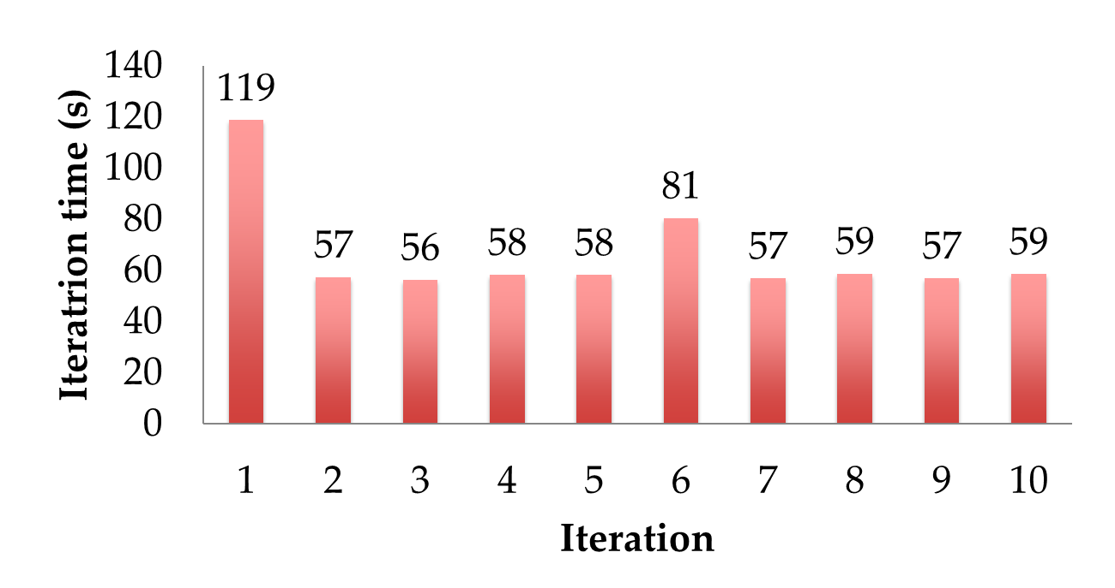
Fault Recovery Results
Failure happens
Notes:
These are for K-means

Slide 62
Example: Logistic Regression
Find best line separating two sets of points
random initial line
+
+
+
+
+
+
–
+
+
–
–
–
+
+
–
–
–
–
–
–
target
Notes:
Note that dataset is reused on each gradient computation

Slide 63
Logistic Regression Code
val data = spark.textFile(...).map(readPoint).cache()
var w = Vector.random(D)
for (i <- 1 to ITERATIONS) {
val gradient = data.map(p =>
(1 / (1 + exp(-p.y*(w dot p.x))) - 1) * p.y * p.x
).reduce(_ + _)
w -= gradient
}
println("Final w: " + w)

Slide 64
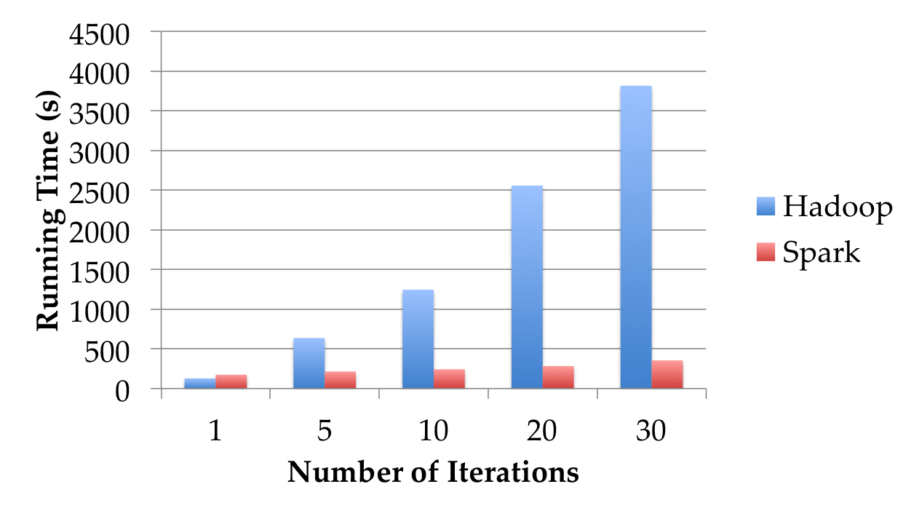
Logistic Regression Performance
127 s / iteration
first iteration 174 s
further iterations 6 s
Notes:
This is for a 29 GB dataset on 20 EC2 m1.xlarge machines (4 cores each)

Slide 65
Ongoing Projects
Pregel on Spark (Bagel): graph processing programming model as a 200-line library
Hive on Spark (Shark): SQL engine
Spark Streaming: incremental processing with in-memory state

Slide 66
If You Want to Try It Out
www.spark-project.org
To run locally, just need Java installed
Easy scripts for launching on Amazon EC2
Can call into any Java library from Scala

Slide 67
Other Resources
Hadoop: http://hadoop.apache.org/common
Pig: http://hadoop.apache.org/pig
Hive: http://hadoop.apache.org/hive
Spark: http://spark-project.org
Hadoop video tutorials: www.cloudera.com/hadoop-training
Amazon Elastic MapReduce:
http://aws.amazon.com/elasticmapreduce/
Notes:
Cloudera’s videos tutorials are accessible from the sidebar of the page linked

