Slide 1


ContextOS
Three-Way Handshake
Faizan Choudhary · Amogh Prabhu · Ankush Bhagat
Future of Work & Enterprise Productivity
Notes:
Hackathon MVP. Team name and members supplied by the owner. ContextOS is a governed shared knowledge workspace for teams and AI agents.

Slide 2
The problem and the idea
Decisions change.
Agent context rarely follows.
A retry limit changes in a meeting.
Development and QA still work
from the old conversation.
ContextOS keeps accepted decisions, their owners, and the work that used them connected.
Notes:
Illustrative checkout scenario, not a customer study. The MVP provides accepted revisions, exact source manifests and dependency-based stale-run detection. Sources: backend/domain.py, README.md.

Slide 3
Opportunity and differentiation
Approach | Useful for | Missing connection
Documents / wikis | Capturing knowledge | Which run used which revision?
Private agent history | Continuing a task | What changed for other roles?
ContextOS MVP | Reviewed shared decisions | Links revisions to affected work
Our focus: accepted knowledge + exact provenance + change awareness
Notes:
This is a conceptual comparison of workflows, not an empirical claim about every competing product. Initial target: small software teams coordinating product, architecture, development, QA and security. Differentiation from ContextOS blueprint and implemented domain contracts.

Slide 4
Features that complete the handoff
Shared knowledge
Independent reviews
Context pages, editor and relationship views
Owner decisions with version and conflict checks
Context-aware work
Change awareness
Grounded task outputs and exact source inspection
Flag affected runs; preserve original evidence
Team access
Guided evaluation
Verified sessions, roles and shared storage
Five personas and twelve step-by-step cases
Notes:
Features are supported by the local test suites. Verified cloud functionality includes sessions, shared review, live task calls, staleness, rerun and persistence across clients. Guided public cases use synthetic offline rehearsal.

Slide 5
One change, traced through the work
Capture
Propose
Review
Use
Refresh
Notes or an
explicit topic
Candidate with
source + reason
Independent
domain owner
Agent receives
accepted revision
Changed sources
flag affected runs
Example: retry limit 3 → 2. Old runs retain v1; fresh work uses v2.
Notes:
Editable process diagram. Model suggestions never publish themselves. Review checks author independence, domain ownership, proposal hash and base revision. A rollback creates a new revision. See backend/domain.py and tests/test_domain.py.

Slide 6
Five personas, a clear next action
Persona | Action | Next best move
Product manager | Clarify intent and acceptance | Propose a requirements topic
Architect | Review architecture decisions | Publish an independent proposal
Developer | Plan implementation from sources | Inspect sources or propose a change
QA engineer | Turn constraints into checks | Refresh work after a source update
Security | Inspect policies and restricted context | Review guardrails in its domain
Notes:
Roles from the implemented membership and domain ownership model. Real sessions use signed role/workspace claims; public synthetic walkthroughs allow persona switching. Next actions are scoped suggestions, never elevated permissions.

Slide 7
Architecture of the deployed MVP
Firestore
Shared revisions + audit
Browser workspace
Cloud Run
FastAPI + governance
Vertex AI
Gemini 2.5 Flash
Team identity
Verified session + claims
Backend enforces permissions before retrieval and publication
Notes:
Editable architecture diagram. Project contextos-512006, Cloud Run and Firestore region asia-south1; Vertex AI global endpoint. Dedicated runtime uses datastore.user, aiplatform.user and a custom two-permission session role. Public synthetic service uses AI_MODE=offline. Sources: DEPLOYMENT.md, backend/app.py, identity.py and store.py.

Slide 8
Technology choices
Experience
Application
Google Cloud
HTML, CSS and JavaScript
Responsive, buildless UI
Scoped actions
Source inspector
Python 3.14 + FastAPI
Transactional rules
Google Gen AI SDK
Cloud Run
Cloud Build
Firestore Native
Team sessions + Vertex AI
Notes:
Actual stack from requirements.txt and deployed configuration. The MCP interface and context-page service are tested locally; this Cloud Run service hosts the web/API application, not a separate public MCP server.

Slide 9
MVP cost and operating limits
Costs follow usage
Current controls
Scale to zero
2 team instances; 1 demo instance
50 model calls per workspace
750 KB per workspace
Cloud Run compute and builds
Firestore reads, writes and storage
Model input, output and thinking tokens
No measured monthly bill yet. Public walkthroughs make no live AI calls.
Notes:
Cost is not claimed to be zero or fixed. Limits are not a global spending cap. Hosting: https://cloud.google.com/run/pricing ; storage: https://cloud.google.com/firestore/pricing ; model pricing: https://cloud.google.com/vertex-ai/generative-ai/pricing . A per-task cost estimate must include all billed model tokens. Source: actual Cloud Run deployment limits, backend/store.py and domain.py.

Slide 10
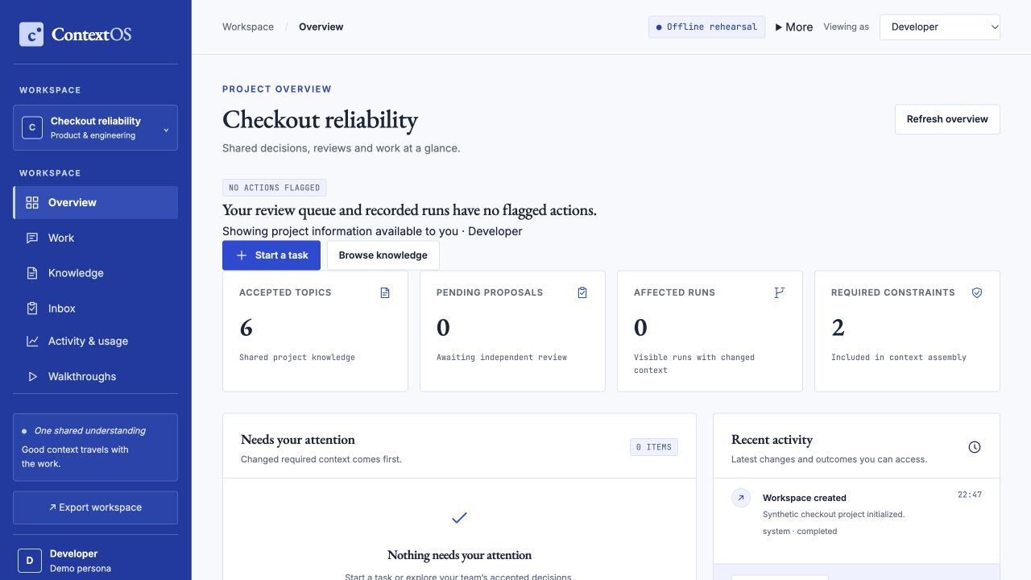
Prototype: an actionable project overview
Inspect priorities
Open the right work
Trace recent actions
Notes:
Actual screenshot of the hosted synthetic MVP, captured 18 October 2026. Not a fabricated mockup. No private workspace content or credentials appear.

Slide 11
Verification evidence
105
36
Live
Python tests pass
JavaScript tests pass
Cloud workflow verified
Verified: two sessions → independent publication → live AI →
source update → stale run → refreshed v2 → logout
Functional evidence; productivity gains and load capacity are not measured.
Notes:
Local suite: 105 Python + 36 Node tests, no skips; two upstream deprecation warnings. Firestore concurrent approval test has exactly one winner and preserves original v1 snapshots. Deployed verifier evidence workspace cloud-verification-d54d3770d77a; the repeated live verification includes the actual browser Origin header and passes after the HTTPS proxy correction. Judge member sign-in, scoped source access, structured extraction and logout also pass. Hosted CI previously passed on 6936f27. No latency/load or productivity benchmark claimed.

Slide 12
SWOT analysis
Strengths | Weaknesses
Reviewed revisions + provenance Permissions before model context | Lexical retrieval; 750 KB workspace No load or productivity benchmark
Opportunities | Threats
Pilot with small engineering teams IDE and repository integrations | Stale or incorrect source material Adoption friction; tool overlap
Response: prove one team’s handoff value before expanding the platform
Notes:
Strategic assessment by the team, not external market research. Mitigations: independent owners, exact sources, explicit uncertainty and limited pilot scope. Semantic retrieval and integrations are roadmap items.

Slide 13
Roadmap and success criteria
Now · hackathon MVP
Governed knowledge, scoped actions, live AI and durable cloud deployment
Next · team pilot
Measure handoff repetition, stale-source detection and grounded task quality
Later · expansion
Stronger retrieval, IDE/repository integrations and operational hardening
Notes:
Future items are explicitly unimplemented roadmap, not shipped claims. Local MCP interface exists; a supported end-user integration/distribution and larger scale remain future work. Pilot metrics need a baseline and evaluation before any savings claim.

Slide 14
Try ContextOS
Explore the public walkthrough
contextos-demo-443743777956.asia-south1.run.app
Test the protected team workspace
contextos-443743777956.asia-south1.run.app
Source: github.com/silent-doom/contextos
Judge credentials supplied privately · Narrated MP4 accompanies this deck
Notes:
Public walkthrough contains synthetic data and deterministic offline source briefings. Team service uses real sessions, Firestore and Vertex AI. Credentials are private and excluded from the deck and Git. Video needs a public YouTube/Vimeo/Drive link at submission; local MP4 is included with deliverables.

