Slide 1
Use-Case Diagram

Slide 2
Activity diagram for
access camera
surveillance —
display camera
views function
Valid passwords/ID
Invalid passwords/ID
Other
functions
No input
Tries remain
Input tries
remain
Thumbnail views
Select a specific camera
Exit
See another camera

Slide 4
What is a Class?
occurrences
roles
things
organizational units
places
external entities
structures
class name
attributes:
operations:

Slide 5
Class Diagram

Slide 6
CRC Modeling
Those classes required to provide the info needed to complete a responsibility
Anything the class knows (attributes) or does (operations)

Slide 7
Behavioral Modeling
State Diagram
ControlPanel

Slide 8
Behavioral Modeling
Sequence Diagram

Slide 9
Flow-Oriented Modeling
computer
based
system
input
output
System = data + function
Data Flow Diagram
Data
External Entity
Process
Data Stores

Slide 10
Flow-Oriented Modeling
Book
Book request by the user
Shelves
Title and author of requested book;
name of user
Author
List of Authors
Get a
book
Book
Book
reception
Title
Book title;
user name
List of titles
List of books borrowed
Title
Search
by topics
List of topics
Display of list of titles
List of titles
referring to the topic
Topic
Topic
Topic request by the user

Slide 11
Flow-Oriented Modeling
Refinement:
Book request = Find book position + Get a book
Book
Get a
book
Shelves
Book
Book
reception
Author
<shelf#, book#>
List of Authors
Find book
position
Title
Book title;
user name
List of titles
Title and author
of requested book;
name of the user
List of books borrowed
Book requested
by the user

Slide 12
Flow-Oriented Modeling
The Data Flow Hierarchy
a
b
x
P
y
level 0
a
c
P2
level 1
f
P1
P4
b
d
P5
P3
e
g
level 2
f
f1
f2
P4.1
P4.2
P4.5
g
e
e1
e2
P4.3
P4.4

Slide 13
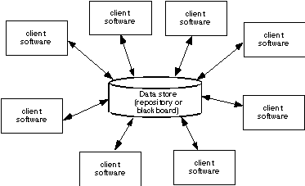
Data-Centered Architecture

Slide 14
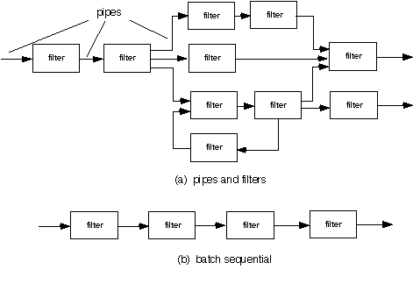
Data Flow Architecture

Slide 15
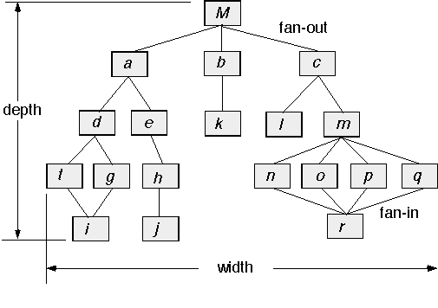
Call and Return Architecture

Slide 16
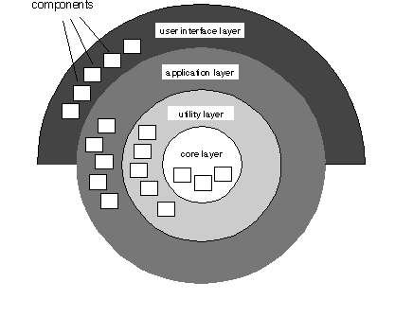
Layered Architecture

Slide 17
Architectural Context

Slide 18
Archetypes

Slide 19
Component Structure

Slide 20
Collaboration Diagram

Slide 21
Refactoring

Slide 22
Activity Diagram

Slide 23
Statechart

Slide 24
Swimlane Diagram

Slide 25
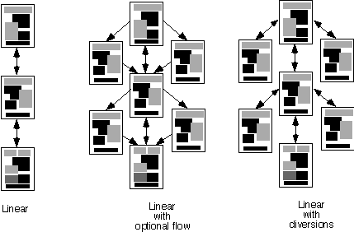
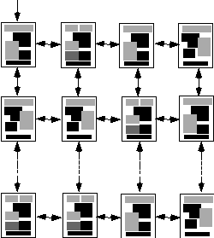
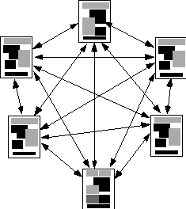
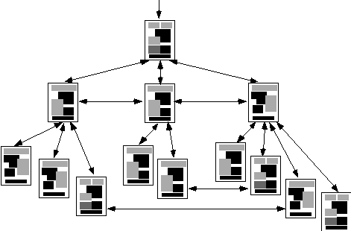
Content Architecture

Slide 26
MVC Architecture

Slide 27
Baselines

Slide 28
Software Configuration Objects

Slide 29
The SCM Process

Slide 30
Risk Management Paradigm
control
track
RISK
identify
plan
analyze

