Slide 1
Ch.6 Human Aspects of Software Engineering

Slide 2


6.1 Characteristics Of A Software Engineer
Traits of Successful Software Engineers
Sense of individual responsibility
Acutely aware of the needs of team members and stakeholders
Brutally honest about design flaws and offers constructive criticism
Resilient under pressure
Heightened sense of fairness
Attention to detail
Pragmatic
Superprofessional
behavior

Slide 3
6.2 The Psychology Of Software Engineering
Behavioral Model for Software Engineering
Software
Boundary Spanning Team Roles
Software
Business milieu
Organizational behavior
Company
Organizational behavior
Business milieu
Ambassador
Scout
Guard
Sentry
Coordinator
Project
Group dynamics
Company
team
Group dynamics
Project
individual
Cognition and motivation
team
individual
Cognition and motivation
Problem
Problem

Slide 4

6.3 The Software Team
Effective Software Team Attributes
Sense of purpose
Sense of involvement
Sense of trust
Sense of improvement
Diversity of team member skill sets
Avoid Team “Toxicity”
A frenzied work atmosphere in which team members waste energy and lose focus on the objectives of the work to be performed.
High frustration caused by personal, business, or technological factors that cause friction among team members.
“Fragmented or poorly coordinated procedures” or a poorly defined or improperly chosen process model affecting accomplishment.
Unclear definition of roles resulting in a lack of accountability and resultant finger-pointing.
“Continuous and repeated exposure to failure” that leads to a loss of confidence and a lowering of morale.

Slide 5
6.4 Team Structures
Factors Affecting Team Structure
the difficulty of the problem to be solved
the size of the resultant program(s) in lines of code or function points
the time that the team will stay together (team lifetime)
the degree to which the problem can be modularized
the required quality and reliability of the system to be built
the rigidity of the delivery date
the degree of sociability (communication) required for the project

Slide 6
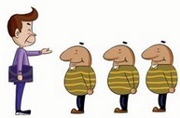
6.4 Team Structures
Organizational Paradigms
Closed paradigm —structures a team along a traditional hierarchy of authority
Random paradigm —structures a team loosely and depends on individual initiative of the team members
Open paradigm —attempts to structure a team in a manner that achieves some of the controls associated with the closed paradigm but also much of the innovation that occurs when using the random paradigm
Synchronous paradigm —relies on the natural compartmentalization of a problem and organizes team members to work on pieces of the problem with little active communication among themselves

Slide 7
6.5 Agile Teams
Generic Agile Teams
Stress individual competency coupled with group collaboration as critical success factors
People trump process and politics can trump people
Agile teams as self-organizing and have many structures
  An adaptive team structure
  Uses elements of Constantine’s random, open, and synchronous structures
  Significant autonomy
Planning is kept to a minimum and constrained only by business requirements and organizational standards

Slide 8

6.5 Agile Teams
XP Team Values
Communication – close informal verbal communication among team members and stakeholders and establishing meaning for metaphors as part of continuous feedback
Simplicity – design for immediate needs nor future needs
Feedback – derives from the implemented software, the customer, and other team members
Courage – the discipline to resist pressure to design for unspecified future requirements
Respect – among team members and stakeholders

Slide 9

6.6 Impact of Social Media
Blogs – can be used share information with team members and customers
Microblogs – allow posting of real-time messages to individuals following the poster (e.g. Twitter)
Targeted on-line forums – allow participants to post questions or opinions and collect answers
Social networking sites– allows connections among software developers for the purpose of sharing information (e.g. Facebook, LinkedIn)
Social book marking– allow developers to keep track of and share web-based resources (e.g. Delicious, Stumble, CiteULike)

Slide 10

6.7 Software Engineering using the Cloud
Benefits
  Provides access to all software engineering work products
  Removes device dependencies and available every where
  Provides avenues for distributing and testing software
  Allows software engineering information developed by one member to be available to all team members
Concerns
  Dispersing cloud services outside the control of the software team may present reliability and security risks
  Potential for interoperability problems becomes high with large number of services distributed on the cloud
  Cloud services stress usability and performance which often conflicts with security, privacy, and reliability

Slide 11
6.8 Collaboration Tools
Services of collaborative development environments(CDEs)
  Namespace that allows secure, private storage or work products
  Calendar for coordinating project events
  Templates that allow team members to create artifacts that have common look and feel
  Metrics support to allow quantitative assessment of each team member’s contributions
  Communication analysis to track messages and isolates patterns that may imply issues to resolve
  Artifact clustering showing work product dependencies

Slide 12
6.9 Global Teams
Team Decisions Making Complications
Problem complexity
Uncertainty and risk associated with the decision
Work associated with decision has unintended effect on another project object (law of unintended consequences)
Different views of the problem lead to different conclusions about the way forward
Global software teams face additional challenges associated with collaboration, coordination, and coordination difficulties

Slide 13
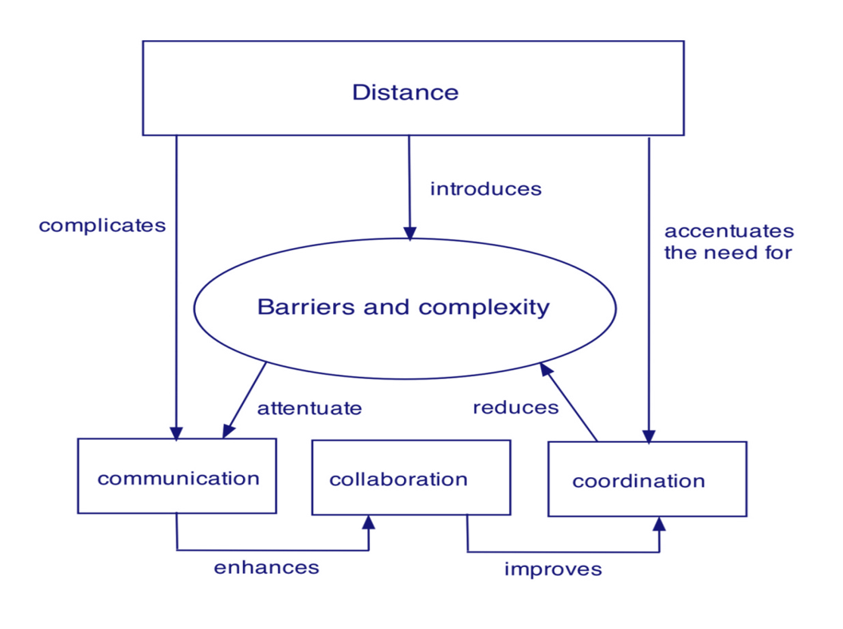
6.9 Global Teams
Factors Affecting Global Software Development Team

