Slide 1
Quiz One
Construct the NFA for the following regular expression, then convert it to a minimum-state DFA.
(a|b)*ba(ab)*

Slide 2
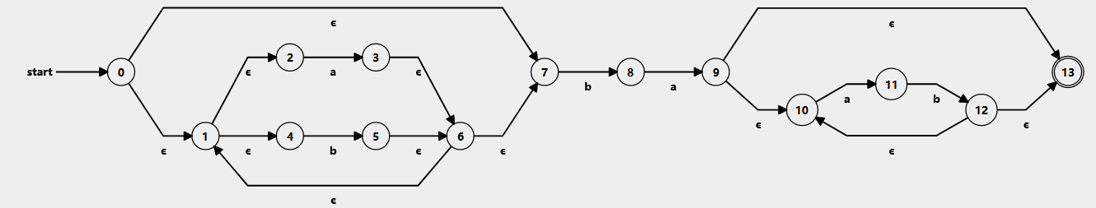

Slide 3
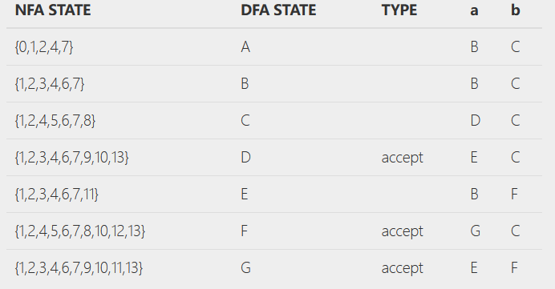
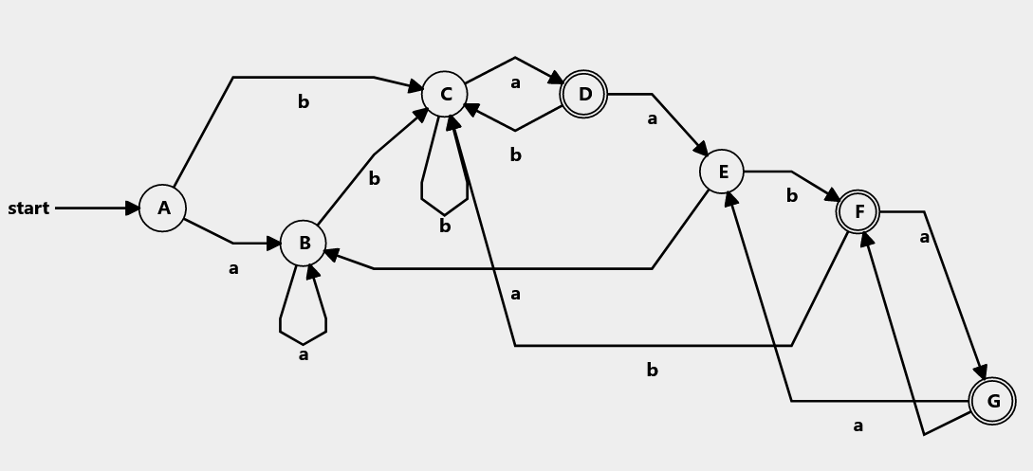

Slide 4
