Slide 1


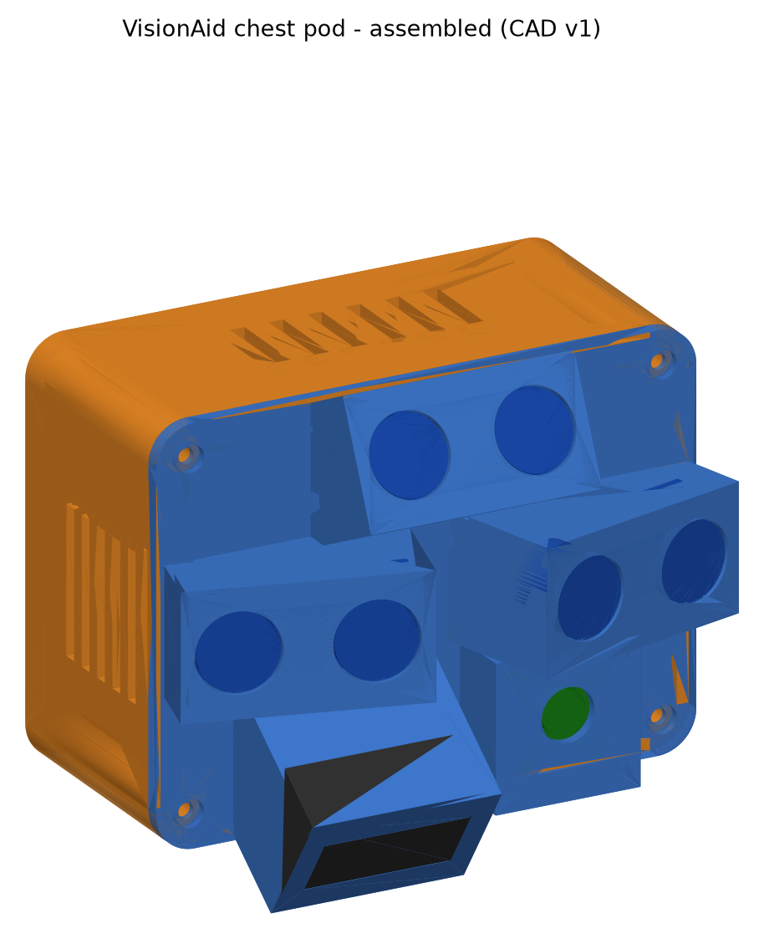
VISHWAKARMA AWARDS 2026-27 · STAGE 2 DESIGN SPECIFICATION
Vishwakarma Application ID: [add before submission]
VisionAid
A chest-worn, fully offline navigation aid that adds head-level-obstacle and drop-off warnings to the white cane - with an FPGA "safety island" whose alerts keep working even if the AI computer fails.
Team ID: [add before submission]
Track: Assistive Solutions & Inclusive Living
Team SVNIT: Jayant Kumawat (lead), Sneha Ahir, Aman Gupta - SVNIT Surat
Mentor institute: IIT Indore
Design files: github.com/silentaf/viswa_id1
CAD v1 of the chest pod (FreeCAD) - design stage, not yet fabricated

Slide 2
Problem Context
43.3 M
295 M
1.99 %
₹3,500
people blind worldwide (2020)
moderate / severe vision impairment
blindness among Indians aged 50+
SmartCane - closest Indian aid
Cited: Bourne et al., Lancet GH 2021
Cited: Bourne et al., Lancet GH 2021
Cited: NBVIS India 2015-19
Cited: IIT Delhi / Assistech
Problem statement
The white cane only senses what it touches at ground level, about one cane-length ahead.
Head-level obstacles (signboards, truck tailgates, branches) and drop-offs (open drains, kerbs, steps) are the hazards it misses; head-level collisions and falls are the mobility accidents blind travellers report (cited: Manduchi & Kurniawan, 2011, survey of 300+ people).
Reading a label or sign still needs a sighted helper or a hand-held phone.
Target beneficiary: blind and low-vision cane users who walk independently on Indian streets and campuses.
Public search disclosure - what exists
Product | Price (cited) | Gap
SmartCane (IIT Delhi) | ≈ ₹3,500 | Above-knee only; no drop-offs, no naming / reading
OrCam MyEye 3 Pro | ≈ US$3,700-4,490 | Reading aid, not mobility; expensive
Envision Glasses | ≈ US$1,899-3,499 | Reading / description; expensive
Phone apps (Lookout, MANI) | free | Need a hand + pointed phone; no continuous warning
Core innovation: head-level + drop-off warnings for the cane user, with an alert path bounded in hardware (FPGA) and an on-device AI layer that names hazards and reads text - fully offline.

Slide 3
User Journey - Before (cane only)
Walks with cane
Head-level obstacle
Collision
Open drain or step down
Needs to read a label
cane sweeps the ground ~1 m ahead
not touched by the cane
head / face injury risk
found only when the cane drops in
asks a stranger / holds a phone
Current pain points
Warning comes from contact: the cane reports an obstacle only when it touches it.
Nothing above the cane: overhanging objects are invisible to it.
Drop-offs are found by falling-in of the cane tip - the user is already at the edge.
Reading and identifying objects depend on another person.
Quantified inefficiency (calculated, not measured)
Warning time for ground obstacles: ~1 m cane reach ÷ 1.2 m/s walking speed ≈ 0.8 s.
Warning time for head-level obstacles: 0 s - the cane never touches them.
Warning before a drop-off: only as far as the cane tip; no advance cue.
Text: every label / sign needs a helper; no independent reading.
Assumptions: 1.2 m/s typical adult walking speed and ~1 m cane reach are design assumptions; Stage 3 user interviews and trials will replace them with measured values.

Slide 4
User Journey - After (cane + VisionAid)
Walks with cane + pod
Obstacle in 3 m
L / R vibration
Floor drops ahead
Presses READ
pod scans 0.3-3 m, waist to head
FPGA classifies distance zone
pulse rate = distance; side = direction
LiDAR: drop-off alarm + buzzer
Pi reads text aloud (offline)
How the user benefits
Warned before contact - including head-level obstacles the cane cannot reach.
Left / right motors on the chest straps say which side the hazard is on.
Drop-off warning ahead of the edge, not at it.
Hands stay free; speech through a bone-conduction headset keeps the ears open to traffic.
Alerts never depend on the AI computer (FPGA safety island).
Quantified efficiency (labels say where each number comes from)
Warning time, 3 m range at 1.2 m/s: ≈ 2.5 s (calculated, target range)
Echo edge → motor on: 136-214 ns (simulated; target ≤ 1 ms)
Update per direction: 99 ms (by design, simulated)
Drop-off alert after floor change: 22 ms (simulated); ≥ 1 m ahead (target)
Read-aloud: ≤ 3 s per short label (target, Stage 3 test)
Honesty rule: no hardware has been built yet - simulated values come from our Verilog testbench (design/fpga); targets are verified on hardware in Stage 3.

Slide 5
System Architecture - Block Diagram
3 × RCWL-1601 ultrasonic
(left, right, head-level)
FPGA SAFETY ISLAND
Sipeed Tang Nano 9K (27 MHz)
echo timing · distance zones
LiDAR drop-off · PWM patterns
watchdog · fault detection
POWER
BIS-certified
USB-C power bank
→ Pi 5
→ 500 mA PTC
→ carrier 5 V
→ AMS1117 3.3 V
Left / right coin motors
(chest straps, wired)
TF-Luna LiDAR
(floor, −35°)
Buzzer
("check device", drop-off)
3 buttons
(READ / MODE / QUIET)
UART 115200 status / config
+ heartbeat + fault line
AI PATH - Raspberry Pi 5
YOLO-nano object names · OCR
text-to-speech (EN / HI)
Camera Module 3
(autofocus)
Bluetooth bone-conduction
headset (speech)
Safety rule: the FPGA drives the motors itself; the Pi can only add information and tune thresholds within clamped limits (it cannot switch alerts off). If the Pi's heartbeat stops, alerts continue and an "AI offline" chirp sounds.

Slide 6
Target Specifications & Hardware Selection
Parameter | Target | Evidence so far | Selected hardware / protocol
Obstacle range (waist-head) | 0.3-3.0 m | sensor class; housings +25° / ±15° (CAD) | 3 × RCWL-1601, 3.3 V, sequenced
Alert latency (echo → motor) | ≤ 1 ms | Simulated 136-214 ns | Tang Nano 9K GW1NR-9 FPGA, 27 MHz
Update period / direction | ≤ 100 ms | 99 ms by design (simulated) | 3 × 33 ms slots (no crosstalk)
Distance resolution | ≤ ±5 cm to 2 m | Simulated 1500 → 1499 mm | 1 µs echo timer (0.17 mm/count)
Drop-off warning | ≥ 1.0 m ahead | Simulated: alert 22 ms after change | Benewake TF-Luna, UART 115200
Object name / OCR | ≤ 1 s / ≤ 3 s | Stage 3 measurement | Raspberry Pi 5 4 GB + Camera Module 3
Pi fails → alert path | unaffected, cue ≤ 1 s | Simulated: AI-offline at 666 ms | FPGA heartbeat watchdog (GPIO17)
Runtime | ≥ 4 h | Calculated 7.3 W → 4.3 h | 10,000 mAh BIS power bank, USB-C
Pod mass | ≤ 250 g | Estimate: likely over (plastic ≈156 g solid) | PETG, 2.5 mm wall; lightening in v2
Architecture rationale: Pi 5 instead of the Stage 1 PYNQ-Z2 (its Cortex-A9 cores are too slow for detection + OCR, and it does not fit the ₹30k grant); FPGA kept for the parallel, cycle-exact, fault-isolated alert path; wired haptics so no radio sits in the safety path.

Slide 7
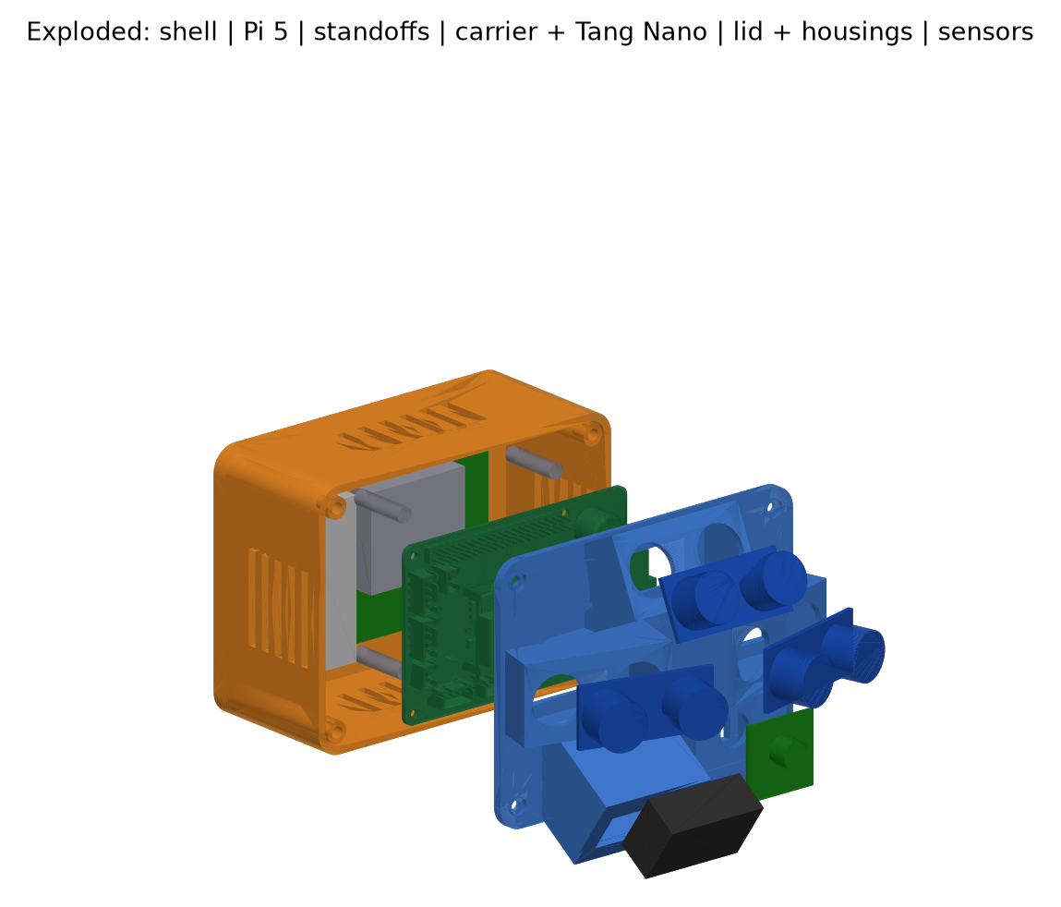
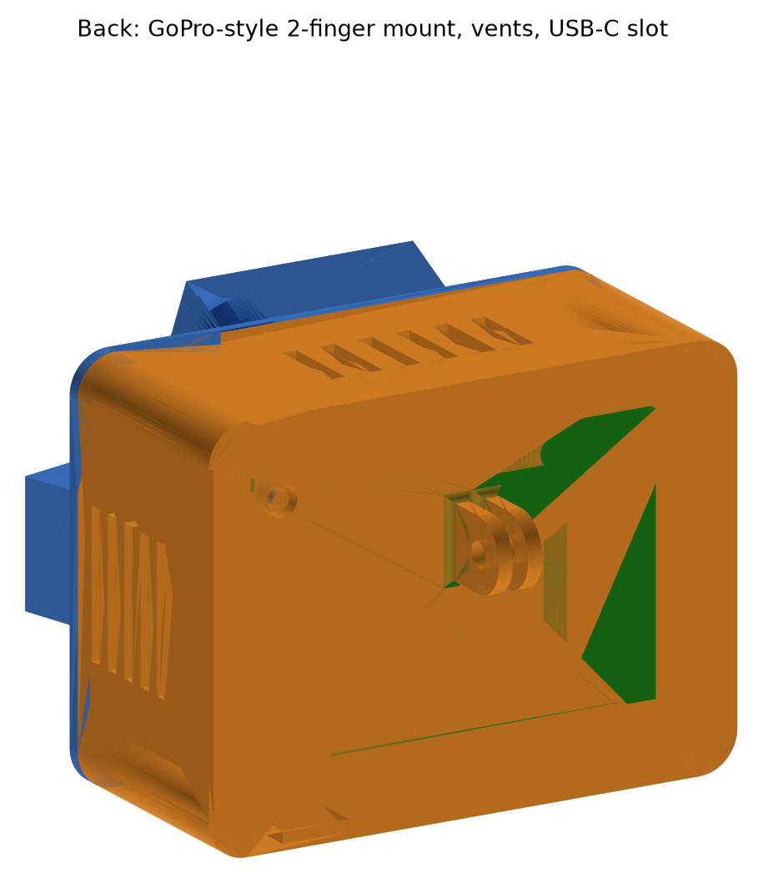
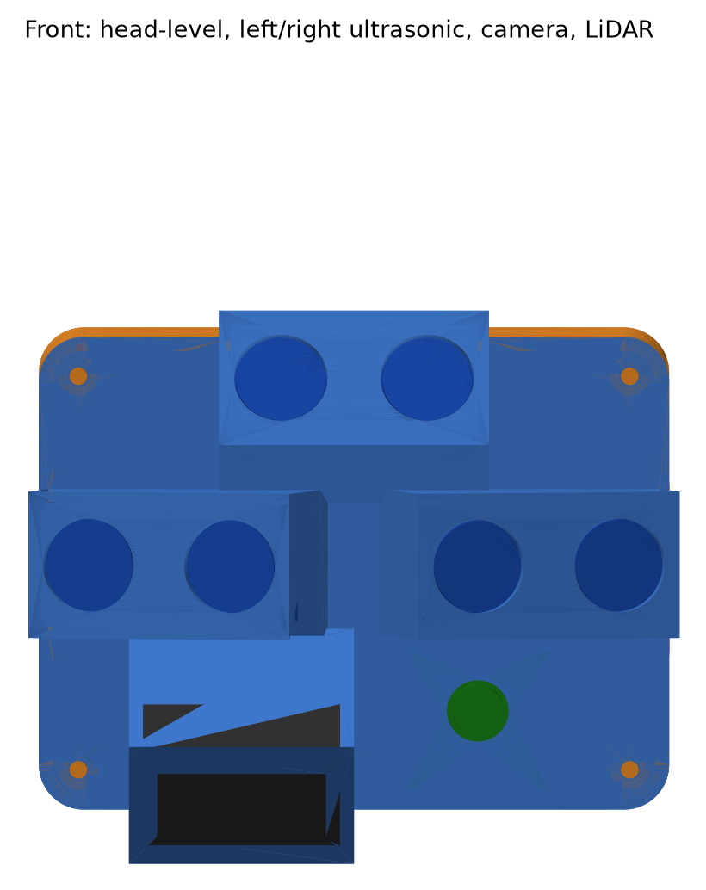
CAD Design & Mechanical Specs
FREECAD · PARAMETRIC
Mechanical specification
Envelope: 112 × 84 × 48 mm shell + front housings
Model: 19-parameter spreadsheet drives sketches, pads, fillets, shell (fully constrained)
Housings: head sensor +25°, side sensors ±15° yaw, LiDAR −35°
Mount: GoPro-style 2-finger (3 mm, M5) on a chest harness
Cooling: side + top/bottom vents for the Pi 5 active cooler
Interference check: 0 mm³ vs Pi, carrier, Tang Nano, sensors
Back: GoPro-style mount, vents
Exploded: shell | Pi 5 | 20 mm standoffs | carrier PCB + Tang Nano | lid + housings | sensors
Front: sensor housings
Design iteration: adding the real Tang Nano 3D model showed a 182 mm³ clash with the lid (HDMI connector) - shell depth raised 44 → 48 mm in one parameter; clash now 0 mm³.

Slide 8
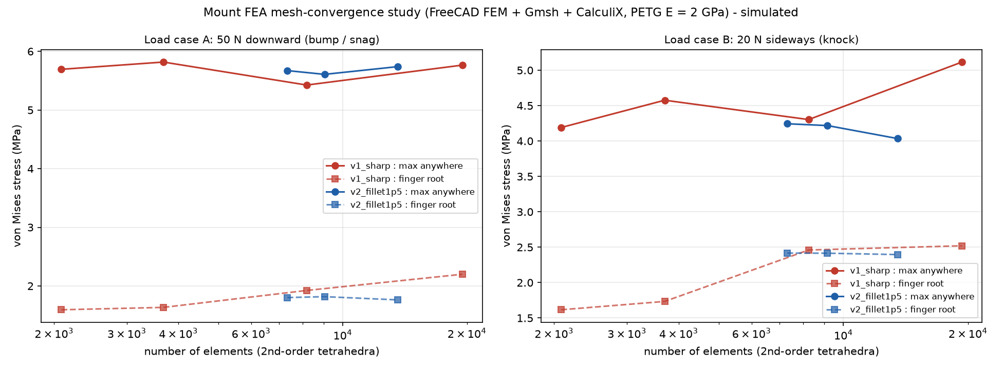
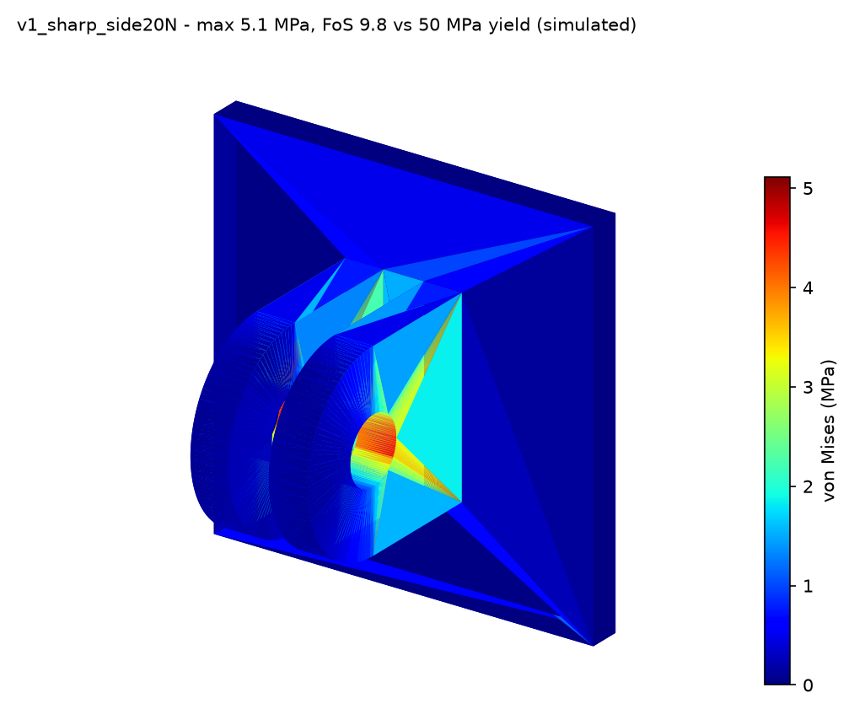
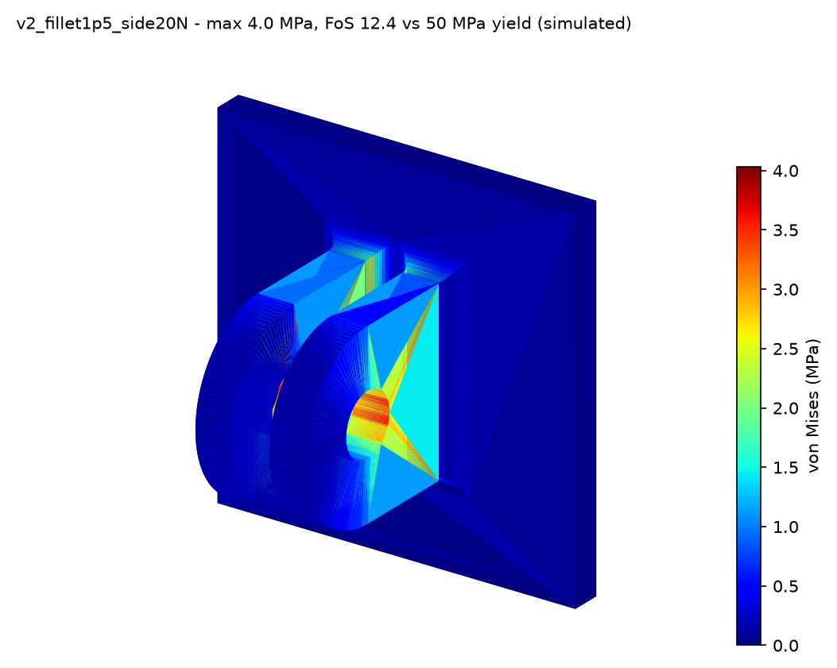
Material Selection & FEA (chest mount)
SIMULATED
Material | Tg / softening | Choice
PLA | ≈ 60 °C | No - softens in a car / summer sun
PETG | ≈ 80 °C | Yes - tough, easy to print
ASA | ≈ 100 °C, UV-stable | Stage 3 option outdoors
FreeCAD FEM + Gmsh + CalculiX
Load A: 50 N down (0.3 kg × ~17 g bump); B: 20 N sideways
PETG: E 2.0 GPa, ν 0.38, yield ≈ 50 MPa; required FoS ≥ 3
Result: worst FoS 8.7; max deflection 0.06 mm
v1: root stress kept rising with mesh refinement → sharp-corner singularity
v2: 1.5 mm root fillets → converged (< 3 % change); now in the CAD
v1 sharp roots - 20 N side
v2 1.5 mm fillets - 20 N side
Limitations: linear isotropic model (printed parts are anisotropic); finest v2 mesh failed to solve, so v2 uses 3 mesh levels; a printed-mount pull test is planned for Stage 3.

Slide 9
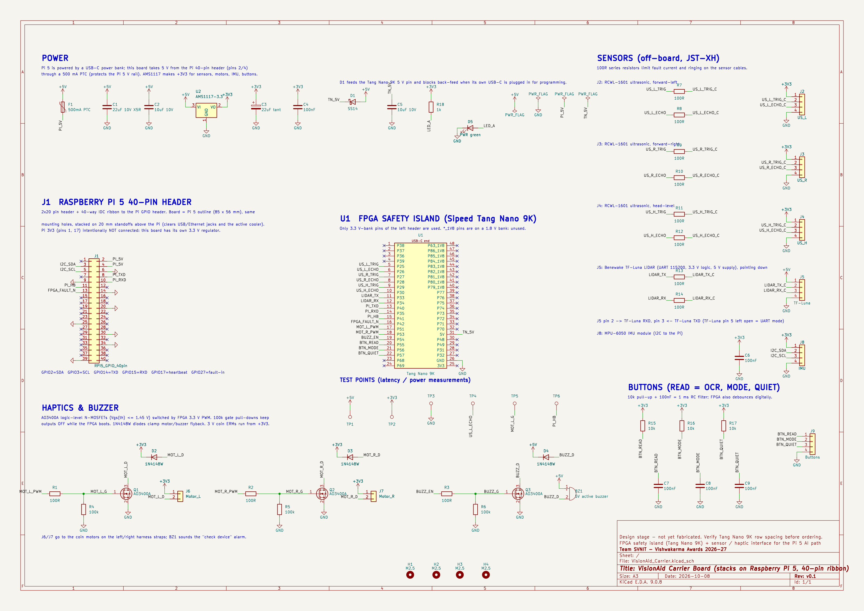
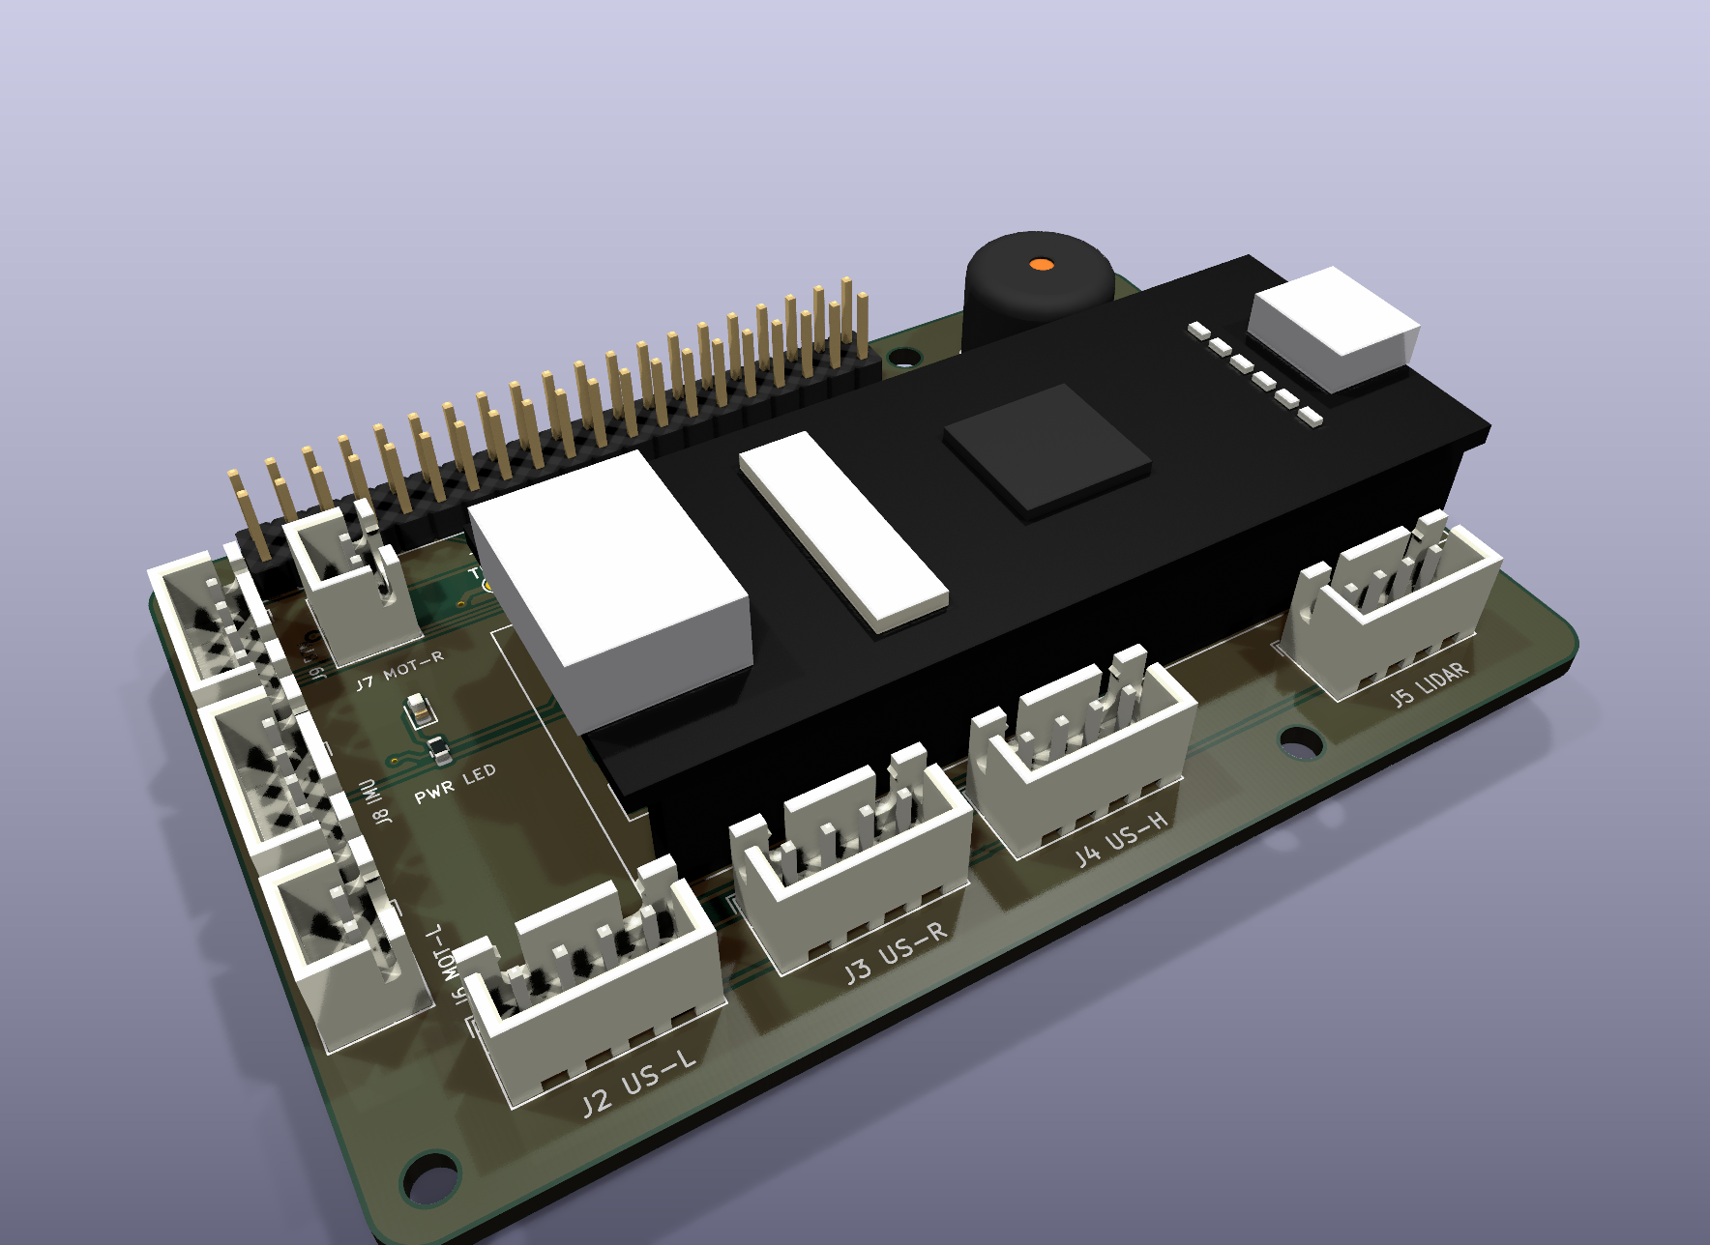
Electronics - Schematic & Carrier PCB
KICAD 9
Power distribution & checks
Power bank → Pi 5 → header 5 V → 500 mA PTC → +5 V
+5 V → AMS1117 → +3V3 (sensors, motors, IMU)
+5 V → SS14 → Tang Nano (blocks USB back-feed)
Verified: ERC 0 · DRC 0 · unrouted 0 · parity 0
Carrier-board schematic (A3): power, Pi header, FPGA, sensors, haptics, buttons, test points
PCB: 85 × 56 mm, 2 layers, Pi 5 outline + mounting holes, 20 mm standoffs + 40-way ribbon; 3.3 V-bank FPGA pins only; MOSFET motor drivers with flyback diodes; Gerbers generated.

Slide 10
Bill of Materials & Sourcing
Component | Part / specification | Qty | Source · origin · lead | ₹ (basis)
AI computer | Raspberry Pi 5 4 GB + active cooler | 1 | KSP / Thingbits · imported, local stock · 2-4 d | 12,550 (quote + est.)
FPGA | Sipeed Tang Nano 9K | 1 | Probots · imported, local stock · 1-3 d | 2,149 (quote)
Camera | Pi Camera Module 3 + cable | 1 | Thingbits · imported, local stock · 2-4 d | 3,450 (quote + est.)
LiDAR | Benewake TF-Luna | 1 | Probots · imported, local stock · 1-3 d | 2,118 (quote)
Ultrasonic + IMU | RCWL-1601 × 4, MPU-6050 | 5 | Robu · local · 2-4 d | 800 (est.)
Feedback | Coin motors × 2, BT bone-conduction headset | 3 | Robu / Amazon.in · 2-5 d | 2,120 (est.)
Power | 10,000 mAh BIS power bank | 1 | local · 1-3 d | 1,200 (est.)
Carrier PCB | 2-layer fab ×5 + SMD parts + connectors + ribbon | 1 | LionCircuits (domestic) · 5-7 d | 3,250 (est.)
Mechanical | PETG, standoffs, inserts, harness, buttons | 1 | Robu / Amazon.in · 2-5 d | 2,350 (est.)
microSD | 64 GB A2 | 1 | local · 1-3 d | 700 (est.)
TOTAL |  |  | Grant ₹30,000 | 30,687
Budget - honest status
At the highest Pi 5 quote the build is ₹687 over the grant.
At the ₹5.5-7.5k distributor price it is ≈ ₹24-26k.
Rule: buy Pi 5 only ≤ ₹9,000, else Pi 4 4 GB.
Power budget (calculated)
Pi 5 + camera + YOLO ≈ 6.25 W (assumption)
FPGA, LiDAR, sensors, motors, losses ≈ 1.1 W
Total ≈ 7.3 W → 4.3 h on 37 Wh × 85 %
Procurement status: nothing ordered in Stage 2 (design round). All parts are stocked by Indian distributors; PCB fab is domestic. Full itemised BOM: design/bom/VisionAid_BOM_Power.xlsx.

Slide 11
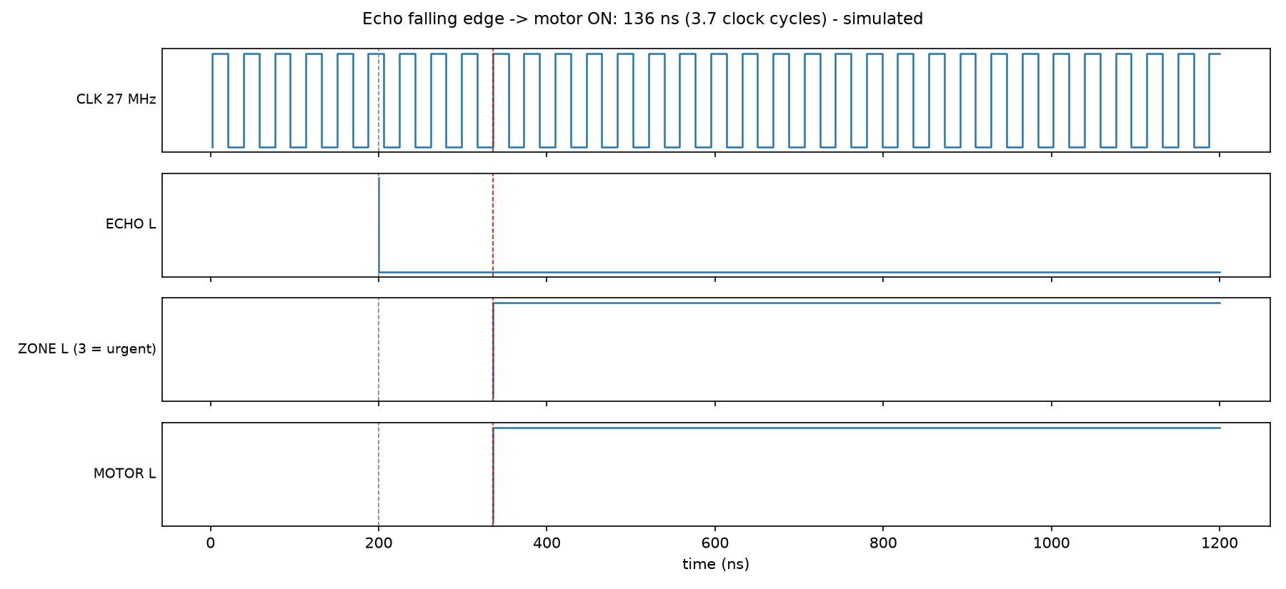
FPGA Safety Island - Verification
SIMULATED
Testbench check (Icarus Verilog) | Result
Distance 1500 / 2500 mm | 1499 / 2499 mm
Echo edge → motor ON | max 214 ns (5.8 cycles)
Status frames to Pi | 45 OK, 0 bad
LiDAR drop-off | alert 22.3 ms after change
Pi heartbeat lost | AI-offline 666 ms; alerts kept working
Sensor unplugged | fault flag + FAULT_N low
Overall | ALL TESTS PASSED
Resources (Yosys, pre-P&R estimate)
≈ 2,255 LUT4 equiv. of 8,640 (≈ 26 %)
568 flip-flops of 6,480 (≈ 9 %)
Confirm with Gowin EDA on hardware
Design: sensors fired one at a time (no crosstalk); distance = t × 0.1715 by shift-multiply; zones escalate instantly, release with 50 mm hysteresis; quiet mode can silence only the "info" level.

Slide 12
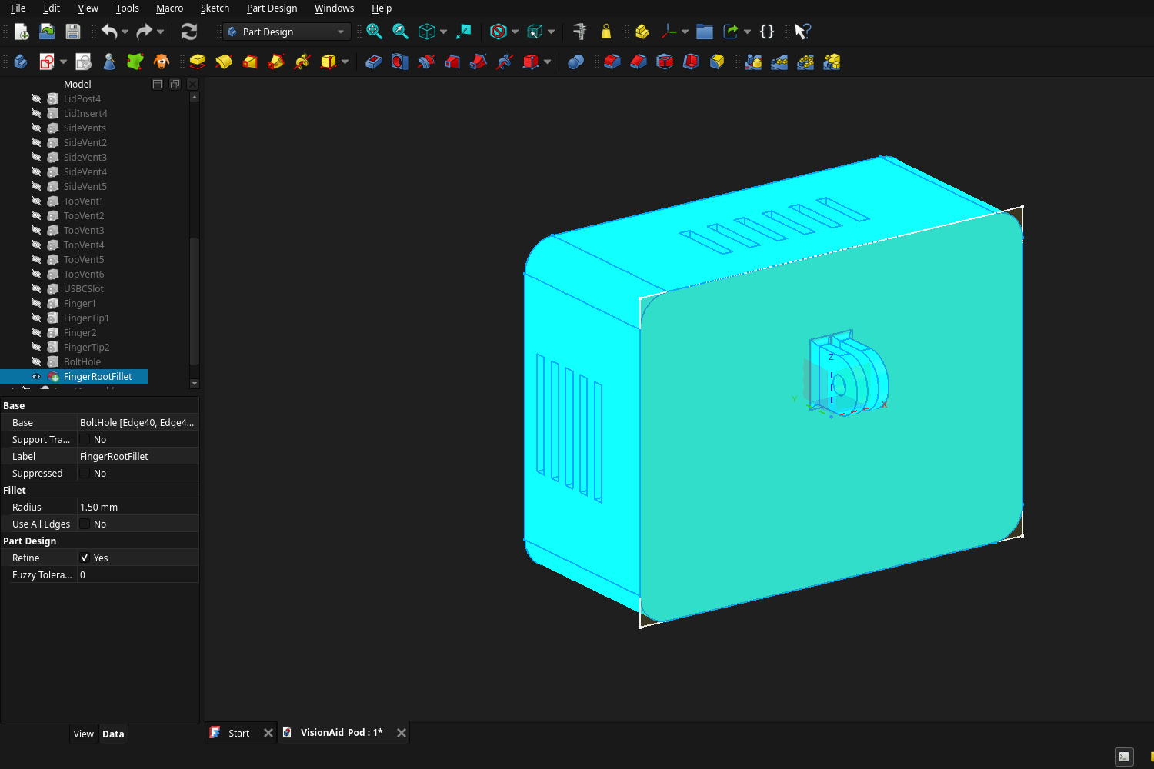
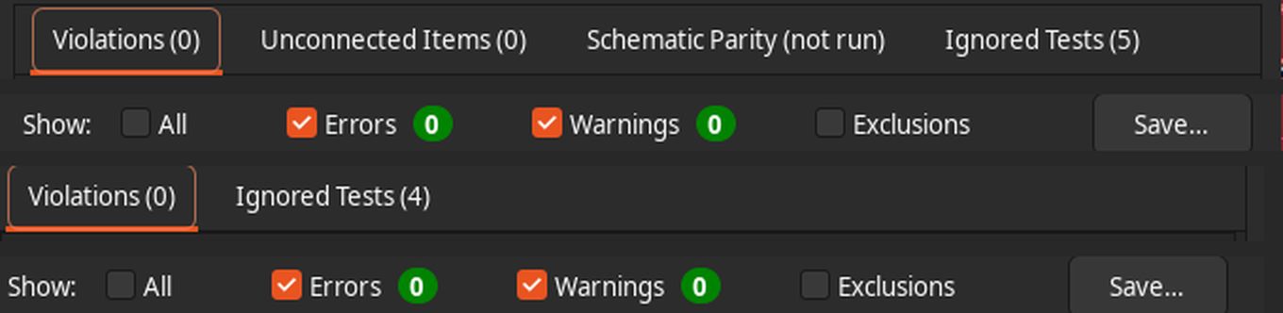
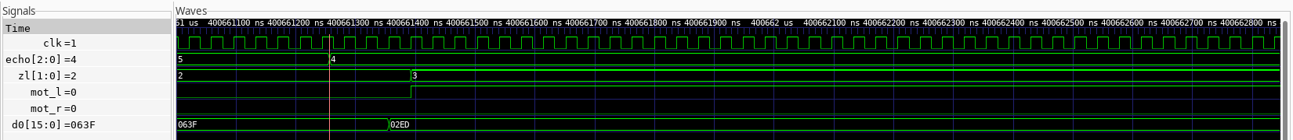
Your Maker Journey - Evidence
PHOTO TO ADD:
team member doing CAD / KiCad with SVNIT ID badge visible
KiCad DRC: 0 violations, 0 unconnected · ERC: 0 errors, 0 warnings
Raw repository (native files)
github.com/silentaf/viswa_id1 - .FCStd, .step, .kicad_sch/.kicad_pcb, .v, .xlsx, timestamped commits
PHOTO TO ADD:
joint review with faculty guide / IIT Indore mentor
FreeCAD feature tree - FingerRootFillet R 1.5 mm
GTKWave: echo falls → distance 749 mm → zone 3 → left motor ON (simulation)
Stage 1 → 2: PYNQ-Z2 → Pi 5 + Tang Nano 9K; per-stage latency specs; LiDAR for drop-offs; FEA-driven fillet; CAD clash fix 44 → 48 mm (details on the next slide).

Slide 13
Stage 1 → Stage 2 Engineering Iterations
Stage 1 said | Stage 2 decision | Why
PYNQ-Z2 does everything | Pi 5 (AI) + Tang Nano 9K FPGA (safety island) | A9 cores too slow for detection + OCR; not in ₹30k; fault isolation
"<10 ms" reflex, "<100 ms" on cover | Per-stage specs: echo → motor ≤ 1 ms | Echo from 3 m alone takes ≈ 17.5 ms - "<10 ms end-to-end" is impossible
Downward ultrasonic for drop-offs | Downward TF-Luna LiDAR (−35°) | Narrow beam gives a clean floor-distance signal
Wristband with 2 motors | L / R motors on the chest straps, wired | Two motors on one wrist are hard to tell apart; no radio in safety path
Custom bone-conduction driver | Bluetooth bone-conduction headset | Pi 5 has no analog audio; speech is the information channel
"< ₹5,500 BOM" | Prototype BOM ≈ ₹24-31k from quotes | The PYNQ-Z2 alone exceeded ₹5,500
"250M+", "₹4-6 lakh" competitors | Cited 2020 data; SmartCane disclosed | Accuracy and honest public-search disclosure
10-15 pilot users | Stage 3, after ethics approval + O&M instructor | Honest scope for a design round
Design-stage iterations: FEA v1 → v2 (1.5 mm root fillets); CAD shell 44 → 48 mm after the real-module interference check; 3D-model and pin checks against the official Tang Nano 9K pin map.

Slide 14
Safety & Hazard Mitigation
Failure mode | Hazard | Embedded fail-safe / mitigation
Ultrasonic stuck / unplugged | Missed obstacle | No-response detector (3 slots) → buzzer "check device" + FAULT_N (simulated)
Pi crash / hang | No object names / OCR | FPGA watchdog → "AI offline" chirp; alert path unaffected (simulated)
Bluetooth headset drops | No speech | Haptics carry all safety alerts; distinct cue
Harness tilt shifts LiDAR | False / missed drop-off | Stand-still floor calibration + IMU pitch check
Pi 5 overheats in pod | Throttling, slow AI | Active cooler + vents in CAD; thermal test in Stage 3
Carrier short circuit | Pi 5 V rail damage | 500 mA PTC fuse on the header supply
Battery fire | Burns | BIS-certified power bank only - no loose Li-ion cells
Alert fatigue | User ignores alerts | Zone hysteresis + quiet mode (silences "info" only)
Standards considered in the design (not certified)
IEC 62368-1 / IS 13252 - ICT equipment safety
IEC 62133-2 / IS 16046 - Li-ion (via BIS power bank)
IEC 60529 - IP54 target for the pod
ISO 10993-5/-10 - skin-contact materials (harness)
ISO 9999 - assistive-product classification
WPC / ETA - only pre-certified radio modules
Design principle: the cane stays the primary aid - VisionAid only adds warnings, and its alert path is independent of the AI computer.

Slide 15
Roadmap - 4-Month Fabrication Plan
Nov 2026
Dec 2026
Jan 2027
Feb 2027
Order parts + carrier PCB (LionCircuits)
FPGA + sensor bring-up on the bench
Range, latency (logic analyser at TP4/TP5), power tests
PCB assembly; Pi software integration
Print + fit enclosure; thermal test in pod
India-class dataset (auto-rickshaw, cow, pothole, drain)
Ethics approval (SVNIT IEC)
Supervised trials: sighted blindfolded first
Then blind volunteers with an O&M instructor
Fix top issues from trials
Re-run all Stage 2 tests on hardware
Field-test-ready unit for Stage 3
Stage 3 commitment
A wearable, battery-powered VisionAid prototype ready for supervised functional field testing, with every Stage 2 target (range, alert latency, drop-off distance, runtime, mass) measured on hardware.
Light weeks: Diwali (8 Nov 2026) and end-semester exams are planned as reduced-workload weeks.

Slide 16
Technical Challenges & Risks
Ultrasonic crosstalk vs update rate
Three sensors firing together hear each other. Sequencing fixes it but limits each direction to one ping per 99 ms (simulated).
Enclosure clash found in CAD
With the real Tang Nano 3D model, the HDMI connector hit the lid by 182 mm³ (CAD interference check).
Weight over target
Enclosure plastic alone ≈ 156 g if solid (CAD volume); with Pi 5 and sensors the pod likely exceeds 250 g.
Budget is tight
At the highest Pi 5 quote the BOM is ₹687 over the ₹30k grant.
Pi 5 heat in a closed pod
Continuous YOLO in a sealed box risks thermal throttling (to be measured in Stage 3).
LiDAR in sunlight / sharp mount corners
TF-Luna range drops in strong sunlight; FEA showed a stress singularity at sharp finger roots (v1).
Source of each risk: our own design files - CAD interference report, FEA study, BOM workbook, FPGA simulation - not assumptions copied from elsewhere.

Slide 17
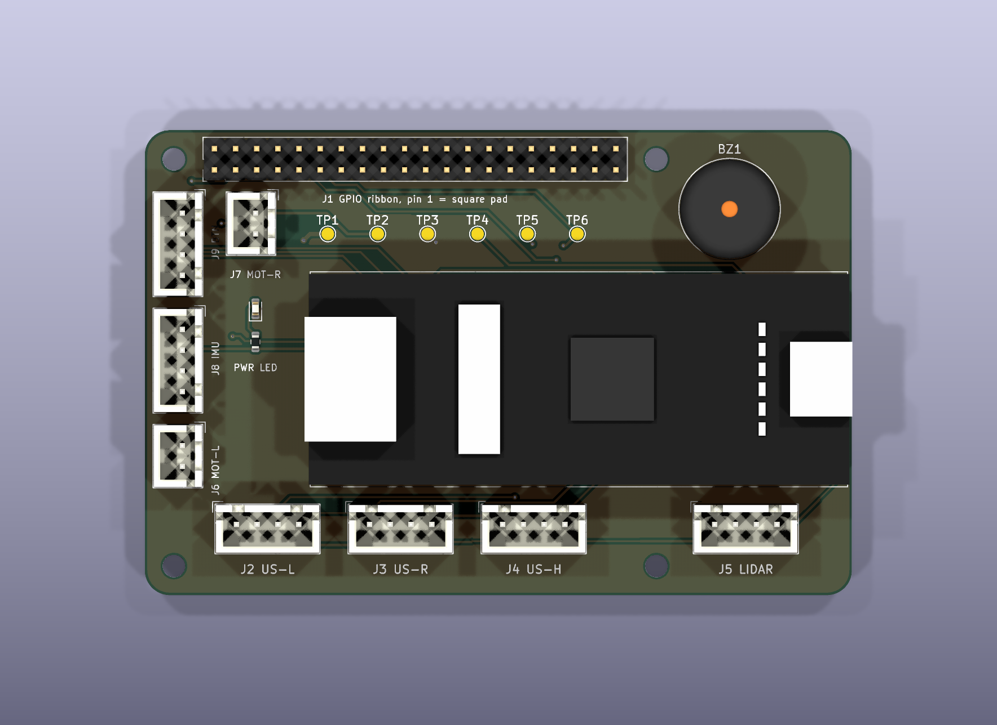
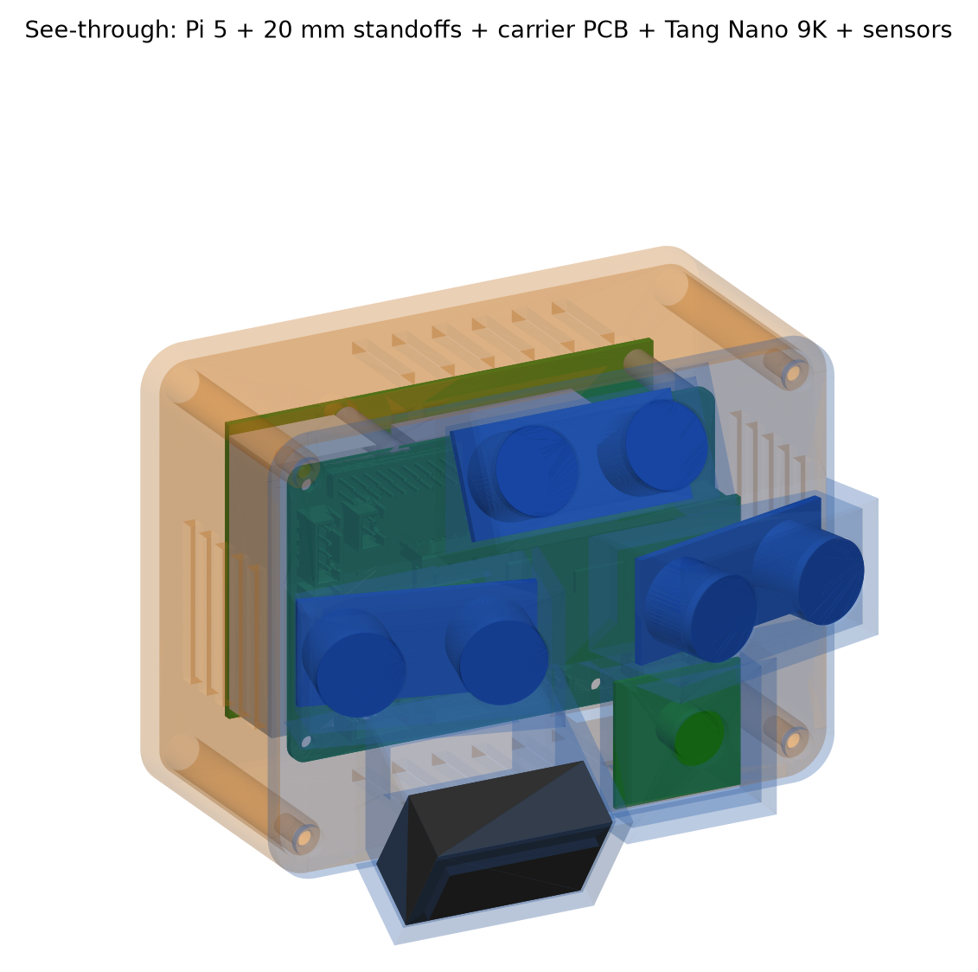
Potential Solutions & Risk Mitigation
Risk | Mitigation / backup
Crosstalk vs rate | Keep sequencing; Stage 3 option: coded pings to fire in parallel
Enclosure clash | Done: shell depth 44 → 48 mm (one parameter); interference now 0 mm³
Weight | v2: 2.0 mm walls + 20 % infill, merge housings, Pi Compute Module later
Budget | Pi 5 only ≤ ₹9,000, else Pi 4 4 GB (same design, lower AI frame rate)
Pi heat | Active cooler + vents; measure temperature/throttle flags in the closed pod
LiDAR sunlight | Amplitude check in the FPGA rejects weak readings; ultrasonic fallback; outdoor test
Mount corners | Done: 1.5 mm root fillets (FEA v2 converged, FoS ≥ 8.7)
Pi failure | Done in design: FPGA watchdog + independent alert path (simulated)
Carrier PCB with the Tang Nano 9K model (KiCad)
Status: "Done" items are already in the design files; the rest are planned and will be verified on hardware in Stage 3.

Slide 18
References & Sources
References
Bourne R. et al., Trends in prevalence of blindness and vision impairment, Lancet Global Health 9(2):e130-e143, 2021.
National Blindness & Visual Impairment Survey India 2015-19, AIIMS / MoHFW (indiavisionatlasnpcb.aiims.edu).
Manduchi R., Kurniawan S., Mobility-related accidents experienced by people with visual impairment, Insight 4(2), 2011.
SmartCane - IIT Delhi / Assistech product information (electronicsforu.com).
OrCam MyEye 3 Pro (orcam.com) and Envision Glasses (letsenvision.com) pricing, 2026.
Sipeed Tang Nano 9K wiki and pin map; Benewake TF-Luna datasheet; Raspberry Pi 5 / Camera Module 3 product briefs.
Tools: KiCad 9, FreeCAD + CalculiX + Gmsh, Icarus Verilog, GTKWave, Yosys, FreeRouting.
Image sources
All diagrams, renders, plots and screenshots in this deck are our own, generated from the project files in github.com/silentaf/viswa_id1:
CAD renders - design/cad (FreeCAD model)
PCB / schematic - design/electronics (KiCad)
FEA plots - design/cad/outputs/fea
Waveforms - design/fpga (testbench)
Screenshots - docs/screenshots
Logos: Vishwakarma Awards / Maker Bhavan Foundation (official template).

