Slide 1
RL for Market-Making
Roman Skoromnyi, Azamat Shablin
2024-03-14

Slide 2
To be discussed today
Problem of market making
Custom Environment description (Roman Skoromnyi)
Baseline agent
Deep Q Learning agent with target network (Roman Skoromnyi)
To be finished: PPO agent (Azamat Shablin)

Slide 3
Market Making with RL Market participants
There are three main types of participants in financial markets:
1) Informed participants (insiders, professionals, etc.)
2) Uninformed participants (retail traders, usually called noise traders)
3) Liquidity providers (market makers)

Slide 4
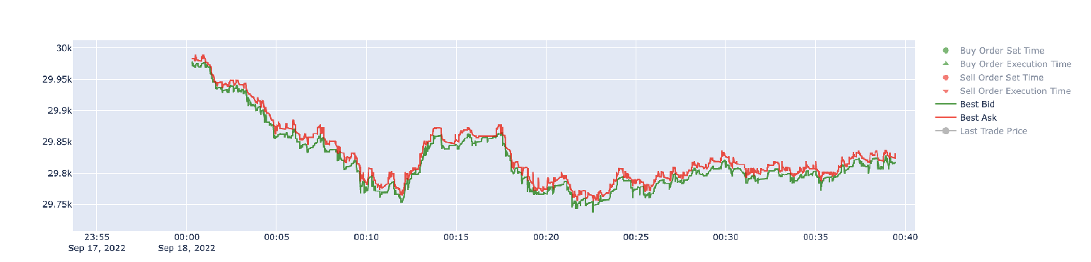
Market Making with RL Market sides
Market consists of two sides: demand (bid) and supply (ask/offer)
Usually bid price is below ask price, difference between them is called bid-ask spread
Usual indication of market price – “midprice”, average between the two

Slide 5
Market Making with RL Limit Order Book
Modern financial markets are based on LOB (limit order book)
Market participant can place different kinds of orders to make deals
Orders to buy/sell
Market orders (done by “takers”)
Limit orders (done by “makers”)
Take profit/ Stop loss

Slide 6
Market Making with RL Market Order vs Limit Order
Market order = take liquidity = “taker” participant, agent accepts corresponding demand/supply price for a deal
Pros: immediate execution
Cons: higher commission from exchange, unknown weighted average price of the deal
Limit order = provide liquidity = “maker”, agent prefers to wait until a market order hits his limit order to buy/sell asset
Pros: lower commission, price is setted by the agent
Cons: unclear order execution time horizon, market may move and limit order will be left far from the perspective of being executed

Slide 7
Market Making with RL Naïve strategy
Market maker sets limit orders to allow other participants use market orders for trades
Naiive strategy: countinuosly set simultaneous limit buy and sell orders at best prices with the same volume, wait until they are executed
There is a lot of uncertainty: usual issue is when only one order is executed, leads to one of the main issues – arising inventory risk

Slide 8
Market Making with RL Market environment
Data: Binance BTC/FDUSD best bid/best ask, trades (2024-01-08 to 2024-01-21), collected via websocket
Each step environment passes 50 ticks, done at the end of the day
Accepted action: list of limit orders to be placed
All limit orders are cancelled every 200 ticks
Historic execution logic based on trades, supports FIFO principle of placed limit orders
Balance handling logic is incorporated into environment

Slide 9
Market Making with RL Baseline agent
Places limit orders every 50 ticks
Price of limit orders is always at best bid + $0.1/best ask – $0.1
Fixed (0.005 BTC) and symmetric quantity of limit orders, if balances allow
Starting balances of 0.2 BTC, $10 000 each day

Slide 10
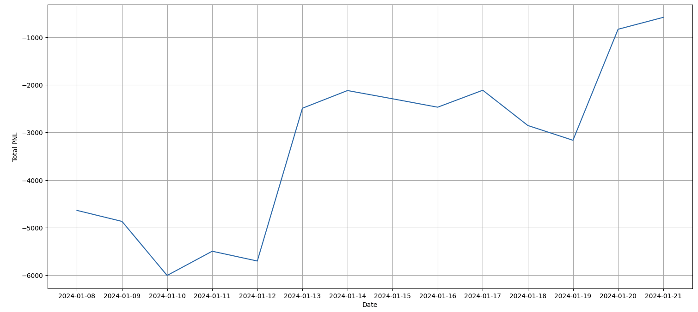
Market Making with RL Baseline agent

Slide 11
Market Making with RL Deep Q Learning agent with target network
Action space: 3x3x3x3 options
Price delta [0, -0.1, 0.1]
Quantity [0, 0.005, 0.1]
Can place two limit orders, buy and sell
State space: 39x1
Bid/ask price, trade price returns during 50 ticks period
Std of price returns’ and quantities
Percentiles of price returns’ and quantities from best bid/ask and trades
Cash balance, amount of inventory, last realized PNL, last unrealized PNL
Trained on each day from the sample separately
Starting balances of 0.2 BTC, $10 000 each day
Replay buffer and target network are used
Reward is realized PNL for previous 50 ticks

Slide 12
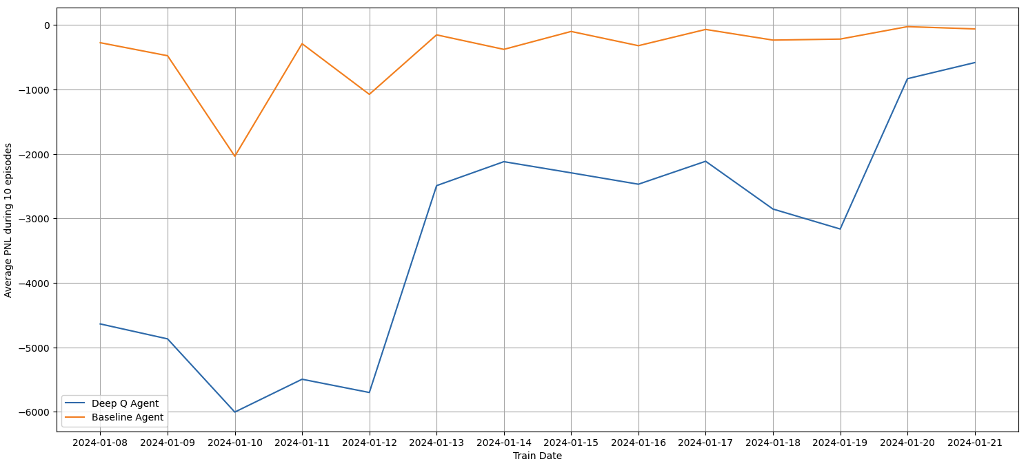
Market Making with RL Deep Q Learning agent with target network

Slide 13
Market Making with RL PPO agent (to be finished)
Action space: 3x3x3x3 options
Sampling from categorical distribution
Price delta [0, -0.1, 0.1]
Quantity [0, 0.005, 0.1]
Can place two limit orders, buy and sell
State space: 39x1
Bid/ask price, trade price returns during 50 ticks period
Std of price returns’ and quantities
Percentiles of price returns’ and quantities from best bid/ask and trades
Cash balance, amount of inventory, last realized PNL, last unrealized PNL
Trained on each day from the sample separately
Starting balances of 0.2 BTC, $10 000 each day
Replay buffer and target network are used
Reward is realized PNL for previous 50 ticks

Slide 14
Спасибо за внимание!

